Slide 1
Flexible body modeling and simulation wrap-up
2023 DARTS Lab Course​
Abhinandan Jain, Aaron Gaut, Carl Leake, Vivian Steyert, Tristan Hasseler, Asher Elmland, Juan Garcia Bonilla

Slide 2
Topics overview
Introduction
Single flexible body modeling
FModal FEM/DARTS bridge
Flexible multibody systems in DARTS
Time domain simulations
Recovering system modes with configuration changes
Servo-elastic effects
Wrap up

Slide 3
DARTS based GN&C flex modeling
Develop and use a pipeline and workflow that includes DARTS’ flexible multibody dynamics capabilities as an integral part to address the several G&C challenges described earlier
DARTS

Slide 4
DARTS/FModal pipeline implications for G&C
We have seen that with FModal, it is easy to regenerate the modal data and update the multibody model as designs and use cases evolve—without having to regenerate new input FEMs.
Building on this, DARTS provides several capabilities that expand the scenario and configuration space that G&C analysts can explore:
Import new component modal data generated by FModal from FEM data.
Articulate the bodies at run-time.
Change mass properties at run-time.
Attach/detach bodies at run-time.
Apply external forces at run-time.
Model multi-point hinges.
Support closed-graph topologies from environmental and inter-body constraints.
Change constraints and hinges at run-time.
Does not require any derivation of new EoMs or software with these changes.
Can trim and linearize to generate system modes at any configuration.
Can do all of this across the full system.
Uses optimal algorithms for speed so can use for closed-loop simulations.
Incorporate control/structure interactions for servo- and aero-elastic problems.
Can cover a very large class of vehicle systems.

Slide 5
DARTS/FModal pipeline implications for G&C (cont)
DARTS/FModal enables a much higher pace of G&C design iterations and analysis over a very large design space and over a project life cycle from early design/concept development, to closed-loop simulations for control software development and testing, V&V, and mission operations.
While not all of the DARTS/Dshell features and capabilities we have covered are needed all of the time, our goal has been to build critical capabilities, with a rich API so that we do not run into a wall when new needs arise.
New types of missions
New domains
New types of technologies
New types of analysis
Increased fidelity needs

Slide 6
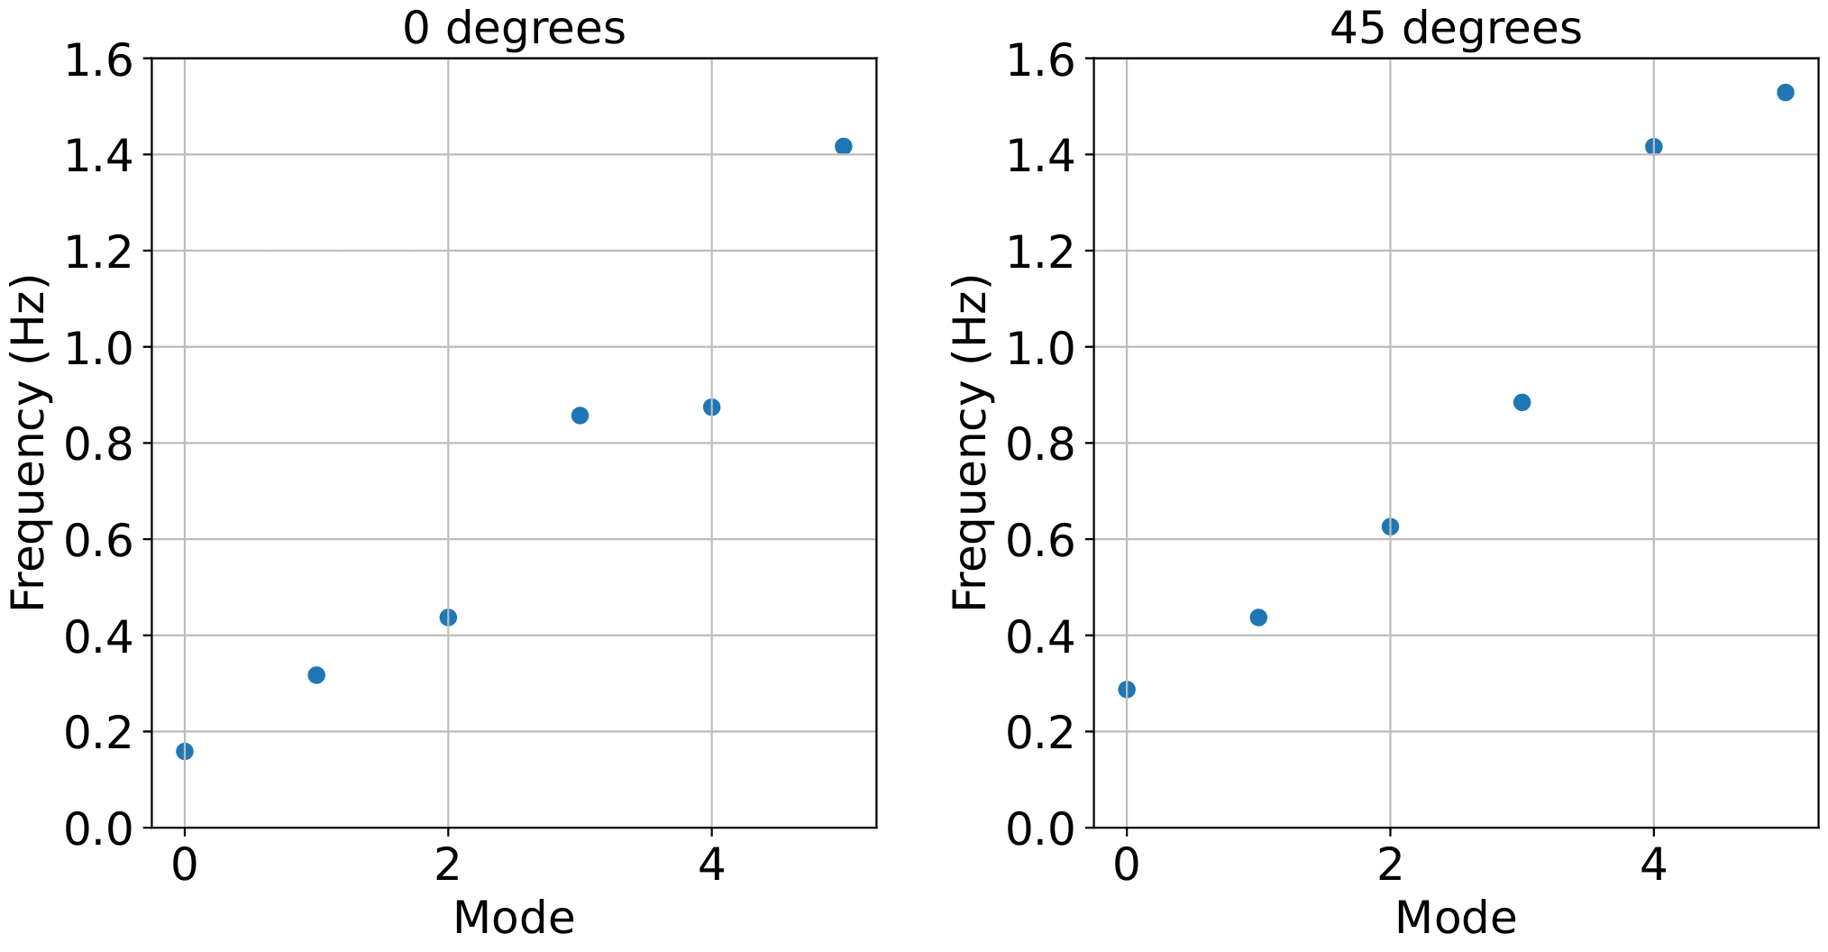
Need for flexible multibody dynamics
The system-level response changes drastically even with simple joint angles change.
Classically, a large number of FEM deliveries are needed to cover all possible vehicle configurations.
To avoid this, one needs a modeling framework that can easily incorporate these changes.
Beams connected at 0 degrees
Beams connected at 45 degrees

Slide 7
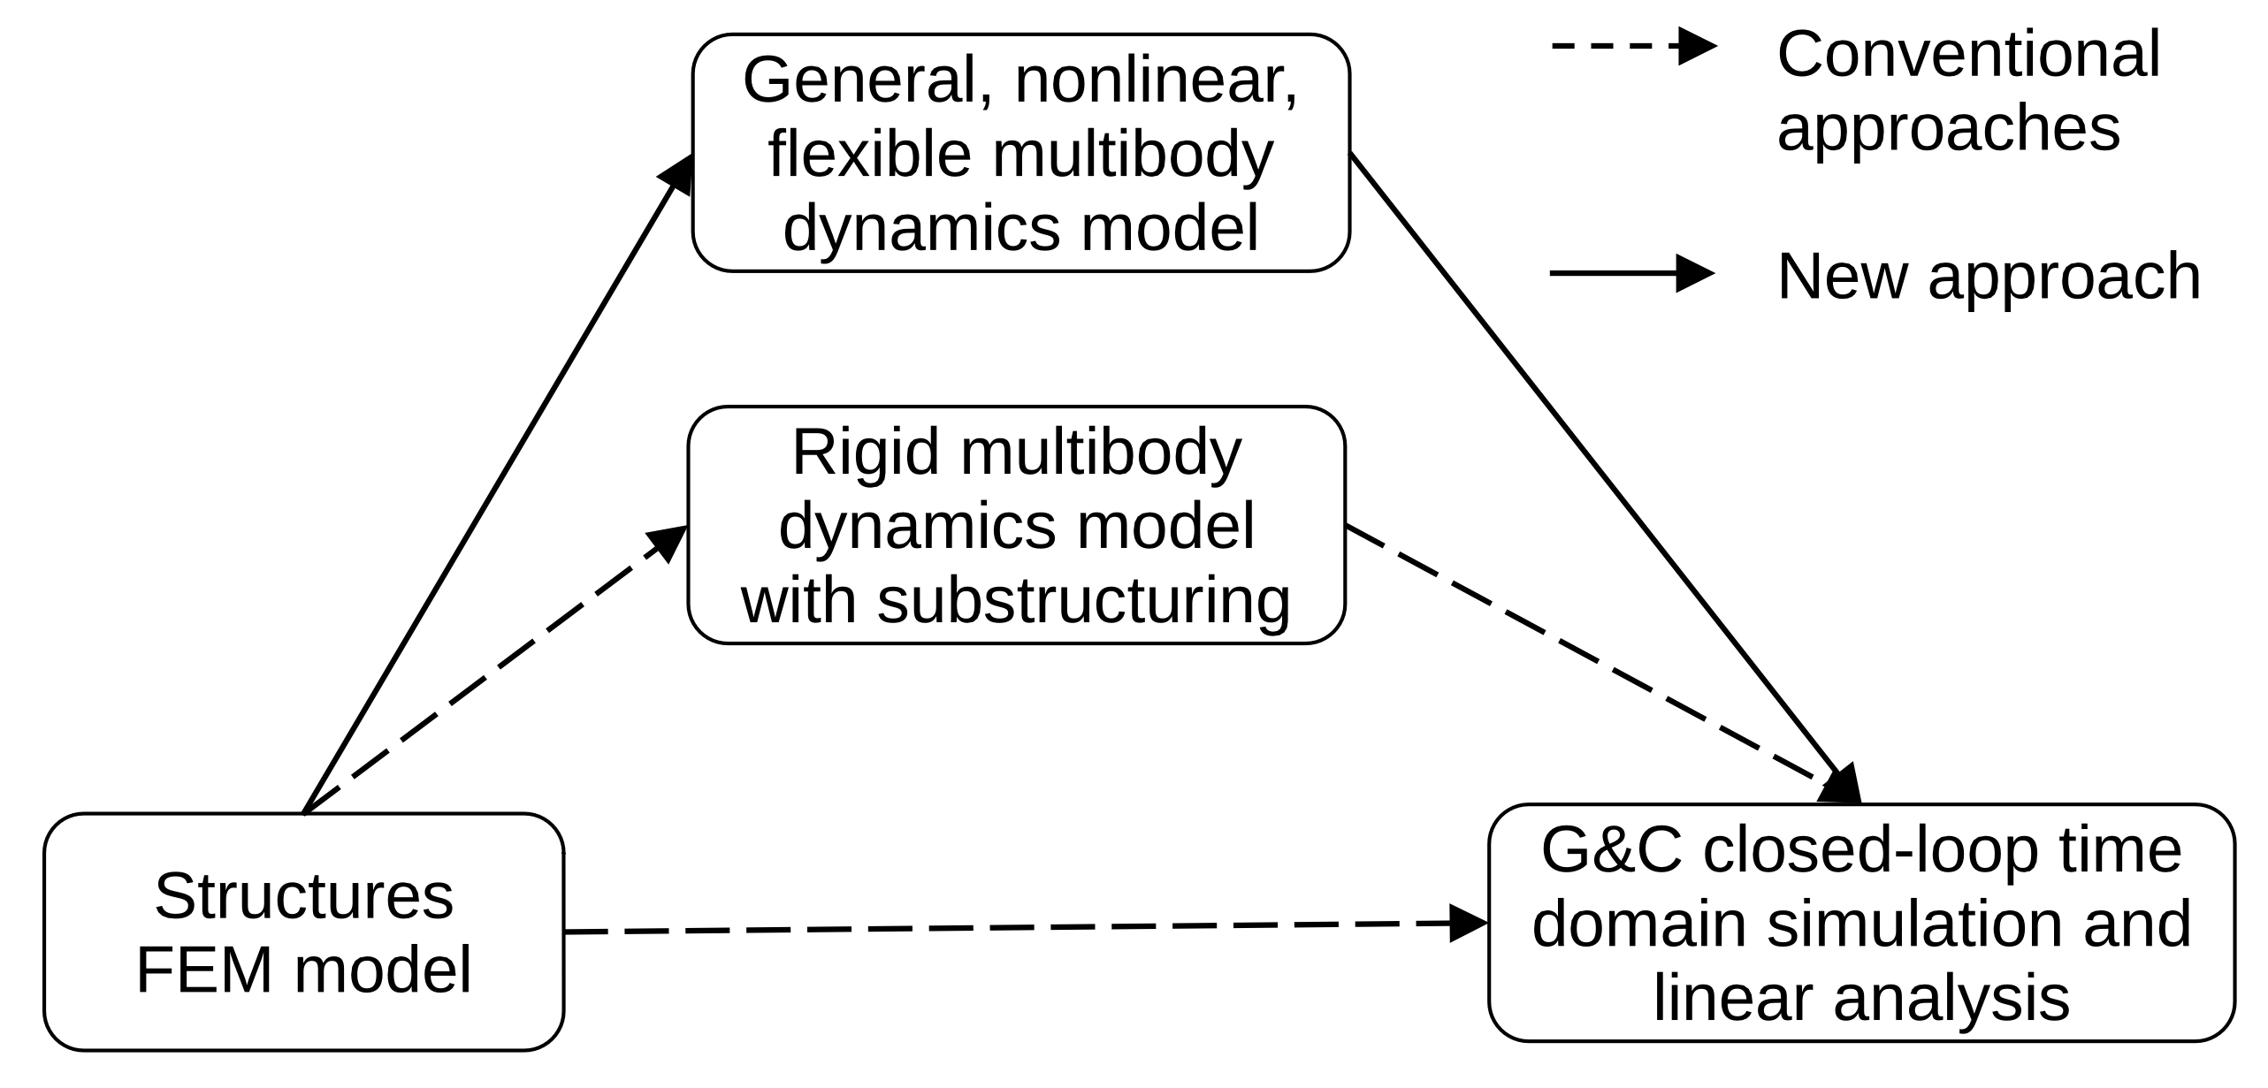
Flexible body modeling approaches

Slide 8
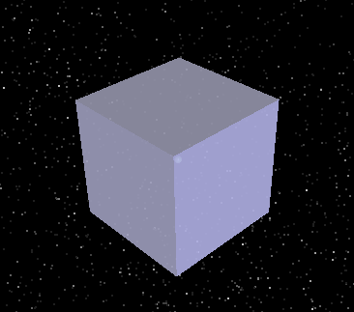
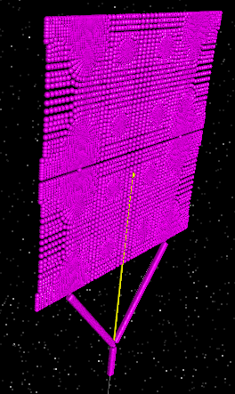
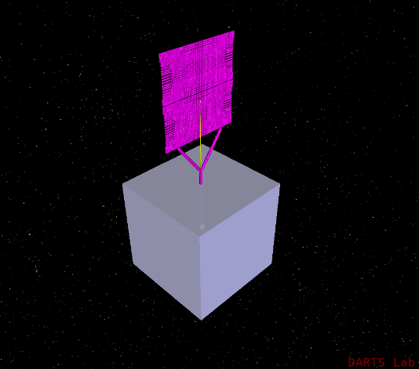
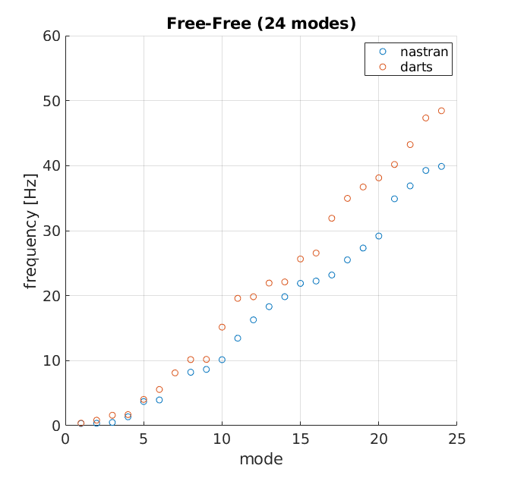
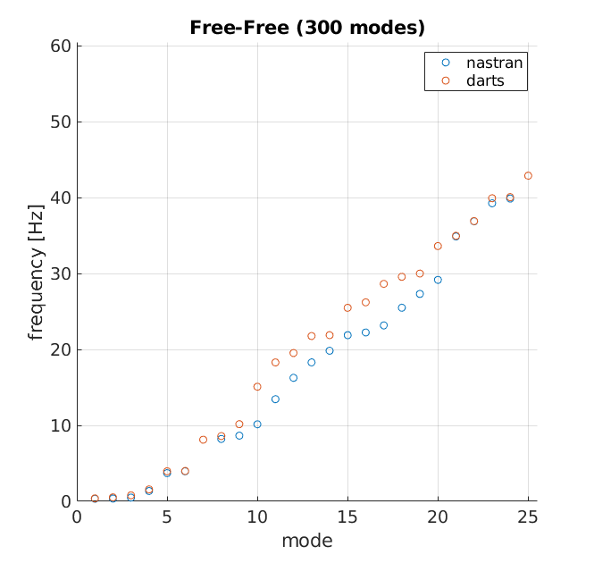
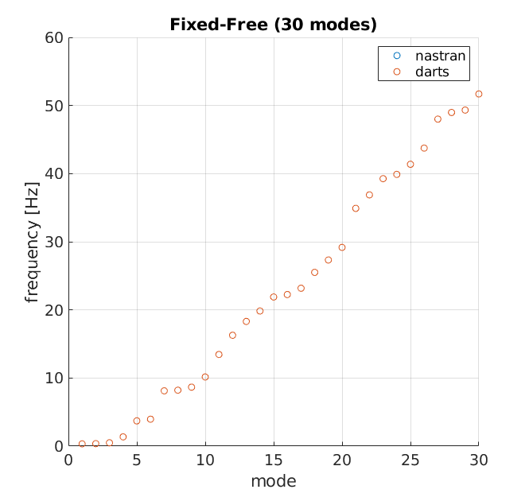
Component modes and C-B approach
22,824 grid points
136,944 DoFs
Craig-Bampton modes are better suited for combining component models with fixed boundary conditions. The figures below show that just 30 Craig-Bampton fixed-free modes does a better job matching the modes of a constrained body than 300 free-free modes.
24 free-free
300 free-free
30 Craig-Bampton fixed-free

Slide 9
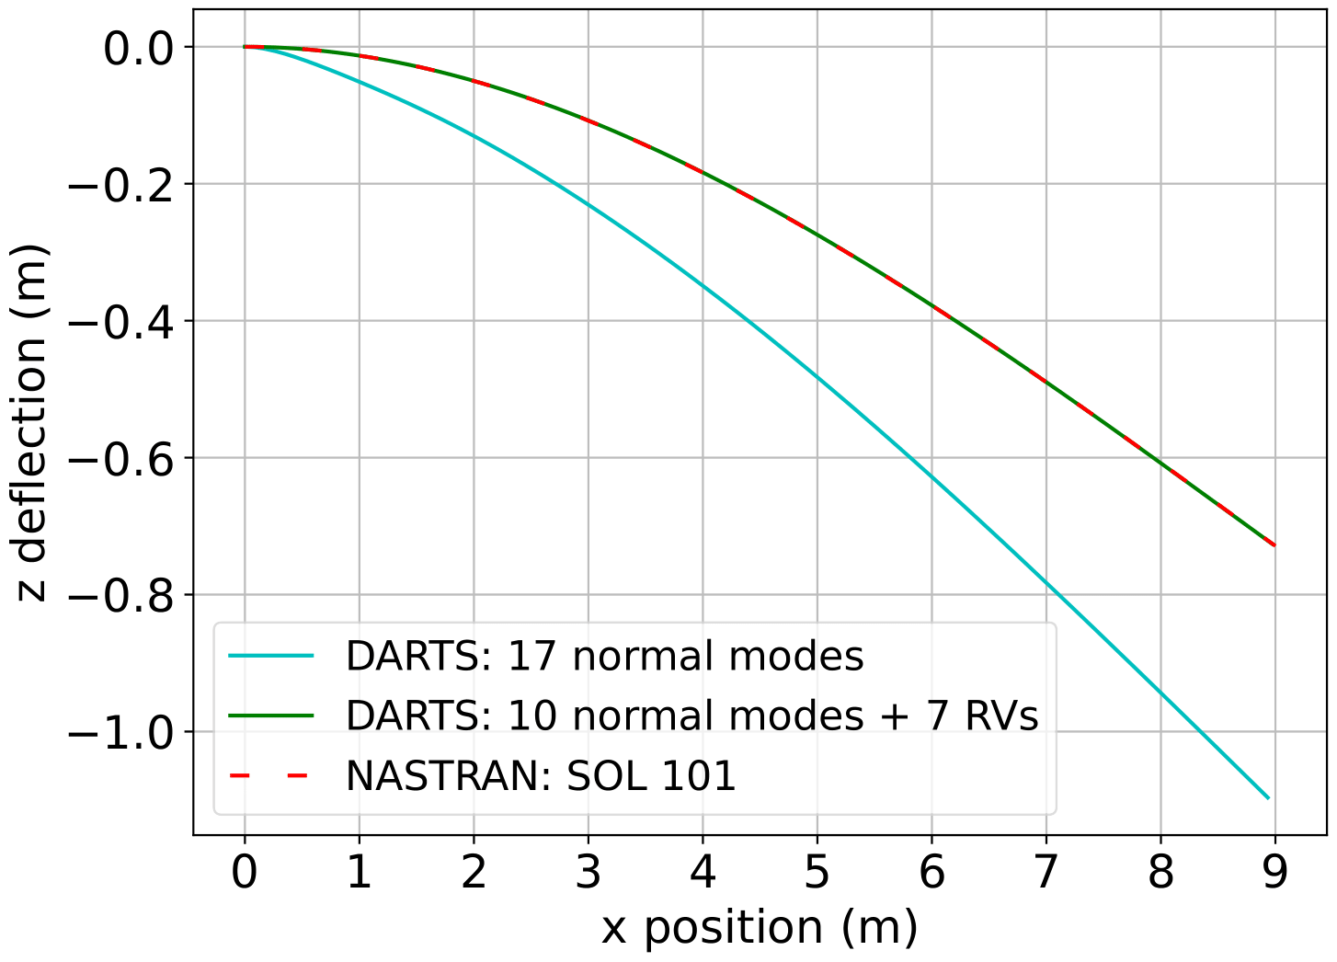
Higher order effects
Residual vectors
Modal integrals shown in red.
Gyroscopic terms not shown for brevity.

Slide 10
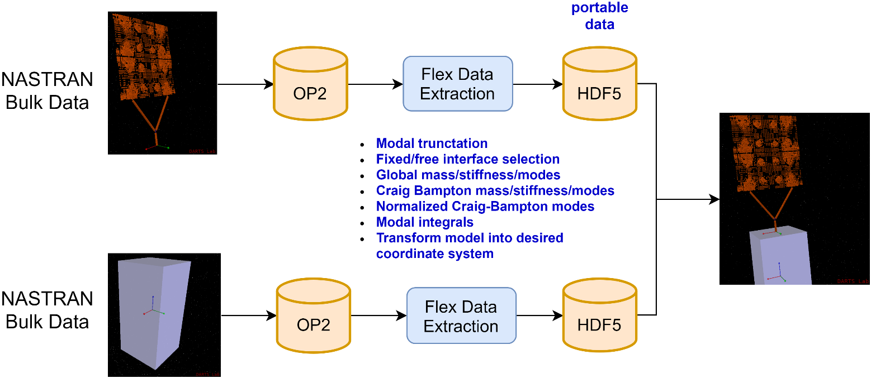
FModal workflow
FEM
FModal
DARTS

Slide 11
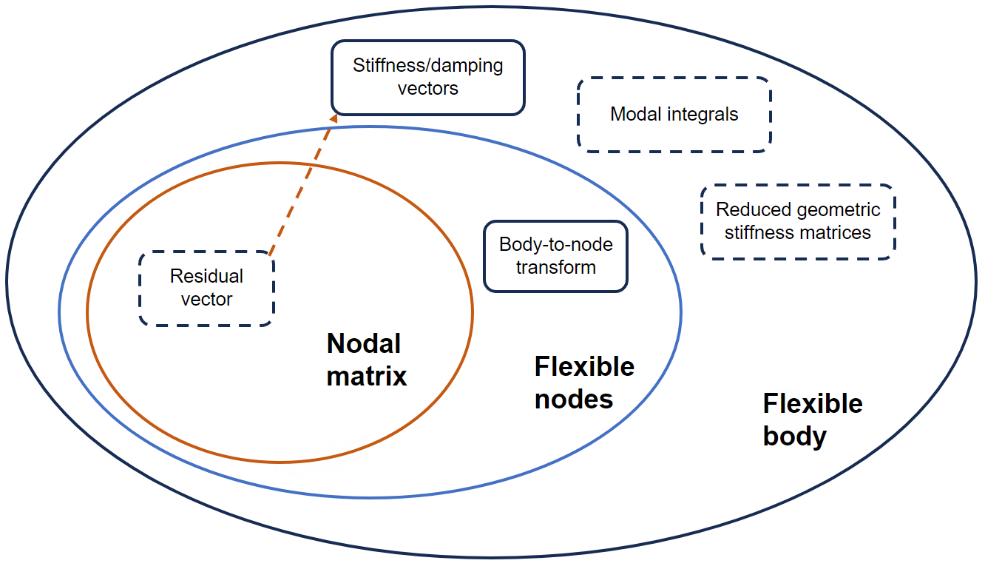
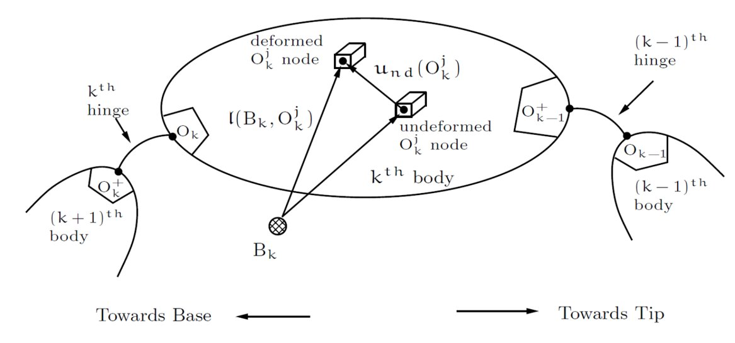
Flexible body definition

Slide 12
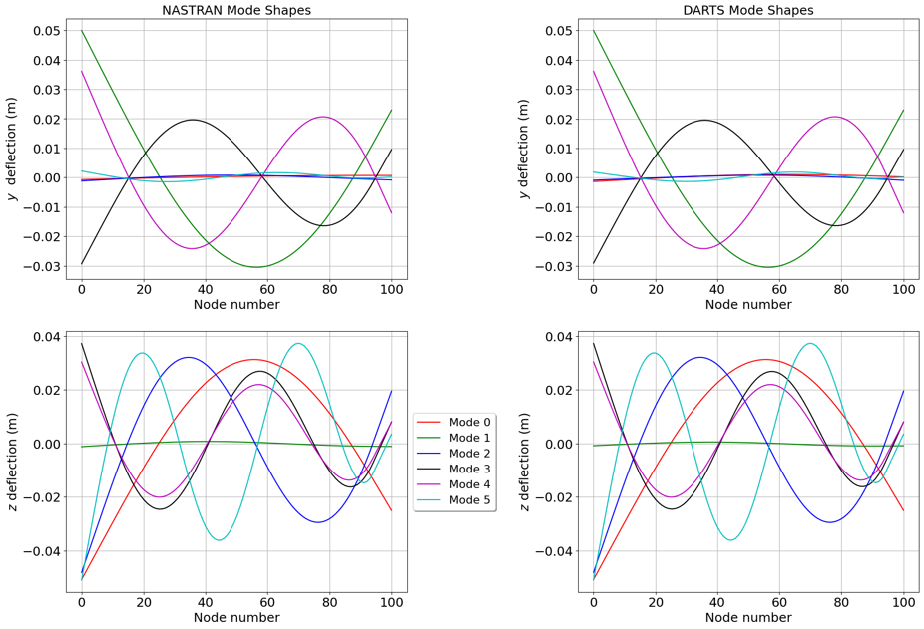
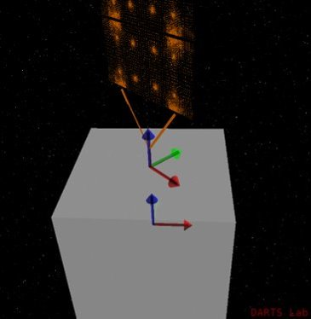
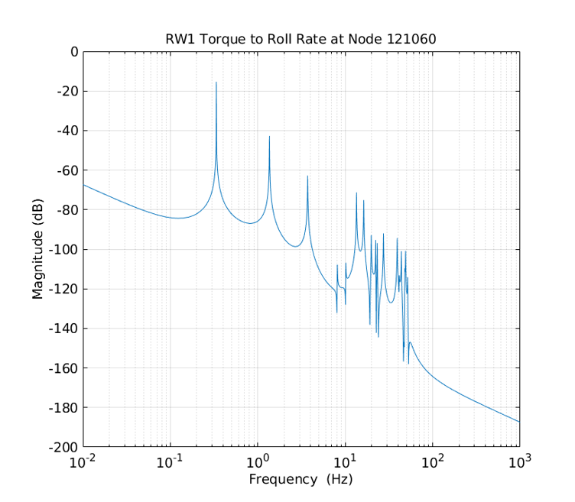
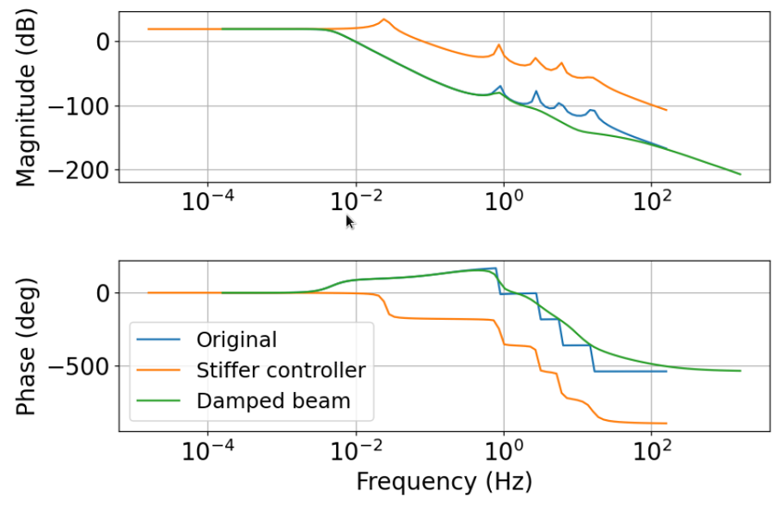
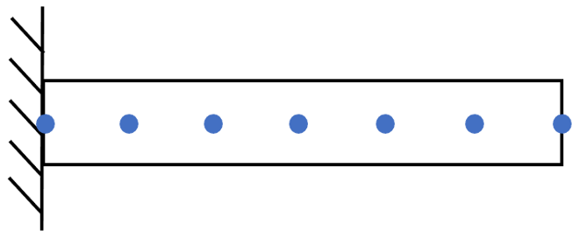
Examples

Slide 13
Thank you for your attention. Any questions?

Slide 14
Backup slides

