Slide 1
Modeling servo-elastic effects
2023 DARTS Lab Course​
Abhinandan Jain, Aaron Gaut, Carl Leake, Vivian Steyert, Tristan Hasseler, Asher Elmland, Juan Garcia Bonilla

Slide 2
Topics overview
Introduction
Single flexible body modeling
FModal FEM/DARTS bridge
Flexible multibody systems in DARTS
Time domain simulations
Recovering system modes with configuration changes
Servo-elastic effects
Wrap up

Slide 3
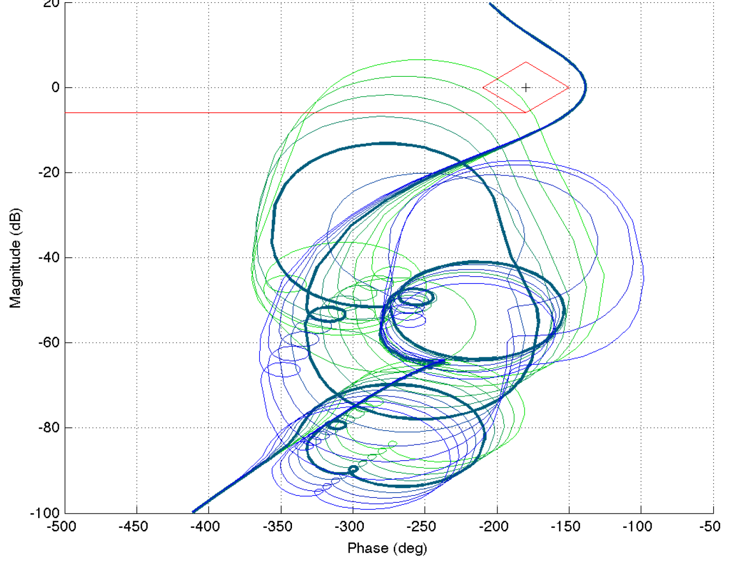
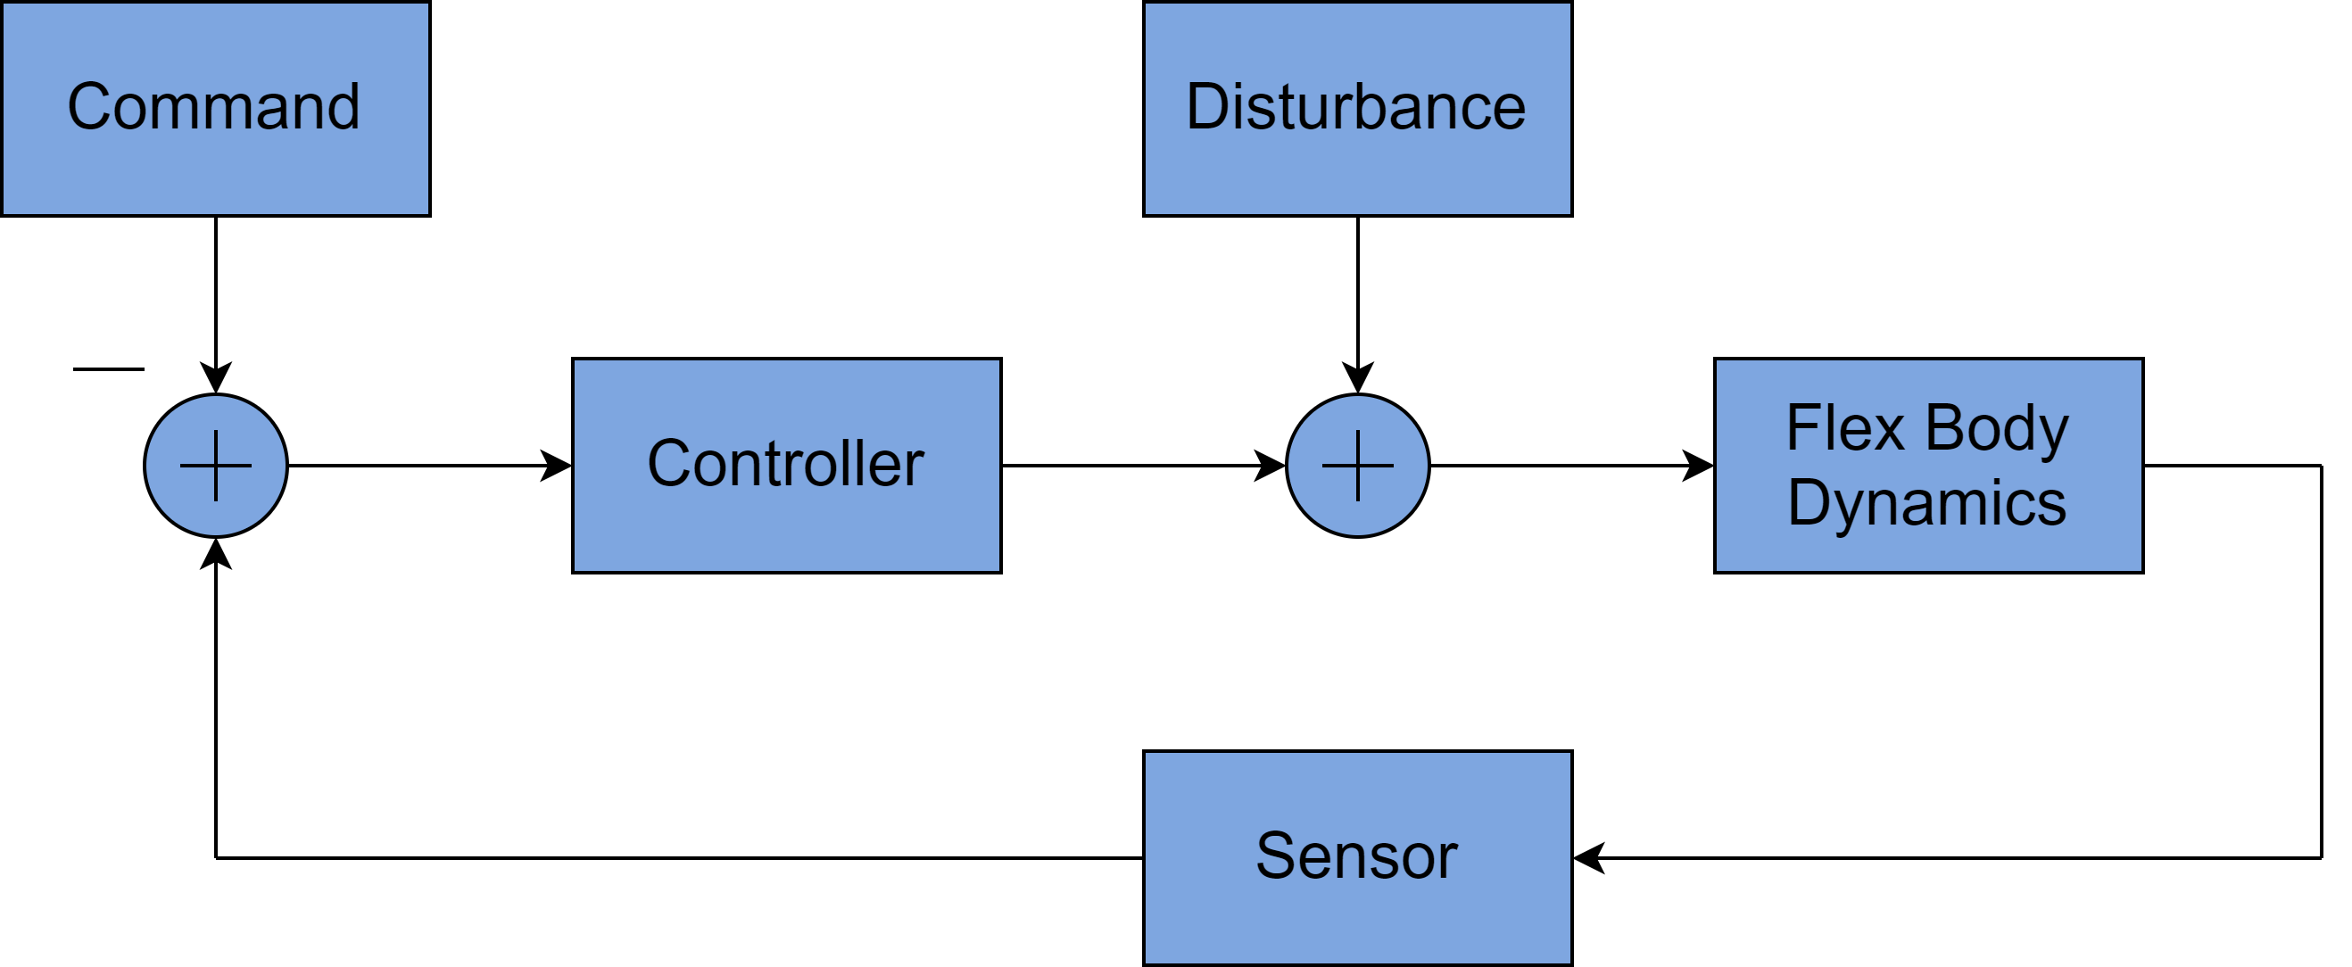
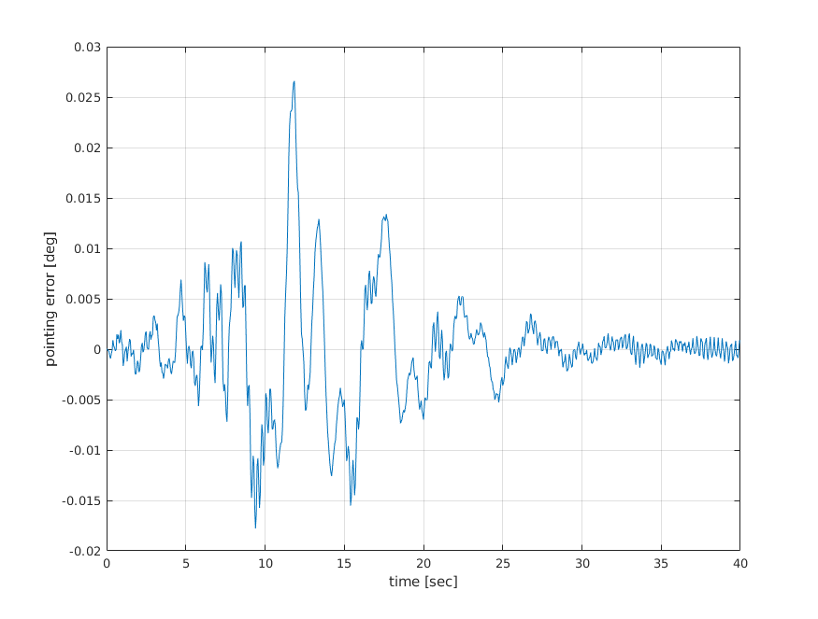
Recap: Impact of Flexible bodies on G&C
Flexible body effects can negatively impact control system stability and performance
Underlying dynamics can be time-varying, multibody, and contain nonlinearities, rigid-flex coupling, and large mode sets.
This analysis is typically carried out for multiple channels, time segments, and modal data sets, therefore requiring many models.
flex body effects
Nichols plots (linear analysis) illustrates the potential for controls-structures interaction
Sample Block Diagram
Time-domain nonlinear model results illustrate undesirable pointing error due to control system interaction with structural modes

Slide 4
Overview
Servo-elastic simulation buildup
Notebook examples

Slide 5
Servo-elastic simulation

Slide 6
Modeling servo-elastic effects
Servo-elastic effects arise when:
The multibody system contains one or more flexible bodies (the elastic part).
Actuators and sensors that are mounted on flexible bodies (the servo part).
Aero-elastic effects arise when aerodynamics models apply loads on flexible bodies.
To study these effects, we need to:
Build a flexible multibody model in DARTS.
Build a full-up vehicle simulation with actuators, sensors, and environment models in Dshell that interact with the DARTS bodies.
Once we have the simulation put together, we can:
Run time-domain simulations.
Use linearization to create state-space models.
Use state-space modes to create bode plots.
Etc.

Slide 7
Servo portion
The servo portion of our servo-elastic actuator will be brought in using Dshell.
Using Dshell models, we can apply forces at joints (motors) or at arbitrary actuator nodes placed on the body (actuators).
These simulations also oftentimes contain quantities of interest that are measured using models, e.g., a noisy IMU.
Again, we can use Dshell for this. We can sense values at joints (encoders) or at arbitrary sensor nodes placed on the body (sensor).

Slide 8
Elastic portion
We have already seen multibody systems that contain one or more flexible bodies today.
Hence, we already know how to build the elastic portion of the servo-elastic simulation.
The last thing we need to define are locations on our body where the actuator(s) will act and sensor(s) will sense:
If the actuator acts at the joint, i.e., a motor, then we already have a flexible node defined there.
If the sensor senses at the joint, i.e., an encoder, then we already have a flexible node defined there.
If the actuator acts elsewhere, we can use an actuator node.
If the sensor acts elsewhere, we can use a sensor node.
The nodes that make up the joint and/or actuator/sensor nodes are the flexible body versions, so they come with a mode shape matrix and will deform as the flexible body deforms.

Slide 9
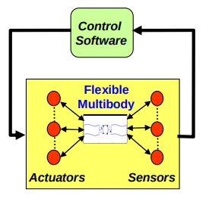
Linearization in DARTS/Dshell
The linearization that we have discussed so far uses finite differences on the full EoMs (including models). This means it extends to the Dshell level without any modifications.
Hence, it will include, by default, the states from the DARTS models as well as the multibody.
This can be disabled if desired via an exclude list.

Slide 10
Examples

Slide 11
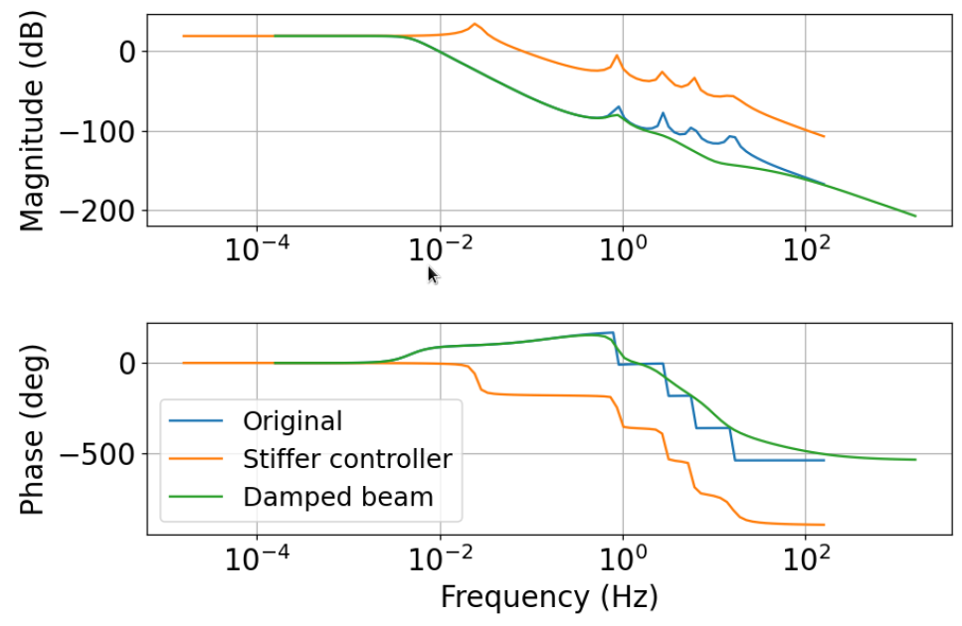
Servo-elastic example
F-FlexDynamics/10-SimpleServoElastic

Slide 12
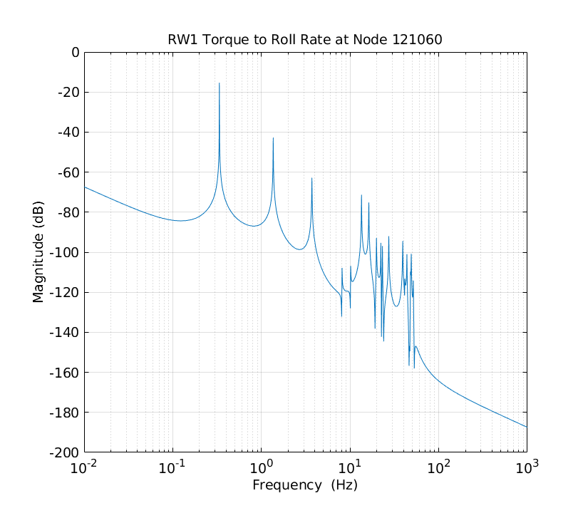
Flexible body linearization and bode plot
F-FlexDynamics/07-SystemLinearization
Control
Software
Flexible
Multibody
Actuators
Sensors

Slide 13
Thank you for your attention. Any questions?

Slide 14
Backup slides

