Slide 1
System modes via DARTS
2023 DARTS Lab Course​
Abhinandan Jain, Aaron Gaut, Carl Leake, Vivian Steyert, Tristan Hasseler, Asher Elmland, Juan Garcia Bonilla

Slide 2
Topics overview
Introduction
Single flexible body modeling
FModal FEM/DARTS bridge
Flexible multibody systems in DARTS
Time domain simulations
Recovering system modes with configuration changes
Servo-elastic effects
Wrap up

Slide 3
Recap: Workflow for recovering system modes under configuration changes
The G&C system cares about the system-level behavior.
Under configuration changes, the state-of-practice has been to get multiple FEM snapshot models of the system to obtain some level of coverage of the configuration space.
However, DARTS can do this more easily.
Use FEM model data for the DARTS component bodies. The component bodies are constant (small deformation, low change in mass properties, etc.) as opposed to the parts that are variable: joints, bodies that change mass noticeably, etc.
Let DARTS generate the full nonlinear system-level model based on the component bodies: a model that is valid across the configuration space.
Use DARTS built-in linearization process to extract the system-level linearized models for a broad range of configurations.
constant
constant
This procedure eliminates the need to get multiple system-level NASTRAN FEM data for at best sparse system-level coverage. Instead, we get component data once, and use DARTS to get dense system-level coverage.

Slide 4
DARTS system models verification and demonstration
We have proposed an approach for building the flexible body model using:
Specific choice of modes
FModal
A-sets
Residual models
Modal integrals
DARTS for the flexible dynamics model
Now we proceed to demonstrate that this process does allow us to recover system modes via DARTS over a large configuration space.

Slide 5
Verification process
Use FModal to generate modal data for component flexible bodies to build up a DARTS flexible body model.
Make configuration changes within DARTS and compute system modal data.
In parallel, develop and use NASTRAN to create snapshot linear models at these different configurations and also compute modal data.
Compare the mode shapes and frequencies from the two paths and verify that they agree.

Slide 6
Configuration changes studies
The vehicle configuration changes that will be examined will include:
Large articulation
Mass property changes of rigid bodies
Attachment/detachment of bodies

Slide 7
System level modes
The component level mode shapes are designed to give the correct modal frequency and shapes for the component bodies, provided that the joints are on nodes that are included in the a-set.
Note that joints don't have to exist, i.e., you can include a node in the a-set, but not put a joint there and still have the correct component modes.
This derivation is done irrespective of the joint angle(s).
This means we should maintain the correct mode shapes as we articulate the joint, i.e., we can have large joint articulation and still get the correct mode shapes.
Similarly, we should be able to modify the mass properties and attach/detach bodies and still maintain the correct mode shapes for the component bodies.
Provided the component bodies have "enough" modes included, we will be able to get the correct system-level mode shapes.
"Enough" here is not well defined and is a value that must be chosen for each component body in the system.

Slide 8
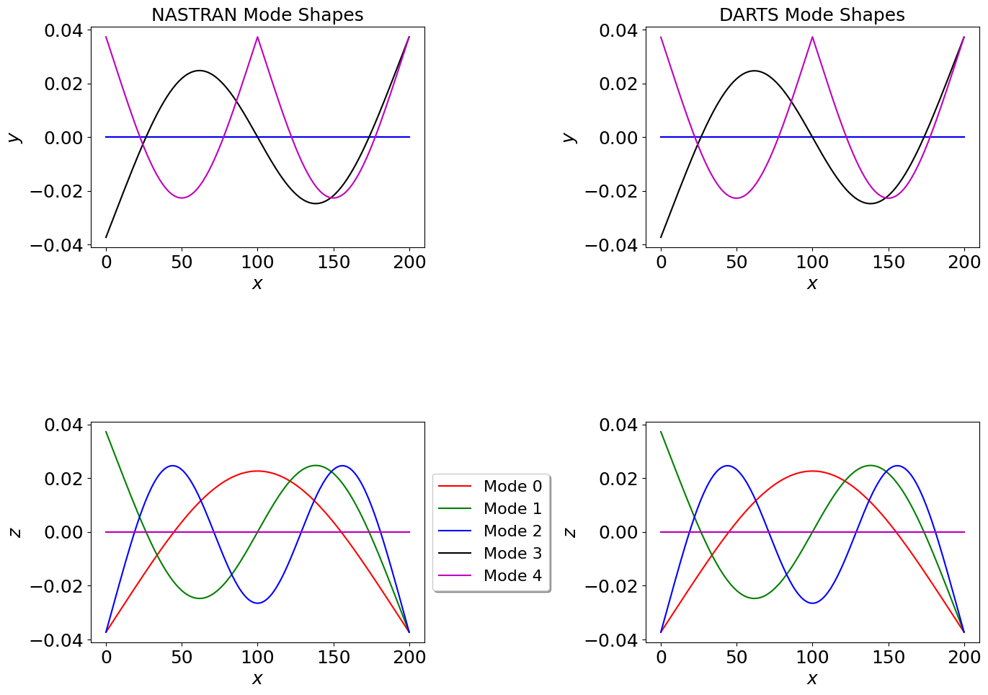
Articulation
F-FlexDynamics/15-LargeArticulationModalAnalysis

Slide 9
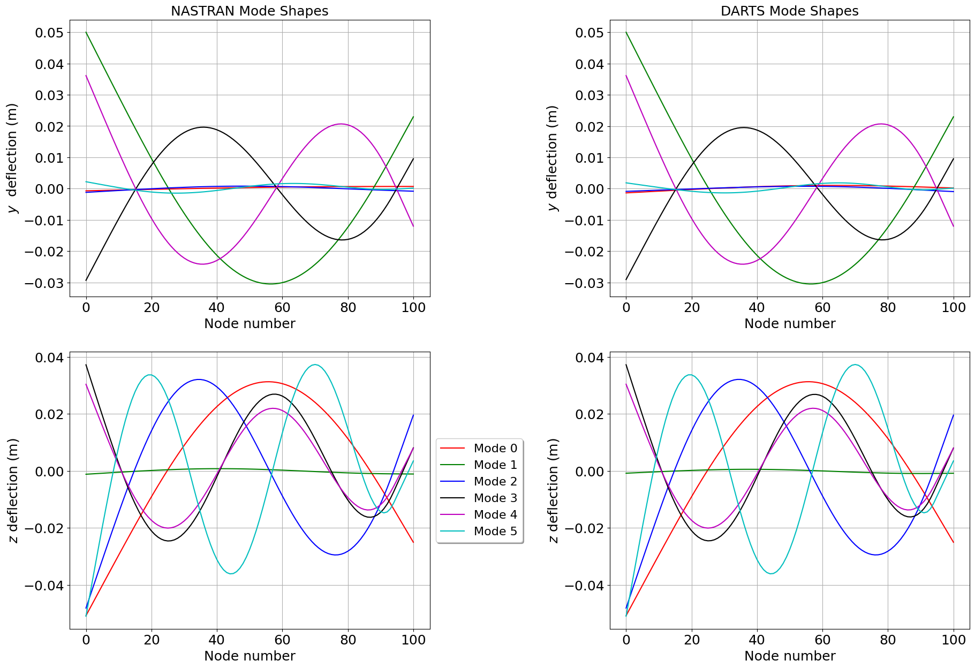
Mass property changes
F-FlexDynamics/13-MassPropertyChangeModalAnalysis

Slide 10
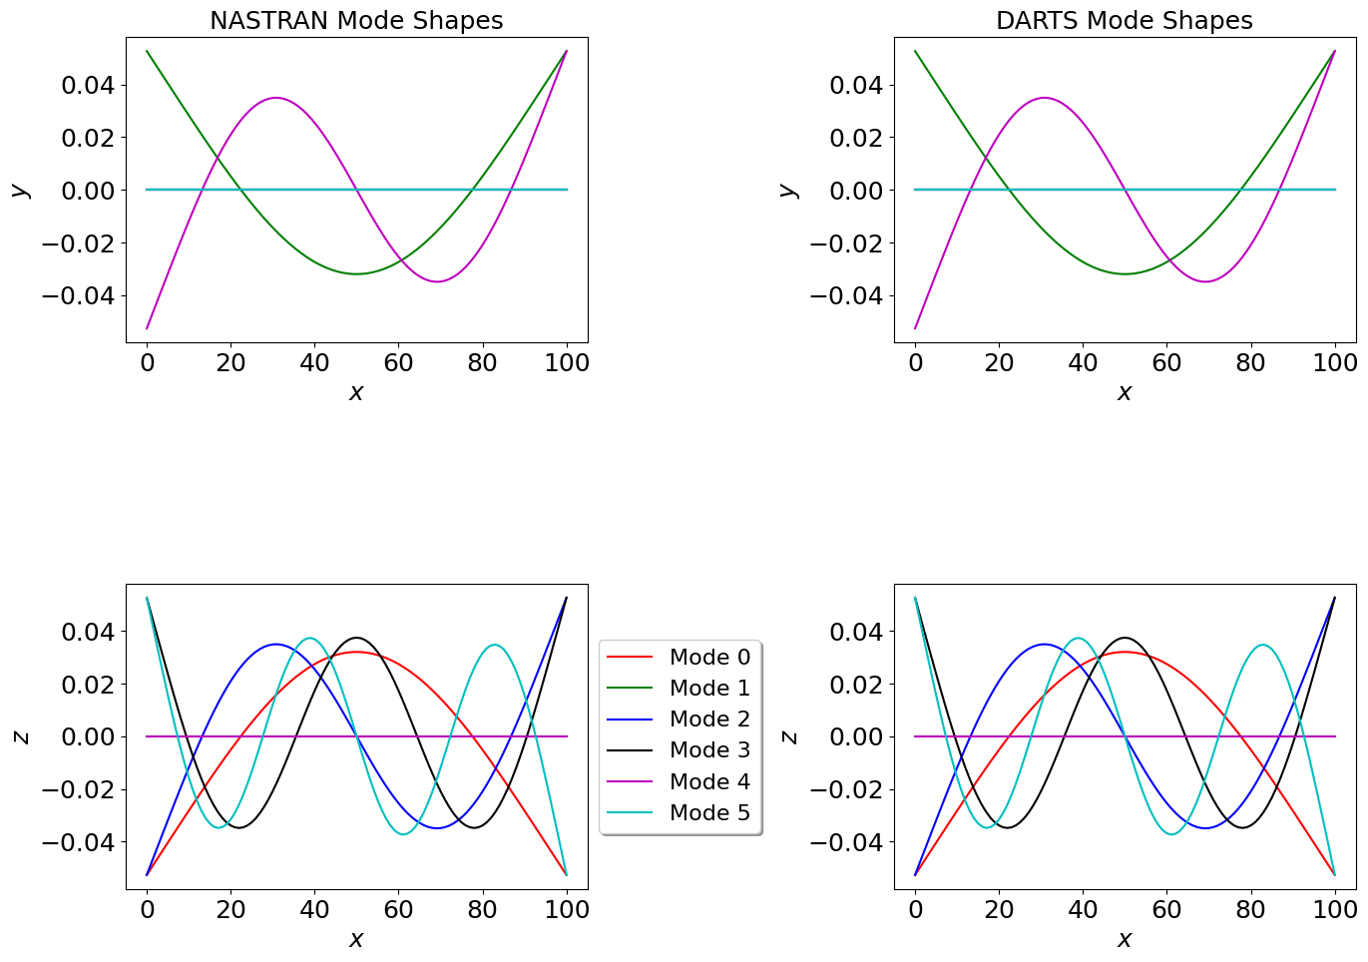
Attachment and detachment
F-FlexDynamics/12-AttachDetachModalAnalysis

Slide 11
Thank you for your attention. Any questions?

Slide 12
Backup slides

