Slide 1
DARTS flexible multibody system model
2023 DARTS Lab Course​
Abhinandan Jain, Aaron Gaut, Carl Leake, Vivian Steyert, Tristan Hasseler, Asher Elmland, Juan Garcia Bonilla

Slide 2
Topics overview
Introduction
Single flexible body modeling
FModal FEM/DARTS bridge
Flexible multibody systems in DARTS
Time domain simulations
Recovering system modes with configuration changes
Servo-elastic effects
Wrap up

Slide 3
Overview
Flexible bodies and nodes in DARTS
Notebook examples

Slide 4
FModal flexible body data recap

Slide 5
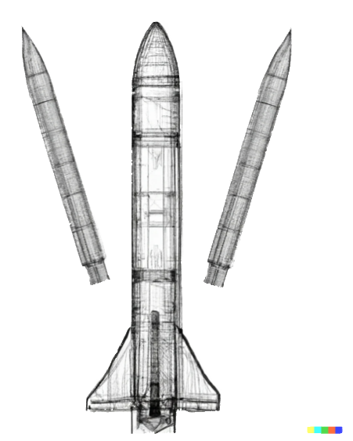
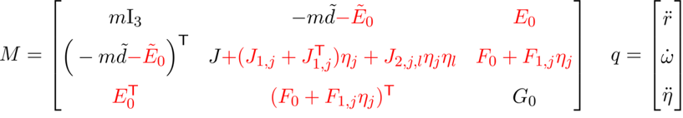
Flexible body model options summary
Number of
modes
Key
Required
a-set
Residual vectors
Optional
Chosen in FModal only
Chosen in FModal and on H5 import
Lumped mass child bodies
Modal integrals

Slide 6
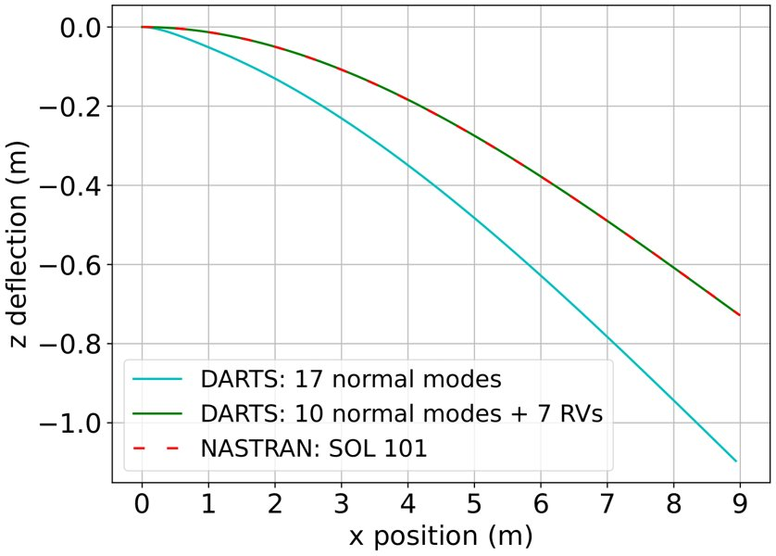
Residual vectors
Residual vectors are specified when you run FModal and create the HDF5 file. These are added into the list of mode shapes and frequencies.
  Since these are added to the mode shape/frequency lists directly, you cannot turn them off when importing flex data into DARTS from the HDF5 file.
  If you decide you don't want them, you will need to re-run FModal and create a new HDF5 file without residual vectors.
Example of a static response validation test for the static deflection of a cantilevered beam under tip load. The DARTS static solution with residual vectors is closer to the NASTRAN solution than without residual vectors.

Slide 7
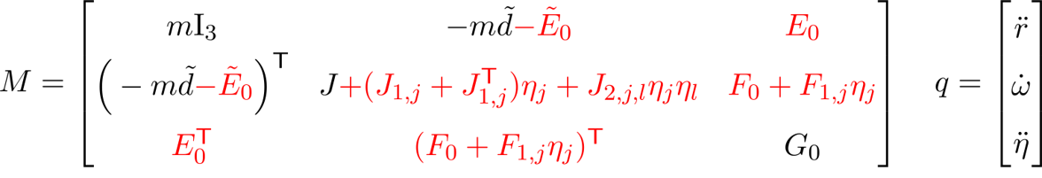
Modal integrals
Unlike residual vectors, these can be enabled/disabled both when running FModal and when importing the HDF5 file content into DARTS.
However, if you want to import modal data from the HDF5 file, they will need to have been created by enabling the modal integrals option when running FModal.
Modal integrals shown in red.
Gyroscopic terms not shown for brevity.

Slide 8
FModal data location in DARTS
Stiffness/damping vectors
This diagram shows where the data produced by FModal ends up in DARTS, i.e., on the flexible body, the flexible node, or the flexible node's nodal matrix.
Modal integrals
Reduced geometric stiffness matrices
Mode shapes
Body-to-node transform
Residual vectors
Nodal matrix
Flexible nodes
Flexible body

Slide 9
Flexible bodies within a multibody model

Slide 10
Multibody context – we have constraints
Mode shapes provide a basis set for describing body deformation,
  Hence the choice should not matter in principle.
  However, the choice of mode shapes has a significant impact on reduced order modeling. The best choice are the ones allowing the use of the smallest number of modes to capture the essential dynamics.
Free-free modes are the natural set of modes for free-floating bodies.
However, in multibody systems, bodies are not entirely free, and have hinge constraints between body pairs that constrain their relative motion.
  Constraints can also arise from attachments to the environment as we saw before, e.g., cantilevered beam.
As with the single-body system, a better choice of mode shapes are the component modes.
  Recall the mode shapes we derived using the Craig-Bampton transformation earlier.

Slide 11
Recap: Component mode synthesis
The new mode shapes (CB-modes) normalize the original system.
  This means that they diagonalize both the stiffness and mass matrix.
  The stiffness matrix entries are the squares of the modal frequencies.
  The mass matrix is an identity matrix.
It is easy to identify and remove the rigid-body modes.
  The rigid-body modes will have small frequency values in the set of flexible body modes.
This allows us to constrain the body in the multibody dynamics simulation by using the modal matrix of the node we want to constrain and a floating reference frame.
With C-B component mode shapes, the DARTS mode shapes match the constrained mode shapes in NASTRAN and they respond to forces at the joint.

Slide 12
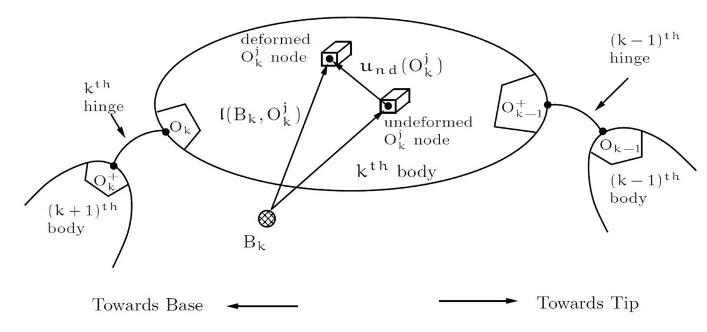
Choosing nodes for the a-set in multibody context
We need to include nodal DoFs at each node where our flexible body will connect to other bodies in the simulation.
  Should include joint nodes and constraint nodes.

Slide 13
Choosing nodes for the a-set
The last question we have to ask ourselves if how many nodal DoFs should be included in the a-set for each node?
  Why?

Slide 14
Choosing nodes for the a-set
The answer is all of them, i.e., all 6 DoFs should be included for each node previously identified.
The reason is that all 6 DoFs of these nodes are used in the joint, either as passive or active DoFs.
This can feel counter-intuitive, because that means that a simple beam connected to the ground with a pinned joint, U-joint, locked joint, etc. will use the exact same a-set.
  The mode shape processing done by FModal is the same regardless of the joint type that will be used in DARTS.

Slide 15
Triple length fixed-fixed beam example
In the example below, three beams are joined to create a triple-length fixed-fixed beam.
All the beams should have all 6 DoFs of both end nodes in their a-set.
Provided the three beams are identical, this means that NASTRAN only needs to be run once to generate the component data for the three bodies.
a-set: joint
a-set: joint
This is added for the left and right beam
a-set: joint
This is added for the left and right beam
a-set: constraint

Slide 16
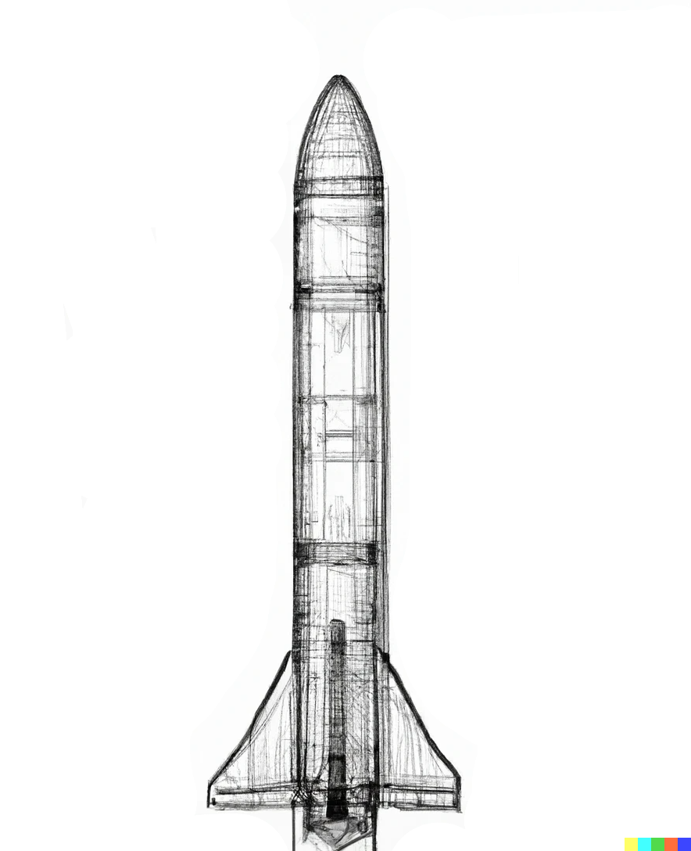
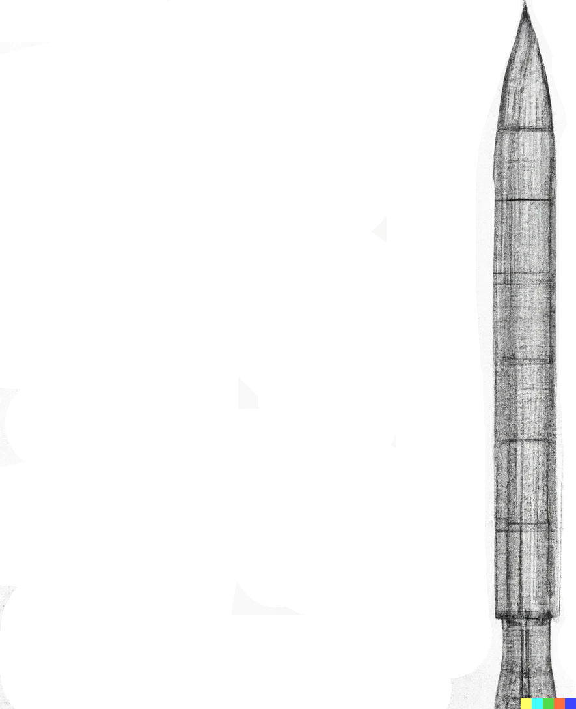
FEM Lumped masses – as DARTS rigid bodies
Rather than leaving lumped masses as part of the flexible body, they can be separated out.
The lumped masses can be imported as separate rigid-bodies in DARTS, which are attached to the flexible body via joints.
The mass properties of these lumped masses can change and they can be attached/detached at run-time.
This image was created with the assistance of DALL·E 2

Slide 17
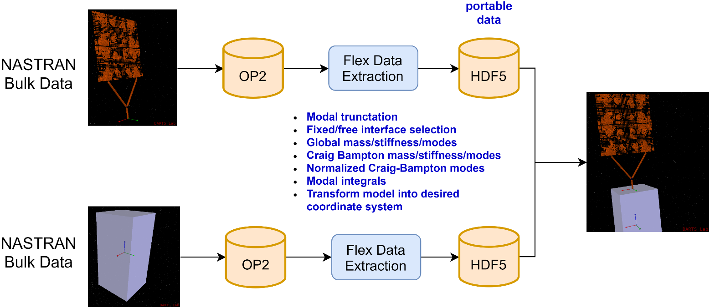
Use FModal for each component body to generate data for the DARTS multibody model
FEM
FModal
DARTS

Slide 18
DARTS Flexible body

Slide 19
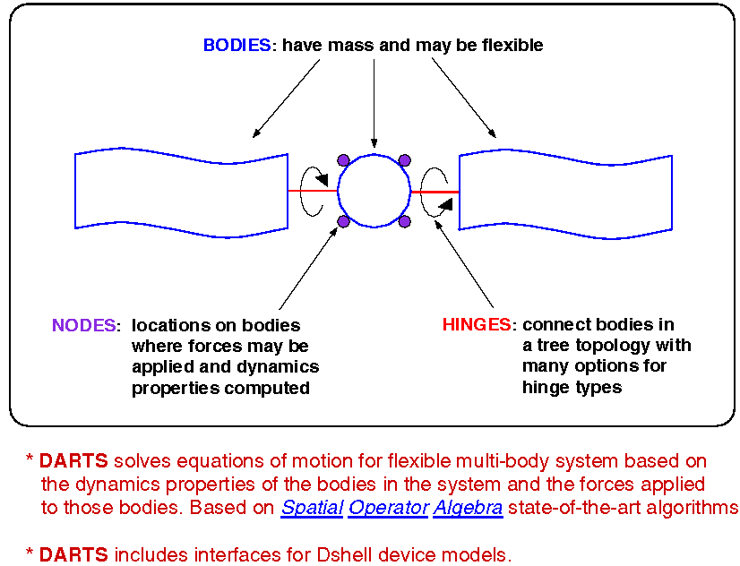
DARTS rigid/flexible real-time multibody dynamics engine
Abhinandan Jain, "Robot and Multibody Dynamics: Analysis and Algorithms", Springer, 2010.

Slide 20
FModal workflow for a single component flexible body
FO6, OP2, and or MAT
file
NASTRAN run deckf
Modified
NASTRAN
run deckf
NASTRAN SOL 103
(modified with DMAPs)
DARTS
FEM
FModal

Slide 21
DARTS flexible bodies
DARTS flexible bodies have all the properties of rigid bodies.
In addition, they also have:
  Stiffness/damping vectors
  Flexible body degrees of freedom
  Flexible body nodes: including pnode and onode
  Optional modal integrals
  Optional reduced geometric stiffness matrices
The rigid body DARTS methods that are used when calculating the dynamics are overridden to include the flexible body contributions.
  Modal integral and geometric stiffening due to inertial loads contributions will also be added if specified when creating the DARTS flexible body.

Slide 22
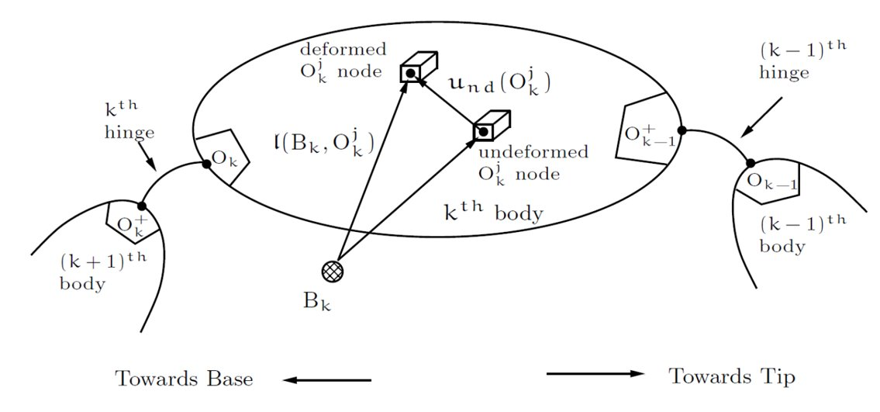
Visual description
o-nodes
p-nodes

Slide 23
DARTS flexible body joints
The joints of flexible bodies are like their rigid counterparts. The difference is that the pnodes and onodes on the flexible body/bodies are flexible body nodes (i.e., they can deform).
This allows the nodes that make up the joint to deform with the flexible body/bodies.

Slide 24
Handling loop constraints in a multibody system
If the body has more than 6 DoFs constrained, e.g., a fixed-fixed beam, then flexible body constraints need to be used.
  This is like how rigid-body constraints must be used for a similarly-constrained rigid body.
For flexible bodies, these constraint nodes have a modal matrix in addition to the normal translation/rotation.
Like rigid-body systems, we can model arbitrary flexible multibody topologies using cut joint constraints, i.e., a tree topology plus flexible body closure constraints.

Slide 25
Higher-order effects
As mentioned previously, flexible bodies provide methods to get/set the modal integrals and reduced geometric stiffening matrices.
Residual vectors appear as mode shapes, so these are incorporated when setting the nodal matrices for the body's nodes.

Slide 26
DARTS Flexible node

Slide 27
DARTS Flexible nodes
Flexible body nodes are similar to rigid body nodes. The difference is they have a nodal matrix derived from the mode shapes associated with them.
This nodal matrix can be used to compute the deformation/rotation of the node as the modal coordinates change.
This matrix is represented in the body reference frame.
  This is so that the node itself can have an arbitrary non-deformed body-to-node transform, i.e., the node may be rotated relative to the body frame in its undeformed state.
The API is similar to rigid-body nodes but contains a few more methods for things like getting/setting the nodal matrix.

Slide 28
Visual description
o-nodes
p-nodes

Slide 29
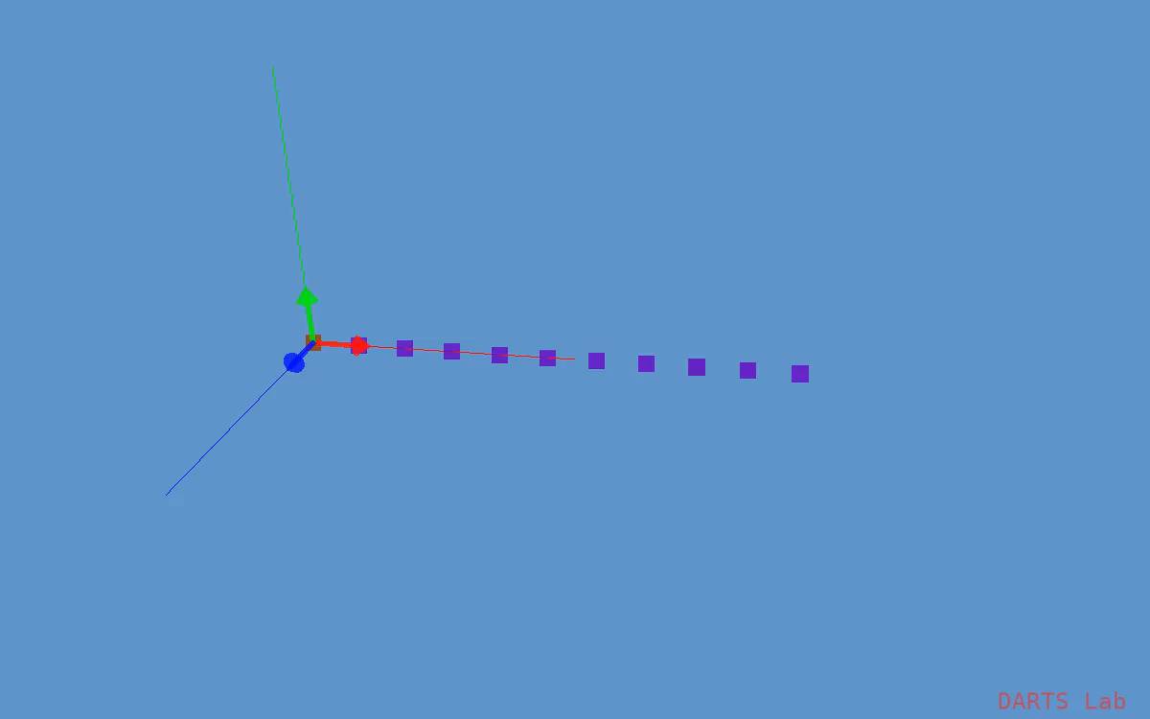
Visual description

Slide 30
Take aways
Flexible bodies have a stiffness/damping vector.
  The stiffness vector is computed from the eigenvalues that were part of the normalized component modes we calculated earlier.
Flexible bodies have modal coordinates, nodes do not.
Nodes have nodal matrices (these are from the normalized component mode shapes we calculated earlier).
  Nodes use their nodal matrix and their associated body's flexible body coordinates to calculate their deformation.
Flexible bodies contain the data for modal integrals, and geometric stiffening due to inertial loads. These effect the dynamics of the body.

Slide 31
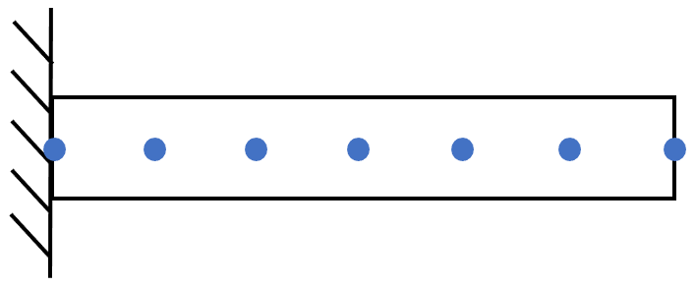
Cantilevered beam modal analysis
F-FlexDynamics/09-CantileverBeamModalAnalysis

Slide 32
Fixed-fixed beam modal analysis
F-FlexDynamics/11-FixedFixedBeamModalAnalysis

Slide 33
DARTS flexible multibody dynamics computational algorithms

Slide 34

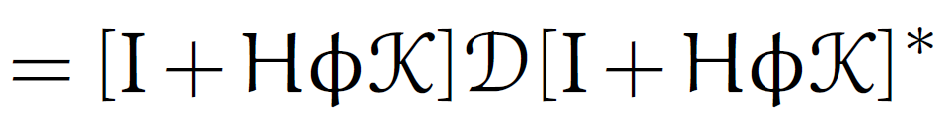

Spatial Operator Algebra (SOA) Methodology
Continues to hold for flexible bodies!
SOA exploits rich mathematical structure of the dynamics
Analytical Newton-Euler factorization of the mass matrix
Analytical Innovations factorization of the mass matrix
Analytical operator expression for the mass matrix inverse for general, rigid/flex tree topology systems of arbitrary size.
Leads to recursive O(N) cost dynamics solution algorithm!

Slide 35
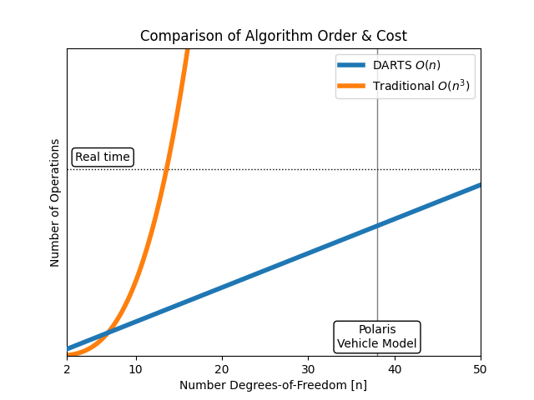
DARTS O(N) Computational Cost
The recursive O(N) forward dynamics algorithms for solving the equations of motion continue to work for flexible bodies!
The O(N) DARTS algorithm is critical for real-time simulation!

Slide 36
DARTS – Rigid to Flexible bodies transition
There are significant algorithmic changes in DARTS for handling body flexibility.
  These changes are however captured by overridden methods in DartsFlexBody and DartsFlexNode classes.
  These classes are derived from the DartsBody and DartsNode classes respectively.
However, the overall EoM solution algorithm continues to remain of O(N) cost.
  The algorithms also allow run-time changes to the multibody topology.
At the user level there are a few changes to DARTS however to accommodate flexible bodies.
  Additional modal data is needed for a flexible body definition.
  The states associated with a flexible body now include modal coordinates and velocities in addition to the hinge articulation coordinates and velocities.

Slide 37
System-level modes

Slide 38
System-level properties
Thus far, we have focused mostly on component flexible body properties. However, our goal is to be able to extract system-level properties.
The system-level properties will change as the multibody system configuration changes.
Our strategy is to rely on DARTS to take us from “constant” and linear component-body properties to the full nonlinear configuration-dependent model.
Once we have that model, we can perform whatever analyses we like, e.g., time-domain simulations, trimming and linearization, etc.
constant
constant

Slide 39
Linearization

Slide 40
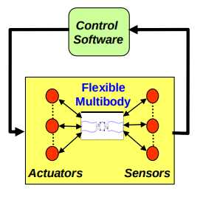
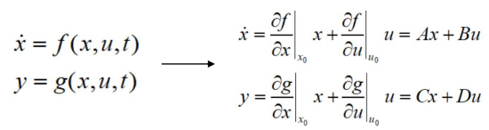
Linearization in DARTS
DARTS contains C++ methods (based on finite differences) that can produce a linear state-space model from a full non-linear model.
  Depending on the situation, the first step may require one to solve for an equilibrium state for a specified initial state and loading.
  The state-space model can be used to generate Bode plots.

Slide 41

Equilibrium and trimming
Linearizations are valid only around equilibrium points.
Hence, solving for equilibrium may be a necessary step, depending on your external loading.
Residual vectors can be an important aspect of getting your equilibrium, and thus your linearization, correct.

Slide 42
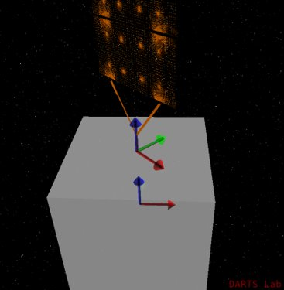
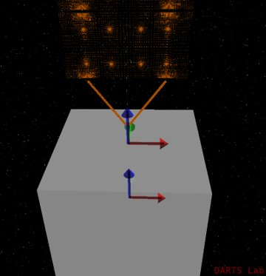
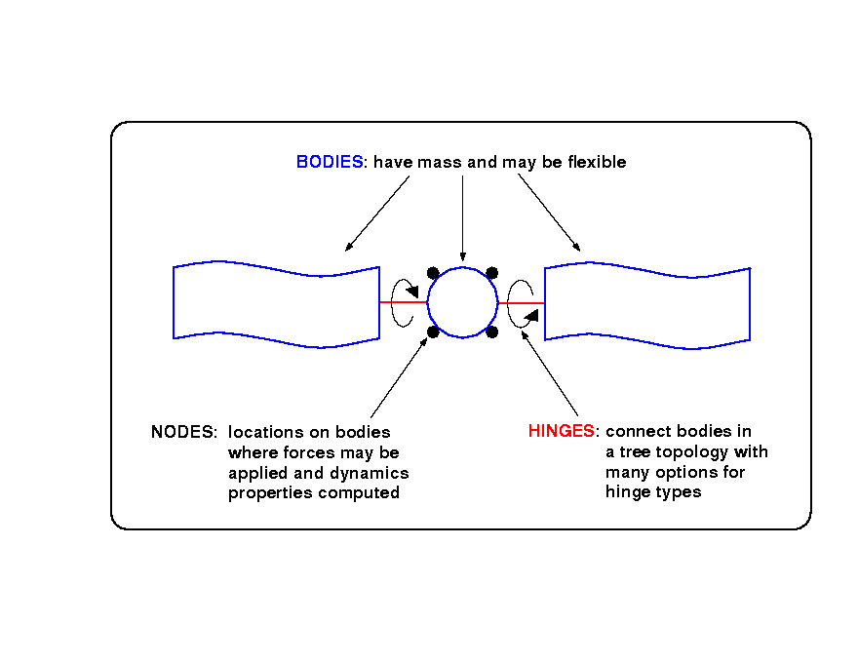
Flexible body linearization: multiple configurations
F-FlexDynamics/08-LinearizeMultipleConfig
Control
Software
Flexible
Multibody
Actuators
Sensors

Slide 43
Thank you for your attention.
Any questions?

Slide 44
Backup slides

Slide 45
Component vs System modes
G&C ultimately cares about system modes.
However, the system is going through large nonlinear changes—thus FEM based system modes are invalid after such changes.
This can necessitate lots of FEM models or narrowing G&C efforts.
How do we solve this problem?
One approach is to start with component body FEM models and use them as a way of accommodating configuration changes so that we can handle the varying system modes.
Can be done using multibody modeling.

Slide 46
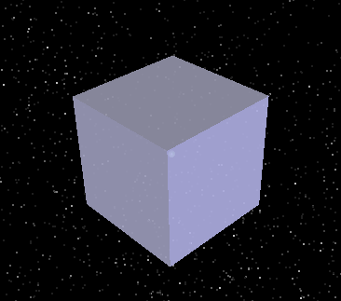
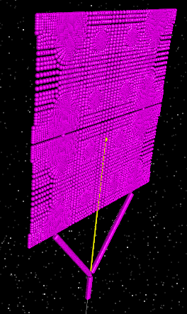
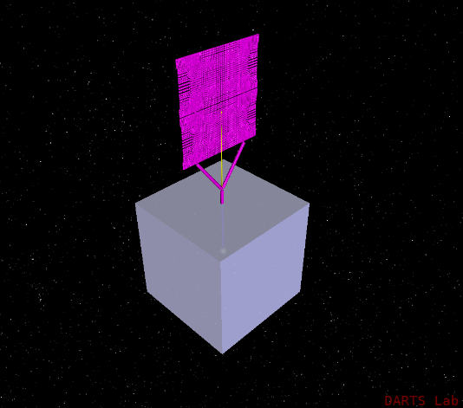
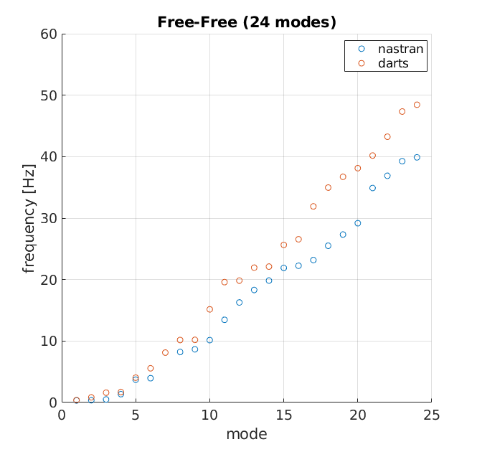
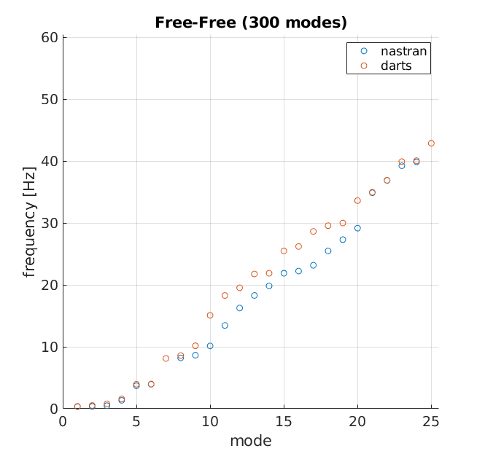
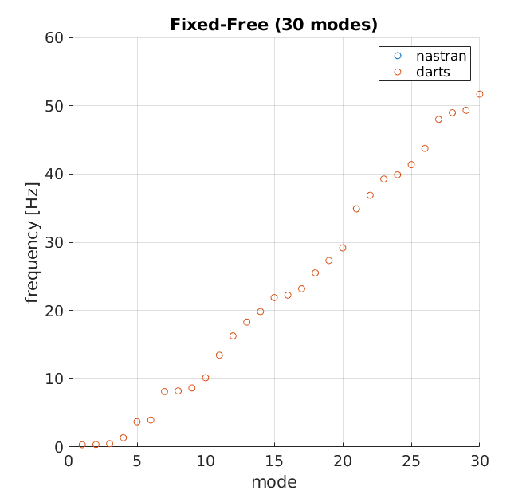
Mode choice effects model accuracy and number of DoFs
  22,824 grid points
  136,944 DoFs
Craig-Bampton (fixed-free) modes are better suited for combining component models with fixed boundary conditions. The figures below show that just 30 Craig-Bampton fixed-free modes does a better job matching the modes of a constrained body than 300 free-free modes.
24 free-free
300 free-free
30 Craig-Bampton fixed-free

Slide 47
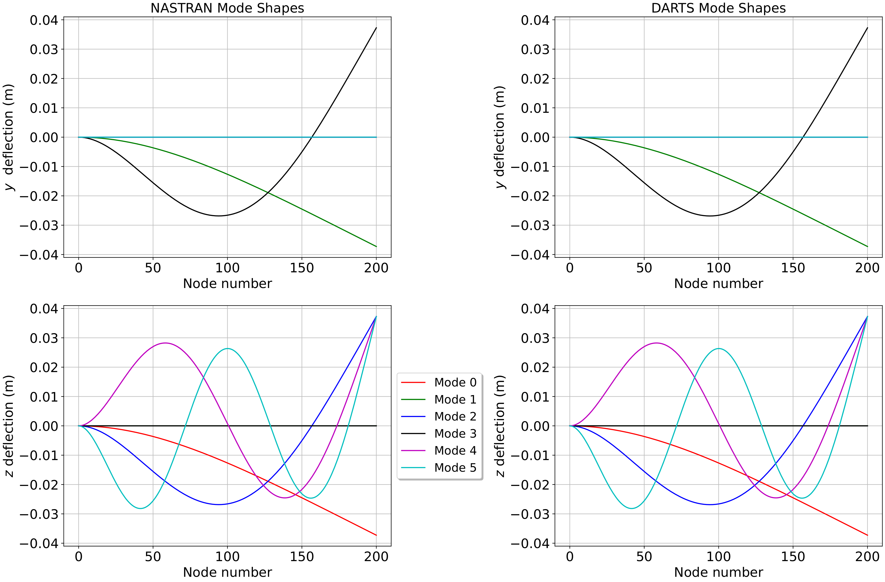
Modal comparison validation test example
Example of a modal comparison validation test for a double-length cantilever beam: NASTRAN (left column) vs. DARTS (right column). The DARTS model is made up of two single-length beams locked together, whereas the NASTRAN model is made up of one double-length cantilever beam.

