Slide 1
FModal tool for Flexible Body Data
2023 DARTS Lab Course
Abhinandan Jain, Aaron Gaut, Carl Leake, Vivian Steyert, Tristan Hasseler, Asher Elmland, Juan Garcia Bonilla

Slide 2
Topics overview
Introduction
Single flexible body modeling
FModal FEM/DARTS bridge
Flexible multibody systems in DARTS
Time domain simulations
Recovering system modes with configuration changes
Servo-elastic effects
Wrap up

Slide 3
Overview
FModal motivation
NASTRAN basics
FModal pipeline
Nastran
ReadHDF5Flex
Examples

Slide 4
FModal motivation

Slide 5
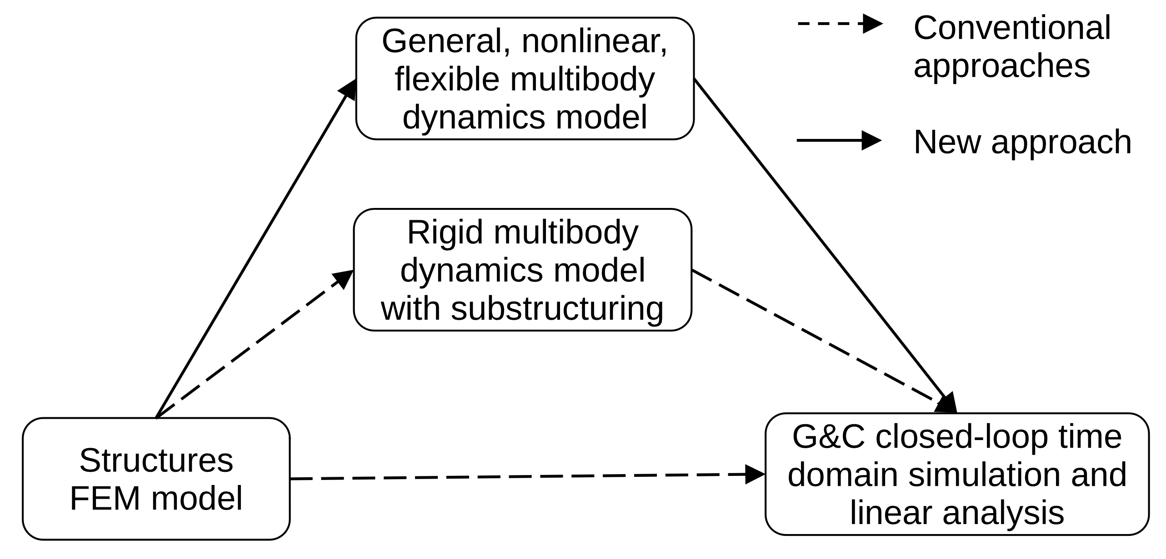
Flexible multibody dynamics preferred approach
Use component flexible body data in flexible multibody dynamics simulators such as DARTS.
Highest fidelity approach of the three shown in the figure.
Does not require complicated hand derivations nor does it require tuning springs/dampers like the other approaches.
Can handle broad range of configuration changes without the need for a new FEM model.

Slide 6
Recap: Single flexible body modal data needs for G&C
Work with floating frame of reference.
Convert FEM nodal model to modal form with mode shapes and frequencies.
Define interface/boundary nodes and compute component modes using C-B.
Define a modes cut-off for reduced order modeling.
Optional: Identify nodes where forces will be applied and compute their residual vectors.
Optional: Compute modal integral data.
Optional: Compute reduced geometric stiffness matrices.
There is significant amount of complexity in correctly processing, extracting, and transferring such a large amount of modal data for component flexible bodies to the multibody model.
The FModal pipeline tool is designed to facilitate this process for component flexible bodies.

Slide 7
FModal overview
FModal supports the processing of component flexible body FEM data for multibody dynamics tools such as DARTS.
Provides a high-level interface for users to generate multibody dynamics model data for component flexible bodies.
Handles all customizations of FEM files and provides a simple Python interface for users to invoke the FEM program.
Handles modal data extraction and post-processing.
Organizes and stores the critical data for a flexible body model in an easy-to-use HDF5 file format for transferring to DARTS for multibody dynamics.
FModal reduces the FEM expertise burden on its user and allows G&C analysts to work directly with and process FEM files.

Slide 8
NASTRAN basics

Slide 9
The typical NASTRAN based workflow
NASTRAN run deckf
Modified
NASTRAN run deckf
FO6, OP2, and or MAT
file
NASTRAN SOL 103
(modified with DMAPs)
Flex data hand-off
GNC
Structures team
One of the approaches discussed earlier. May be a collaboration of teams depending on the approach used.
GNC team

Slide 10
Basics of what a NASTRAN FEM model is
Bulk Data Section (BULK): This section contains the majority of the input data required for analysis. It includes information such as nodes, elements, material properties, boundary conditions, and loads.
This information is provided by the structures team.
Executive Control Section (EXECUTIVE): This section provides control statements that define the overall analysis options and settings. It includes instructions related to analysis type (e.g., static deflection, modal analysis), solution parameters, subcase definitions, and output requests.
Optional information. Re-written by FModal as needed.
Case Control Section (CASE CONTROL): This section specifies the loading and analysis sequence for different subcases. It defines load steps, time steps, and other control parameters related to the analysis process.
Optional information. Re-written by FModal as needed.

Slide 11
NASTRAN terminology
Solver – defines the type of solution NASTRAN will use. For example:
101 – static deformation
103 – modal analysis
F06 file – This file contains the output of the solution in plain text. It is easy for humans to read but is fairly large and more difficult to write a parser for (compared to other formats).
Op2 file – Optional output file type that contains data in binary. It is based on FORTRAN data formatting. This file is smaller and easier to parse than F06 files.

Slide 12
FModal pipeline: NASTRAN

Slide 13
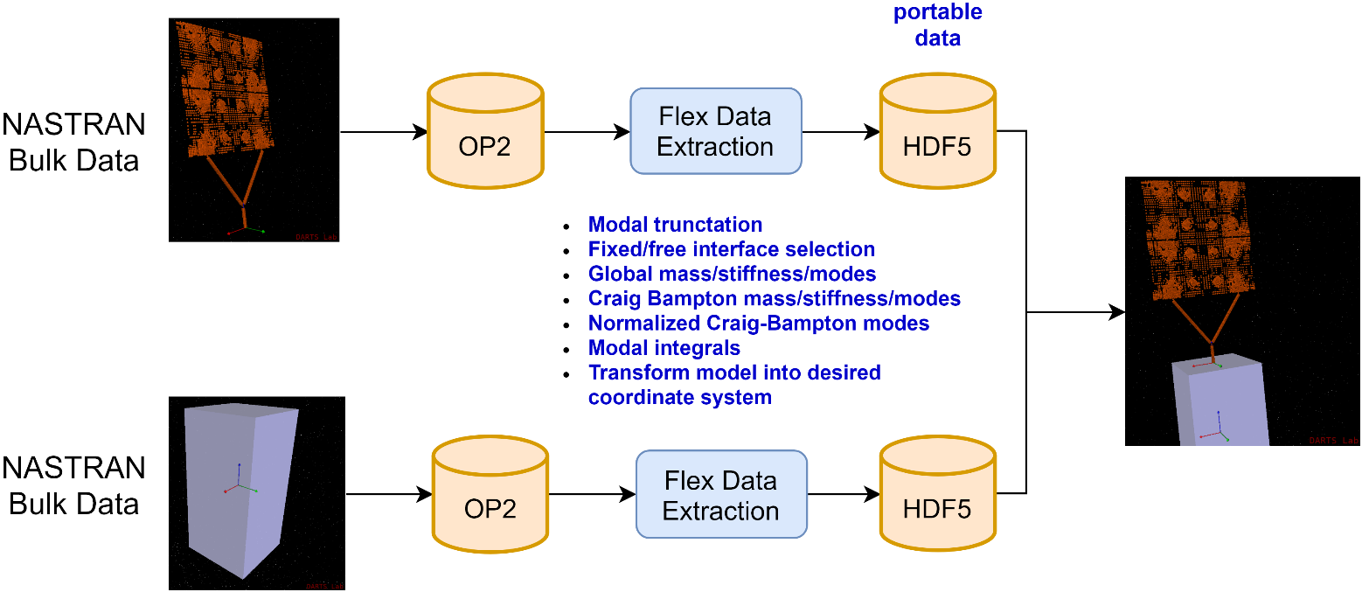
FModal workflow for a single component flexible body
FO6, OP2, and or MAT
file
NASTRAN run deckf
Modified
NASTRAN
run deckf
NASTRAN SOL 103
(modified with DMAPs)
GNC
FEM
FModal
FModal facilitates local processing of FEM data – steps that are often left to the structures team that generates the FEM data.

Slide 14
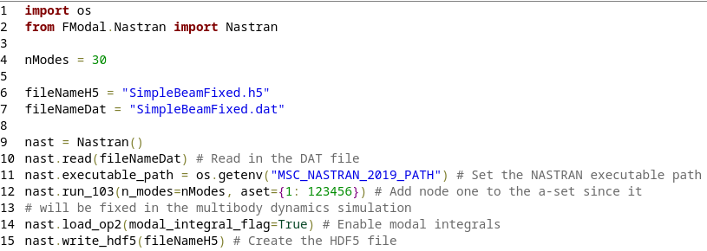
FModal: Python script and HDF5 output

Slide 15
FModal/DARTS features
Choose nodal DoFs in the a-set (that will be constrained in the multibody dynamics formulation).
These are the DoFs that remain as nodal DoFs in the C-B transformation.
Choose nodal DoFs to use for residual vector calculation
Choose number of modes
Enable/disable modal integrals
F
Modal integrals shown in red.
Gyroscopic terms not shown for brevity.
Add this node's DoFs to the a-set
Add this node's DoFs to the residual vector set

Slide 16
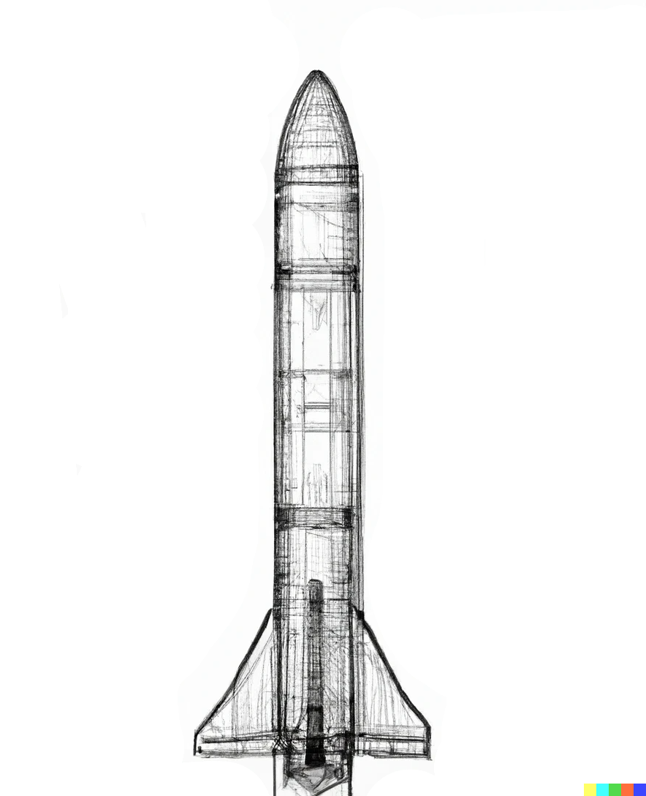
Additional FModal/DARTS features
Enable/disable separating lumped bodies.
Can automatically detach lumped masses from the FEM and add their mass properties into a rigid child bodies section of the HDF5 file.
This allows the user to easily attach/detach the child bodies (e.g., SRBs) within multibody simulations.
This also allows the user to easily change the mass properties of the child bodies (e.g., fuel tank) within multibody simulations.
Lumped masses become separate rigid bodies in the multibody simulation. This means they can be attached/detached or have their mass properties changed.
This makes multibody structures such as a launch vehicle with separable solid rocket boosters easier to create.
This image was created with the assistance of DALL·E 2

Slide 17
FModal pipeline: ReadHDF5Flex

Slide 18
ReadHDF5Flex utility
FModal's Nastran utility gets us from a NASTRAN FEM file to an HDF5 file with the data we need.
Now, we need something to get us from the HDF5 file to a DARTS component flexible body.
FModal's ReadHDF5Flex utility does just that.
This utility also contains convenience methods to:
Obtain commonly viewed portions of the HDF5 file, e.g., mass or inertia.
View mode shapes.

Slide 19
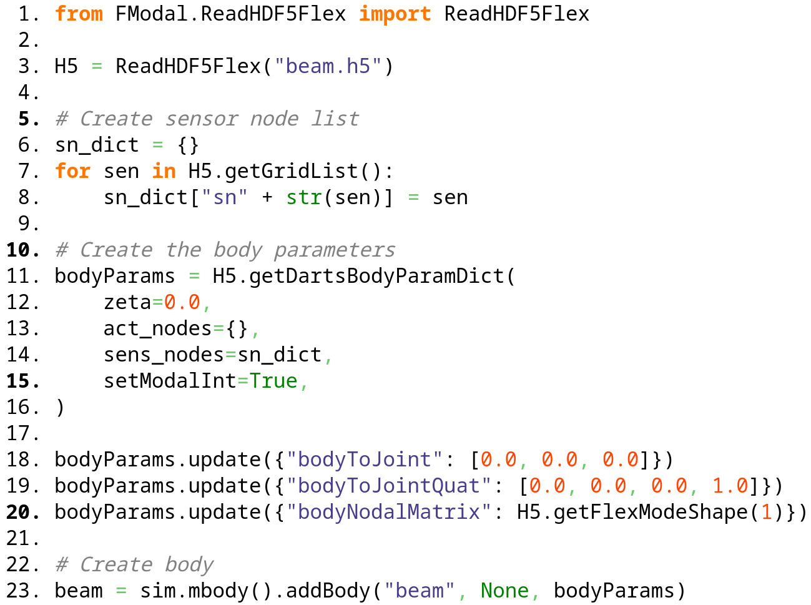
Python code example

Slide 20
ReadHDF5Flex features
Convert mass and distance units.
Set damping value.
Enable/disable modal integrals.
Add DARTS actuator/sensor nodes.
Use convenience functions to set most of the flexible body parameters.
Can get body parameter dictionaries for child bodies as well.
These are the lumped masses that were separated when running FModal.
F
Use this node's properties for the joint
Add these as sensor nodes
Add this as an actuator node

Slide 21
Using FModal for multibody systems

Slide 22
Use FModal for each component body
FEM
FModal
DARTS

Slide 23
FModal examples

Slide 24
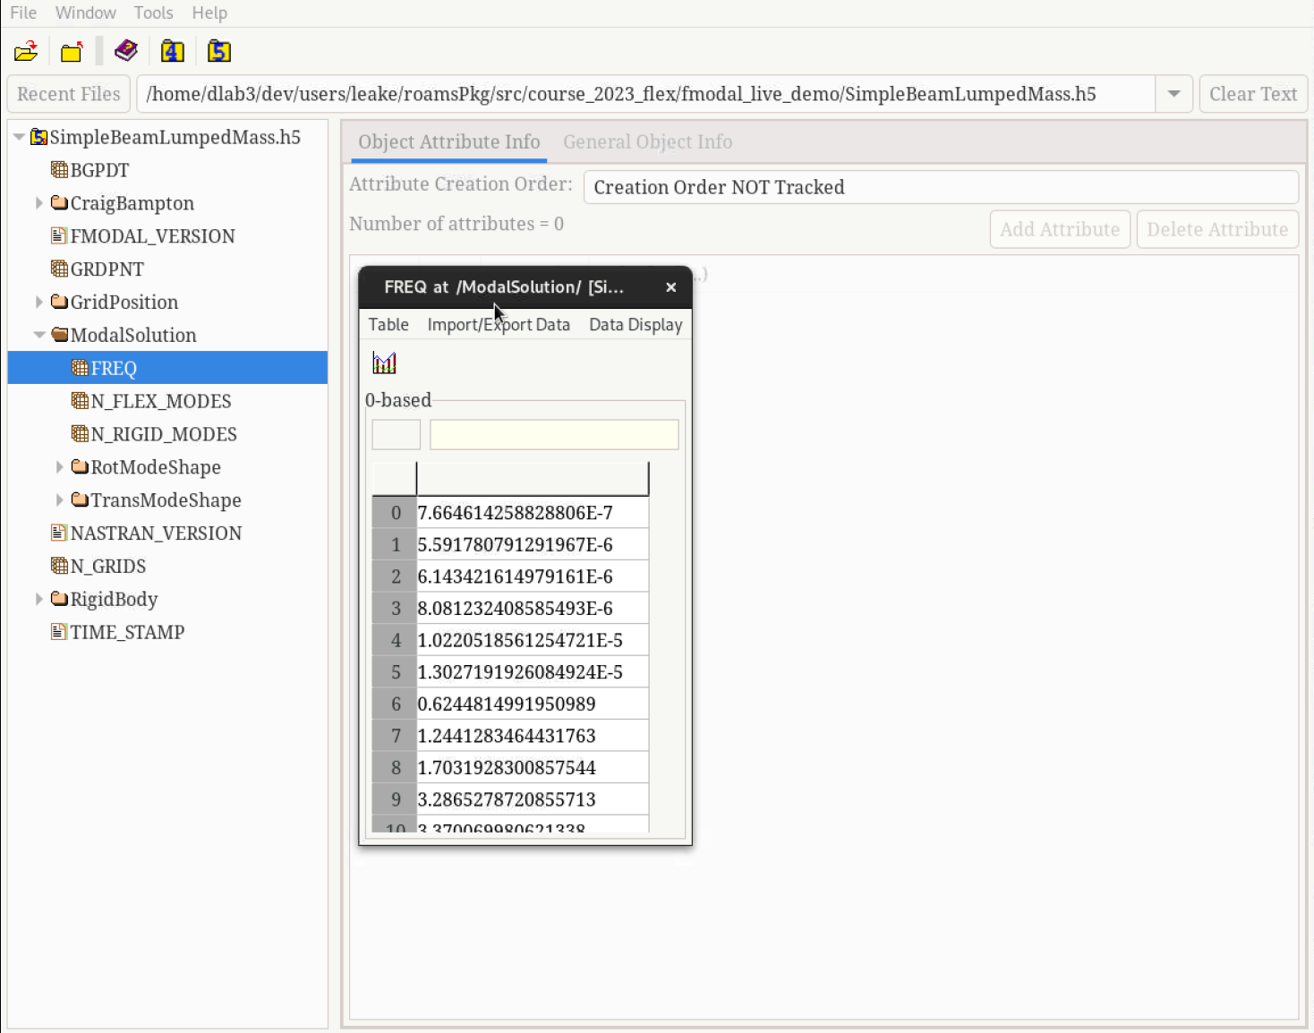
FModal live demo
Notes:
/home/dlab3/repo/PKGBUILDS/ROAMSDshellPkg/Course2023/src/course_2023_flex/fmodal_live_demo

Slide 25
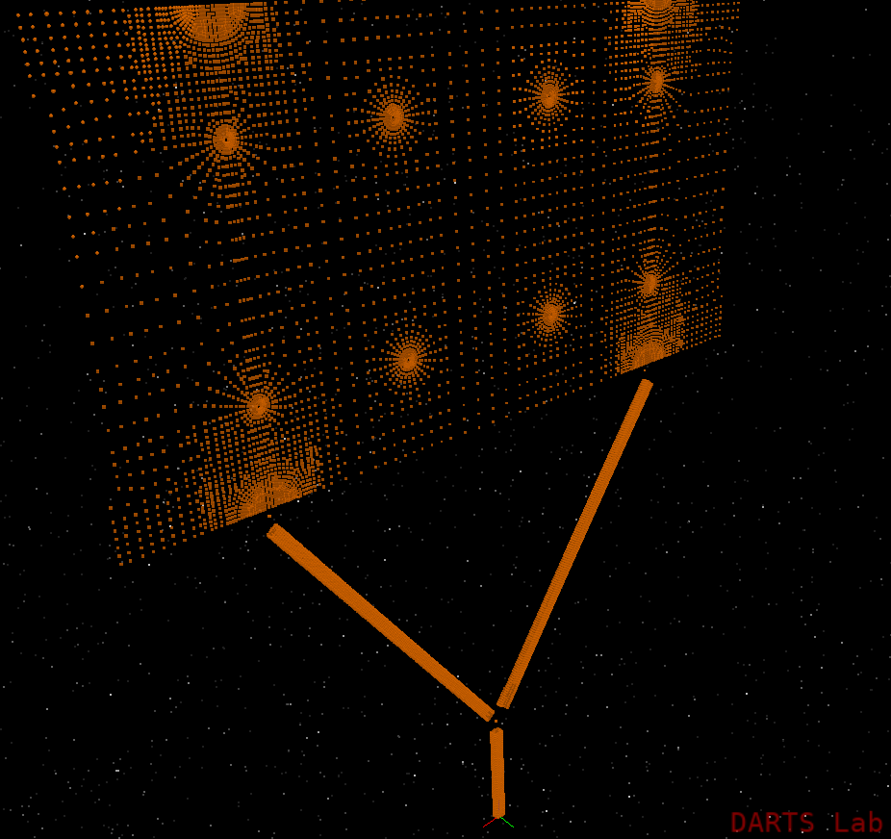
ReadHDF5Flex notebook
F-FlexDynamics/03-ReadHDF5Flex

Slide 26
G&C design iteration implications from FModal
With FModal, it is easy to regenerate the modal data and update the multibody model as designs and use cases evolve without having to regenerate new input FEMs.
Use case examples
We decide to include the effect of a test stand attachment on a launch vehicle’s dynamics.
Simply need to update the a-set to include the attachment grid points and re-run FModal to update the modal data.
We are seeking to optimize the placement of sensors and actuators on a spacecraft.
Simply add the candidate actuator DoFs to the residual vector list when running FModal. Then, one can analyze the effect of the sensor/actuator locations in the multibody, e.g., with Bode plots.
We want to examine the dynamics at a different fuel fill level.
Request a FEM file with the fuel tank as a lumped mass. Then, separate this lumped mass using Fmodal and in DARTS change the mass properties of the fuel tank over time.
We want to try a different frequency cut off for the modes.
Re-run FModal with a different number of modes.
We decide we want to check out the effect of modal integrals.
Re-run FModal to include them if this was not already done. Then, enable them when importing the flexible body via ReadHDF5Flex.
We want to examine the effect of separating a heat-shield
Request a FEM file with the heat-shield as a separate body. Detach the heat-shield at run-time in DARTS.
FModal enables a much higher pace of G&C design iterations over a very large design space.

Slide 27
Thank you for your attention. Any questions?

Slide 28
Backup slides

Slide 29
Raw code from ReadHDF5Flex exmaple
from FModal.ReadHDF5Flex import ReadHDF5Flex
H5 = ReadHDF5Flex("beam.h5")
# Create sensor node list
sn_dict = {}
for sen in H5.getGridList():
sn_dict["sn" + str(sen)] = sen
# Create the body parameters
bodyParams = H5.getDartsBodyParamDict(
zeta=0.0,
act_nodes={},
sens_nodes=sn_dict,
setModalInt=True,
)
bodyParams.update({"bodyToJoint": [0.0, 0.0, 0.0]})
bodyParams.update({"bodyToJointQuat": [0.0, 0.0, 0.0, 1.0]})
bodyParams.update({"bodyNodalMatrix": H5.getFlexModeShape(1)})
# Create body
beam = sim.mbody().addBody("beam", None, bodyParams)

Slide 30
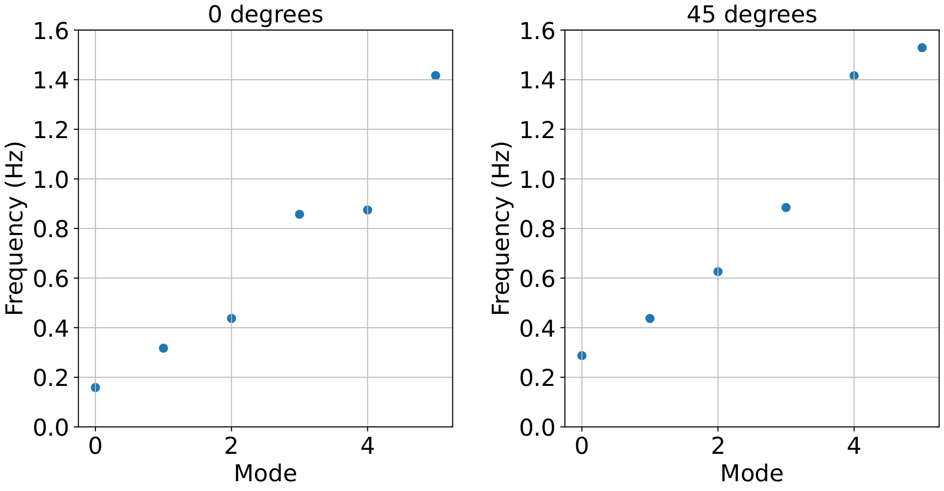
Primer
The system-level response changes drastically when even with simple joint angles change.
Classically, a large number of FEM deliveries are needed to cover all possible vehicle configurations.
To avoid this, one needs a modeling framework that can easily incorporate these changes.
Beams connected at 0 degrees
Beams connected at 45 degrees

Slide 31
DARTS approach
The problem is a gap between system models used to generate modes and the full range of nonlinear dynamics models needed for GNC.
One approach to solving the problem is use a system-level FEM and single-body approach.
Requires many FEM deliveries to cover the scope of vehicle configurations.
Hinders time-domain simulation capability.
Our approach is to use a multibody model to integrate component bodies (one FEM per body) that are connected via joints. In other words:
Find parts that are constant (small deformation, low change in mass properties, etc.) vs. parts that are variable
Get FEMs for the parts that are constant
Let multibody dynamics handle the things that change
Recover system modes from there
constant
constant

