Slide 1
Introduction DARTS flexible body dynamics for G&C
2023 DARTS Lab Course​
Abhinandan Jain, Aaron Gaut, Carl Leake, Vivian Steyert, Tristan Hasseler, Asher Elmland, Juan Garcia Bonilla

Slide 2
Topics overview
Introduction
Single flexible body modeling
FModal FEM/DARTS bridge
Flexible multibody systems in DARTS
Time domain simulations
Recovering system modes with configuration changes
Servo-elastic effects
Wrap up

Slide 3
Acknowledgements and references
Large portions of the current flexible body modeling pipeline (FModal, dynamic EOMs, etc.) build upon an NESC funded project (led by Aaron Schutte).
A. S. Schutte, A. Jain, J. R. Brouwer, T. S. VanZwieten, and K. A. Simpson, “Development and verification of a pipeline for modeling flexible multibody dynamics,” NESC Technical Memo, Tech. Rep. NASA/TM-2020- 5008164, NESC-RP-18-01312, August 2020. [Online]. Available: https://ntrs.nasa.gov/citations/20205008164
Carl Leake, Abhinandan Jain "FModal: A Flexible Body Dynamics Modeling Pipeline for Guidance and Control", IEEE Aerospace Conference, Big Sky, Montana, 2023. https://dartslab.jpl.nasa.gov/References/pdf/2023-fmodal-bigsky.pdf
A large part of the V&V and development work was carried out by Carl Leake as part of his NSTRF graduate student fellowship and subsequently after joining JPL.
Reuben Issac (intern) implemented residual vectors and made contributions to the validation test-suite.
Alexandra Kissel made contributions to the validation test-suite and wrote/edited many of the Jupyter notebooks we will use today.

Slide 4
Where does this topic fit in the big picture?
Closed-Loop
Flight s/w
Autonomy/Control
Devices
Thrusters, IMU,
Cameras etc
Environment
Terrain, Gravity
Atmosphere,
Ephemerides etc
Analysis
Data logging
Parametric
Monte Carlo
Sim Manager
propagation, fsm,
events
Dynamics
Rigid/flex bodies
Articulation
Attach/detach etc
Geometry
CAD parts
Primitives
Visualization
3D graphics
stripcharts
Usability
Introspection
CLI, GUIs, Scripting
Docs, Training
Knowledge base
Evolution
R&D, new applications
new tools & capabilities
Deployment
Bundling
Porting
Issue tracking
S/W Mgmt
Version control
Build system
Test suite
Reusability
Architecture
Configurability
Refactoring

Slide 5
What is a flexible body?
The focus so far has been on rigid bodies in the context of a multibody system.
Rigid bodies articulate, but do not deform.
Rigid bodies have 6 translational and rotational degrees of freedom.
A body that can deform is referred to as a flexible body
In addition to the 6 rigid-body DoFs to define its position and attitude, additional degrees of freedom are needed to describe the deformed shape of the body.
From a dynamics perspective, the rigid and deformation DoFs are coupled, i.e., non-zero rates in one can induce motion in the other.

Slide 6
G&C context for Flexible body dynamics modeling
Space structures are light weight and/or have large loads. Examples include:
Launch vehicles
Solar panels
Deployable structures and platforms
Rotorcraft
Manipulators (e.g., ISS)
Precision pointing for science observations
Are susceptible to vibrations from body flexibility.
Servo-elastic and aero-elastic effects can be significant.
Accurate flexible body dynamics models over the full configuration space are required for ensuring stability and robustness, precision maneuvers, and pointing performance.

Slide 7
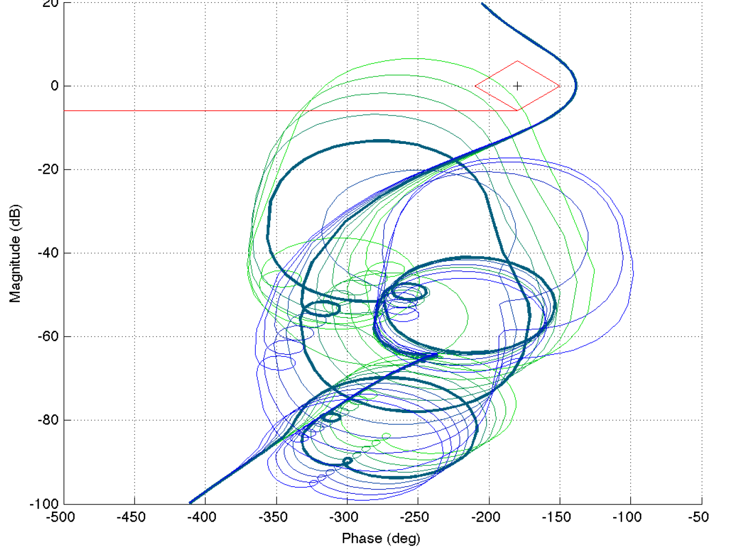
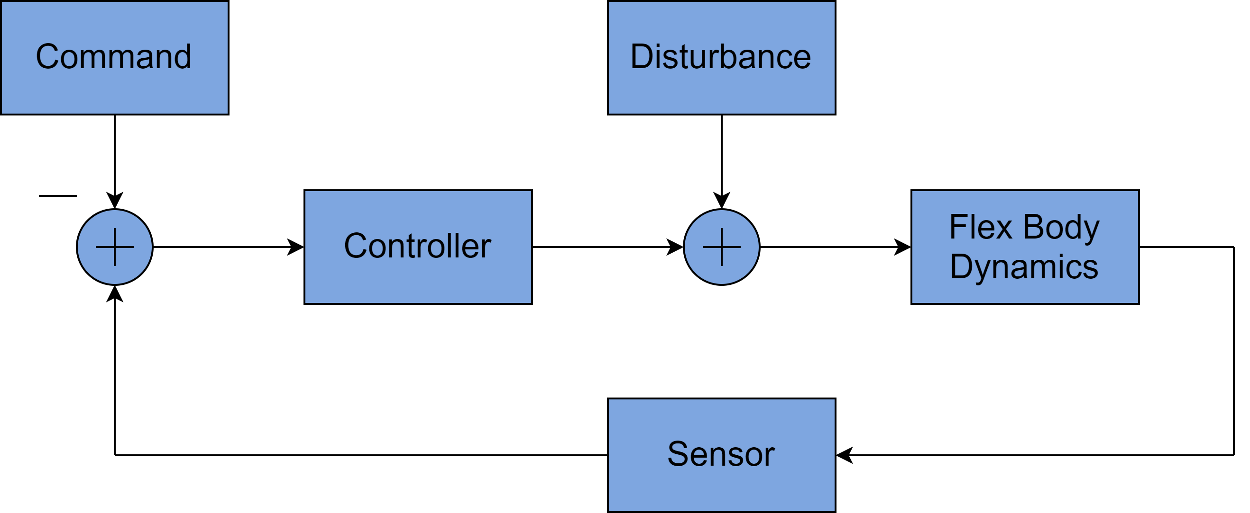
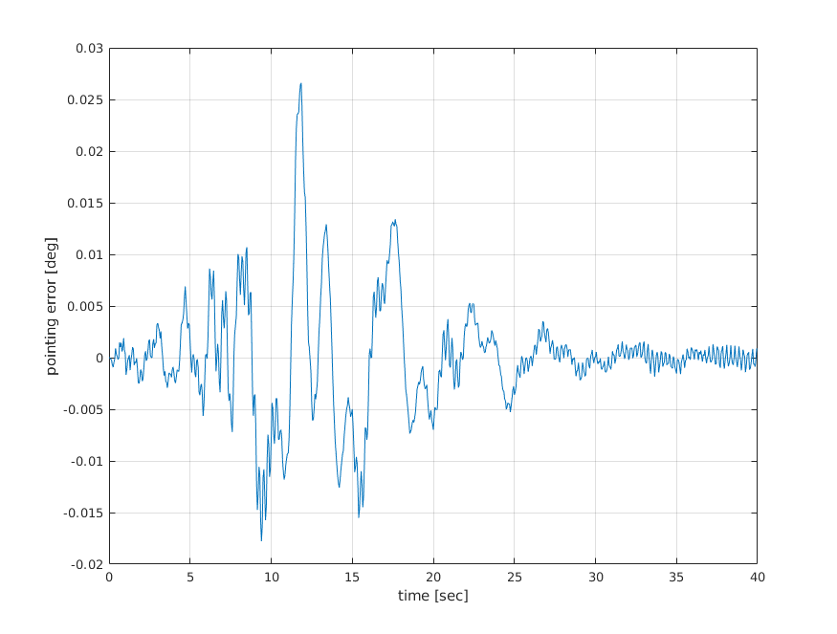
Impact of Flexible bodies on G&C
Flexible body effects can negatively impact control system stability and performance.
Underlying dynamics can be time-varying and multibody, and can contain nonlinearities, rigid-flex coupling, and large mode sets.
This analysis is typically carried out for multiple channels, time segments, and modal data sets, thereby requiring many models.
flex body effects
Nichols plots (linear analysis) illustrates the potential for controls-structures interaction
Sample Block Diagram
Time-domain nonlinear model results illustrate undesirable pointing error due to control system interaction with structural modes

Slide 8
The role of flex multibody dynamics modeling for G&C
We have already seen examples of the use of rigid multibody dynamics modeling for the closed-loop simulation of platforms for:
design
closed-loop testing and performance analysis
operations
When systems have flexible bodies, we need to extend the rigid multibody models to also account for flexible body dynamics.
Flexible multibody dynamics models are significantly more complex.
They are also computationally more expensive than rigid multibody dynamics models.

Slide 9
Scope of today’s session
Flexible body dynamics is a very broad area.
Vibration analysis, loads and dynamics, structural analysis, control design, etc.
We will not be covering the broad area.
Instead, we will focus on flexible body modeling in the context of control system design and closed-loop control, i.e., G&C focused.
Will focus on vehicle multibody systems with bodies undergoing large articulation, configuration changes, and small deformation.

Slide 10
Flexible Launch Vehicle Closed-Loop Simulation

Slide 11
Flexible body dynamics challenges for G&C

Slide 12
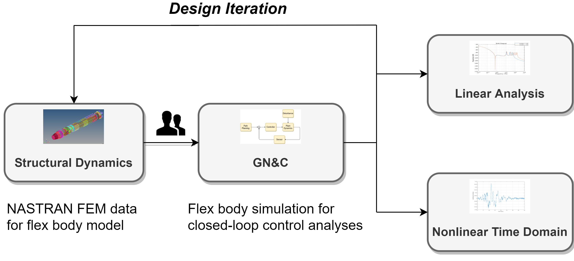
G&C challenge: Multiple disciplines involved
The raw data for flexible body models typically comes from finite element analysis performed by structural analysis experts.
These models are expensive and time consuming to create.
In addition, the FEM models are linear models for point configurations of the system.
Because of the multiple disciplines and teams, design and G&C design iterations become expensive, time consuming, and challenging.

Slide 13
G&C challenge: Flex multibody dynamics modeling
Rigid multibody dynamics are non-linear and complex, and the presence of flexible bodies makes the problem worse.
In addition, there is still the need for fast computational methods in order to support closed-loop time-domain simulations.
General purpose, validated flexible body dynamics solutions that are fast, do not require customization, development, and tailoring across the vehicle configuration space are not readily available.​

Slide 14
Flexible body modeling state of practice
Custom models
Rigid multibody dynamics model with ad-hoc substructuring, superposition, etc.
Structures FEM model
G&C closed-loop time domain simulation and linear analysis
Hand derived models

Slide 15
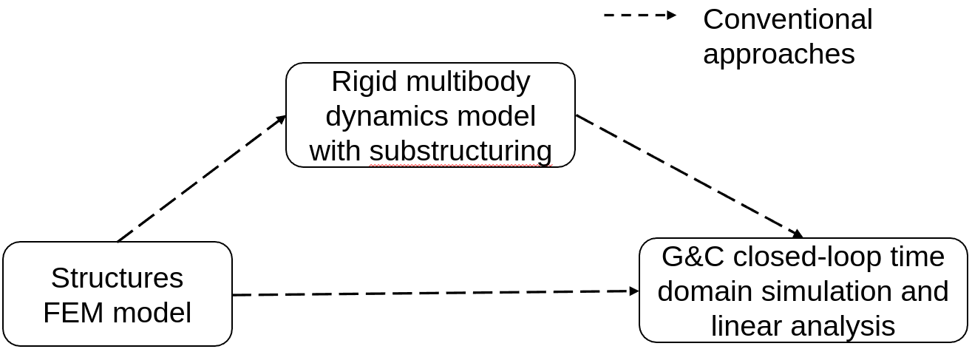
FEM to GNC directly
Hand-derive linear GNC model directly from the FEM model.
Make sure the model can handle changes from large articulation.
Hand derivations can be complex even for just a few flexible bodies.
Even more complex to handle configuration changes.
Alternatively, use system-level flexible model snapshots.
Requires a FEM delivery for each system configuration of interest.
Configurations must now span joint angles of interest.
Can be costly and time-consuming if there are many configurations.

Slide 16
Substructuring approach using rigid multibody dynamics
Use substructuring to break flexible bodies into a set of rigid bodies with spring/damper joints.
Does not require complicated hand derivations like the previous approach.
Requires tuning the springs/dampers.
This may need to be done on a per-configuration basis.
The tuning can be a very complex process and almost an art-form.
May still require many FEM deliveries.

Slide 17
G&C challenge: Dependency on linear models
G&C designs have to be robust and deliver performance for vehicles with:
Non-linear rigid/flexible body dynamics.
Time varying dynamics.
Time-varying configurations (articulation, attachment and detachment, mass property changes, etc.).
Most control design techniques are based on linear system-level models.
Since the dynamics are fundamentally nonlinear there is a need to be able to generate a large family of linearized models to cover the configuration design space for G&C design.

Slide 18
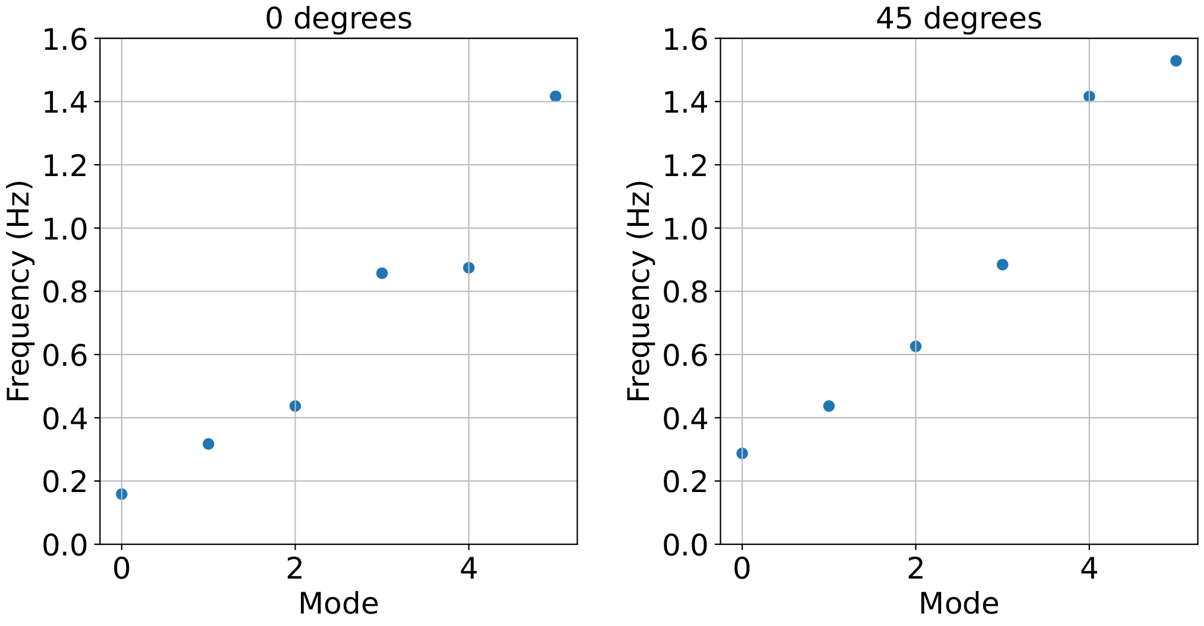
System level modes vary with configuration
The system-level response changes drastically even when just joint angles change.
Hence, a large number of FEM deliveries are needed to cover all possible vehicle configurations.
To avoid this, one needs a modeling framework that can easily incorporate these changes.
Beams connected at 0 degrees
Beams connected at 45 degrees

Slide 19
G&C challenge: Model reduction
FEM derived model data can be very large with millions of degrees of freedom.
Such large models are impractical for control system design and modeling.
This requires the development and use of reduced-order flexible body models to support G&C needs.
This needs to be done with care to ensure that the reduced-order models adequately capture the critical system dynamics over the full configuration space.

Slide 20
G&C challenge: Large set of derived flexible model parameters
Flexible multibody dynamics models require a large number of parameters derived from FEM models.
The derivation requires custom processing of the FEM data.
Also, these parameter data sets need to be transferred into the downstream dynamics models.
The derivation and transfer process is complex, fragile, and error prone. The state of practice is to ignore many of the terms, leading to the use of degraded and inaccurate dynamics models.

Slide 21
G&C challenge: Closed-loop simulation
System-level G&C testing and performance evaluations are typically done using closed-loop, time-domain simulations with full non-linear vehicle dynamics models.
Proper testing and validation requires:
Accurate flexible body dynamics models
Validation of such flexible body models
Fast performance to support closed-loop simulations
Fast, general-purpose rigid/flexible vehicle dynamics multibody modeling solutions suitable for closed-loop simulations are not easily available and are hard to create.

Slide 22
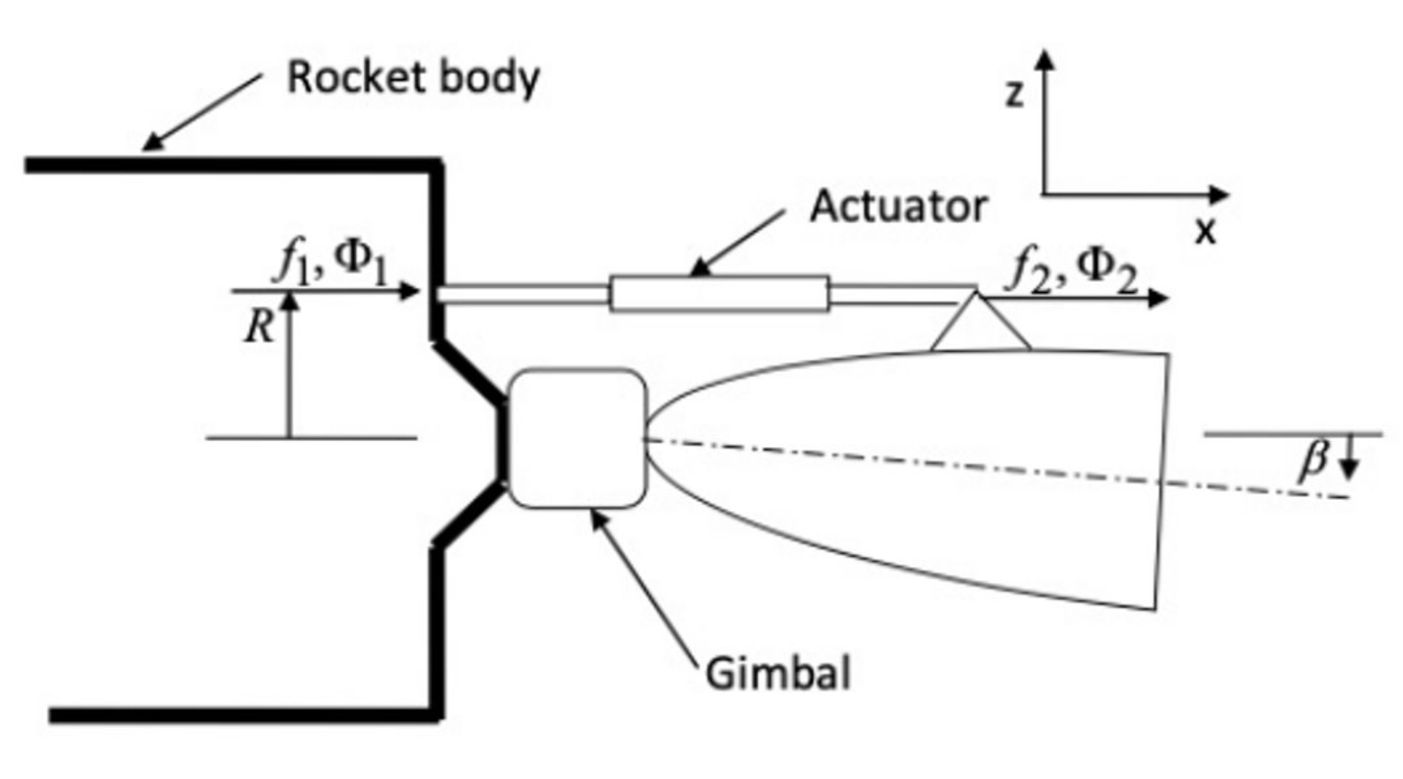
G&C challenge: Servo/aero-elastic effects
Beyond multibody dynamics, vehicle models need to include coupling with sensors, actuators, and the environment as well since these interactions can affect control performance, e.g., servo- and aero-elastic effects.
Need convenient way to build full-up vehicle models that include flexible body dynamics with such servo- and aero-elastic effects.

Slide 23
G&C challenges: Summary
Flex dynamics modeling
Multiple disciplines involved
Dependency on linear models
Model reduction
Large set of derived flex modeling parameters
Closed-loop testing
Servo-elastic effects

Slide 24
Preview of DARTS based solution

Slide 25
DARTS rigid multibody dynamics modeling
We have already seen DARTS as a tool for rigid body dynamics modeling
General purpose – can accommodate arbitrary number of bodies and multibody topologies.
Uses minimal coordinate dynamics to reduce model size and avoid DAE solvers.
Uses linear complexity, low-cost dynamics algorithms for speed.
Easily accommodates run-time changes to system topology from configuration changes.
Provides dynamics backbone for Dshell simulation framework to allow integration with actuator/sensor/environment models for full-up, system-level vehicle models.
All of these features continue to hold within DARTS when we add flexible bodies to the system!

Slide 26
DARTS flexible multibody dynamics modeling
DARTS is a general-purpose flexible body dynamics modeling tool.
Supports arbitrary topologies and run-time changes to the topology.
Still uses minimal coordinates for rigid and flexible bodies to avoid the need for DAE solvers.
Provides low-cost algorithms for solving the EoMs for closed loop simulation.
Can still be used within Dshell to integrate with actuator, sensor, and environment models to develop full-up system models.
Support built-in general-purpose model linearization capabilities.
We will focus today on describing and elaborating on a paradigm and workflow for G&C flexible body dynamics modeling enabled by these broad and general DARTS capabilities.

Slide 27
Workflow for recovering system modes/models under configuration changes for G&C
The G&C system cares about the system level behavior.
Under configuration changes, the state-of-practice is to get multiple FEM snapshot models of the system to obtain some level of coverage of the configuration space.
However, DARTS can simplify this process.
Use FEM model data for the DARTS component bodies. The component bodies are constant (small deformation, low change in mass properties, etc.) in contrast with the parts that do vary: joints, bodies that change mass noticeably, etc.
Let DARTS generate the full nonlinear system-level model based on the component bodies: a model that is valid across the configuration space.
Use DARTS built-in linearization process to extract the system-level linearized models across the full configuration envelope.
constant
constant
This process avoids the need to develop multiple system-level NASTRAN FEM data—for at best sparse system-level coverage. Instead, we just need to get component data once and use DARTS to get dense system-level model coverage.

Slide 28
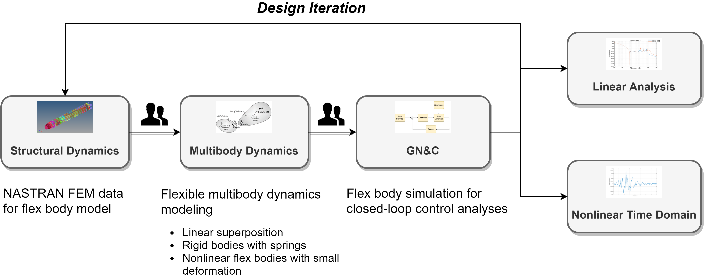
DARTS based G&C flex modeling
Develop and use a pipeline and workflow that includes DARTS’ flexible multibody dynamics capabilities as an integral part to address the several G&C challenges described earlier
FModal
DARTS

Slide 29
FModal overview
FModal is a tool to facilitate this flexible multibody dynamics modeling approach. Its features include:
a high-level interface for users to generate dynamics model data for flexible bodies.
handling all modifications of the FEM files and providing a simple interface for users to invoke the FEM program.
handling modal data extraction and post-processing under the hood.
storing the critical data needed to create the flexible body model in an easy-to-use file format for transferring to multibody dynamics programs.
FModal reduces the FEM expertise burden on users and allows G&C analysts to work directly with FEM model data.

Slide 30
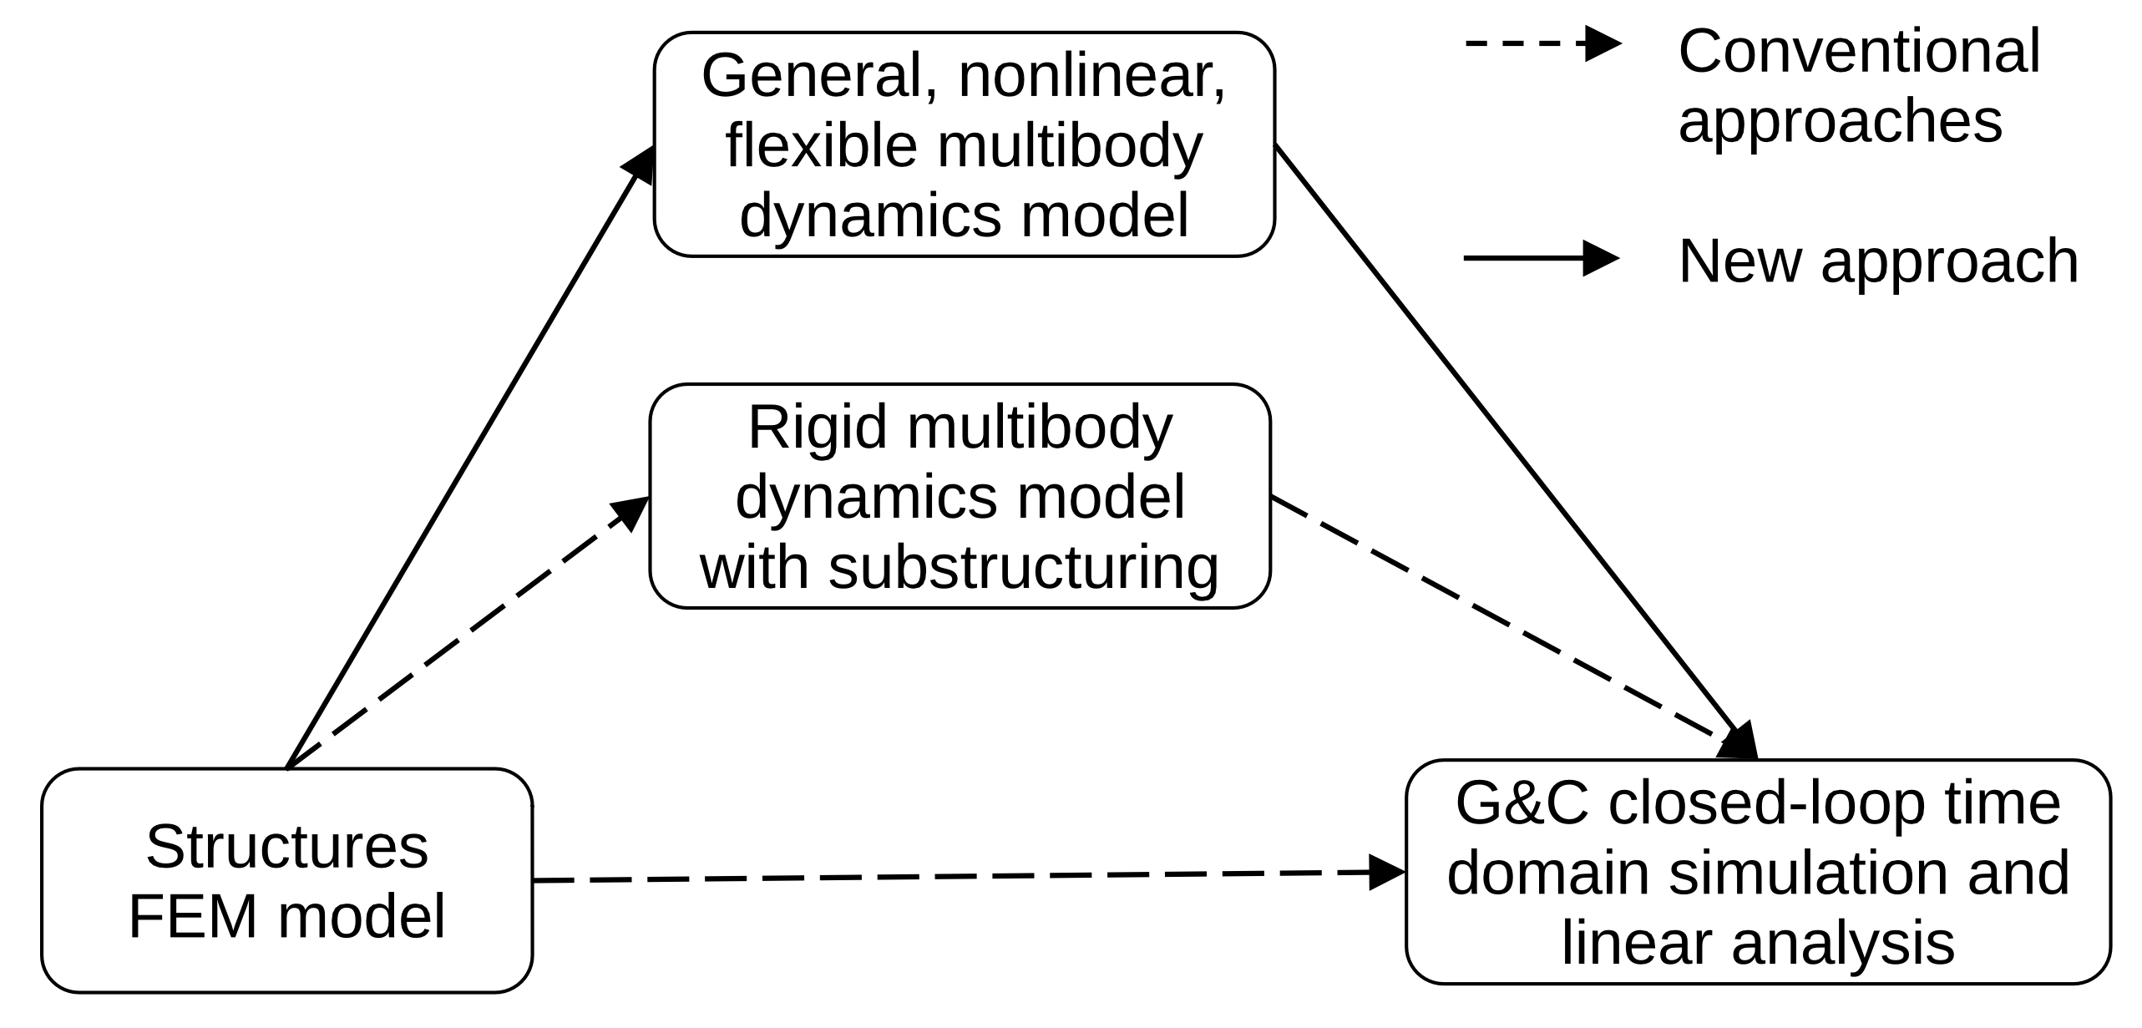
Component to System flexible multibody dynamics
Use component flexible bodies in a flexible multibody dynamics simulator.
Highest fidelity approach of the three
Does not require complicated hand derivations nor does it require tuning springs/dampers like the previous approaches.
Can potentially handle configurations changes without the need for a new FEM delivery.
The difficulty in extracting and transferring the large amount of processed modal data for the component flexible bodies to the multibody model and connecting the bodies correctly is simplified using FModal.

Slide 31
G&C challenges (revisited): DARTS solutions
Flexible dynamics modeling: General purpose DARTS flexible dynamics.
Multiple disciplines involved: Use FModal-based pipeline and workflow.
Dependency on linear models: Provide an easy way to generate linear models with system modes using component body data.
Model reduction: Use modes approach to select reduced modes (i.e., reduced DoFs).
Large set of derived flexible modeling parameters: Use FModal capabilities to compute and automate transfer of the parameters.
Closed-loop testing: Use fast flexible body dynamics algorithms in DARTS.
Servo/aero-elastic effects: Use Dshell to include additional models to model these coupled dynamics.

Slide 32
DARTS flexible body modeling approach
DARTS
FModal

Slide 33
Thank you for your attention. Any questions?

Slide 34
Backup slides

Slide 35
GN&C flex modeling challenges
Multiple specialties and domains are involved, which require hand-offs, leading to disconnects and delays. This adversely impacts ability to develop and refine G&C models.

Slide 36
GN&C flex modeling challenges
Commonly faced challenges:
Time-consuming design iterations
Lack of GN&C-focused sanity checks prior to model delivery
Reliance on custom tool sets that can be difficult to modify and often incorporate complex dynamics in an ad-hoc manner
Costly code development to interface structures datasets with GN&C tools

