Slide 1
Lighting, Terrain, Perception Sensor modeling Building an Exemplar Sim 2023 DARTS Lab Course
Abhinandan Jain, Aaron Gaut, Carl Leake, Vivian Steyert, Tristan Hasseler, Asher Elmland, Juan Garcia Bonilla

Slide 2
Exemplar sim topics overview
Exemplar sim goals
Creating the Vehicle assembly
Creating the SimulationExecutive
Setting up DataLogging
Running the simulation
Rendering related models

Slide 3
Outline
Requirements
Rendering recap
OptixScene rendering pipeline
Lighting modeling
Large terrain modeling
Perception sensor modeling
Visualization setup

Slide 4
Requirements
Rendering based modeling
Lighting
Terrain – especially large terrains
Shadows
Perception sensors – nominal as well as imperfections
Need engineering quality rendering for use in closed loop simulation for closing the loop around machine vision autonomy/G&C software
Real-time performance
Tailorable fidelity

Slide 5
Rendering/Visualization Recap

Slide 6
Geometry Processing Engines
There are multiple of geometry engine providers with varying functionality and APIs.
OpenGL, Ogre3D, Coin3D, OpenInventor, OpenSceneGraph …
3D Graphics
position & orientation updates from sim
Computational
geometry
Bullet, FCL, PQP, ANN …
Geometry
Raytracing
Blender, Optix, Maya …
etc.

Slide 7
Setting up visualization in simulation
Create a visualization scene
Can be used by multiple client scenes
Default scene specified by "mode" (using mode="optix")
sim.setupVisualization(
scene_origin_frame,
noShadows=not cfgobj["graphics"]["viewport_shadows"],
stickPartsRadius=cfgobj["graphics"]["stick_part_radius"],
sky=cfgobj["graphics"]["sky"],
skip_lights=not cfgobj["graphics"]["lights"],
shadow_casting_light=cfgobj["graphics"]["viewport_shadows"],
viewport_size=cfgobj["graphics"]["viewport_size"],
redraw_delay=cfgobj["graphics"]["redraw_delay"],
sim_time=cfgobj["graphics"]["viewport_sim_time"],
mode=cfgobj["graphics"]["mode"],
lcm_provider_url=cfgobj["graphics"]["server_uri"],
start_server=cfgobj["graphics"]["server_start"],
lcm_uuids=cfgobj["graphics"]["server_uuids"],
scene_ambient=cfgobj["graphics"]["scene_ambient"],
client_scene=None,
**kwargs,
)
from Dutils.DclickUtils import setupVisualization
self.setupSceneGeometries()
setupVisualization(self, self.rotor_craft_asm._body, self._cfgobj)
self.rotor_craft_asm.createPartGeometries()

Slide 8
Problem: Improving rendering quality
Raster graphics (eg. Dspace) is limited – especially for shadows, indirect reflections
Ray and path tracing techniques significantly improve rendering fidelity, but have traditionally been very slow

Slide 9
OptixScene Real-Time Ray-Tracing based Rendering

Slide 10
OptixScene reconfigurable ray-tracing pipeline
Raytracing
builds upon NVIDIA’s Optix CUDA based,
GPU-accelerated backward ray-tracing engine
Configurable Optix pipeline
Action Graph
Filter
Graph
Action Graph
(Scene Updates)
Filter Graph
(Image Modification)
Raytrace Render
scene
image
Noise
Vignette
Optix Build
Jitter Accumulate
Access Filter
Clipmap Update
Lens Distortion
Hapke Model
Output
DEM
CAHVORE
Parameters
Material
Properties
Noise
Parameters
Output
Sensor
Image
Camera sensor example

Slide 11
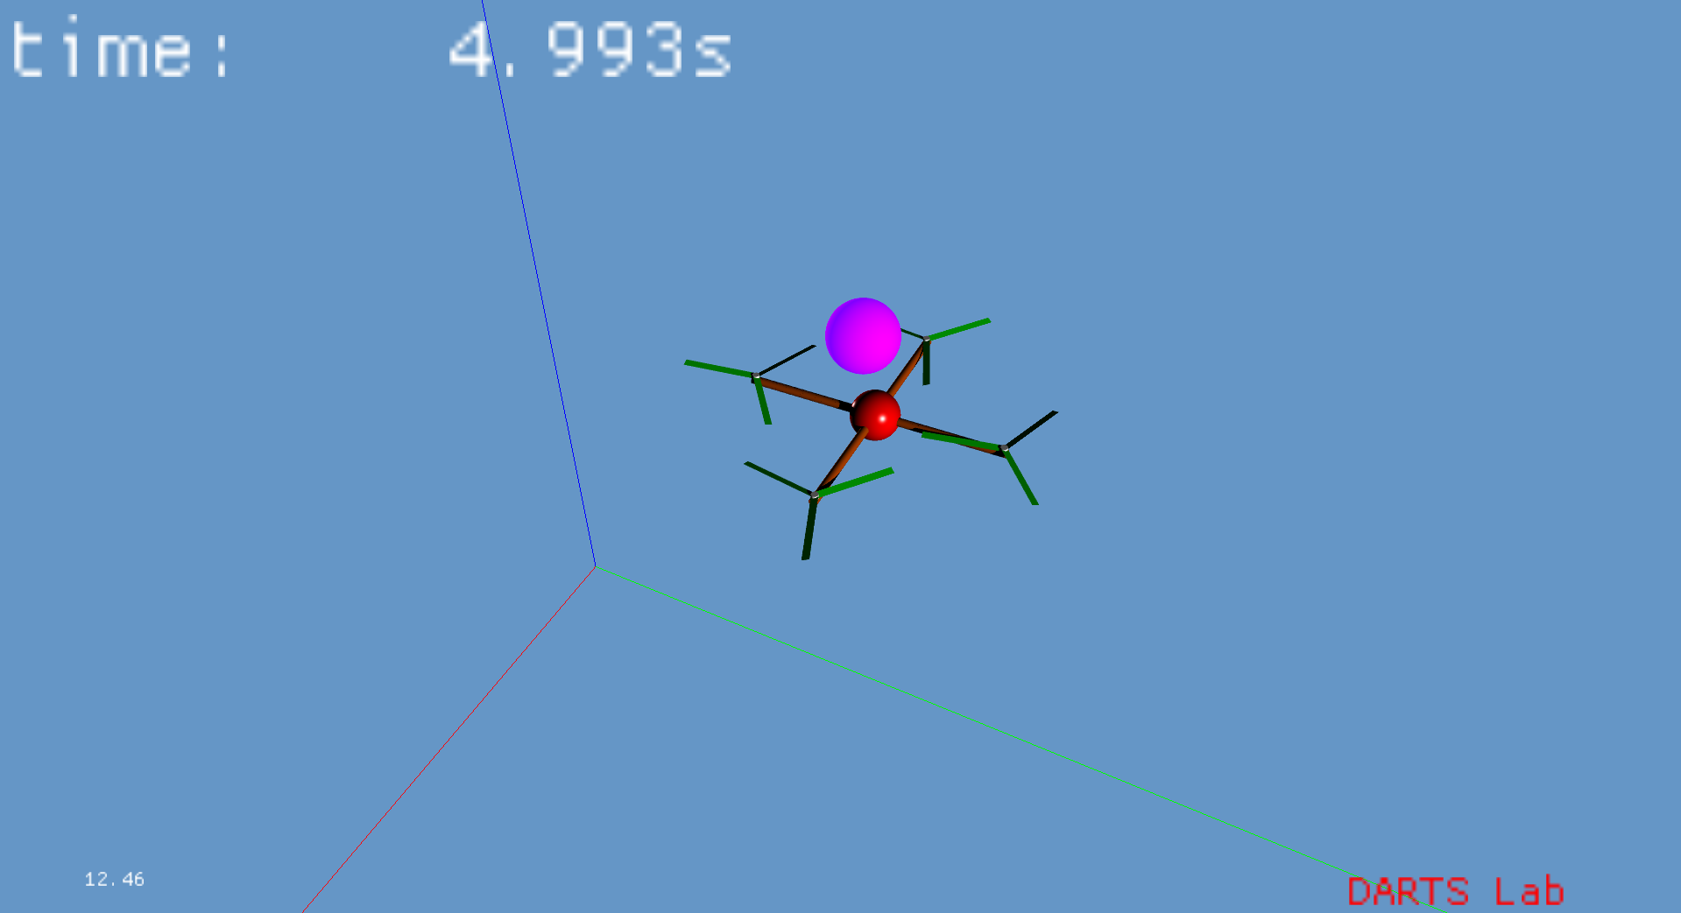
Setting up scene geometry
Part geometry was created by the rotorcraft bodies
Can modify these if desired – skipping here

Slide 12
Problem: How do we manage lights in the scene?
The light source for rendering is typically the sun.
But there are times where we need additional light source and change their behavior. How do we do this?

Slide 13
Lighting

Slide 14
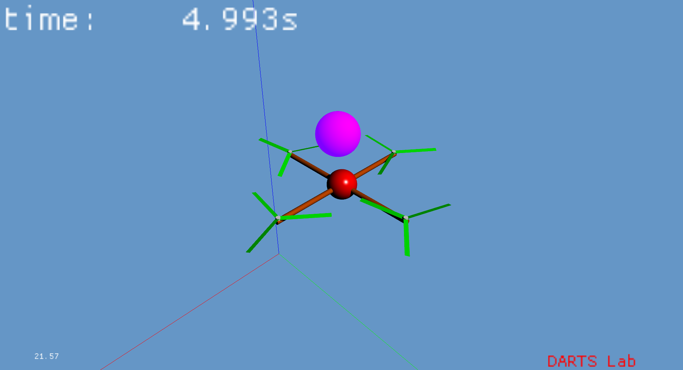
Adding and Modifying Lights
A default light is added during visualization setup
Can be disabled
Default light can be modified
Additional lights can be added to scene manager
# change the intensity of the default lights
l1 = sm.defaultLights()[0]
l1.intensity(0)
l2 = sm.defaultLights()[1]
l2.intensity(0)
# add a new light to the scene
l3 = sm.createLight(DScene_Py.SceneObject.PHYSICAL, {}, 'another light')
l3.relTransform(SOAHomTran(SOAVector3(0,1000,1000)))

Slide 15
Problem: Terrain data sets can be complex
Terrain data sets can be large, and rendering them requires special care
What are the capabilities to support this?

Slide 16
Terrain environment

Slide 17
Adding a Terrain Programmatically
Terrain created as TopoGeometry
Created from digital elevation map
Loaded from HDF5 store
Large terrains can be configured with clipmap parameters
# Create a TopoGeometry for terrain (visually) below the rotorcraft
def topo(scene, root_frame):
# get the dem from a store
xml_store_path = os.getenv("YAM_ROOT") + "/etc/RoamsHDF5Cache/"
store = CORE_Py.openHDF5Store(xml_store_path)
dem = store.loadObject("Leveller3")
store.close()
# Create the topo geometry
extras = {"use_clipmaps": 1,
"clipmap_exp": 9,
"texture": os.getenv("YAM_ROOT") + "/etc/OptixScene/assets/grass_3K.jpg",
"texture_tile_x": 10,
"texture_tile_y": 10,
"use_terrain_noise": False,
}
topo = scene.createTopoGeometry(dem, SceneObject.PHYSICAL | SceneObject.ORNAMENTAL, extras, "topo")
topo.relTransform(SOAHomTran(SOAVector3(0,0,-.5)))
root_frame.attachSceneObject(topo)
return topo

Slide 18
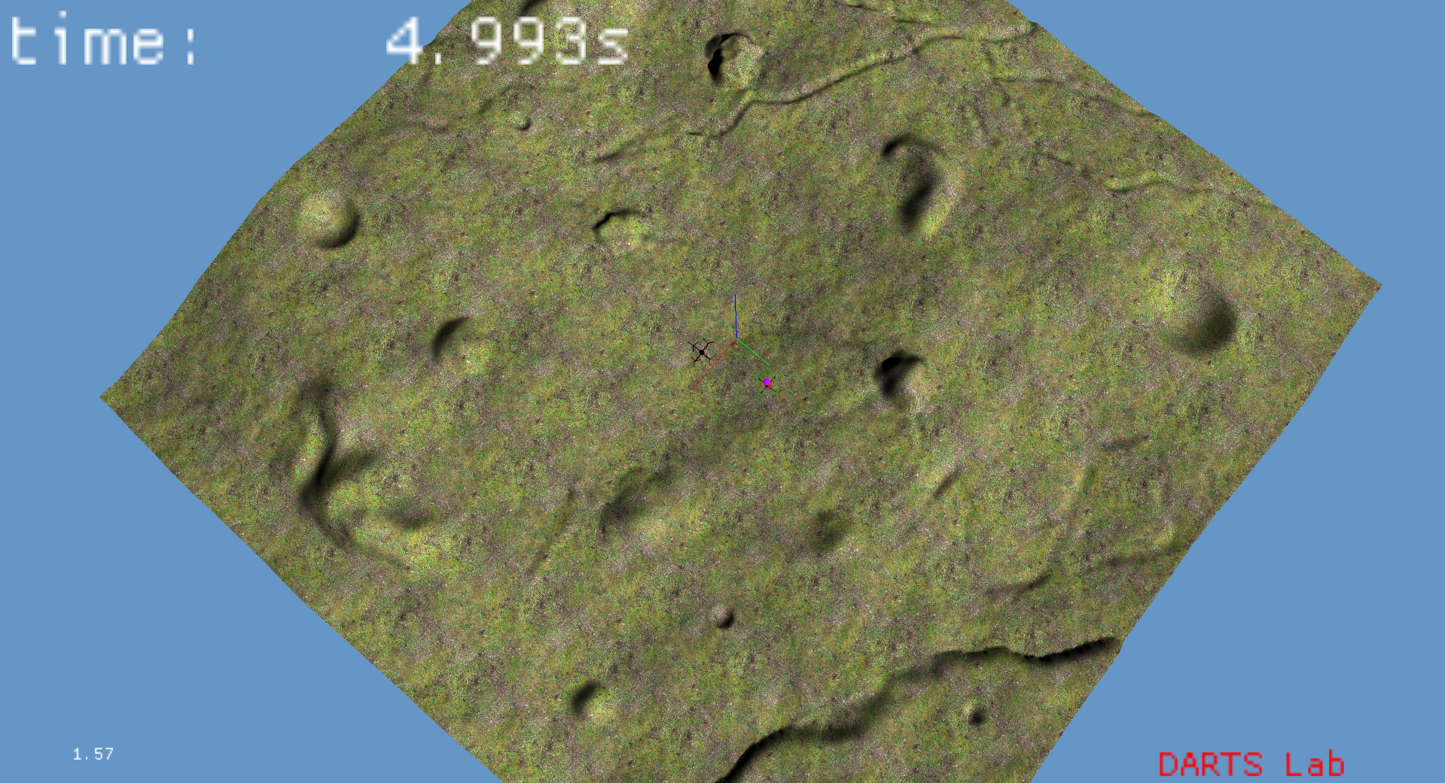
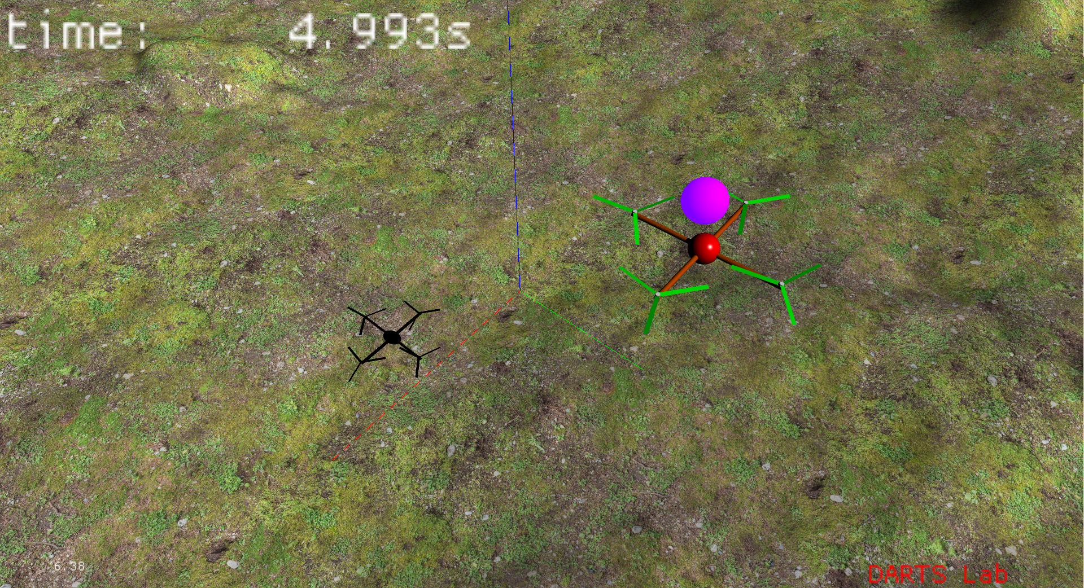
Problem with repeated textures
Tile texture
Fine detail, but repeated artifacts
Don't tile texture
No repeated artifacts, but lack of detail close up

Slide 19
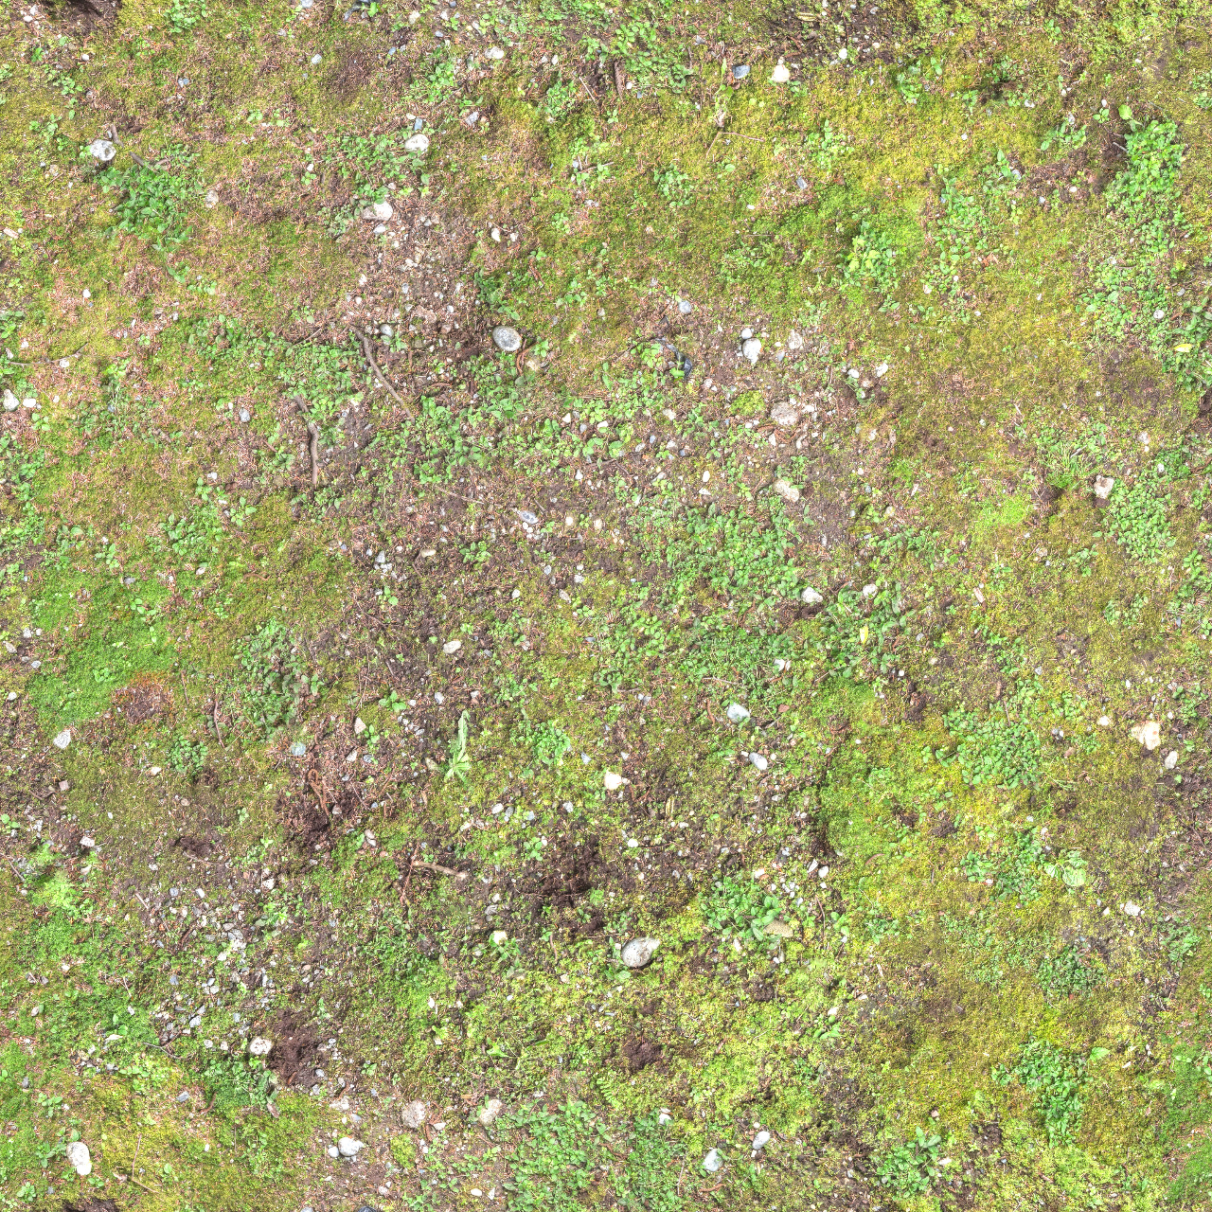
Customize the TopoGeometry
Can layer textures and multiple resolutions
Limits aliasing
Adds detail at multiple scales
Normal map
def improve_terrain_visuals(terrain):
optix_terrain = terrain.implementation(sm.visualizationClientScene()).upCast()
phongMat = DScene_Py.PhongMaterial()
color_texture = os.path.join(os.environ["YAM_ROOT"], 'etc/OptixScene/assets/grass_3K.jpg')
normal_texture = os.path.join(os.environ["YAM_ROOT"], 'etc/OptixScene/assets/normal_noise.png')
optix_terrain.addTextureLayer(color_texture, 1.0, 1.0, "override", .5, True, 0.1, 1.0, 1.0)
optix_terrain.addTextureLayer(color_texture, 1/13.0, 1/13.0, "add", .5, True, 0.1, 1/13.0, 1/13.0)
optix_terrain.addNormalTextureLayer(normal_texture, 3.0, 3.0, "override", .2, True, 0.1, 3.0, 3.0)
optix_terrain.addNormalTextureLayer(normal_texture, .21, .21, "add", .2, True, 0.1, .21, .21)
optix_terrain.setAlbedoTexTiling(1, 1, True)
optix_terrain.setNormalTexTiling(1, 1, True)
optix_terrain.overrideUVsWithVertices(1, 0, 1, 1) # u-y, v-x
optix_terrain.setPhongMaterial(phongMat)
Diffuse map

Slide 20
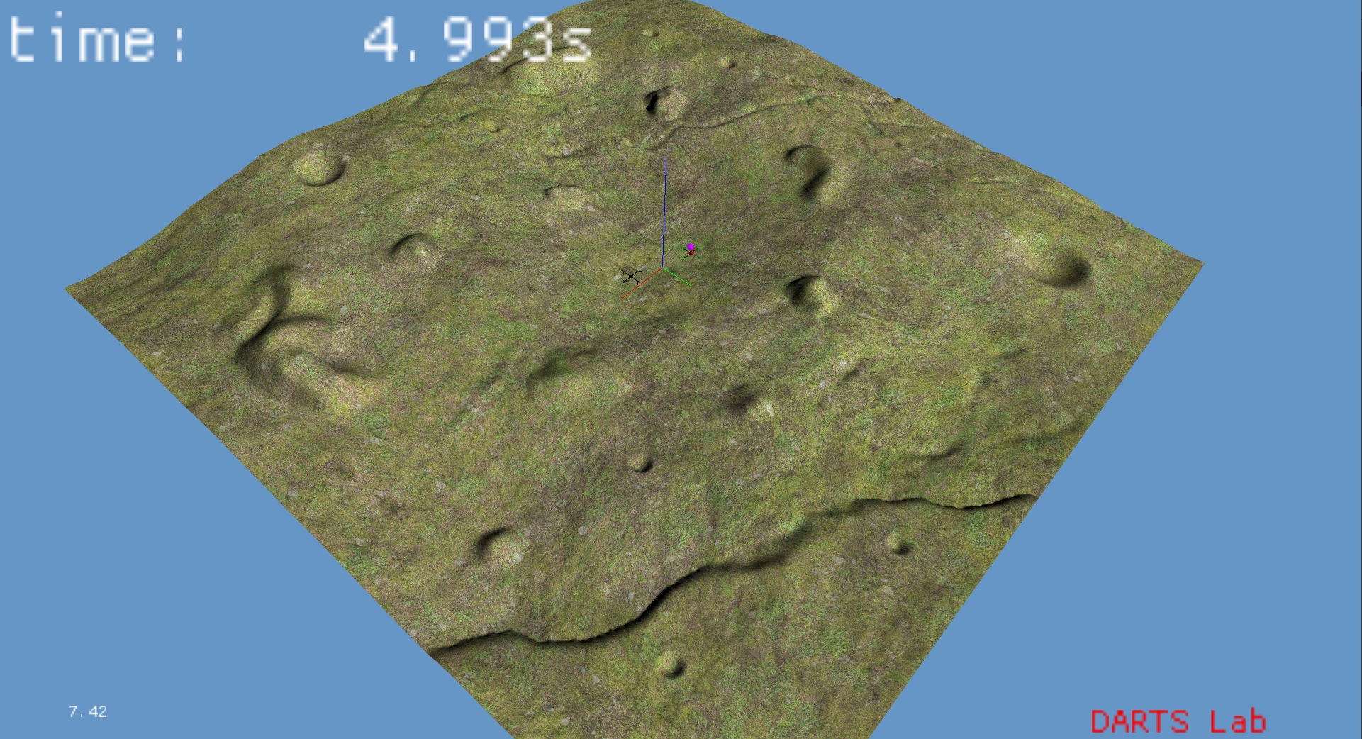
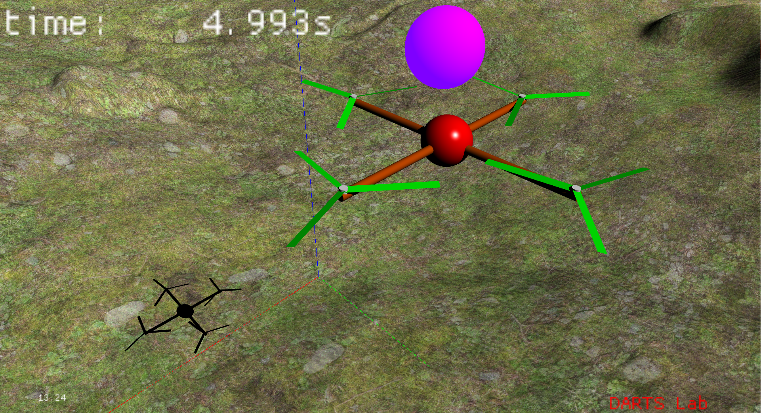
Terrain with Layered Textures
Layers can add multi-scale detail while limiting aliasing
Useful when viewing from multiple distances
Avoids pop-in or changing features
Avoids need to create high-res texture that is then mip-mapped

Slide 21
Problem: Engineering perception sensors
Autonomous systems typically rely on perception sensors to close the loop
What support is there for modeling such sensors – with their nominal and off-nominal characteristics with real-time performance?

Slide 22
Perception Sensor Modeling

Slide 23
Sensors exposed to simulation through Dshell
Camera wrapped and added with an assembly
Legacy model supports DspaceScene or OptixScene
New model streamlines class hierarchy and computation
Use new optix model where it satisfies the need
Legacy Model
New Model
CamImageSynthAltModel
OptixCahvoreCameraModel
CameraImage
DOptixCamera
DspaceOgreOffscreenRenderer
DOptixCamera
dsOffscreenViewport
Dshell
Renderer

Slide 24
Adding Camera Assembly to Simulation
Add a Dshell camera assembly to the simulation
OptixScene-specific CAHVORE CUDA based camera model
# add a camera to the craft
def add_camera():
# create camera configuration
camera_config = {"Inert2RoverQuat": [0, 0, 0, 1], "dspaceServerMode": False, "type": "hazcam", "optixModel": True}
# set camera parameters (cahvore file for lens distortion and default orientation - this could also be in the cahvore file)
camera_params = cahvoreFileParam(
params={
"cameraFileName": os.path.join(os.environ["YAM_ROOT"], 'etc/RotorCraft/data/camera.cahvore'),
"orientQuat": SOAQuaternion(SOAVector3(3.14, 0, 0))(),
}
)
# create the camera assembly
camera_asm = cameraOptixLocalNoMountAssembly(
sim.topAssembly(),
"cameraAsm",
config=camera_config,
context={"body": sim.rotor_craft_asm._body},
params={
"MountCamLocation": camera_params,
"frameRate": 1.0
},
)
...

Slide 25
Adding Camera Assembly to Simulation
# add a camera to the craft
def add_camera():
...
# bind camera params and lock the simulation
camera_asm.bindParams()
sim.lockObject()
# prep camera to take image
camera_asm.useImages(True)
camera_asm.imageFormat("png")
# take image
camera_asm.takePicture("example_image")
sim.step()
# make sure the camera won't be saving images to file
c = camera_asm.getModelFromTag("camera")
c.specNode()["param.output_image"](0) # do not write to file
c.specNode()["param.output_buffer"](1) # render image buffer
c.specNode()["param.imageOnDemand"](True) # only take image upon request
c.specNode()["flowIn.takePicture"](True) # request an image to be take
# open a viewport for the sensor so we can see what is going on
viewport = camera_asm.getOptixSensor().createViewport(
width=640, # window resolution
height=360, # window resolution
vw_type=DScene_Py.VIEWPORT_TYPE_SENSOR, # window type - this is for viewing and no interaction
extra_parameters={}, # optional parameters
)
Finalize the model and lock the simulation
Can modify the model parameters using spec nodes

Slide 26
Accessing Model’s Data
Image data is available as flowOut
Given as pointer to the image data
Can be tied into another model
camera_asm.getModelFromTag("camera").specNode()["flowOut"]["ptrImageBuffer"]()

Slide 27
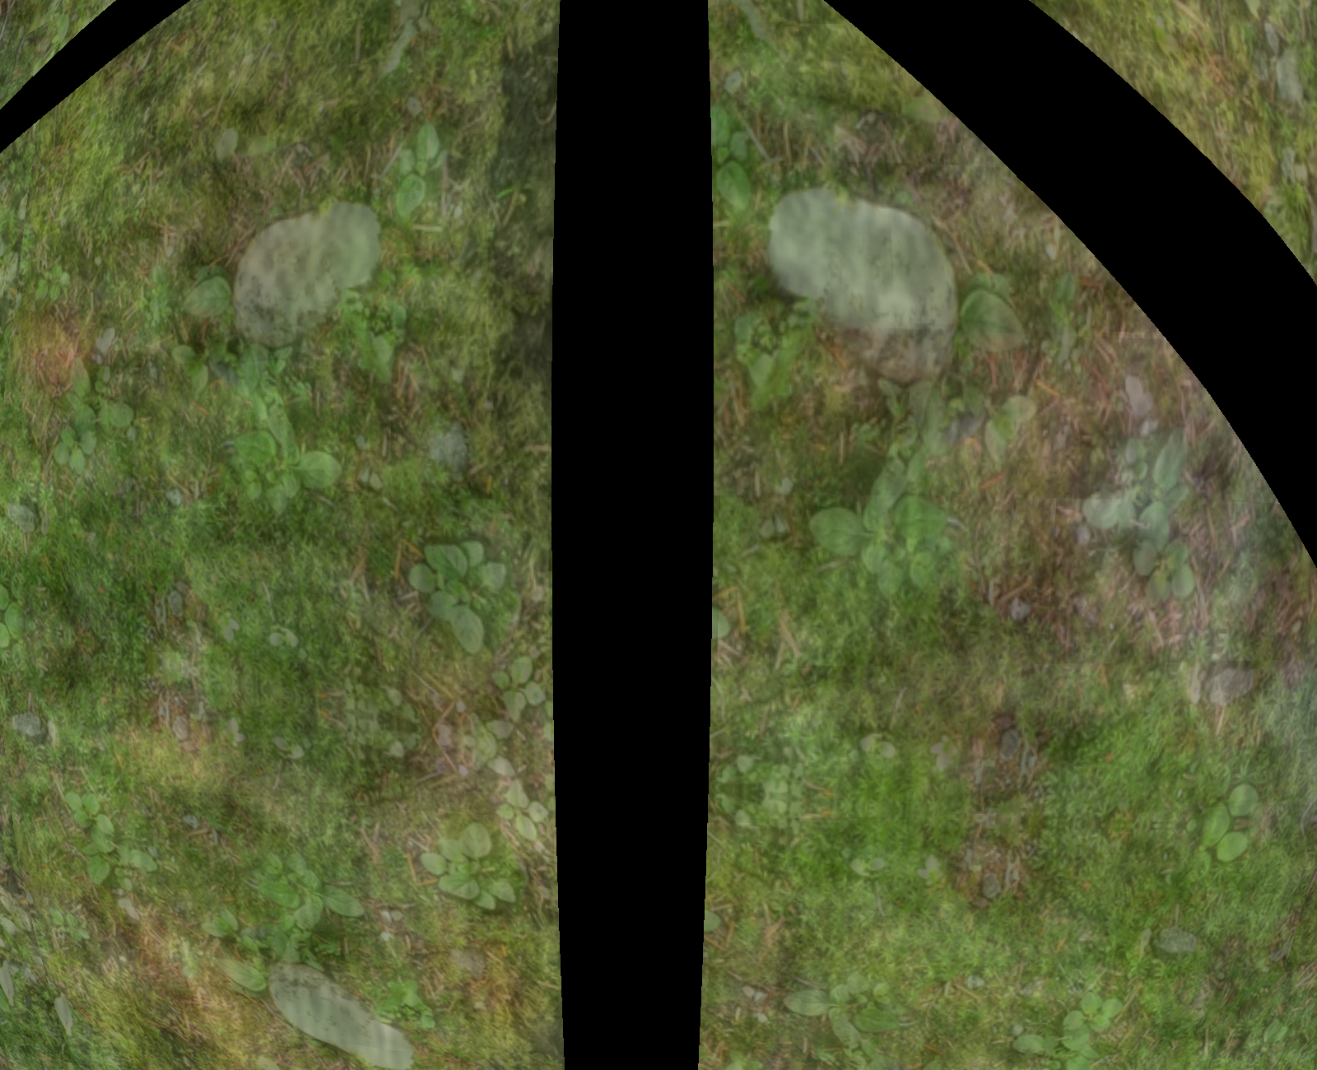
Accessing Model’s Data
Can command the model to take an image
# prep camera to take image
camera_asm.useImages(True)
camera_asm.imageFormat("png")
# take image
camera_asm.takePicture("example_image")
sim.step()
Camera looking down at the terrain from the rotorcraft
(black are the hard shadows from the rotorcraft)

Slide 28
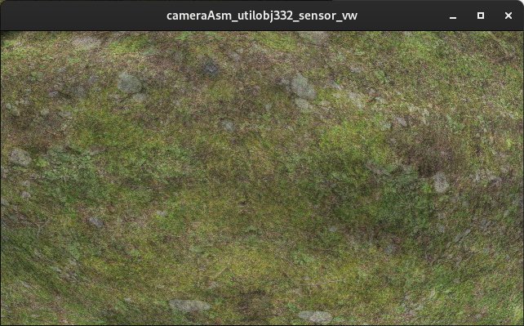
Accessing Model’s Data
# open a viewport for the sensor so we can see what is going on
from DScene import DScene_Py
viewport = camera_asm.getOptixSensor().createViewport(
width=640, # window resolution
height=360, # window resolution
# window type - this is for viewing and no interaction
vw_type=DScene_Py.VIEWPORT_TYPE_SENSOR,
extra_parameters={}, # optional parameters
)
Optix doesn't need a window
Can run headless (without graphics context)
Can open a window (i.e. viewport) for the sensor
Helpful for sim setup and debugging

Slide 29
Visualization and Sensor Simulation
Visualization for interacting with simulation
Moving around, debugging
Sensor simulation to generate synthetic images from camera location

Slide 30
Adding Lidar Assembly to Simulation
# add a lidar to the craft
def add_lidar():
beam_dim = 100
# definition of beam directions
def grid_beams(count):
from math import pi
directions = []
origins = []
fov = pi/2
offset = -0.1
for i in range(beam_dim):
for j in range(beam_dim):
origins.append([0,0,offset])
directions.append([fov*i/beam_dim-fov/2,fov*j/beam_dim-fov/2,-1])
return OptixLidarParam({
"directions": directions,
"origins": origins,
})
lidar_config = {"beams": beam_dim*beam_dim}
lidar_params = {"Lidar": grid_beams(beam_dim)}
lidar_context = {"optix_scene": sm.visualizationClientScene(),
"frame":sim.rotor_craft_asm._body.frame(),
}
# create the lidar assembly
lidar_asm = OptixLidarAssembly(
sim.topAssembly(),
"lidarAsm",
config=lidar_config,
context=lidar_context,
params=lidar_params,
signalTies={},
)
lidar_asm.bindParams()
sim.lockObject()
return lidar_asm
Lidar attached to a frame
Rotorcraft body frame
Lidar beams can be custom origin, direction pairs

Slide 31
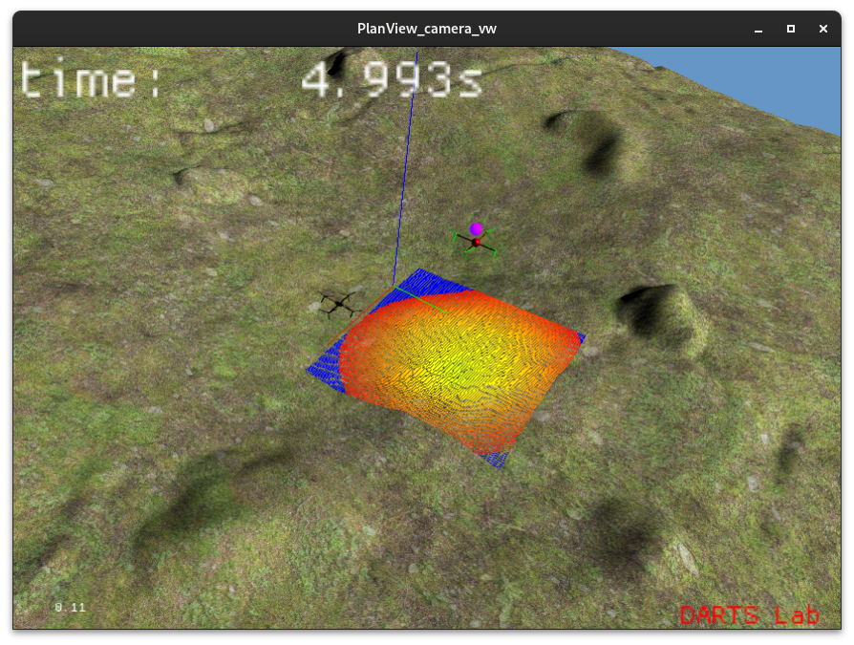
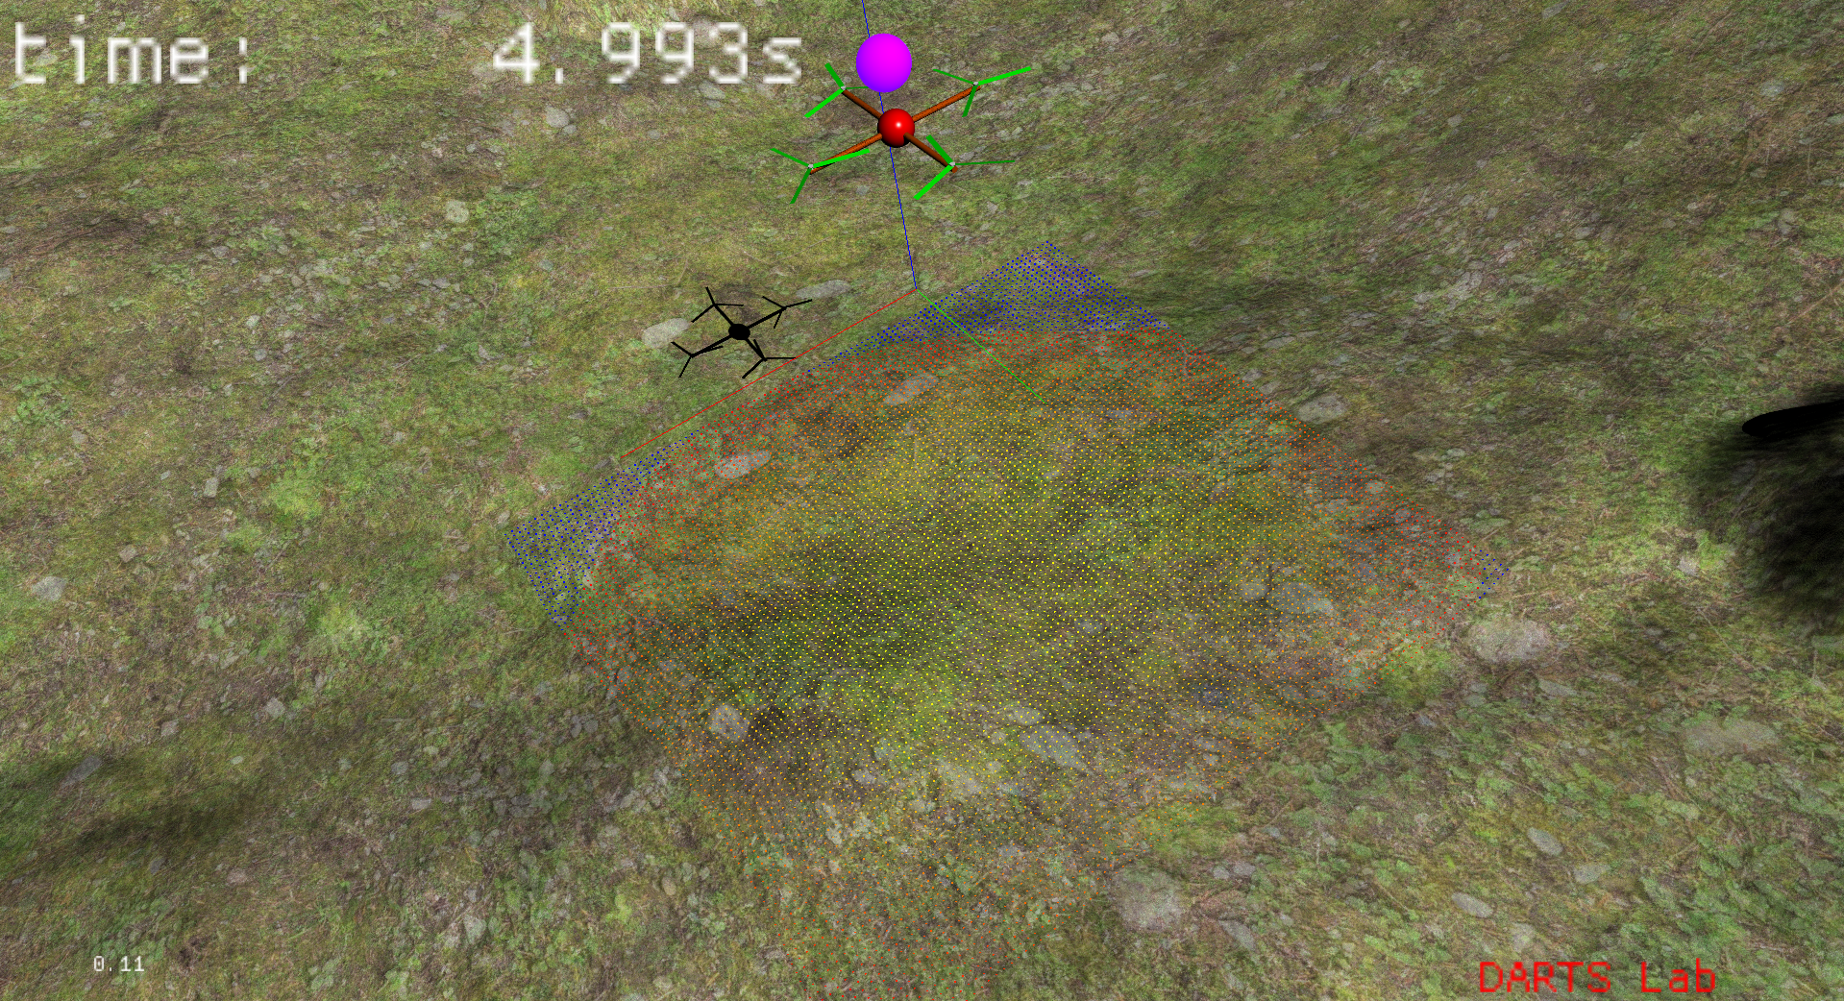
Visualizing the point cloud
Lidar point cloud can be stenciled on another viewport
lidar = add_lidar()
# add the lidar pointcloud to the visualization
planview = sm.defaultViewport().implementation(
sm.visualizationClientScene()).upCast()
planview.registerSensorForGL(lidar.viewport().getSensor())
# hide the lidar viewport, since we have a better way to visual the data
lidar.viewport().hide()

Slide 32
Recap

Slide 33
Recap
Visualization setup independent of scene type
Can modify scene objects
Geometries
Materials
Lights
Specialized texturing provided for terrain
Large terrains are often viewed from multiple scales
Texture layering improves the visual representation
Clipmaps reduce the complexity of the geometric representation
Sensors added to simulation using assemblies
Modeled using Optix (headless)
OptixScene can also provide interactive visualization

