Slide 1
Running the Simulation Building an Exemplar Sim 2023 DARTS Lab Course​
Abhinandan Jain, Aaron Gaut, Carl Leake, Vivian Steyert, Tristan Hasseler, Asher Elmland, Juan Garcia Bonilla

Slide 2
Exemplar sim topics overview
Exemplar sim goals
Creating the Vehicle assembly
Creating the SimulationExecutive
Setting up DataLogging
Running the simulation
Rendering related models

Slide 3
Outline
Recent time stepping improvements
Data logging and plotting
Debugging
Checkpointing and warm start
Tuning performance

Slide 4
Problem: Sim time-stepping still has elements based on fixed-step paradigm
The notion of simulation step size is a remnant from the days when we had all models stepping at the same rate – deprecate it
Increase simulation speed by removing unneeded hops
Integration sub-steps are only needed for fixed-step integrators, not variable step integrators
Notes:
Early ver – fixed step (RK4)
New: Reflect multirate cap.

Slide 5
Time Stepping Updates

Slide 6
Time Stepping updates
Refactor time stepping to better reflect multi-rate simulation paradigm
Simulation hops should be only determined by model multi-rate needs
Remove sub-steps handling from simulation level, and delegate to fixed-step integrators
Switch to using TimeSpecs uniformly everywhere for time (instead of TimeSpecs and doubles)
Acknowledgement: Conlain Kelly made invaluable contributions to the refactoring of the simulation time stepping code during his internship.
Notes:
Early ver – fixed step (RK4)
New: Reflect multirate cap.

Slide 7
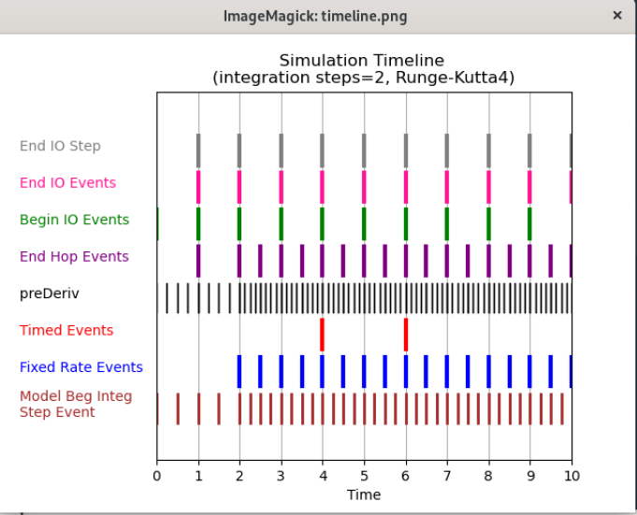
Previous time stepping (stop-and-go)
Based on the notion of a simulation IO step
Simulation IO drove the time stepping.
If step size was 1 second and we advanced 3.5 seconds, then we would step until we got to 3 seconds and then move the last 0.5.
Events could be registered to fire at the IO.

Slide 8
New time stepping approach (continuous)
Driven by multi-rate needs of models, events and data-logging.
Simulation is there to serve their needs, not the other way around
Usage
_run() with a stopping condition specified
Simulation orchestrates whatever the user has created and registered in the simulation model
Replaces simulation “step size” based time propagation
begin/end IO step events no longer exist
Instead user needs to register the events (eg. data logging) that are desired
stepValidationEvents used to stop the sim from moving forward in time. Now, if you want that behavior, you need to request it by setting sim.e_stop = True in your callback. The default is now to continue stepping the sim forward.
Notes:
Is there a more detailed explanation we can point people to?
Don’t focus on _run - used by advTimeBy, etc...; key idea is the change from fixed step to full multirate

Slide 9
Problem: Need sim post-analysis capability
Data logging can generate large log files
It would be useful to have standard tools to help with post-analysis of the logged data
Notes:
Early ver – fixed step (RK4)
New: Reflect multirate cap.

Slide 10
Data Logs, Plots, and Post-analysis

Slide 11
Demo: HDF5 Data Logging and H5View
Notes:
HDF5 log a quadcopter during hover -> maneuver -> hover
Log will be used in the plotme demo
Exit and examine data logging file in H5View

Slide 12
Demo: Run-time Plots
Notes:
Rerun the simulation with existing logger switched to run time plotting

Slide 13
What is Plotme
Plotme is an in-house CLI tool that plots the variables in an HDF5 file.
Supports the data organization of HDF5 files produced by DataRecorder
Originally developed for the Venus Aerobot project; generalized to work with any DataRecorder HDF5 file.
$ python plotme -h
usage: plotme [-h] [-fh5 [H5_FILE ...]] [-dxy [DIFFXY ...]] [-pxy [PLOTXY ...]]
[-pxys [PLOTXYS ...]] [-rbt RBTHRESH] [-pf PLOTFREQ] [-pp PLOTPICKLE] [-l]
[--compare-data [COMPARE_DATA ...]] [--component [COMPONENT ...]] [-i INFO]
[-cmp] [--label] [-s] [--eps-ext] [--same-scale] [--save-dir SAVE_DIR]
[--save-csv [SAVE_CSV ...]]

Slide 14
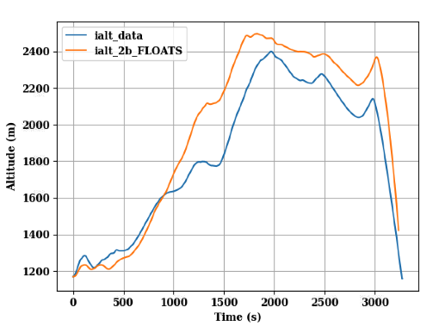
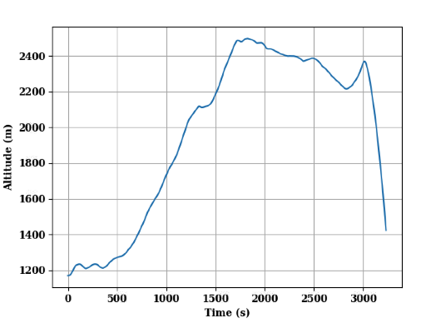
Examples: -pxy
Labels are created either when using --label, --compare-data, or --same-scale options. The name is usually coming from the variable plotted + _ + the name of the h5 file after the last “_”
python plotme -fh5 test_2b.h5 -pxy sim_time ialt
python plotme -fh5 test_2b.h5 -pxy sim_time ialt --compare-data ../../data/blackrock_test/20220716-2b/positionVelocity-Gondola.txt 0 3

Slide 15
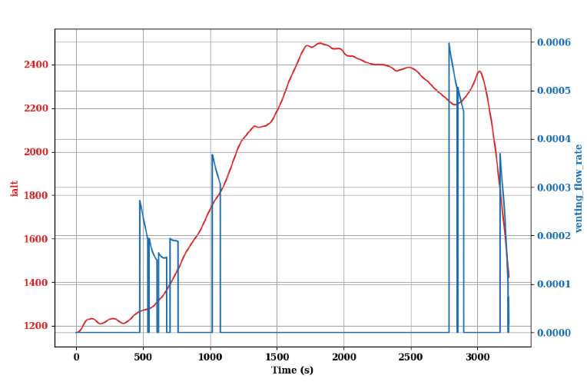
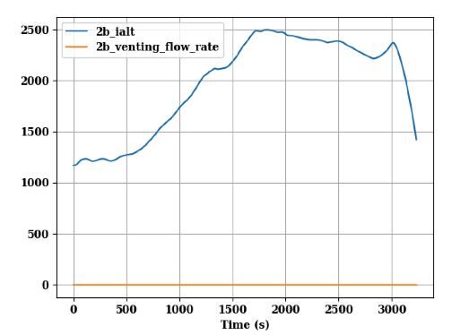
Examples: -pxys
python plotme -fh5 test_2b.h5 -pxys sim_time ialt venting_flow_rate
python plotme -fh5 test_2b.h5 -pxys sim_time ialt venting_flow_rate --same-scale

Slide 16
Demo: plotme
Notes:
For plotme there are Carolina’s slides from 2023-04-06
Use the HDF5 log from the previous demo
Using plotme or pandas or alternative to generate plots of variables
Plot the rotor speeds over time
Apply custom legend labels
Plot the xy trajectory (shows x doesn't have to be time)
Go through –help dump in demo

Slide 17
Problem: Need ability to turn on/off model messages for run-time debugging
There is a need from time to time to debug simulation behavior by turning on messages from individual models to trace the numerics
Want to do this without having impact on performance during production runs
Notes:
Early ver – fixed step (RK4)
New: Reflect multirate cap.

Slide 18
Using DebugLog

Slide 19
Using DebugLog
DebugLog adds text-based logging to DARTS sims
User can set verbosity: from logging only critical errors to a detailed trace
Messages sources can be configured granularly
Example: only log messages from a certain model in the sim
User can define custom sources and sinks of log messages

Slide 20
Demo: Using DebugLog
Notes:
Show ability to turn on DebugLog messages
Start with trace mode, to help communicate the trace of what is happening
Use Dshell gui to turn on/off debug mode for specific models

Slide 21
Problem: How do we debug crashes, bad numerics etc from simulations
Simulations can misbehave at times. How do we debug?
How do we do pro-active scrubbing of the code?
Notes:
Early ver – fixed step (RK4)
New: Reflect multirate cap.

Slide 22
Debugging with pdb

Slide 23
Using pdb
pdb is an interactive debugger for Python
Part of the standard library: https://docs.python.org/3/library/pdb.html
Some examples of what it can do:
Step through a program one line at a time
Run until a given line number or function is reached
Stop whenever an exception is thrown
Inspect currently defined variables

Slide 24
Demo: Debugging with pdb
Notes:
If it doesn't exist, introduce an assert in a Quadrotor assembly that we can trip with a bad config/param
Show analyzing assert message
First insert a breakpoint() into the method to inspect the state and find the problem
Show using pdb to inspect the state without modifying source code
Fix the bad config/param

Slide 25
NaNs and Floating Point exception issues

Slide 26
NaNs and floating point exception issues
Bad numerics such as singularities can result in crashes way downstream
Would like to detect the original problem
Invoke SOA_Py.enableFloatingPointExceptions(True) to trigger an exception where the NaN first occurs

Slide 27
Demo: Catching Floating Point Exceptions
Notes:
Artificially introduce a singularity to the quadcopter (set a blade's moment of inertia to zero? Reproduce something similar to COMPASS?)
Show the error beforehand, not helpful
Uncomment call to enable floating point exceptions
Show the new error

Slide 28
Debugging with gdb

Slide 29
Using gdb
gdb is an interactive debugger for C/C++
Some examples of what it can do:
Step through a program one line at a time
Stop every time a function is called
Stop whenever an exception is thrown
Stop whenever a segfault occurs
Inspect currently defined variables
Examine a core dump
Move up and down the call stack
Jump between threads
Python integration (py-bt)

Slide 30
Demo: Debugging with gdb
Notes:
Introduce an error in C++ code for the quadrotor's GNC model – python callback?
Show use of gdb to find the error
Show use of py-bt to find where the Python call is happening <- Important
Show using ‘catch throw’ to trap on exception

Slide 31
Memory corruption issues

Slide 32
Memory corruption issues
Caused when a program writes to the wrong location in memory, potentially overwriting another variable. May occur when:
Writing to an index outside of an array's bounds
Using a pointer after its data has been deleted (use-after-free error)
Some tools to find the offending code:
valgrind
gdb
asan

Slide 33
Demo: Using asan
Notes:
Demo with a simple standalone program
Have to build with –fsanitize=address etc asan flag

Slide 34
Repeatability issues

Slide 35
Repeatability issues
If a sim produces different results each time it is run, there are some common culprits:
A random number generator (RNG) may be using a random seed. Be sure to explicitly set a constant seed for any RNG used in the sim
An uninitialized value may be used in the sim. This is undefined behavior, but often results in wild, nondeterministic numerics.
Use clang/msan for detecting use of uninitialized variables

Slide 36
Demo: Using msan
Notes:
Demo with a simple standalone program
Have to build with –fsanitize=memory and clang compiler for this

Slide 37
Problem: Working with long sim runs
Some simulation runs can take a long time, and debugging an issue that shows up deep into a run can be time consuming and difficult
Notes:
Early ver – fixed step (RK4)
New: Reflect multirate cap.

Slide 38
Checkpointing and warm start

Slide 39
Checkpointing and restoring
May want to start a simulation from a mid-way point
Checkpoint just before a crash, then restore and debug
Start a Monte Carlo mid-way into a sim

Slide 40
Checkpointing limitations
Checkpointing uses Checkpoint/Restore In Userspace (CRIU) to save everything in memory to a file. Some things that are known to cause issues:
GPU memory, including graphics
Logging to HDF5

Slide 41
Problem: Integrator performance depends on the dynamics
There is support for a large family of integrators within Dshell, but there is no clear way to pick the best one, and its options and tolerances for a problem at hand
Notes:
Early ver – fixed step (RK4)
New: Reflect multirate cap.

Slide 42
Tuning the Integrator

Slide 43
Tuning the integrator
Fixed-step 4th order Runge-Kutta is the default
Many other options are available (adaptive, implicit, stiff, higher-order, etc...)
Includes most things from the SUNDIALS 6.5 suite
Many integrators have parameters such as tolerances to tune
Options have been recently expanded with the introduction of the DSundials module.
Changing these settings may greatly improve performance and/or accuracy

Slide 44
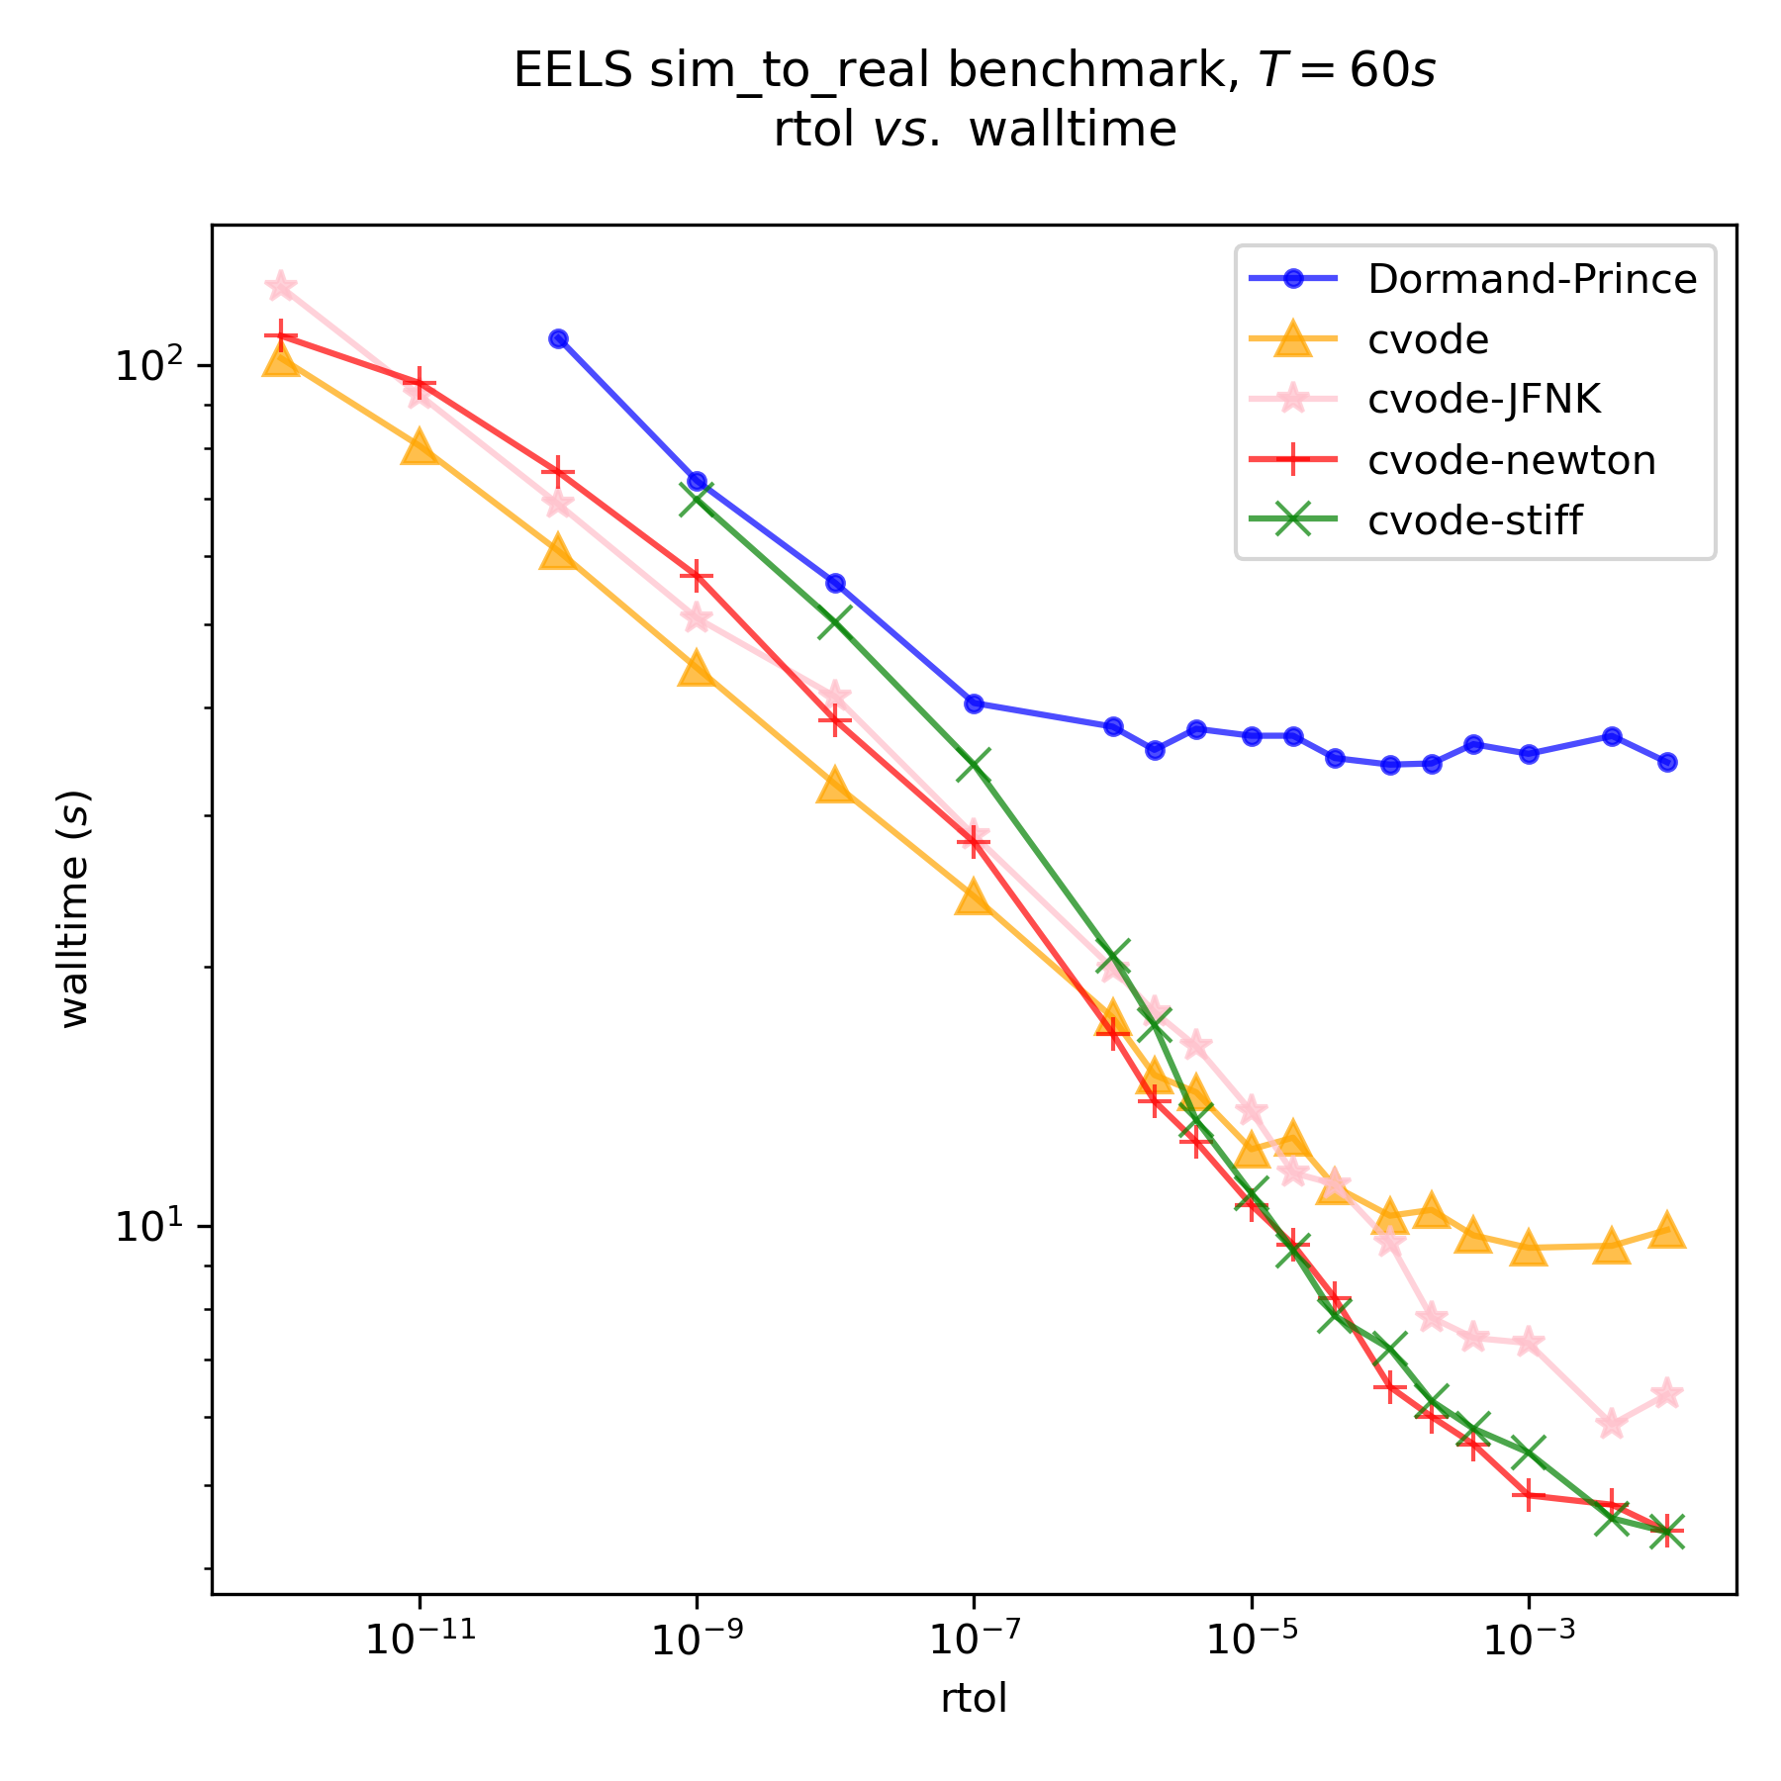
Tuning the integrator
Methodical approach:
Select viable set of integrators and settings
Choose a representative benchmark sim
Do an exhaustive sweep
Acknowledgement: Conlain Kelly developed the procedure for tuning and selecting integrators during his internship.

Slide 45
Problem: Improving simulation performance
What is a good way to identify performance bottlenecks to help improve simulation speed?
Notes:
Early ver – fixed step (RK4)
New: Reflect multirate cap.

Slide 46
Performance Profiling

Slide 47
Performance profiling
If a sim is slow: don't guess, profile!
Records the time spent in each function call so you can determine which functions are taking the longest
May also track memory usage in a similar manner
yep is a modern profiler that works well with C++/Python code like DARTS

Slide 48
Demo: Performance Profiling
Notes:
Check Carl’s yep based profiling technique from team talk sprint on 2022-09-01
Run the quadcopter sim for a bit while profiling

Slide 49
Recap

Slide 50
Recap
Recent time stepping improvements
Data logging and plotting
Debugging
Checkpointing and Restoring
Tuning performance

Slide 51
Backup

Slide 52
Time Stepping updates
Use from Carl Leake’s team talk of 2023-06-01

Slide 53
Overview
Previous time stepping
New time stepping
Simulation events
Other changes
Conclusion
TBD
How about referring to legacy time-stepping as 'stop-and-go' and the new was as 'continuous' or 'smooth' or 'goal-driven'?

Slide 54
New time stepping method
Build up a timeline based on model periods, timed events, etc.
Move from one spot on that timeline to the next.
Prevents unnecessary stopping at what used to be IO step boundaries if no models are registered to stop there.
Since the notion of an IO step no longer exists, we now call this the default model period, because that is what it is.
sim.stepSize and sim.ioStepSize have been deprecated in favor of sim.defaultModelPeriod.
The process stops (we stop moving along the timeline) when a stop callback is triggered.
Renamed internal methods and variables in the Simulation class to better reflect what they do/are.

Slide 55
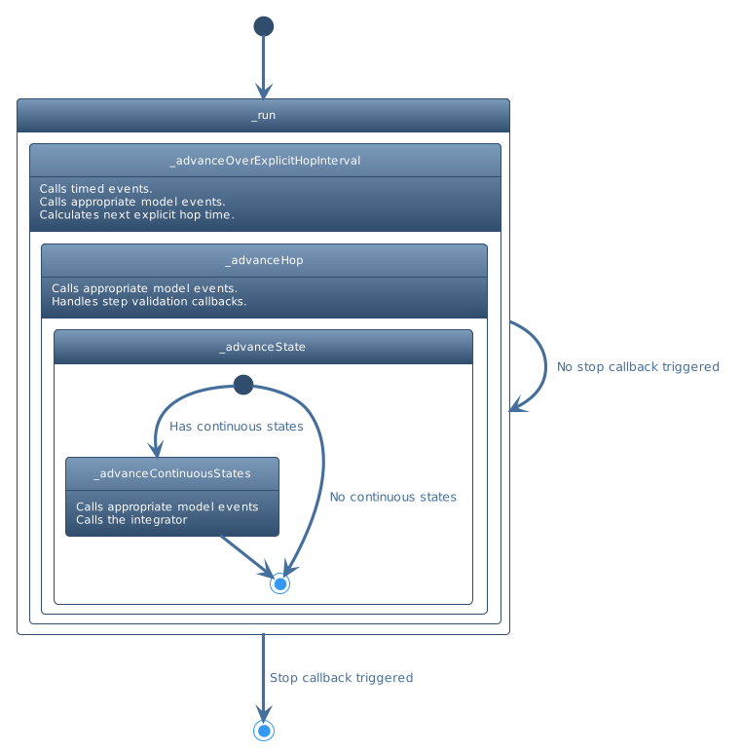
Time stepping method overview
Notes:
Remove?

Slide 56
Simulation events
begin/end IO step events no longer exist.
Timed events can be used to mimic this behavior by just setting the repost interval to be the same as the default model period.
A before_step timed event queue was created for events that should run before the dynamics for a certain time (replacement for begin IO step).
The registerBeginIOStepEvent and registerEndIOStepEvent methods are deprecated. Currently, all these events do is register a timed event with the appropriate queue and repost interval.
We keep track of these events behind the scenes and modify events' repost interval if the default model period changes.
A convenience function was added to timed callback events to do this easily.

Slide 57
Simulation events
Added a priority minor counter to callback events. This allows us to sort events with the same time and priority value by the order they were registered in. This retains old behavior where begin/endIOStepEvents with the same priority would execute in the order they were registered in.

Slide 58
Other changes
Model begin IO events now fire at the correct time; before the next hop boundary is calculated.
This also allows model begin IO step events to register simulation timed events. This can be used for things like adding a delay to a flowOut.
The times passed into the model begin IO and end IO events were incorrect.
We now just pass in the current time to these events. If these events need the other time (beginning or end of the IO step) they can calculate it themselves since each model knows its own IO period.
Renamed numIntegrationsSteps to numIntegrationStepsPerHop
Deprecated numIntegrationsSteps and integrationSteps
Notes:
https://dartsgitlab-internal.jpl.nasa.gov/darts-lab/jpl-internal/all-access/development/simulation-framework/dshellpp/-/issues/22

Slide 59
Other changes
stepValidationEvents used to stop the sim from moving forward in time. Now, if you want that behavior, you need to request it by setting sim.e_stop = True in your callback. The default is now to continue stepping the sim forward.

Slide 60
Notes to update old reg tests
Begin and EndIOStepEvents now run at the actual IO steps rather than at the IO steps + the beginning/end of the residual step. You may need to call sim.executeBeginIOStepEvents or sim.executeEndIOStepEvents at the appropriate time if you are stepping just over/under the IO step size often.
For example, suppose the IO step size is one second, but you call sim.advanceTimeBy(0.7). In the previous architecture, this would call the EndIOStepEvents at 0.7 seconds and the BeginIOStepEvents at the same time when you begin to step the sim again. In the new paradigm, we only run these events at the IO boundaries. If you'd like to retain the old behavior, then you will need to add EndIOStepEvents and BeginIOStepEvents in the appropriate spots.

Slide 61
Notes to update old reg tests
Model IO step events also used to run at off-IO boundaries when advanceTimeTo or advanceTimeBy were called. Sometimes, calling an updateFlowOuts manually is required. For example. in DshellDsends/test/test_AspireThrusterAssembly.
Step validation events no longer stop the current step unless explicitly told to do so. You can stop the sim from running by adding sim.e_stop = True to your callback.
There is a ROLLBACK_TIME_STEP_REFACTOR macro in Simulation.cc. It can be enabled by defining ROLLBACK_TIME_STEP_REFACTOR at the top. This will print out warnings that can be useful in helping to update reg tests. Users should also ensure deprecation messages are printed out, as there are some helpful messages there as well.

Slide 62
Independent Command Line Options
Can be used with or without any other options:
-h, --help show this help message and exit
-fh5 [H5_FILE ...], --h5_file [H5_FILE ...]
HDF5 file path
-dxy [DIFFXY ...], --diffxy [DIFFXY ...]
difference XY plot HDF5 file
-pxy [PLOTXY ...], --plotxy [PLOTXY ...]
XY plot HDF5 file
-pxys [PLOTXYS ...], --plotxys [PLOTXYS ...]
XYs plot HDF5 file: first argument is X, the others are Ys
-rbt RBTHRESH, --rbthresh RBTHRESH
rigid body threshold for frequency plot
-pf PLOTFREQ, --plotfreq PLOTFREQ
plot frequencies of a list of linear model HDF5 files
-pp PLOTPICKLE, --plotpickle PLOTPICKLE
plot pickle files in provided path
-l, --list_vars list variables in HDF5 file

Slide 63
Dependent Command Line Options
Used with -pxy or -pxys:
--compare-data [COMPARE_DATA ...]
This option must be used with -pxy to compare in the same plot the
data coming from a txt file. First argument is the .txt file to read, then the column for the x
var and the column of the y var.
--component [COMPONENT ...]
This option must be used with -pxy to plots one component. It only
accepts int and if the index is out of range it will raise an error.If nothing is specified it will
plot all the components.
-i INFO, --info INFO print info about variable in HDF5 file
-cmp, --compare compare two variables
--label Add labels to plot
-s, --save Save plots
--eps-ext Save plots in the 'eps' format. False by default (PNG by default).
Valid only if used with '-s' option.
--same-scale Use the same scalewhen using -pxys and 3 args (X Y1 Y2). By default
it uses different scales, on 2 different axis.
--save-dir SAVE_DIR Specify where to save the plots.
--save-csv [SAVE_CSV ...]
Specify the name of the csv file to save the data in (with csv extension) and the columns of data to write
from list of variables in HDF5 file. Simulation time always included, no need to be specified!

Slide 64
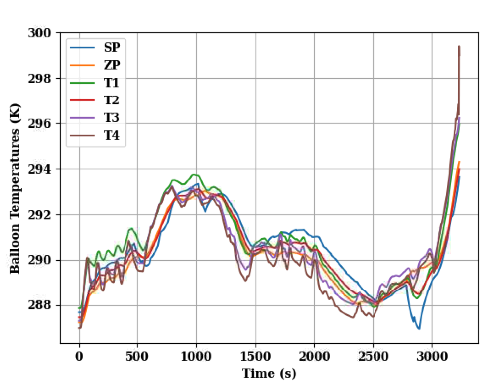
Code Specific to VenusAerobot Sims
In some cases, like for the balloon temperatures, the legend is customized.
Same for some axis titles.
These are the only behaviours that are specific to this project.
By default the axis labels and titles takes name from the variables name (as they appear in the list).
To see the complete list of variables:
python plotme -fh5 test_2b.h5 -l
python plotme -fh5 test_2b.h5 -pxy sim_time biab_temp

Slide 65
Problem: Simulation numerics can be dryn and challenging to work with
Being limited to just numerics does not make it easy at times to catch model errors
We have 3D graphics visualization capability available in DARTS.
How can we use it to better understand model and simulation behavior?
Notes:
Early ver – fixed step (RK4)
New: Reflect multirate cap.

Slide 66
Using Visualization

Slide 67
Visualization bells and whistles demo
Enabling trails
Showing frames
Lights??

