Slide 1
Creating the SimulationExecutive Building an Exemplar Sim 2023 DARTS Lab Course
Abhinandan Jain, Aaron Gaut, Carl Leake, Vivian Steyert, Tristan Hasseler, Asher Elmland, Juan Garcia Bonilla

Slide 2
Exemplar sim topics overview
Exemplar sim goals
Creating the Vehicle assembly
Creating the SimulationExecutive
Setting up DataLogging
Running the simulation
Rendering related models

Slide 3
Outline
Requirements
Deep dive into Dclick and ParamLinker
Building the exemplar SimulationExecutive
Debugging/verifying the simulation model

Slide 4
Goals of the SimulationExecutive
Launcher for the simulation.
Construct all the entities required for the simulation.
Provide command line options for tailoring the run.
Provide a way to specify simulation options from a configuration file as well as to save the options for reuse later.
Allow multiple such configuration option files and command line overrides to be used in combination.
Provide a way to set model parameters from the run deck.
Standardize options for commonly used aspects, e.g., graphics, integrator, verbosity, etc.

Slide 5
Requirements on the SimulationExecutive
Build all major sim components
Rotorcraft models
Gravity
Terrain
Integrator
Command line interface (CLI)
Visualization
Data logging
Events
Finite state machine (FSM)

Slide 6
Simulation features recap

Slide 7
Simulation architecture
Done via a Python script
Use assembly hierarchy to
Create a data flow of Dshell models
Create a multibody dynamic model for the vehicle
Register events
Set up data logging
Set up visualization
Set up FSM
Set up CLI

Slide 8
Problem: Need a uniform way to organize and manage the many, many sim options
To avoid having to change user scripts and code, simulation applications need a command line interface (CLI) to set options to configure the simulation.
As the number of options grows, we also need a provision for specifying the options via an options file as well as exporting the options used in running a simulation (in a form that can be re-used as input later).
Would like help messages describing the options.
Would like to standardize the options for areas such as visualization, terrain data etc. that show up repeatedly across simulation applications.
Would like ability to set parameter values from the CLI.
We have built upon the open-source click module to develop the Dclick module to meet these needs.

Slide 9
Dclick based CLI

Slide 10
Dclick demo
RotorCraft/test/test_cli
RotorCraft/data/configs/default.yaml
Show changing fuselage color
Show –full-out-cfg capability
Show multicommand changing the properties of multiple rotors

Slide 11
Dclick design
Allows the addition of custom subcommands to an application for its API.
Can also import in standard subcommand definitions (e.g., visualization, sim etc.)
Uses click (instead of argparse) since it has support for multi-commands.
Multi-commands allow multiple use of a subcommand with different option values.
This is handy for dealing with multiple instances, such as multiple vehicles, or multiple terrain instances.
Allows us to specify different options for the individual vehicle/terrain instances.
Automatically generates help messages at the top level as well as for subcommands.
Allows importing and exporting of option values to YAML, JSON, ConfigObj files.
Handy for ensuring repeatability even when default behaviors evolve over time.

Slide 12
Dclick features
Specify values via defaults, config files, or CLI parameters.
Can use multiple config files.
Overwriting should happen in the order of: defaults < config files < CLI options.
Handle float, int, string, and lists of them, as well as enum (choices) data types.
Able to enforce range limits (e.,g. value is >= 0).
Handle multiple instances of the same command.
Validate input to ensure it is of correct type.
Generate help messages automatically (given help strings for each option) and store them in an easy-to-access hierarchy.

Slide 13
Dclick solution
The 3rd-party click package is used to:
Create the CLI application.
Add default values if applicable.
Handle and validate CLI options.
Create hierarchical help output given help strings for each option/command.
Pydantic is used to handle and validate config file options.
The merging of these two (config files and CLI options) is done by Dclick.
The combination of all of this plus helper functions and some common DARTS-related commands is called Dclick.

Slide 14
Dclick usage
The cli provides useful built-in top-level options (which can be extended)
--in-cfg: Full or partial input config file.
--full-out-cfg: Full output config file.
--delta-out-cfg: Delta output config file.
--write-default-cfg: Flag to write a default config file using the master configspec.
--write-configspec: Flag to output a default master configspec file (master_configspec.ini).
--delta-options: Flag to output command line options corresponding to the current options.
--file-exec: A file to execute after simulation is locked and ready to go.

Slide 15
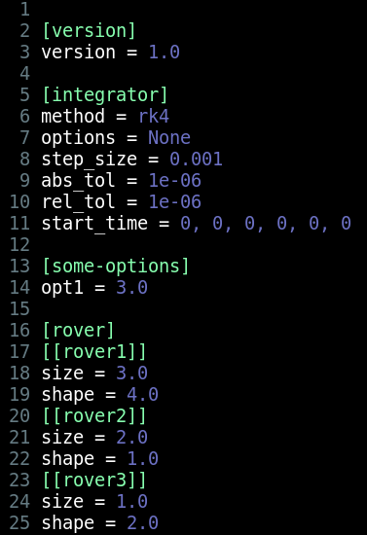
Sample config file
Notes:
Say again that can be yaml, ini, etc.

Slide 16
Problem: Need ability to override params from the CLI
It is handy to be able to set individual model parameter values from the CLI.
For example, values for spring constants, thruster Isp, IMU noise, etc.
This can be very useful for Monte Carlo and parametric runs.
Also, can support the need for input decks that can be used to track option values to allow repeatability of old sim runs.

Slide 17
ParamLinker
We have already seen the ModelLinker that allows us to automate the creation of BaseDParam parameter classes from the model .mdl files.
ParamLinker allows us to automatically export the BaseDParam fields as options to the Dclick CLI.
This process adds CLI options for setting the parameters of each assembly (and hence model) instance.
The combination of ModelLinker and ParamLinker provides a convenient way to handle disparate param values across the family of models and assemblies.
A lot of repetitive parameter related code is not needed.
The param classes and CLI options automatically stay in sync as .mdl file parameter values evolve.

Slide 18
Problem: Need for parameter curation
The CLI and input decks provide raw parameter values.
Need a standardized way to process these parameters to generate derived ones as needed to get ready for passing on to models.

Slide 19
Parameter curation

Slide 20
Parameter curation process: RotorCraftParams
After parameters are obtained through Dclick, they require some curation.
Everything from Dclick gets sent into one Python dictionary.
Even with ParamLinker, one still needs to actually create the param class instances (often just one-liners).
In some cases, extra logic is needed as different parameter classes get created depending on flags from Dclick.
Our convention has been to do this post-processing and validation in a file called <SimName>Params.py, e.g., RotorCraftParams.py

Slide 21
RotorCraftParams & ParamLinker demo
RotorCraft/python/executive/RotorCraftParams.py
Show general idea: post-processing params from Dclick
Show creating inertia matrix parameter from input list
Show creating different params for lift depending on lift config type
Show creating GNC parameters if gnc enabled

Slide 22
RotorCraft SimulationExecutive - Demo

Slide 23
Walk through creating the SimulationExecutive
A walk through of writing the SimulationExecutive for the rotorcraft. Will see:
Adding the vehicle
Adding gravity
Adding terrain
Visualization setup

Slide 24
Problem: What checks can we do to verify that the vehicle model has been built correctly?
The simulation model has lots of parts—multibody, models, signals, assemblies, data flow, parameters etc.
How does a user go about doing sanity checks to verify that the model has been assembled properly?

Slide 25
Reviewing/debugging the simulation model
We are not done once the SimulationExecutive is launched, and the model instances are created.
We need to review the instanced simulation model to check for any errors.
Check multibody model.
Check body connectivity.
Check hinge types.
Check system level mass properties.
Check the model data flow.
Isolated/dangling signals.
Incorrect connections.
Multi-rate settings.
Check granularity.
Check model parameter values.
Check the graphics.
There are some GUIs available to help review the model.

Slide 26
Using the Dshell GUI - Demo

Slide 27
Using the Dshell GUI demo
Different pages
Viewing flow graphs
Viewing model params
Viewing assembly hierarchy, config, context, params
Perusing signal ties

Slide 28
Using the Ndarts GUI - Demo

Slide 29
Using the Ndarts GUI demo
Showing frames
Viewing frames tree
Showing actuator/sensor nodes
Articulation of DoFs
Graphics parts

Slide 30
Command line debugging - Demo

Slide 31
Debugging from the command line demo
Displaying multibody model and tree
sim.mbody().display_model()
sim.mbody().display_tree()
Using different graphs
sim.topAssembly().showModelsGraph()
sim.mbody().showBodiesGraph()
sim.frameContainer().rootFrame().showFramesGraph()
Using dump() methods
Using integrator spec nodes

Slide 32
Generating dataframe displays - Demo

Slide 33
Generating dataframe displays demo
sim.model("front_rotor_lift",0,True).asDataFrame()
sim.displayModels() to get name of model to look for first
sim.eventsAsDataFrame()
Many more examples in the notebooks

Slide 34
Recap

Slide 35
Recap
We have introduced the process of creating a SimulationExecutive for the rotorcraft problem.
Reviewed and used new capabilities.
Dclick for CLI.
ModelLinker and ParamLinker for parameters.
Reviewed process for debugging and verifying the simulation model.
Dshell GUI
Ndarts GUI
Debugging from the command line
Displaying data frames

Slide 36
Backup

Slide 37
Dclick details

Slide 38
Dclick commands
Specified using a series of Python decorators
The last line of the decorated function is boilerplate to merge options into cli

Slide 39
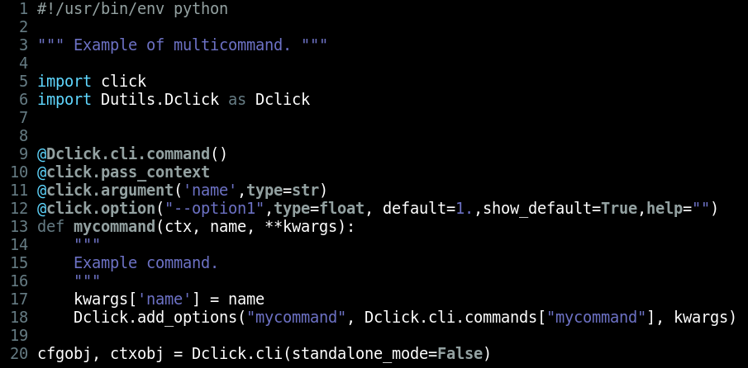
Dclick multi-commands
Similar to Dclick command, but they have the name argument
The syntax on CLI is “command --options name”

Slide 40
ParamLinker details

Slide 41
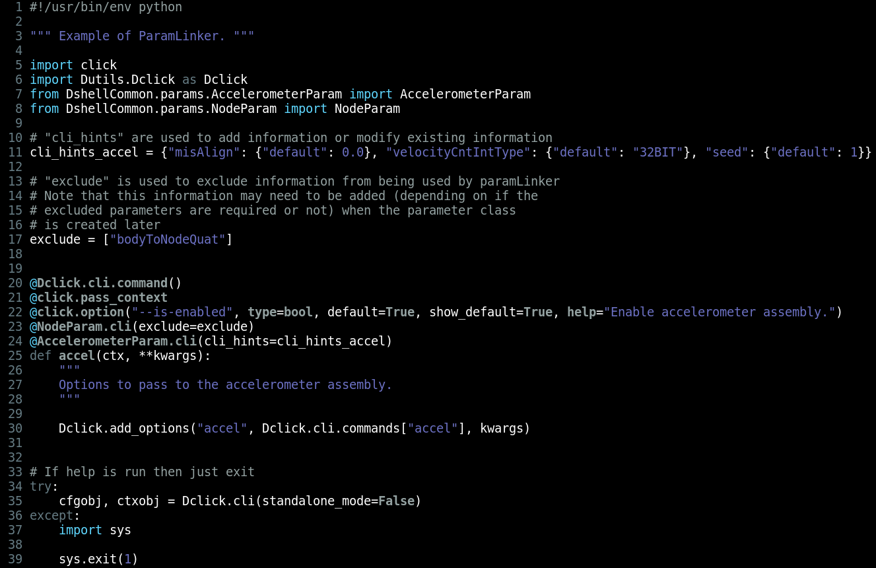
ParamLinker example

Slide 42
ParamLinker example

