Slide 1
Creating the Vehicle Assembly Building an Exemplar Sim 2023 DARTS Lab Course
Abhinandan Jain, Aaron Gaut, Carl Leake, Vivian Steyert, Tristan Hasseler, Asher Elmland, Juan Garcia Bonilla

Slide 2
Exemplar sim topics overview
Exemplar sim goals
Creating the Vehicle assembly
Creating the SimulationExecutive
Setting up DataLogging
Running the simulation
Rendering related models

Slide 3
Outline
Requirements on the vehicle model​
New concepts​
ModelLinker​
Improving LSP support​
BaseDParam class​
DAssembly class​
Building the exemplar RotorCraft assembly​
AssemblyBuilder to procedural assemblies conversion

Slide 4
Requirements on RotorCraft vehicle model
Configurable rotorcraft flight dynamics model with
Vehicle multibody dynamics
Configurable number of rotors and layout
Aerodynamics
Controller
Parameterized
Visualization graphics

Slide 5
Vehicle Modeling Recap

Slide 6
Assembly/Model Main Ideas
Creating assemblies
Creating data flow with inter-connected Dshell models
Creating multibody model with mass properties

Slide 7
Recall: An Assembly Constructor
Python Assembly constructor: __init__(self, name, config, context, params, signalTies, description, tag)
self – the new assembly object
name – name of the new assembly
config – creation options
context – how to embed in the rest of the sim
params – Parameter data for contained models, etc
signalTies – How to connect (tie) external signals with internal signals for models, sub-assemblies
description – Description of the assembly
tag – A tag for simple retrieval
Notes:
This is a slide from the previous day. Mostly, want to remind people about config, context, params, because those will be discussed more in this talk.

Slide 8
Recall: Assemblies create the simulation backbone: multibody, models, and data flow
Assembly hierarchy
The purpose of an Assembly is to construct the multibody, models, and data flow.
Once that is complete, the assembly’s work is done and is not generally needed at runtime
Asm2
Asm4
Python
An Assembly is a Factory creating dataflow and multibody models
Asm1
Asm3
Asm5
Construction
Run-time
mdl2
mdl3
bd1
bd3
mdl1
C++
mdl4
mdl5
bd2
Emergent model dataflow
Emergent multibody model
Notes:
This is a slide from the previous day. Here, they should remember that assemblies are used to construct multibody, models, and data flow.

Slide 9
Problem: Duplicative parameter definitions
Simulation parameters are required for:
Dshell models
Assembly parameters
Transferring parameters from assembly to models in bindParams
Command line interface and input deck options for parameter value overrides
ModelLinker has been designed to ensure usage consistency and reduce code duplication for handling of model parameters

Slide 10
ModelLinker

Slide 11
ModelLinker flowchart
Create BaseParam class from mdl param data
mdl files
Model 1
Model 2
...
Model N
Key
Can be automated via modelLinker
Must be handled manually
User-defined parameters
Parameter Class
Set model parameters in bindParams()
BaseParam class
Parameter Class
Used by assembly elsewhere
ModelLinker automates the creation of the BaseParam parameter class using the parameter meta data already available in the Dshell model “mdl” files.
Model 1
Model 2
...
Model N

Slide 12
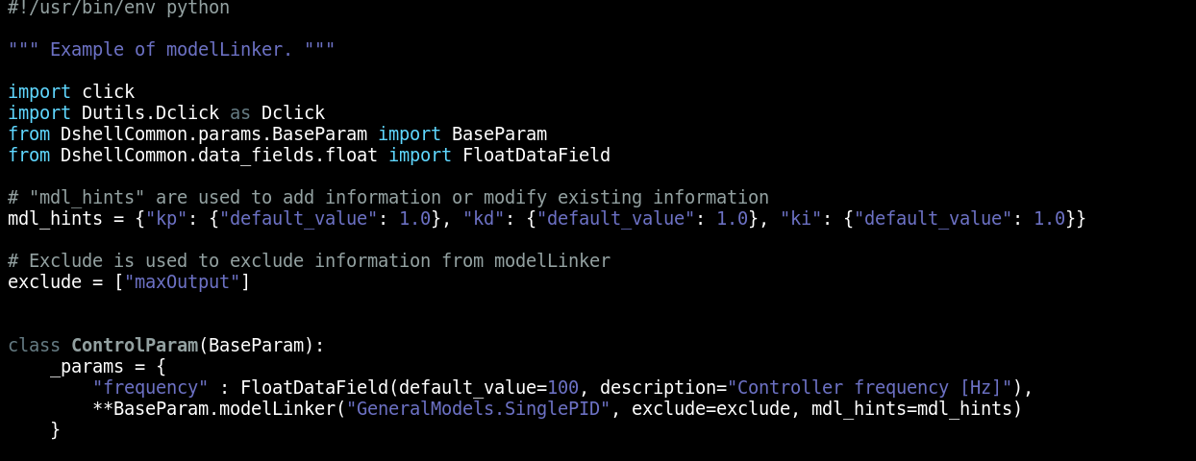
ModelLinker example
Create BaseParam class from mdl param data
⠇
Set model parameters in bindParams()

Slide 13
ModelLinker Demo
RotorCraftModels/RotorLiftLinear.mdl
Show there are several parameters to specify
RotorCraft/python/params/RotorLiftLinearParam.py
Show model linking, lack of code duplication
Show default being hinted

Slide 14
Problem: Large code base with many modules & classes
The DARTS code base relies on a large number inter-dependent modules and libraries.
It is difficult for developers and users to remember all function names, keyword arguments, etc. and navigate and get use the codebase
Example, was that keyword argument snake case or camel case?
LSPs can give us that information on demand.
Moreover, it can catch simple errors before we ever run our code, e.g., passed a float to something that should have been an integer.
Most modern editors—vscode, vim, emacs, etc.—have LSP support.

Slide 15
Language Server Protocol (LSP) support

Slide 16
Overview
LSP
Actual meaning of the acronym
What are they and what do they do
Practical meaning of the acronym
Common uses
Demo
Acknowledgement: Much of this, and the work to follow (LSP to DAssembly), was pioneered and inspired by ex-intern and soon to be JPLer and DARTS team member Juan Garcia Bonilla.

Slide 17
Common uses
Common uses:
Jumping to definitions without TAGS files.
Info on hover.
Info on completion.
Autocompletion.
Error/warning diagnostics.
Catch errors early while writing which is quicker than having to compile/run code and then catch them.
Anecdotes:
Writing in a language I don't know.
Traversing through a code base I've never used before.
Acknowledgement: Much of this, and the work to follow (LSP to DAssembly), was pioneered and inspired by ex-intern and soon to be JPLer and DARTS team member Juan Garcia Bonilla.

Slide 18
LSP Demo
RotorCraft/python/assemblies/RotorLiftLinearAssembly.py
Show go to definition for params.node
Show autocompletion and type hints for params.node.reference_frame_path
RotorCraft/ExtraDVars.cc
Show go to definition and declaration.
Show type hinting.
Show useful warnings with Frame2Frame vs. Frame2Frame*

Slide 19
Problem: Python type checking (actually lack thereof)
Languages such as C++ enforce strict type checking.
It is clear what type variables are.
Type mismatches are caught early at compile time.
Signature
This is not the case with Python. There is no built-in type checking or enforcement.
This 'flexibility' allows room for lots of errors, with errors caught deep down in the code.
This can especially be a big problem with large code bases with interacting classes such as in DARTS/Dshell.
Python 3 has introduced type hints to help with this, but checking is still not built in.
Some of the improvements we will describe are geared towards addressing these weaknesses.

Slide 20
Python type hints and checking

Slide 21
Using type annotations
To get the most out of your LSP, code needs to be written with annotations that the LSP can leverage.
Anonymous data is not helpful.
This is where type annotations come in—especially for dynamically-typed languages like Python.
Not an issue for languages like C++.
Also type annotations help improve the documentation of Python code by explicitly defining argument and return types.

Slide 22
Python type hinting
It’s a form of documentation: as you develop code, you declare the type of your variables so that the code is easier to maintain.
def greet_n_times(name: str, n: int) -> List[str]:
result: List[str] = []
for i in range(n):
result.append(f"Hello {name}!")
return result

Slide 23
Using classes for data
Python allows us to easily pass around containers such as lists, tuples, and dictionaries with arbitrary data.
However, we pay a heavy price for this flexibility since it is unclear to other users what is allowed and not allowed.
Instead, it is much better to define and use class arguments for data that is passed around.
Such classes can do their checking for data correctness and can also have helper methods.

Slide 24
Problem: Python ‘dict’ types are error prone
Python dictionaries are very forgiving.
You can add any key/values type combinations you want.
This can make it difficult for users to know what is legal, and lead to confusing code.
Dictionaries also don’t do any validation.
We would like to go beyond simple type checking and validate more complex things, e.g., quaternions, three-vectors with a magnitude > 0, etc.
However, we want something that still works like a dictionary.
Can be accessed, changed, etc. just like a Python dictionary can.
Dictionaries are useful data containers, but don’t give the LSP any information.
Using classes is much nicer for this.

Slide 25
InputDict class

Slide 26
InputDict base class
InputDict Is an LSP friendly, general purpose dict class.
This is a base class for key/value data sets (such as params) that needs to be passed around.
Will use this class instead of anonymous dicts .
Includes extensive checking and flexibility in defining new data types and constraints on them.
Can turn on strict run-time type checking if desired (off by default).

Slide 27
InputDict example
from DshellCommon.input_dict.input_dict import Dfield, InputDict
class HouseInformation(InputDict):
"""Contains information about a Dune House.
Parameters
----------
name : str
Desc. Name
major : bool
Desc. Major
"""
name : str
major: bool = False
info = HouseInformation(name="Atreides", major=True)
Declare and instantiate an InputDict
LSP-friendly type hinting, defaults
Can get/set fields as regular dictionary for legacy code
Can get/set fields as class attributes
previous_name = info.name
info.name = "Harkonen”
previous_name = info["name"]
info["name"] = "Harkonen"

Slide 28
Extended DARTS types
For many use cases in DARTS, checking the type of a value is not enough.
For example, we might want to ask the user for the number of rotors. While this must be an integer, it must also be greater than zero. But there is no python uint!
In this case, we use FieldCheck classes. These classes have a function “check” that will return True only if the input is valid according to the predefined criteria.
For example, we can define and use a FieldCheck subclass called PositiveCheck:
from Dutils.typing.field_check import FieldCheck
class PositiveCheck(FieldCheck):
def check(self, value):
return 0 < value
from Dutils.typing import Annotated
PositiveInt = Annotated[int, PositiveCheck()]
Definition of PositiveCheck
Definition of PositiveInt, an extension of int
Notes:
Call out the use of Annotated in the example code

Slide 29
Problem: The legacy BaseParam is not LSP friendly and over-relies on dicts
The BaseParam class was used for Assembly params definition.
Is not LSP friendly making it hard to use for developers and users.
Defining param data fields and constraint checking is awkward.
BaseDParam is a re-design of BaseParam to remedy these shortcomings.
Is derived from InputDict and hence is LSP friendly.

Slide 30
BaseDParam
A new version of BaseParam – but derived from InputDict.
Hence LSP friendly!
Can use param-conv utility to help convert from BaseParam to BaseDParam.

Slide 31
BaseDParam conversion with param-conv
The script will transform every param DataField into a field in the resulting BaseDParam.
Descriptions are automatically used in the docstring.
Provides a starting point for conversion. BaseDataField params will get type “Any” by default.
INB_TO_JOINT: Vector3DataField(
required=False,
quantity="Length",
description="The 3-vector ...",
default_value=[0.0, 0.0, 0.0],
),
INB_TO_JOINT_QUAT: QuaternionDataField(
required=False,
description="The quaternion ...",
default_value=[0.0, 0.0, 0.0, 1.0],
),
inb_to_joint : Annotated[LengthArray, SizeCheck(3)] = [0.0, 0.0, 0.0]
inb_to_joint_quat: Quaternion = [0.0, 0.0, 0.0, 1.0]

Slide 32
BaseDParam Demo
RotorCraft/python/executive/RotorPartsParam.py
Show adding a new param
Show types with annotations
Show description
Show the one-liner in the rotor-craft script

Slide 33
Problem: The legacy Assembly class is not LSP friendly and over-relies on dicts
Besides params, assemblies take context and config data inputs.
In the past, context and config have been anonymous dicts.
Not LSP friendly.
Thus, hard to tell what the right content should be.
Why not derive config and context from InputDict to fix this problem?
The new DAssembly class does precisely this – with config, context, and params all derived from InputDict.
Is LSP friendly.
Hence, code is very clear on what data is permitted.

Slide 34
DAssembly

Slide 35
DAssembly design
DAssembly is a sibling of the C++ Assembly class.
The previous Python Assembly class has been renamed AssemblyLegacy but in a backwards friendly way.
DAssembly and AssemblyLegacy derived classes can co-exist.
Convention is to use *DAssembly suffix for DAssembly based assemblies that are replacing legacy assemblies.
Other features:
Define the assembly specific config and context and param classes all within the assembly itself so they are collocated.
The optional/required param declarations are no longer needed.

Slide 36
Defining a new DAssembly
The main difference between Assembly and DAssembly is in how the fields of the config, context, and params are specified (and their types).
Assembly: Params
DAssembly: Params
class TargetAssembly(Assembly):
_param_types = {
"Target": TargetParam,
"Bodies": BodyParam
}
_requiredParamFields = ["Target"]
_optionalParamFields = ["Bodies"]
class TargetDAssembly(DAssembly):
class Params(DAssembly.Params):
target: TargetDParam
bodies: Dict[str, BodyDParam] = DEF_BODIES
params: Params

Slide 37
Defining a new DAssembly
The main difference between Assembly and DAssembly is in how the fields of the config, context, and params are specified (and their types).
Assembly: Config
DAssembly: Config
class TargetAssembly(Assembly):
_requiredConfigFields = []
_optionalConfigFields = [
"inertia_frame",
"topos",
]
class TargetDAssembly(DAssembly):
class Config(DAssembly.Config):
inertial_frame: Optional[str] = None
topos: Dict[str, TopoBaseDConfig] = {}
config: Config

Slide 38
DAssembly Example: RotorAssembly

Slide 39
RotorAssembly
RotorCraft/python/assemblies/RotorAssembly.py
Show params, config, context.
Show Union type used in params because there are options for the type.
Show Optional type used in params.
RotorCraft/python/assemblies/RotorAssemblyLegacy.py
Show part before __init__ for comparison against RotorAssembly.py.
Show (briefly, e.g., with addSignals and addModels) that rest of code doesn’t change much.

Slide 40
Problem: AssemblyBuilder process is fragile, but migration is challenging
Want users to migrate from dict-based assembly creation to procedural function calls

Slide 41
AssemblyBuilder versus procedural process
The AssemblyBuilder uses an input data dictionary to orchestrate the construction of the assemblies.
The dictionaries can be hard to get right.
We are limited by what the data fields support.
It is simpler to expose the actual assembly creation procedure so it can be more easily tailored.
However, there is a large body of code that is based on the AssemblyBuilder, and manual conversion can be time consuming and error prone.
Converting this to procedural code can be a tedious and fragile process.
Hence, we have developed a tool to help automate the conversion.

Slide 42
Converting from AssemblyBuilder to Procedural process

Slide 43
The Problem
Would like to help users migrate from dict-based assembly creation to procedural function calls
This is messy and annoying...
Let’s automate this process!

Slide 44
How to Convert Your Code
Import from AssemblyBuilder and add function calls to the code to be converted:
startProfiling() -- start tracing function calls
setProfilingParameters() -- set some function tracing parameters
writeProcedural() -- write the procedural function calls to file
Acknowledgement: This conversion tool has been developed by ex-intern and soon to be JPLer and DARTS team member Sam Tobin.

Slide 45
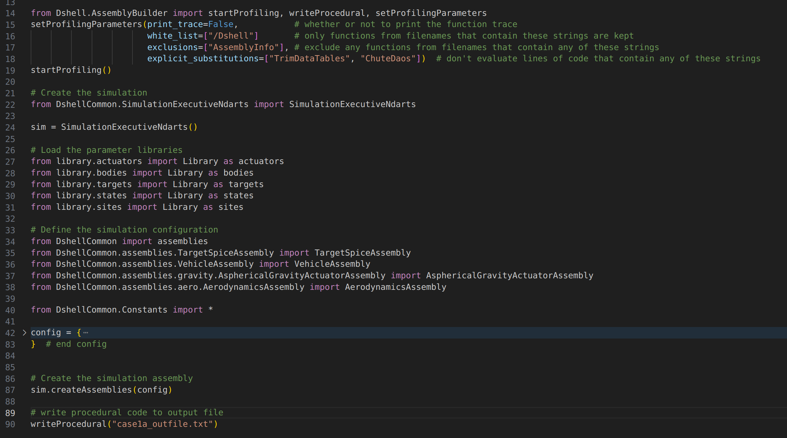
How to Convert Your Code - Example
Writes output to case1a_outfile.txt

Slide 46
AssemblyBuilder converter demo
RotorCraft/test/test_assemblies/test_LegAssembly

Slide 47
Recap

Slide 48
Recap
Have developed a new design for the QuadCopter vehicle based upon:
ModelLinker to get parameters directly to/from models where applicable.
BaseDParam and InputDict based context and config classes.
DAssembly class.
Discussed process for converting from AssemblyBuilder to procedural process.

Slide 49
Backup

Slide 50
LSP details and setup

Slide 51
LSP - Actual acronym meaning
LSP – Language Server Protocol
Language servers – provide code completion, references, refactoring, help, diagnostics, etc. for a given language
Talk to language clients, e.g., your text editor.
Pyright is an example of a language server for Python.
The LSP defines the messages that are passed back and forth.
Reference: https://www.toptal.com/javascript/language-server-protocol-tutorial

Slide 52
LSP – Practical acronym meaning
Although LSP actually stands for Language Server Protocol, the acronym is often used as a catch-all term (at least on the client side) for things related to LSP.
For example, neovim refers to setting up autocompletion, language servers, diagnostic messages, errors, etc. as setting up your LSP.

Slide 53
LSP – What does it do?
Acts as a bridge between servers and clients.
Saves everyone time, as servers don't have to write code to interface with each client or vice-versa.

Slide 54
Setup with DARTS
Language servers need information to do their job:
Where are the packages, header files, etc. located.
Run your client using srun so PYTHON_PATH, PATH, etc. are set for you.
There is a top-level make target called compile-commands that can be used to build the compile_command.json file used by C++ language servers.

Slide 55
AssemblyBuilder conversion details

Slide 56
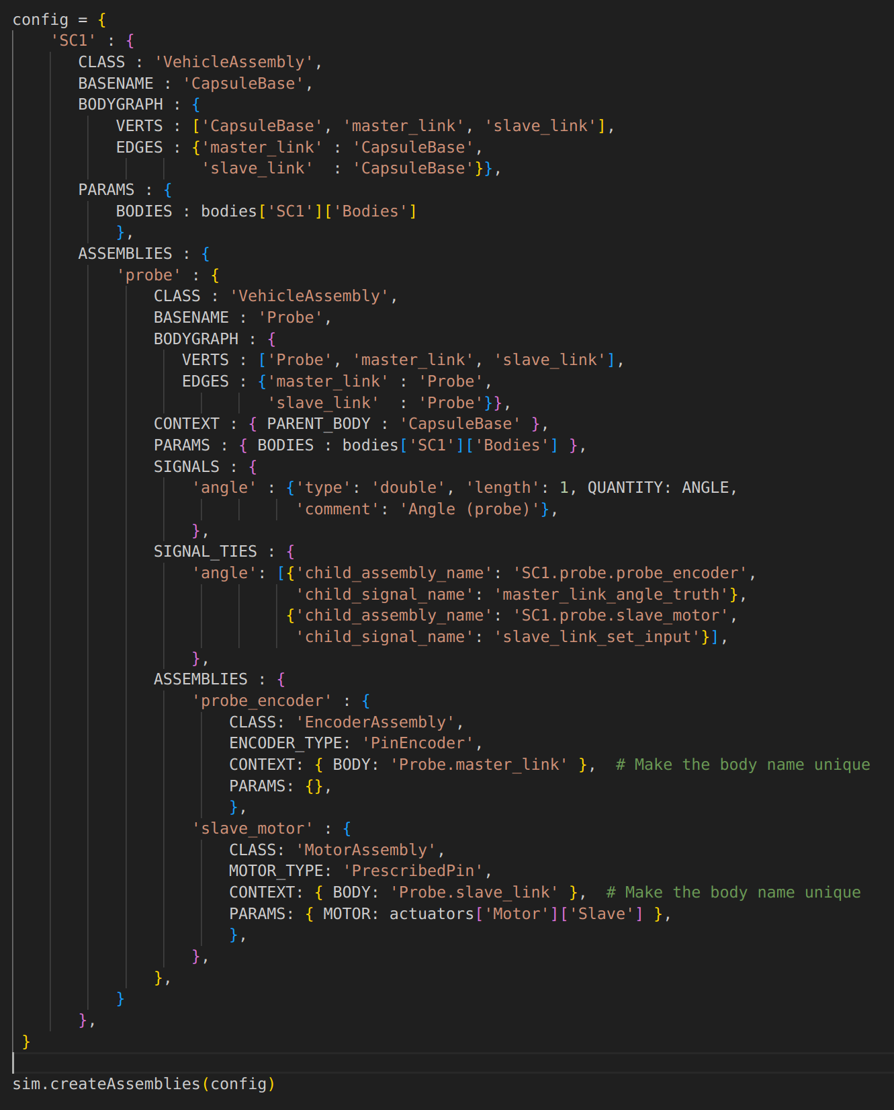
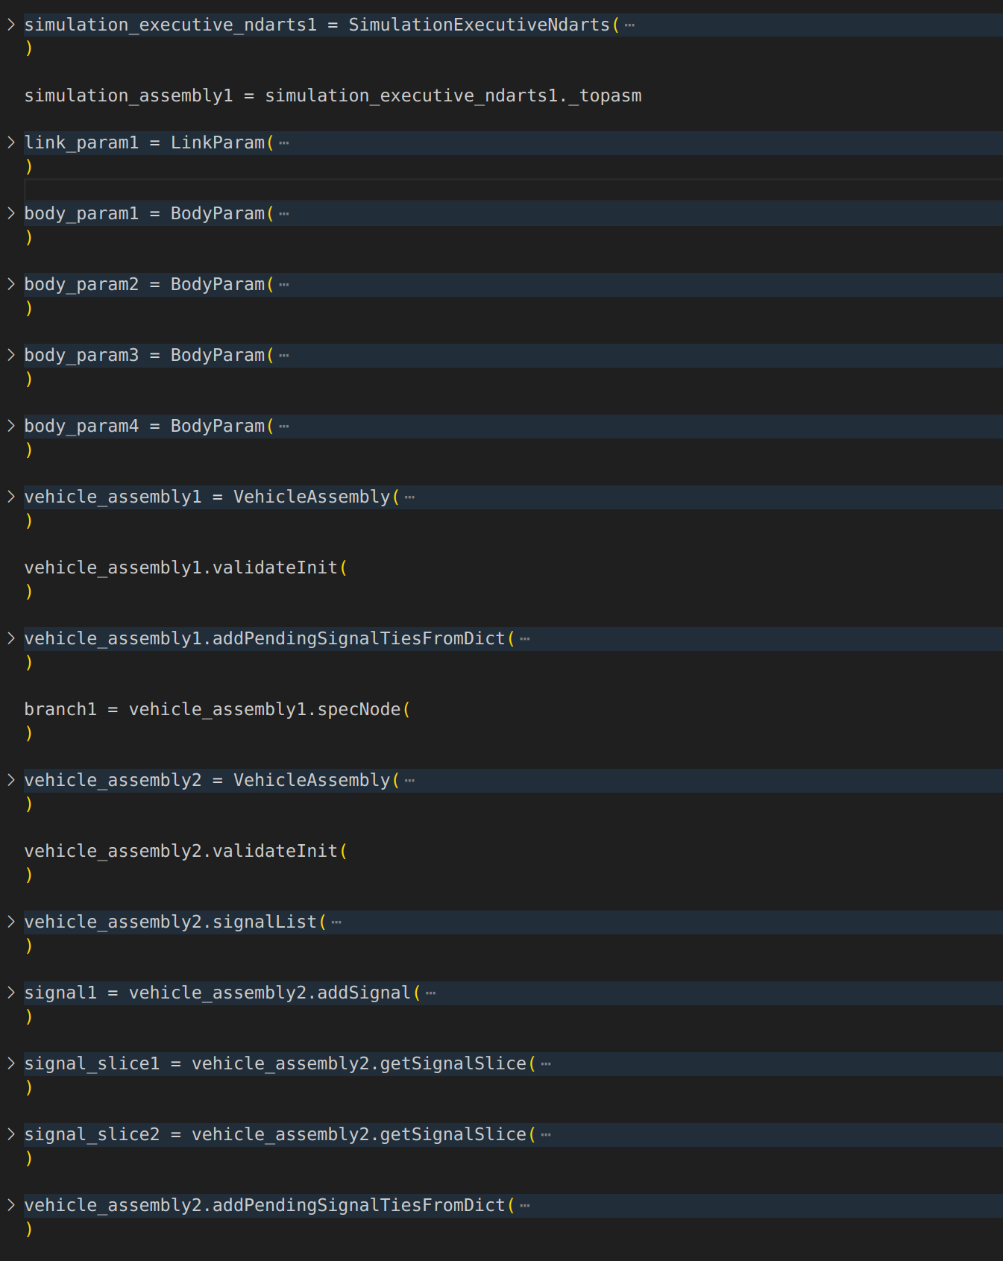
The Problem
Want users to migrate from dict-based assembly creation to procedural function calls. Here we show auto-generated code for the “after” version.

Slide 57
The Solution Process
1. Trace all function calls in assembly creation process
2. Filter function calls (only keep relevant ones)
3. Assign variable names
4. Print function calls

Slide 58
createAssemblies() Function Trace
“Expand” functions that take config dictionary as an argument
i.e. replace AssemblyBuilder functions with procedural calls
Remember: we can use frame.f_code.co_name to get the function name!
SimulationExecutive
createAssemblies()
Assembly
createChildAssemblies()
AssemblyBuilder.py
createAssembliesFromDict()
_createAssembly()
_createNewSignals()
_filterSignalTies()
*this is a little simplified, but should give a decent picture

