Slide 1
Quadcopter Reference Problem Part 4
2023 DARTS Lab Course
Abhinandan Jain, Aaron Gaut, Carl Leake, Vivian Steyert, Tristan Hasseler, Asher Elmland, Juan Garcia Bonilla

Slide 2
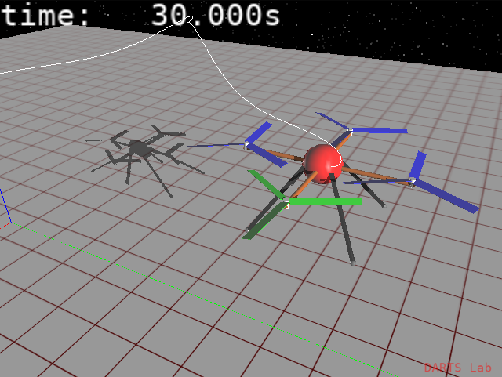
Legs Notebook
(notebook: Quadrotor/11-Legs)
Create a new leg assembly class to add legs to the rotorcraft
2

Slide 3
Adding Terrain to a Simulation
Terrain is needed for vehicle simulations in a variety of domains
Needs include:
  Terrain/vehicle and terrain/tool interaction
  Imager modeling
  Handling of terrain data that is too large to fit in memory
  Variety of sources, formats, resolutions, and data layers
SimScape
3

Slide 4
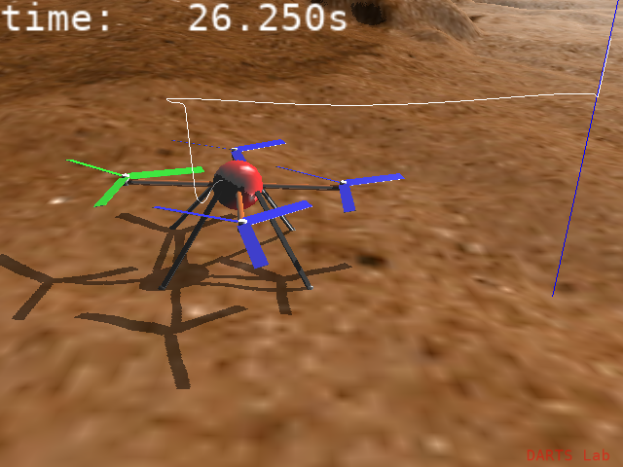
Terrain Notebook
(notebook: Quadrotor/12-Terrain)
Use SimScape to add terrain to the simulation
Land the rotorcraft
4

Slide 5
Improving Graphical Fidelity
How can we improve the rotorcraft's appearance?
DARTS offers choices on a sliding scale between quality and ease of use:
  Stick parts
    Automatic
    Simple but functional
  Primitive parts
    Built using basic shapes
    More control than stick parts
  CAD parts
    Detailed 3D meshes made using external tools
    Harder to modify
We are here
5

Slide 6
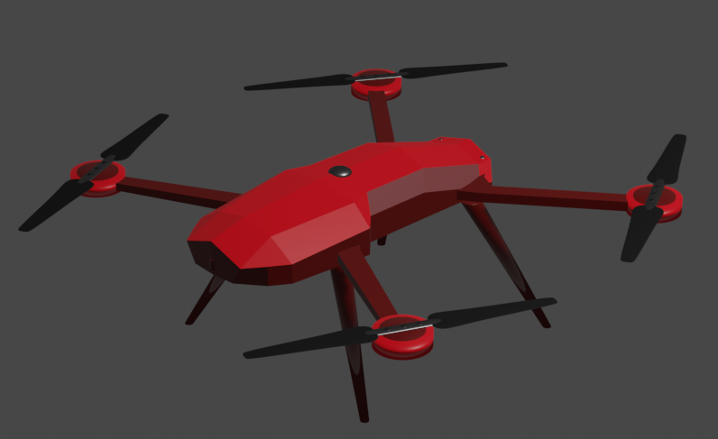
CAD Parts Notebook
(notebook: Quadrotor/13-CAD)
Replace the rotorcraft's primitive graphics objects with 3D CAD meshes created in Blender
6

