Slide 1
Computer Graphics for Engineering Models 2023 DARTS Lab Course
Abhinandan Jain, Aaron Gaut, Carl Leake, Vivian Steyert, Tristan Hasseler, Asher Elmland, Juan Garcia Bonilla

Slide 2
Where does this topic fit in the big picture?
Closed-Loop
Flight s/w
Autonomy/Control
Devices
Thrusters, IMU,
Cameras etc
Environment
Terrain, Gravity
Atmosphere,
Ephemerides etc
Analysis
Data logging
Parametric
Monte Carlo
Sim Manager
propagation, fsm,
events
Dynamics
Rigid/flex bodies
Articulation
Attach/detach etc
Geometry
CAD parts
Primitives
Visualization
3D graphics
stripcharts
Usability
Introspection
CLI, GUIs, Scripting
Docs, Training
Knowledge base
Evolution
R&D, new applications
new tools & capabilities
Deployment
Bundling
Porting
Issue tracking
S/W Mgmt
Version control
Build system
Test suite
Reusability
Architecture
Configurability
Refactoring

Slide 3
Ground vehicle component assemblies
Scenario
SunPosition
Environment
Gravity
link 1
…
Locomotion
Software
link n
Navigation
Vehicle1
Hardware
Arm
link 1
…
Vehicle2
link n
Chassis
Mast
Left
Wheels
Suspension
Sensors
wheel 1
…
wheel n
Cameras
…
Right
IMU
SunSensor
Contact
Motors
Front
Nav

Slide 4
Motivation

Slide 5
Motivation
Provide engineering simulation
Perception systems
mobility, obstacle detection, path planning
landing
camera/lidar sensor modeling
Non-ideal configurations (noise, distortion, etc)
Solar radiation pressure modeling
Solar panel exposure modeling

Slide 6
Geometry Processing Needs
Meeting simulation needs can involve multiple geometry engines using the geometry model data
visualization, playback, camera/lidar sensor modeling
3D Graphics
position & orientation updates from sim
collision detection, landing, mobility, comm. modeling, obstacle detection, path planning
Computational
geometry
Geometry
sensor modeling, high-end rendering
Raytracing
etc.

Slide 7
Geometry Processing Engines
There are multiple of geometry engine providers with varying functionality and APIs.
OpenGL, Ogre3D, Coin3D, OpenInventor, OpenSceneGraph …
3D Graphics
position & orientation updates from sim
Computational
geometry
Bullet, FCL, PQP, ANN …
Geometry
Raytracing
Blender, Optix, Maya …
etc.

Slide 8
Visualization vs Sensor Modeling
Visualization and camera modeling overlap in significant ways
Need sensors other than mon-RGB cameras
stereo cameras, lidar, radar, etc
Visualization needs:
Fast, interactive renderings to a user (with a window)
Helpful debug information (trails, boxes, text, frustums, etc
Sensor modeling needs
Specific model implementations (may need to be high fidelity)
Camera: non-ideal lens models
Lidar: different lighting and material properties/parameters

Slide 9
Engineering Simulation and Analysis

Slide 10
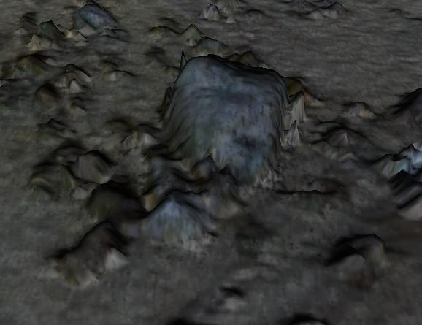
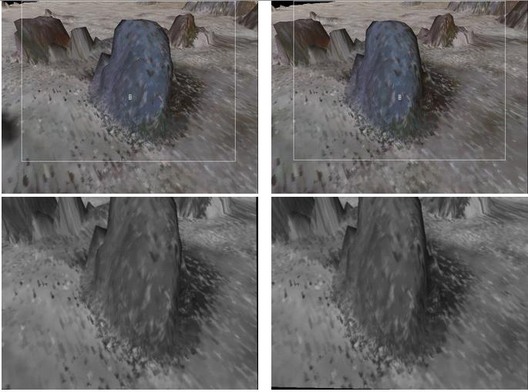
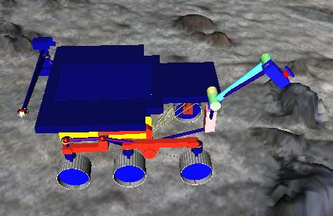
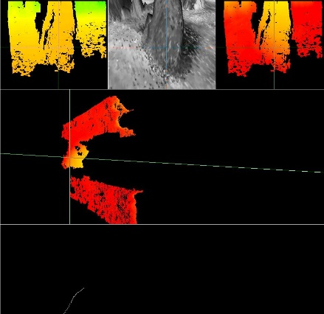
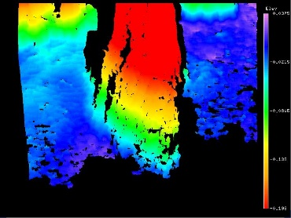
Synthetic Generation of Camera Stereo Pair Images
Terrain Model
ROAMS
Simulated stereo image pair
Camera models
Stereo processing
Uses CAHVORE camera model parameters: different locations of cameras, non-aligned optical axes, off-center optical axes etc., radial distortion in next phase.
Stereo software successfully extracts range map from images.
Range & Elevation maps
distance
height
Enables testing of navigation and stereo in the loop for rover mobility and instrument placement scenarios

Slide 11
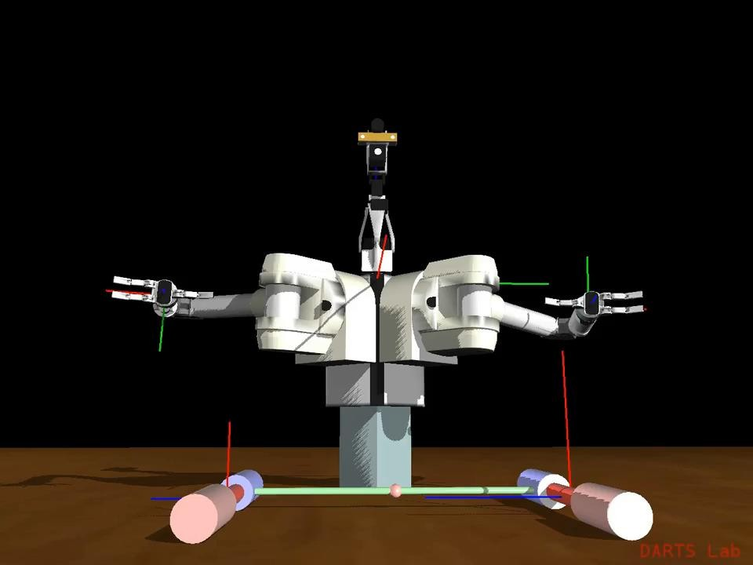
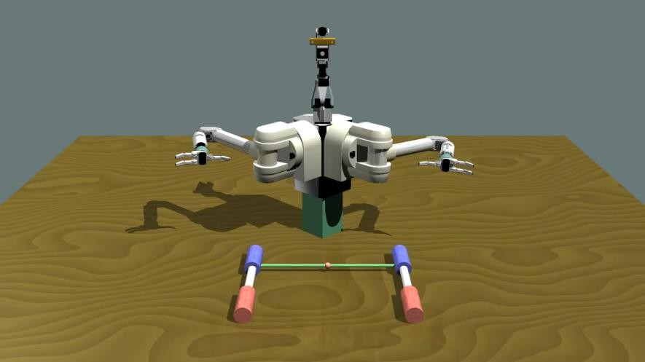
Improving visual fidelity
Projects are starting to want higher fidelity camera renders to feed into perception algorithms.
Figure 2: High quality Blender renderer. Ray-traced backends like Blender and Optix are capable of higher fidelity than our OpenGL renderer.
Figure 1: Standard OpenGL renderer used by our camera models.
Goal: Generalize camera models to work with any renderer

Slide 12
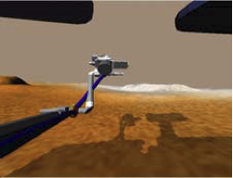
CAHVORE Camera Modeling
The Dshell++ camera models simulate radial and fish-eye distortion in camera lenses and make use of Dspace's offscreen rendering capability as part of the camera modeling process, to achieve real-time performance when operating with the simulation in a closed-loop mode.

Slide 13
Lidar simulation

Slide 14
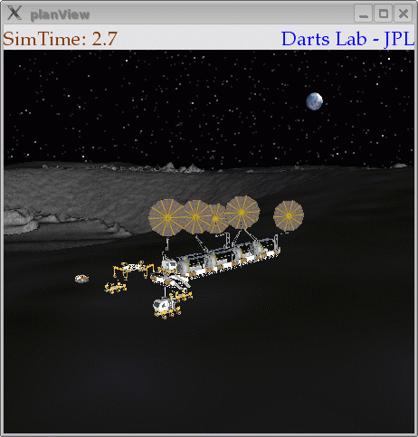
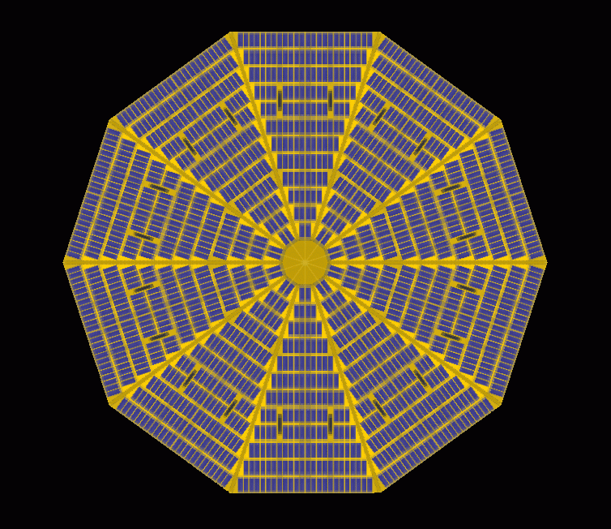
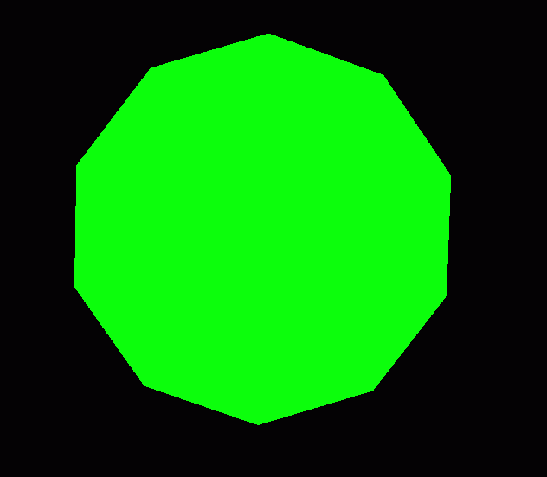
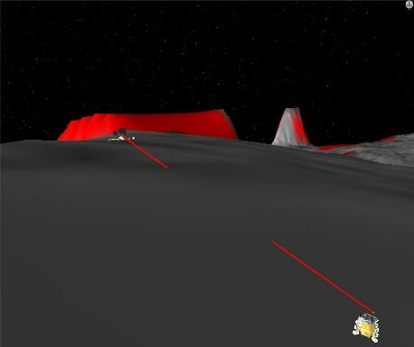
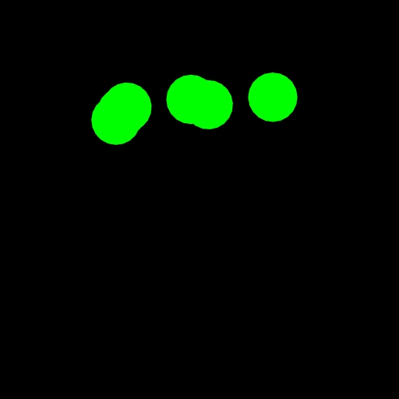
Engineering Analysis
Dspace’s rendering engine can be used to perform compute intensive operations such as vehicle camera modeling, horizon scan, line of sight computation and solar array power analysis

Slide 15
OptixScene for sensor modeling with reconfigurable pipeline
Using real-time ray/path tracing DARTS/IRIS engine
IRIS supports perception sensor simulation for in-the-loop autonomy development and testing
But can also be used for rendering/visualization
IRIS has a configurable sensing pipeline
GPU/CUDA hardware accelerated ray tracing
Full control over
Ray definitions
Ray generation and tracing
Material and lighting functions
Action Graph
Raytracing
Filter
Graph
Actions to set up scene geometry & update materials
Rendering
Filters perform arbitrary logic on data buffer

Slide 16
OptixScene reconfigurable pipeline: camera example
Raytracing
builds upon NVIDIA’s Optix CUDA based,
GPU-accelerated backward ray-tracing engine
Configurable Optix pipeline
Action Graph
Filter
Graph
Action Graph
(Scene Updates)
Filter Graph
(Image Modification)
Raytrace Render
scene
image
Noise
Vignette
Optix Build
Jitter Accumulate
Access Filter
Clipmap Update
Lens Distortion
Hapke Model
Output
DEM
CAHVORE
Parameters
Material
Properties
Noise
Parameters
Output
Sensor
Image

Slide 17
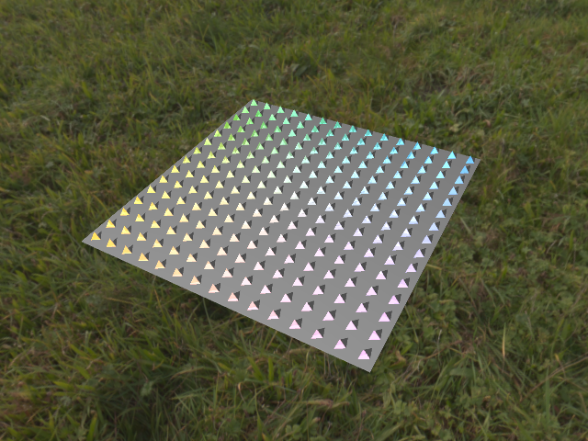
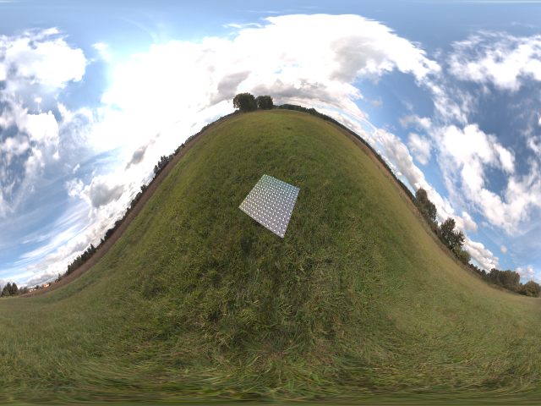
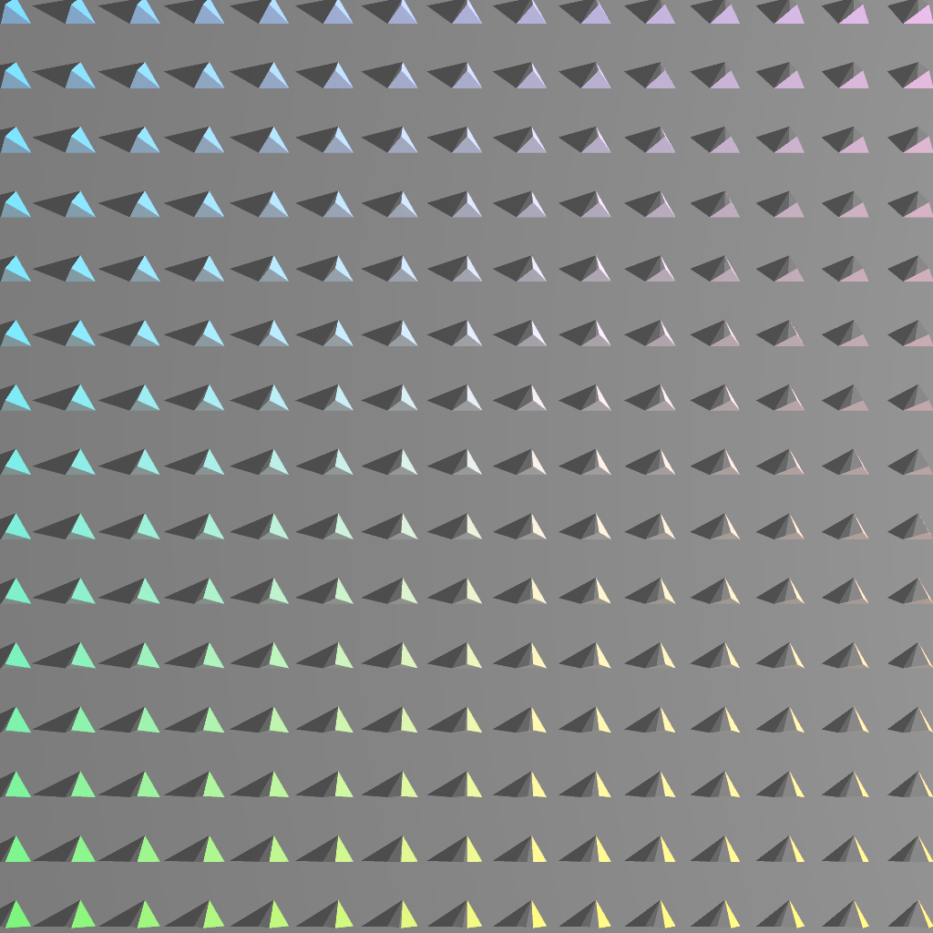
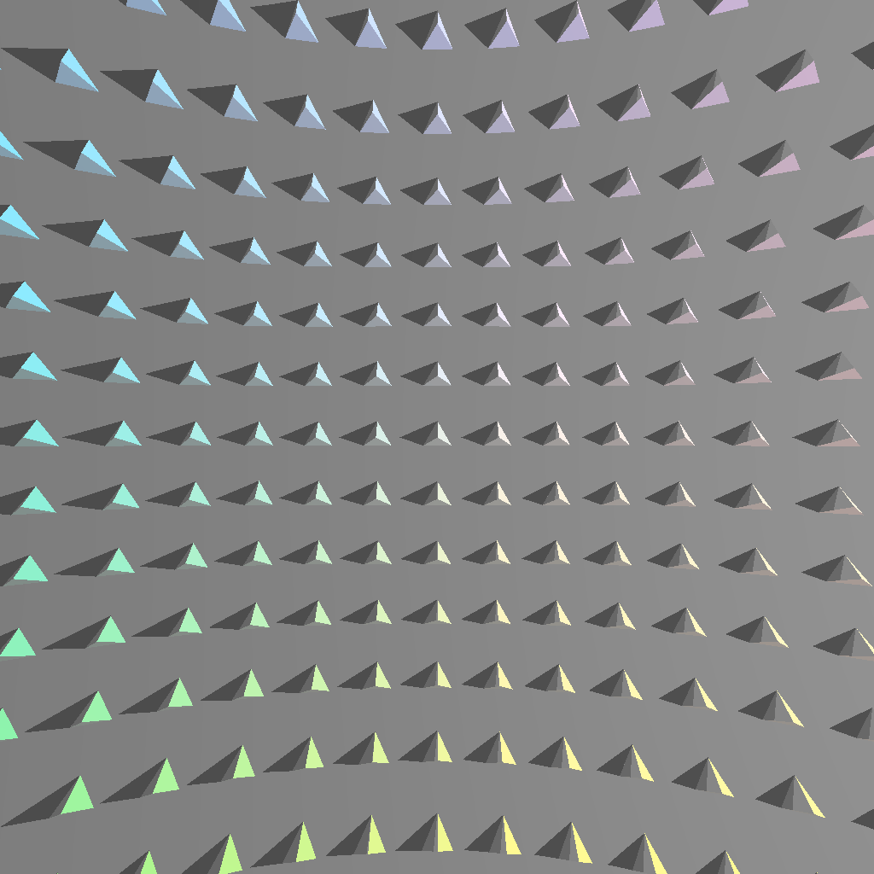
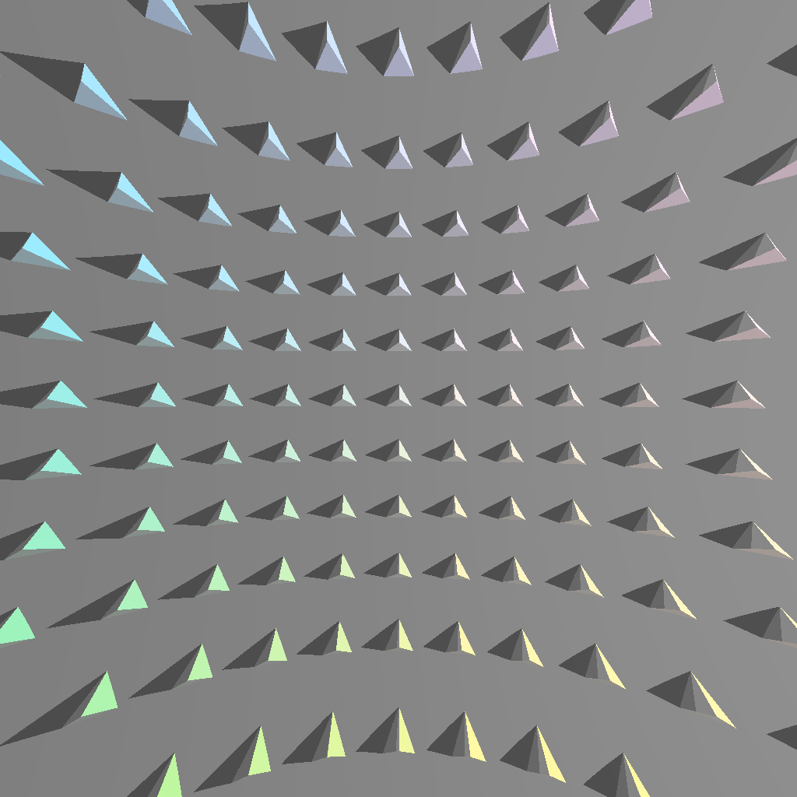
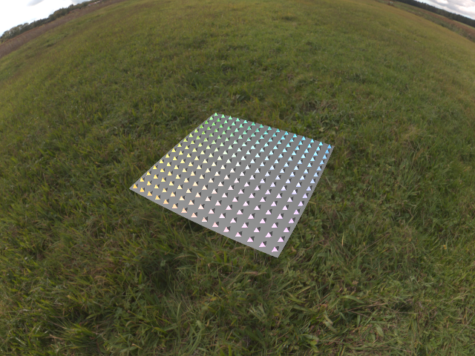
Camera Sensor Lens Models
Camera
Adjustable Lens Model
Pinhole, Fisheye, Spherical, CAHV(OR(E))
Jitter/Anti-Aliasing
Lens model implemented via ray distortion on GPU
Pinhole
CAHV
CAHVOR
CAHVORE
Spherical
FishEye

Slide 18
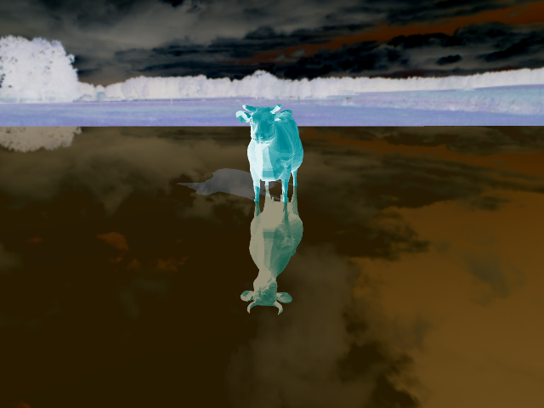
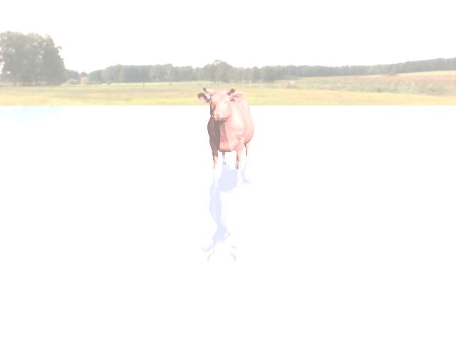
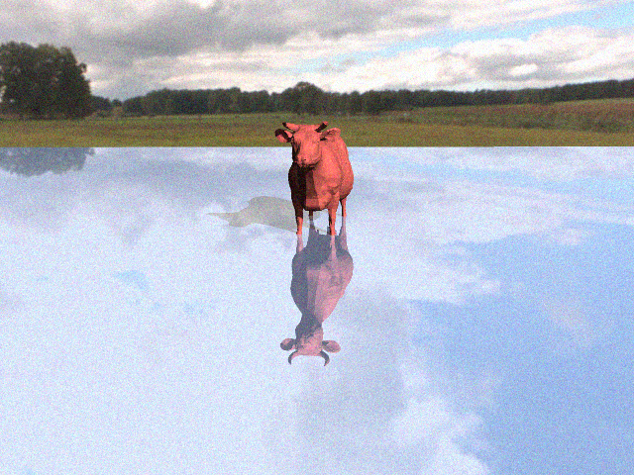
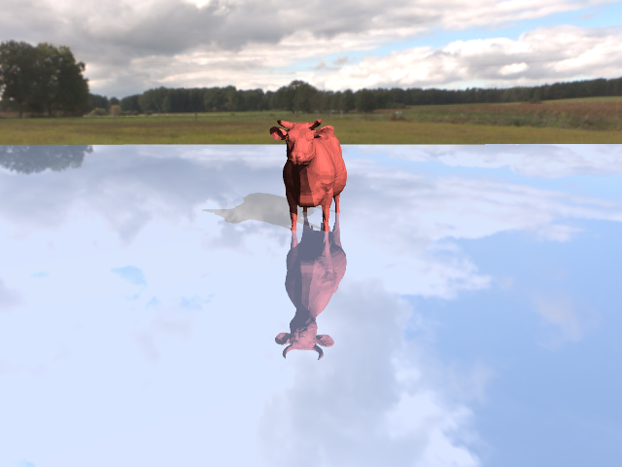
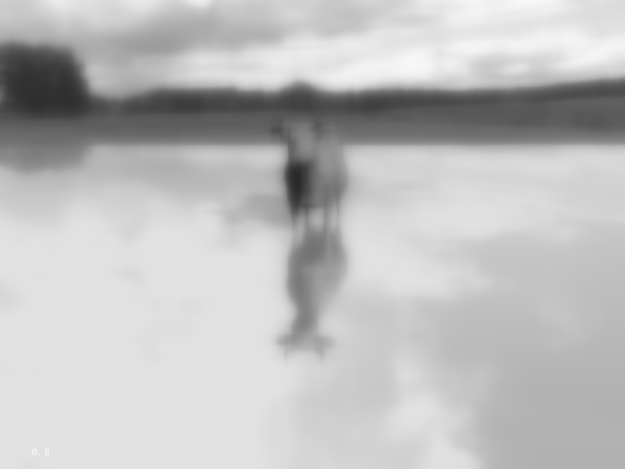
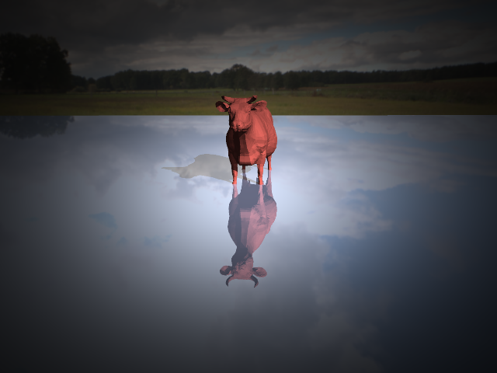
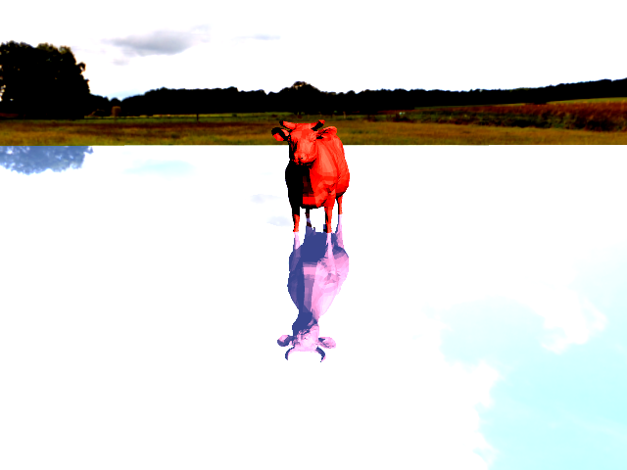
Supported Camera Effect Filters
Negative
Brightness
Gaussian noise
Original
Gaussian blur + grayscale
Vignette
Contrast

Slide 19
LIDAR Sensor Models
Models supported:
Uniform grid of beams specified based on :
Horizontal/Vertical FOV
Resolution (Number of Horizontal/Vertical Layers)
User-defined array of beams:
each with an arbitrary source and direction in the sensor frame
Shaders supported:
Diffuse
Distance
Lidar attached to descent vehicle
Point cloud overlaid onto camera output
Point cloud colored by distance overlaid on terrain

Slide 20
Solar Radiation Pressure Model
Compute force and moment on spacecraft due to radiation
Ray traced model
Leverages geometry and the scene
Uses rays to sample the incident radiation on the spacecraft
Calculates force from material properties
Includes shadowing effects
spacecraft
Solar radiation

Slide 21
Cameras exposed to simulation through Dshell
Legacy Model
New Model
CamImageSynthAltModel
OptixCahvoreCameraModel
CameraImage
DOptixCamera
DspaceOgreOffscreenRenderer
DOptixCamera
dsOffscreenViewport
Dshell
Renderer

Slide 22
Lidar exposed to simulation through Dshell ​
Instantiate via OptixLidarAssembly
Configures model, context, parameters
OptixLIDARModel deals with frequency and connections in simulation
Multirate model
Creates a DOptixLidarSensor to generate point cloud from the scene
Lidar Dshell Model
OptixLidarAssembly
OptixLIDARModel
DOptixLidarBeamsCustomSensor

Slide 23
SRP exposed to simulation through Dshell
Instantiate via OptixSRPAssembly
Configures model, context, parameters
SRP is an actuator
Applies force/moment to body
Creates a DOptixSRPSensor to calculate force and moment from radiation
SRP Dshell Model
OptixSRPAssembly
OptixSRPModel (actuator)
DOptixSRPSensor

Slide 24
Wrap up
Graphics not just for visualization
Primarily leverage OptixScene
These problems map well to ray tracing
Supported in Dshell
Cameras (mono and stereo)
Lidar (custom configurations)
SRP (actuator)
Flexible pipeline for modeling new sensors and needs
e.g. can support time-evolution during ray tracing

