Slide 1
Quadcopter Reference Problem Part 3
2023 DARTS Lab Course
Abhinandan Jain, Aaron Gaut, Carl Leake, Vivian Steyert, Tristan Hasseler, Asher Elmland, Juan Garcia Bonilla

Slide 2
Goal: Build a vehicle simulator
Control
Software
Dynamics is only a part of the overall simulator
Also need to model actuator/sensor devices and environment interactions
These other models are tightly coupled with the dynamics module
Multibody
Actuators
Sensors
How we manage the interfaces between the dynamics and device models has a crucial impact on sim brittleness and scalability.

Slide 3
Quadcopter Models & Data Flows
Vehicle dynamics, devices, environment and controller in closed loop
Gravity
model
desired rotor speed
Thrust, Encoder,
Controller
cmd
Rotor 1
Multibody
model
Flight
Controller
Thrust, Encoder,
Controller
Rotor 2
Fuselage
Rotor 3
Thrust, Encoder,
Controller
Rotor 4
Thrust, Encoder,
Controller
fuselage
state
rotor speed and torque
State
sensor

Slide 4
Multibody-Centric Design Pattern
Multibody dynamics is complex and involves specialized skills
The dynamics model and solver are traditionally a black box for the simulator
The multibody-centric approach thus builds the central dynamics as a monolithic black box
Device etc models are built separately and integrated with the multibody dynamics
Close the loop with the flight/control software
Control
Software
Multibody
Actuators
Sensors
Artificial divide, in spite of tight coupling, makes the interfaces between the dynamics and device physics complex!

Slide 5
Problems with this Approach
Adding a rotor, landing leg, camera requires simultaneous changes to the monolithic multibody model, and its complex interfaces to accommodate the new device models
  Easy to get this wrong
  The simulator design is brittle and accommodating changes and extensions is difficult
Design brittleness arises from the monolithic multibody model from the multibody-centric design pattern
5

Slide 6
Simulation Complexity
Project | Frames | Dvars | Bodies | Models | Signals | Assemblies
Quadcopter | 33 | 2480 | 5 | 20 | 62 | 21
Mars Heli | 112 | 13000 | 22 | 32 | 76 | 21
Rocky8 | 157 | 21750 | 23 | 96 | 294 | 94
HMMWV | 265 | 24115 | 36 | 34 | 92 | 34
Athlete | 250 | 34649 | 43 | 176 | 586 | 182
RoboSimian | 301 | 71310 | 69 | 167 | 341 | 249
Dual-Arm | 508 | 11858 | 41 | - | - | -
ISS Jettison | 64 | 7147 | 4 | 30 | 123 | 28
SLS | 274 | 23230 | 41 | 110 | 614 | 103
PERA | 114 | 6625 | 7 | 46 | 171 | 52
Orion | 251 | 18724 | 32 | 99 | 564 | 118
Mars 2020 | 190 | 32326 | 23 | 60 | 107 | 55
6

Slide 7
Multibody-Centric Design Pattern
Issues with the multibody-centric design pattern
  Artificial separation between dynamics and device physics models is at odds with the tight coupling between them!
  Treats data and methods as separate entities
  Requires lots of cross coupling and use of global data structures to manage interfaces
  Structural changes in one place have ripple effect of multiple changes in other places
  Difficult to scale up the design
  Complexity growth can box you in!
  Very difficult for anybody but original developers to reuse component models
Dshell uses a different design pattern – that does away with the monolithic multibody model
7

Slide 8
Subsystem-Centric Design Pattern
Ndarts allows multibody model to be built up incrementally and in a distributed way
The multibody model is an emergent model from building sub-systems
Does away with complex booking and interfaces with device models
Control
Software
DARTS
Actuators
Sensors
At creation, each device model is provided the node/hinge object it needs – so no explicit global interface is needed.

Slide 9
Use assemblies to create all components of a subsystem
Build up simulations via a hierarchy of assemblies.
Gravity
model
desired rotor speed
Thrust, Encoder
Controller
Rotor assembly
cmd
Rotor 1
Multibody
model
Flight
Controller
Thrust, Encoder
Controller
Rotor 2
Fuselage
Thrust, Encoder
Controller
Rotor 3
Rotor 4
Thrust, Encoder
Controller
fuselage
state
State
sensor
rotor speed and torque

Slide 10
Single rotor assembly details
A rotor assembly includes a rotor body with a node, coupled to encoder, controller, motor models and thrust model
Rotor body
thrust
thrust
torque
speed
encoder
speed
controller
volt
motor
desired speed
(from flight controller)

Slide 11
Quadcopter assembly hierarchy
Flight
controller
Gravity
Motor
Rotorcraft
Rotor 1
Thrust
Motor
Fuselage
Rotor 2
Assembly containment hierarchy
Thrust
Motor
Rotor 3
Thrust
Rotor 4
Motor
Each rotor assembly creates its body, nodes etc
Assemblies are objects, so can have multiple instances
Thrust

Slide 12
Emergent mechanism & dataflow
Assembly hierarchy
Asm2
Asm4
Factory creating dataflow and multibody models
Asm1
Asm3
Asm5
Construction
Run-time
mdl2
mdl3
bd1
bd3
mdl1
mdl4
mdl5
bd2
Emergent multibody model
Emergent model dataflow

Slide 13
Why sub-system centric design pattern?
The multibody model is not a monolithic module that we explicitly build!
  Built incrementally by the yard
Device models that interact with dynamics have narrow access to the node or hinge they need
  Minimizes coupling and interfaces
  Device models do not know or care about other aspects of the multibody model
Modular and decoupled design
Much easier to modify and scale up
13

Slide 14
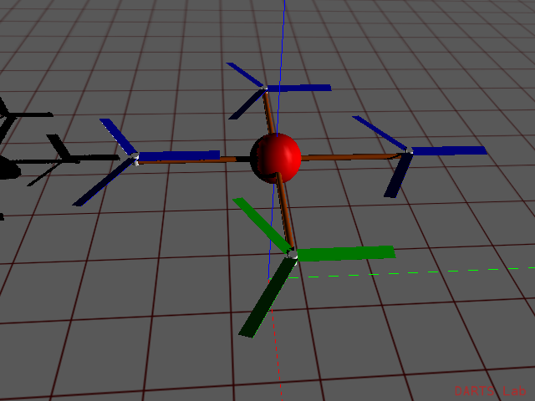
Classes Notebook
(notebook: Quadrotor/06-Classes)
Refactor quadrotor sim using a subsystem centric design
14

Slide 15
Reusability and tooling
A core goal of DARTS/Dshell is reusability of assemblies across a variety of simulations
Want to have tooling that can operate on any assembly
Need a common style and interface to enable reusability and tooling
  Solution: the Dshell Assembly class, which all assemblies are derived from.
15

Slide 16
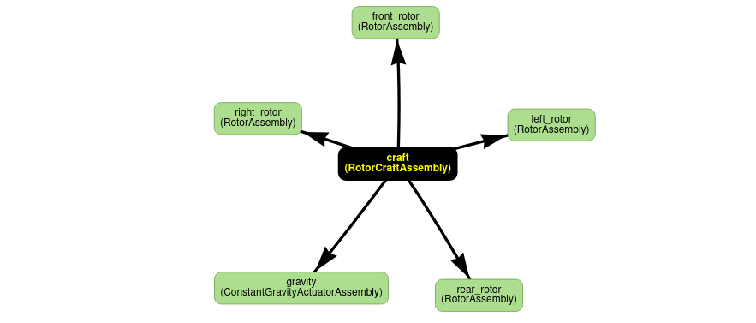
Assembly Notebook
(notebook: Quadrotor/07-Assembly)
Refactoring the previous notebook to use proper Dshell Assemblies.
16

Slide 17
Component Dataflow
So far, component modeling has been done using methods of assemblies
Some problems:
Dependencies between components can get complicated, especially if they are across assemblies
Component models may need to be updated at different parts of a simulation step
The model evaluation occurs in Python
Dshell Models are our solution
17

Slide 18
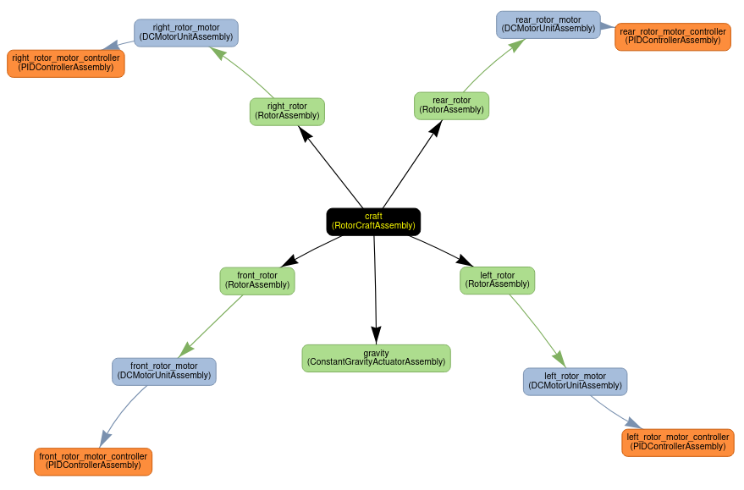
Models Notebook
(notebook: Quadrotor/08-Model)
Refactor the previous assembly notebook to use C++ level Dshell Models instead of Python functions
18

Slide 19
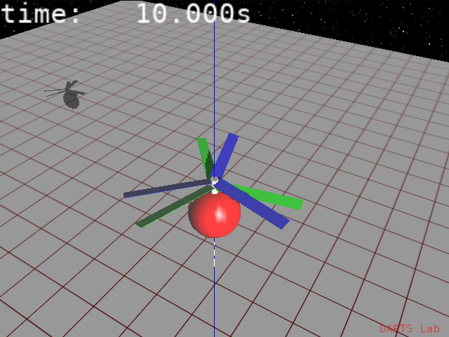
Configuration Change Notebook
(notebook: Quadrotor/09-Config_change)
Now that we are using a subsystem centric design, configuration changes are much easier
Notebook: convert the quadrotor simulation to a coaxial helicopter
Imagine the steps required to do this with a multibody centric design.
19

Slide 20
Advanced Simulation Scheduling
So far we have been stepping the sim uniformly at a fixed rate
Sometimes there is a need for more advanced scheduling:
  Models that update irregularly or at a rate different from the rest of the sim (multirate models)
  Events that must occur exactly when a condition is met, even if it’s between steps (step validation)
20

Slide 21
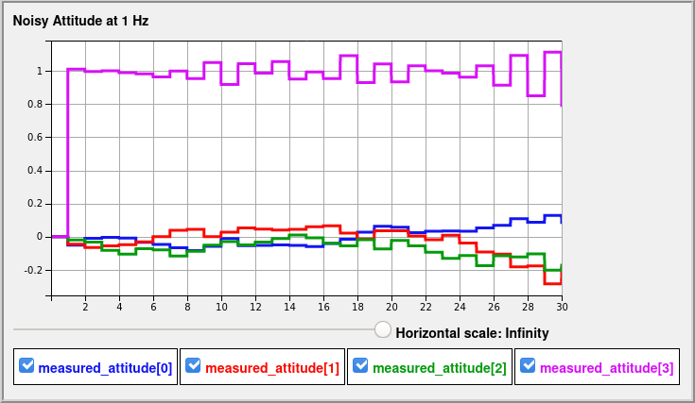
Advanced Scheduling Notebook
(notebook: Quadrotor/10-Multirate)
Exercising advanced time stepping functionality:
  Add a sensor model that updates at 1 Hz
  Cut off rotors for landing at a precise altitude
21

