Slide 1
Dshell Architecture Overview
Abhinandan Jain, Aaron Gaut, Carl Leake, Vivian Steyert, Tristan Hasseler, Asher Elmland, Juan Garcia Bonilla

Slide 2
DARTS Lab Simulation World
Closed-Loop
Flight s/w
Autonomy/Control
Devices
Thrusters, IMU,
Cameras etc
Environment
Terrain, Gravity
Atmosphere,
Ephemerides etc
Analysis
Data logging
Parametric
Monte Carlo
Sim Manager
propagation, fsm,
events
Dynamics
Rigid/flex bodies
Articulation
Attach/detach etc
Geometry
CAD parts
Primitives
Visualization
3D graphics
stripcharts
Usability
Introspection
CLI, GUIs, Scripting
Docs, Training
Knowledge base
Evolution
R&D, new applications
new tools & capabilities
Model and Services
Deployment
Bundling
Porting
Issue tracking
S/W Mgmt
Version control
Build system
Test suite
Reusability
Architecture
Configurability
Refactoring
Architecture

Slide 3
Goal: Build a vehicle simulator
Control
Software
Dynamics is only a part of the overall simulator
Also need to model actuator/sensor devices and environment interactions
These other models are tightly coupled with the dynamics module
Multibody
Actuators
Sensors
How we manage the interfaces between the dynamics and device models has a crucial impact on sim brittleness and scalability.

Slide 4
Simulation Scaling Challenge
Project | Frames | Dvars | Bodies | Models | Signals | Assemblies
Quadcopter | 33 | 2480 | 5 | 20 | 62 | 21
Mars Heli | 112 | 13000 | 22 | 32 | 76 | 21
Rocky8 | 157 | 21750 | 23 | 96 | 294 | 94
HMMWV | 265 | 24115 | 36 | 34 | 92 | 34
Athlete | 250 | 34649 | 43 | 176 | 586 | 182
RoboSimian | 301 | 71310 | 69 | 167 | 341 | 249
Dual-Arm | 508 | 11858 | 41 | - | - | -
ARTEMIS I

Slide 5
Context
We have seen some of the key pieces, eg. DARTS needed for the modeling physics of complex vehicle dynamics
Even with these in hand, additional challenges remain for building and using heavy-hitting real-life engineering simulations
  Need non-brittle, evolvable/pliable design
  Support for multiple vehicle/testbed configurations
  Reusable across testbeds, projects and domains
  Auditable/traceable implementation for reviews and V&V
  Usable by non-developers

Slide 6
Dshell Framework

Slide 7
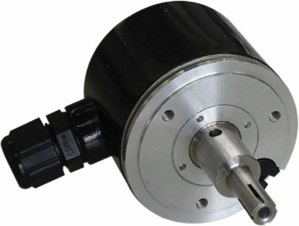
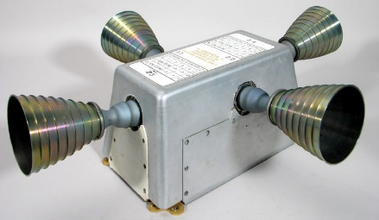
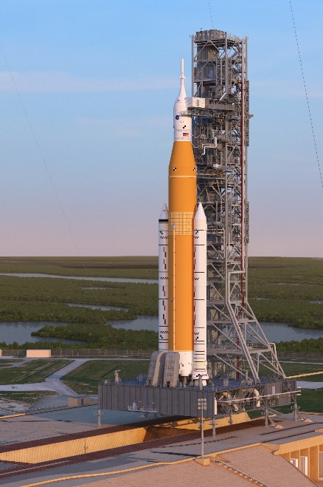
DARTS/Dshell Architecture Goals
Support modeling a wide range of systems in a variety of domains
  Library of reusable subsystem models
    Single device models (eg, encoder)
    Multi-part subsystem models (set of thrusters)
  Simple to assemble available subsystem models into a full system model
  Straight-forward to adapt/create new domain-specific subsystem models
Manage simulation complexity

Slide 8
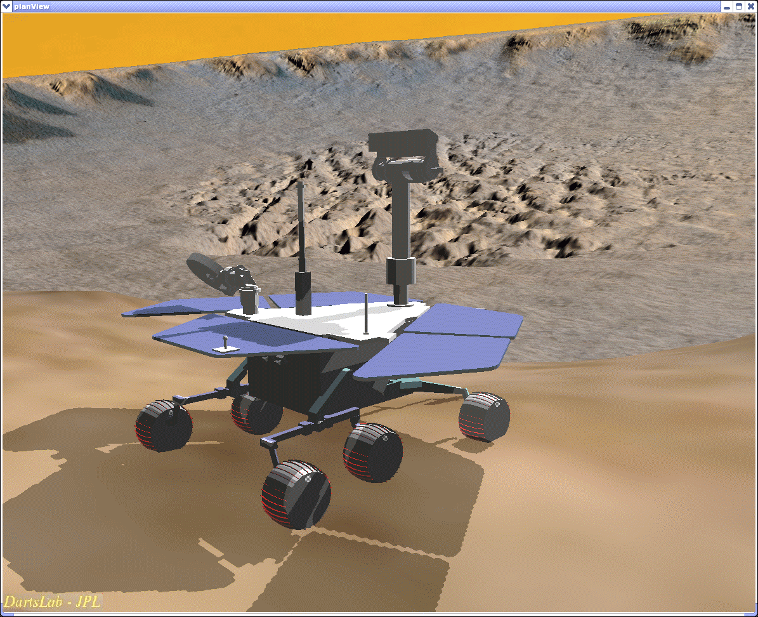
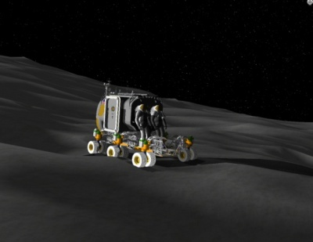
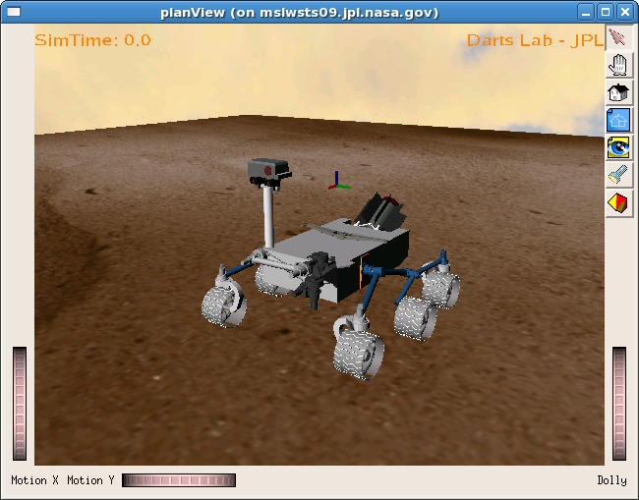
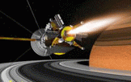

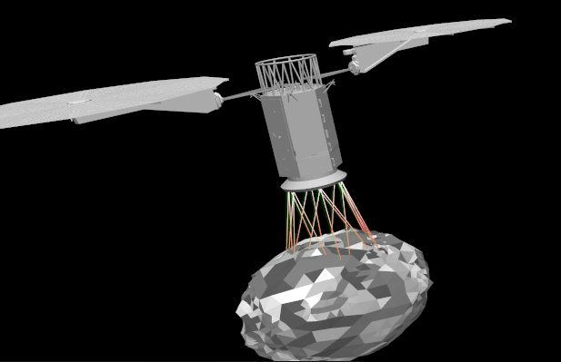
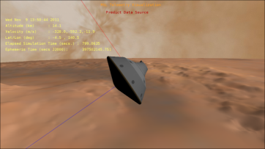
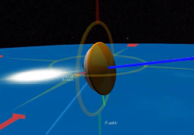
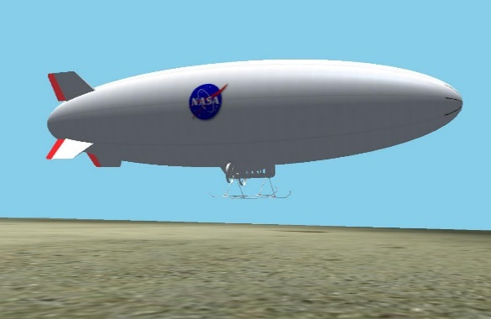
Vehicle Simulation Examples
Rovers
Spacecraft
Aerial

Slide 9
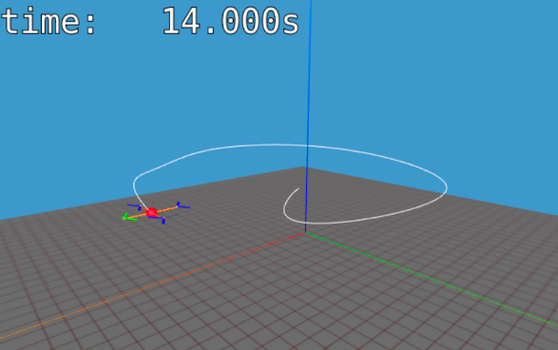
Notebook: Quadcopter Simulation
E-Dshell/01_Intro_Quadcopter

Slide 10
Simulations
Simulations CONTAIN:
Vehicle model(s)
  Multibody system, frames, graphics
  Device models, data flows
  “Black board” for data access (DVar)
Sequencing/state machine (FSM)
Event manager
Integrator
Simulations DO:
Time stepping (integration)
Handles events, FSM, logging
Introspection support (DVars, gui)
Multibody
System
Models &
Data Flows
Sub-system
assemblies
Sequencing
State-Machine
Event
Manager

Slide 11
Dshell Models and Dataflow

Slide 12
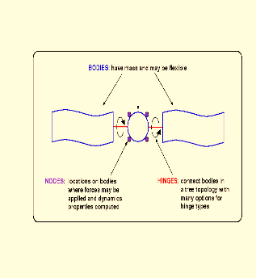
Typical Spacecraft Simulation
Control
Software
Multibody has the kinematic, dynamic state of all bodies in simulation
  Large articulations
  Many degrees of freedom
  Rigid & flexible bodies
Component models of devices which interact with the Multibody or model other processes
  Multibody interfaces with sensor/actuator component models to apply forces/torques, extract positions, velocities, etc.
Closing the loop with software
Integrator/time propagator
DARTS
Actuators
Sensors
Hardware bodies
Component Models
Overall
System Model

Slide 13
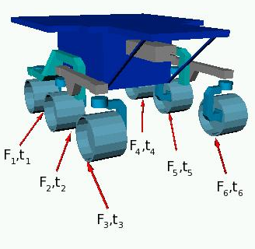
Key Existing Dshell Models
Wide range of reusable Dshell component models
  Many application areas
    spacecraft, rovers, ground vehicles, robotics, EDL, aircraft, etc
  Range of computational complexity
    Simple (encoders)
    Computationally complex
    (cameras, terra-mechanics, aero dynamics)
  Variations for different fidelity
  (eg. thrusters, gravity)
  Class hierarchies
Users can start using the existing models and assemblies right away
Create custom models to match specialized hardware
More info about existing models, etc, in next session

Slide 14
Quadcopter Models & Data Flows
Vehicle dynamics, devices, environment and controller in closed loop
Gravity
model
desired rotor speed
Thrust, Encoder,
Controller
cmd
Rotor 1
Multibody
model
Flight
Controller
Thrust, Encoder,
Controller
Rotor 2
Fuselage
Rotor 3
Thrust, Encoder,
Controller
Rotor 4
Thrust, Encoder,
Controller
fuselage
state
rotor speed and torque
State
sensor

Slide 15
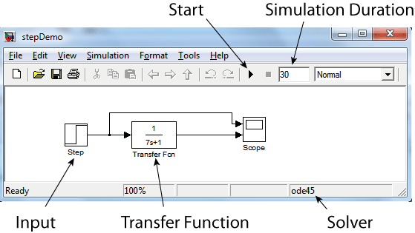
Parallels with Simulink
Similar components based approach
  Both use dataflows
  Darts/Dshell predates Simulink
Key difference is the presence of the multibody dynamics block
  Computationally complex
  Has interfaces to most of the models (many signal lines in and out)
  Interfaces depends on the specific mechanism and other models in the sim
  Treat it as a foundational model available to all the other components
  Not built into Matlab/Simulink
Image by By Thomas Haslwanter
[CC BY-SA 3.0], via Wikimedia Commons

Slide 16
Dshell Assemblies
(subsystems)

Slide 17
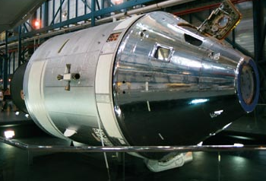
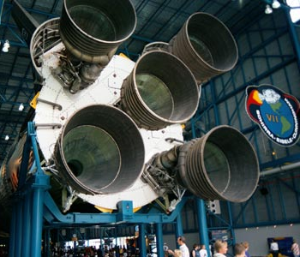
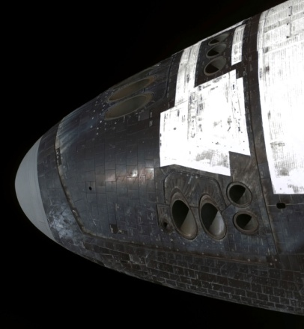
Recurring subsystems in spacecraft
Generic Thruster Subsystem
Similar Thruster Subsystems:
Similar functions/topology
Differing parameters
Spacecraft chassis body
Fuel Tank
Goal:
Create reusable “assemblies” to model generic subsystems
Fuel Lines +
pump + valving
Thruster

Slide 18
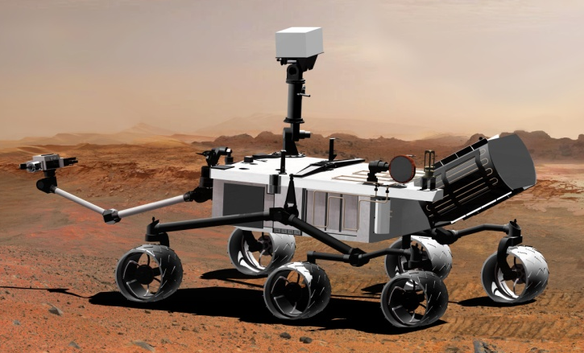
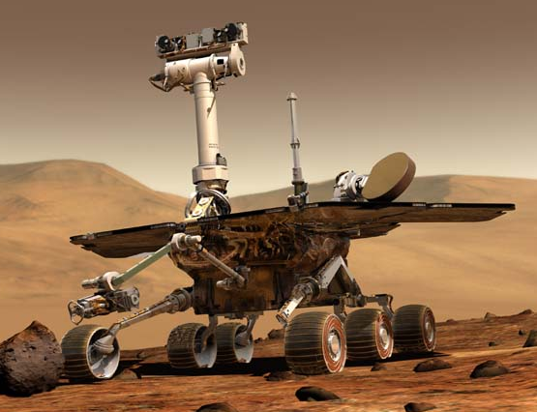
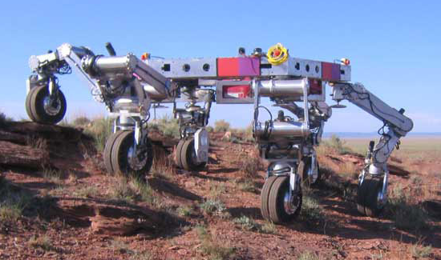
Recurring subsystems in robotic ground vehicles
Generic Wheel Subsystem
Similar Wheel Subsystems:
Similar function/topology
Differing parameters
Parent body
Steer motor + encoder
“Ankle” Body
Goal:
Create reusable “assemblies” to model generic subsystems
Wheel drive motor + encoder
Wheel

Slide 19
How to Assemble a Simulation Model
The full simulation model involves many components that need to be created and assembled correctly in order to faithfully model the system
We need a way to assemble the simulation efficiently, take advantage of reusable components/subsystems, and avoid complications of creating everything from scratch each time
We have “templates” for building subsystems, called “Assemblies”
➔ We need “Assemblies!”
System Description
Follow Recipe
Live System Model

Slide 20
What is an “Assembly”?
An Assembly is a template for creating a set of signals, models, and sub-assemblies to implement a subsystem
  Each Assembly class is usually a Python class that constructs the desired subsystem using data to customize it
    Topology (eg, number of components) ← “config”
    How it relates to the rest of the simulation ← “context”
    Parameterization ← “params”
  Based on an underlying C++ class for basics
    such as tracking signals created by the assembly
  Primary use in construction phase to construct
  the multibody, models, and dataflow
    Runtime is all in C++ for speed (unless python
    functions are used at runtime, eg for events)
  More details about Assemblies in a later session
Multibody
System
Models
& Data Flows

Slide 21
Approaches to Building Simulations
“Pre-fab” approach (baked-in)
  Use an Assembly that creates all of its application-specific children
  Assemblies usually do this for their children
Assembly builder approach (data driven)
  Provide a ‘config’ dictionary to the AssemblyBuilder to create all specified assemblies, etc
Hybrid (typical approach)
  Use combination of above approaches
    Run scripts often use Pre-fab assemblies as sub-assemblies for the “AssemblyBuilder”
Python script
Instance pre-written Assembly to create the sim
Python script
dictionary with describing assemblies to create
AssemblyBuilder digests dictionary and creates the sim

Slide 22
Relationship between assemblies, Dshell models & multibody
Assembly hierarchy
Asm2
Asm4
Factory creating dataflow and multibody models
Asm1
Asm3
Asm5
Construction
Run-time
mdl2
mdl3
bd1
bd3
mdl1
mdl4
mdl5
bd2
Emergent multibody model
Emergent model dataflow

Slide 23
Running Simulations

Slide 24
Simulation Manager – Building Sim
SimulationExecutiveRoams
Create simulation executive (manager)
Select/prepare integrator
Create assemblies (which will create models, bodies, etc)
  Apply parameters for multibody, models, assemblies
Set up graphics
Set initial states
Set up simulation runtime logic (events, FSMs)
Set up logging
Execute simulation (step time)
SimulationExecutiveNdarts
Python
C++
Simulation
integrators, multibody, frames, DVar containers, time keeper, scheduler, creates masking I/F, dgui, etc

Slide 25
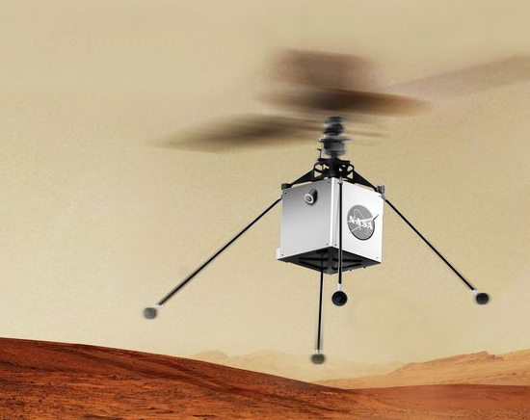
Ways to run a simulation
EDL, Spacecraft
  Run user-created scripts
  Highly customizable
Roams, Helicat
  Dedicated application-specific software, specialized simulation manager, GUI
  No run script
  Limited options for different configurations

Slide 26
Notebook: Quadcopter Simulation
E-Dshell/Part-1-Architecture/01-Intro-Quadcopter
Point out bodies graph, models, and dataflows
Vehicle dynamics, devices, environment and controller in closed loop
Gravity
model
desired rotor speed
Thrust, Encoder,
Controller
cmd
Rotor 1
Multibody
model
Flight
Controller
Thrust, Encoder,
Controller
Rotor 2
Fuselage
Thrust, Encoder,
Controller
Rotor 3
Rotor 4
Thrust, Encoder,
Controller
fuselage
state
rotor speed and torque
State
sensor

Slide 27
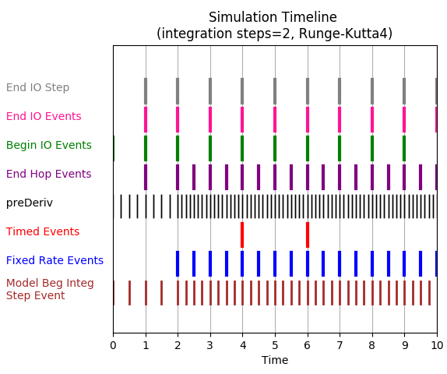
Integration and time stepping
Features of time advancement
Wide number of available integrators
  Fixed, variable step, stiff, non-stiff
Dynamics solvers
  Implicit, explicit, DAE, etc
Multiple rate models
Event handling
Zero-crossing events
  Ability to revert integration
  steps, eg, for zero-crossing
  event detection
Done by C++ layer for speed
More details later

Slide 28
Architectural Advantages

Slide 29
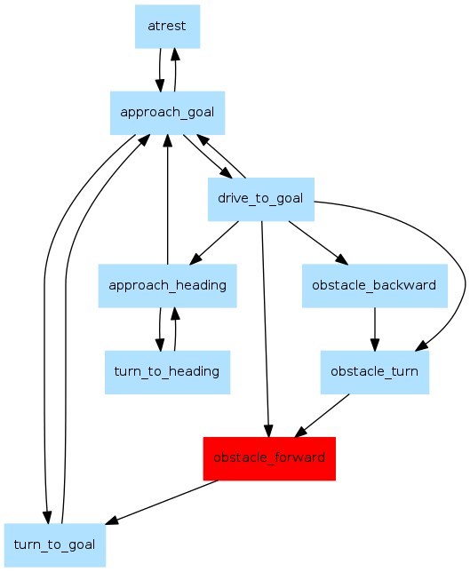
Controlling Simulation Sequencing Logic
Often need to change simulation behavior as system evolves through different modes over time (eg. EDL sequence)
Finite State Machines offer ability to configure a state/sequencing machine with states and transitions to handle a wide range of simulation events
  Deploying parachutes at set dynamic pressure
  Timed separations
  More details later

Slide 30
Units Support
Units are supported at the C++ level
  Systems of units (SI, etc)
  Parameters, variables, etc, configured with quantity type (eg, length, time, etc)
  Units derived from system of units and quantity types
  Arbitrary conversions between variables with compatible types supported.
Support for input with unit conversions at python level as well
  Unit conversions consistent between C++ & Python I/O

Slide 31
Events
Support arbitrary events
  Timed events
  Events that occur at every time step
  Events that occur exactly when a specific condition occurs (zero-crossing)
More details later!
Event
Manager

Slide 32
Linearization in Dshell
DARTS/Dshell provides tools for full nonlinear system simulation
Linear state space models for control design can be obtained in Dshell
Control
Software
Flexible
Multibody
DARTS
Actuators
Sensors
DVar spec nodes

Slide 33
Options for Closing the Loop
As a subsystem
Need to close the loop with the flight/control software. Options include
  Insert flight software into a model to control other parts of the simulation
  DARTS/Dshell simulation model as stand-in for real system when developing flight software
    MATLAB, Mathematica, other simulation systems
  Replace Dshell Models with actual hardware/software models (Dshell model does I/O with actual device/sw)
I/O with external simulation/model by
  Direct C++ calls
  Socket communication, ROS interface etc
External simulation
(manages time)
New
state
Control inputs, time step
DARTS/Dshell simulation model
Hardware in the loop
DARTS/Dshell simulation
Stubbed Device Model
Actual Device

Slide 34
Extensive Introspection
Most objects, from vectors, matrices to bodies, models, assemblies etc. have the dump(prefix=‘’) method
  Will generate output with internal info about the object
  The prefix will be applied to each line
  Very useful for debugging and interacting with the sim
New ‘*asDataFrame()’ methods for convenient tabulations of data

Slide 35
Extensive Error checking
Lots of “assert”-like built in error checking to catch user and other errors. For example
  Catch building of bad SOAQuaternion (non-unity norm)
  Catch creation of bad spatial inertia (inertia not positive semi-definite)
  Catch passing in of bad data (incompatible data or bad types) to assemblies, models etc
  Units checking
  Checks that simulation is in “locked” state before using
These provide a safety net in catching user errors at early stages within a simulation.

Slide 36
Support for Structural Changes
Need to support structural changes to model during simulation run (eg. body separation, deployment events, touchdown)
Dshell classes have the lockObject() method to put the simulation into a valid state when there are structural changes.
lockObject finalizes an object so that it can be fully used.
  Especially important since many types of configuration changes (add/delete bodies) are allowed at run-time
For example
  Verify that inertia properties are valid for bodies
  Compute the number for DOFs in the multibody system
  Verify that the integrator and its state have been properly set up by the sim
  Verify that a subgraph bodies form a tree
  Resort the order of the models in the data flow
Normal sequence:
  create object, do stuff to it, lock it, use it
  modify object, lock it, use it
Sim.lockObject recursively locks all the objects in the simulation

Slide 37
Consistent Common Base Class
Most of the C++ simulation classes - frames, bodies, nodes, models, signals, assemblies are derived from a common base class, NdartsBaseObject, hence they all have
  name (not necessarily unique)
  uuid (unique)
  DVar spec node
  lock() method
  can be looked up
  via their uuid
  dump() method
Helps establish common
conventions and usage
patterns
NdartsBaseObject
Signal
DVar
classes
Frame
Model
Simulation
Node
Hinge
Body
Etc

Slide 38
Backup

Slide 39
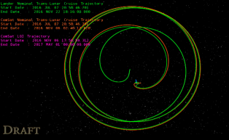
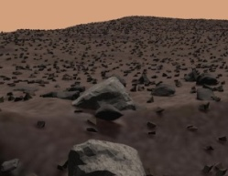
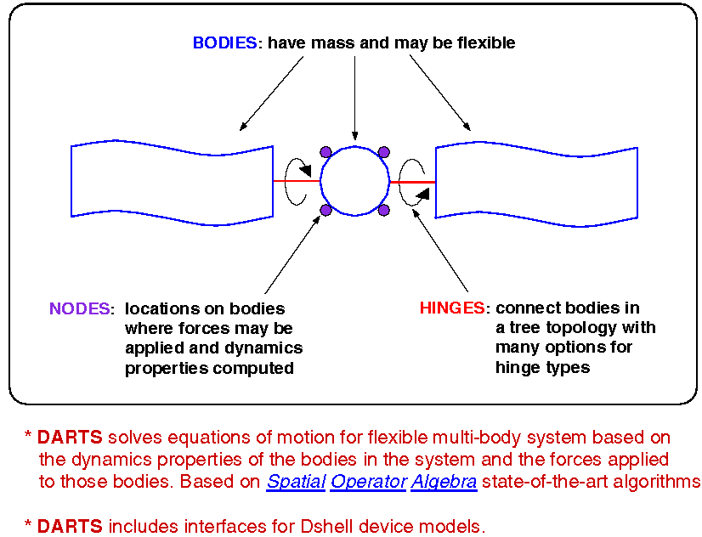
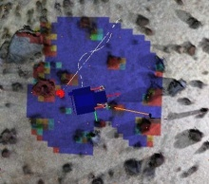
Recap
Ephemerides
What are the key goals of the DARTS/Dshell architecture?
  Modularity for evolution, reusable components, flexible usage, performance
What are the key elements of a simulation?
  Vehicle model, terrain, environment, 3D, gui, parameters, events/sequencing, integrator
What are the key elements of a
vehicle model?
  Multibody model, actuator/sensor/flow
  models dataflow, control s/w, part
  geometries, assemblies
How are the elements of a simulation assembled?
  Assemblies create bodies, Dshell models, etc, and put all the parts together to make a complete simulation
How do you run a simulation?
  Use a simulation manager to advance time, simulation
Sub-system
assemblies
Model Data Flow
Vehicle/Terrain Interaction
SimScape
Terrain
Geometry
Multibody
System
DARTS
Multibody Dynamics
Sequencing
State-Machine
Dspace
3D Graphics,
GPU Shaders
Data logging
GUIs,
stripcharts
Event
Manager

Slide 40
What is next?
Model basics / details
Assembly basics / details

Slide 41
Linearization in DARTS
DARTS/Dshell provides tools for full nonlinear system simulation
Linear state space models can be obtained in Dshell
Control
Software
Flexible
Multibody
DARTS
Actuators
Sensors
DVar spec nodes

Slide 42
Questions to Address
What are the key goals of the DARTS/Dshell architecture?
What are the key elements of the DARTS/Dshell simulations?
What are the key elements of a vehicle model?
How are the elements of a simulation assembled?
How do you run a simulation?

Slide 43
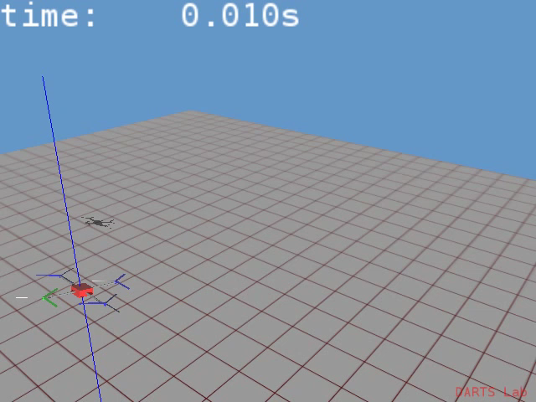
Start with Basic Quadcopter sim
Basic Quadcopter simulation
Fuselage & 4 rotors
Simplified rotor thrust model
Closed loop flight control
  Eventual goal is to build a flight like simulation

Slide 44
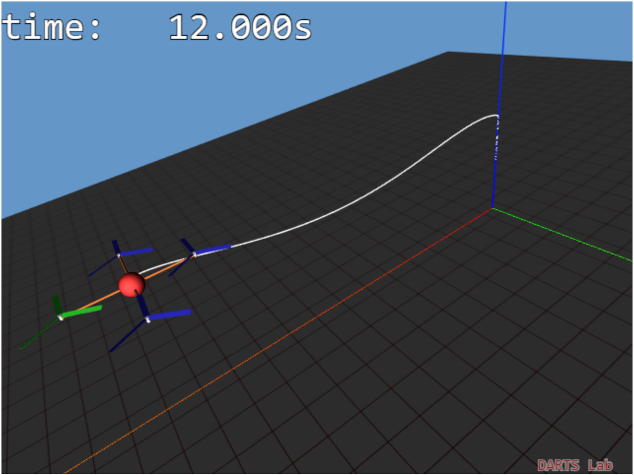
Quadrotor multibody-centric model
(Notebook: 1E-Multibody/3-quadrotor-mechanism)
Create Ndarts model via model file
Add external actuator and gnc blocks
Close the loop with the multibody model

Slide 45
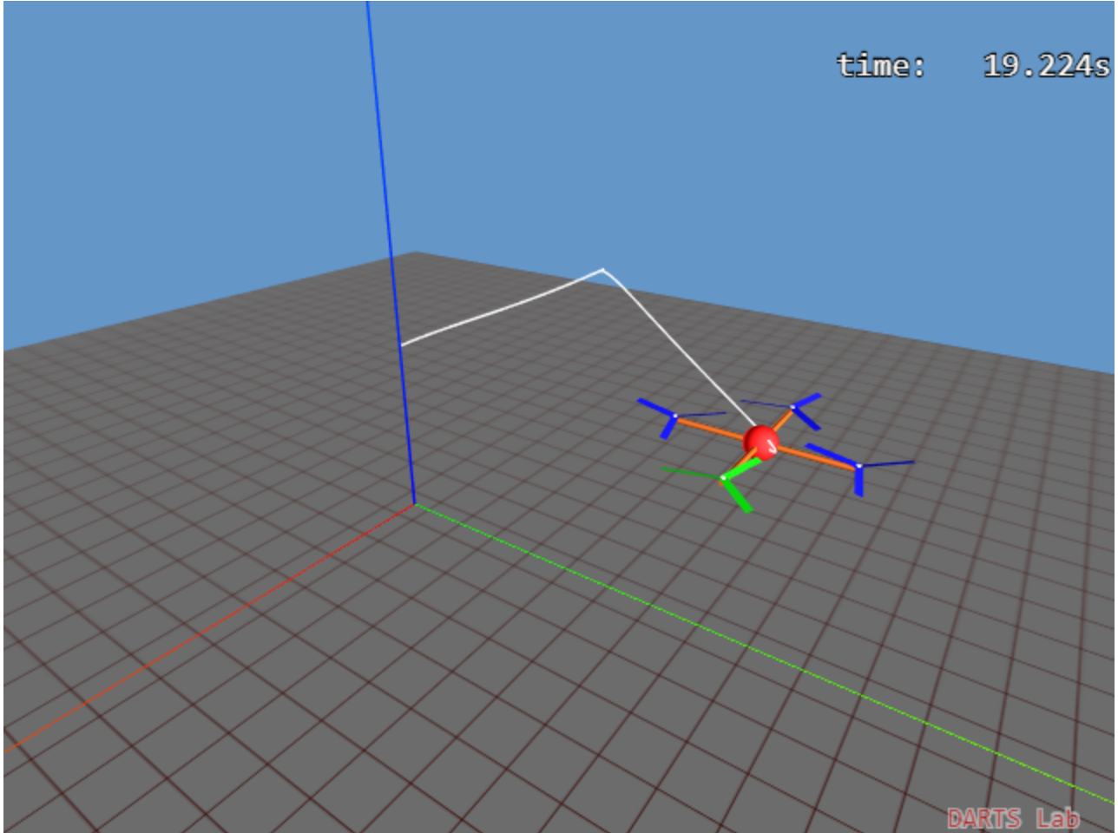
Quadcopter assembly notebook
(Notebook: 1E-Multibody/5-quadrotor-subsystem)
The same quadrotor model, but more compact and extendable using assemblies

Slide 46
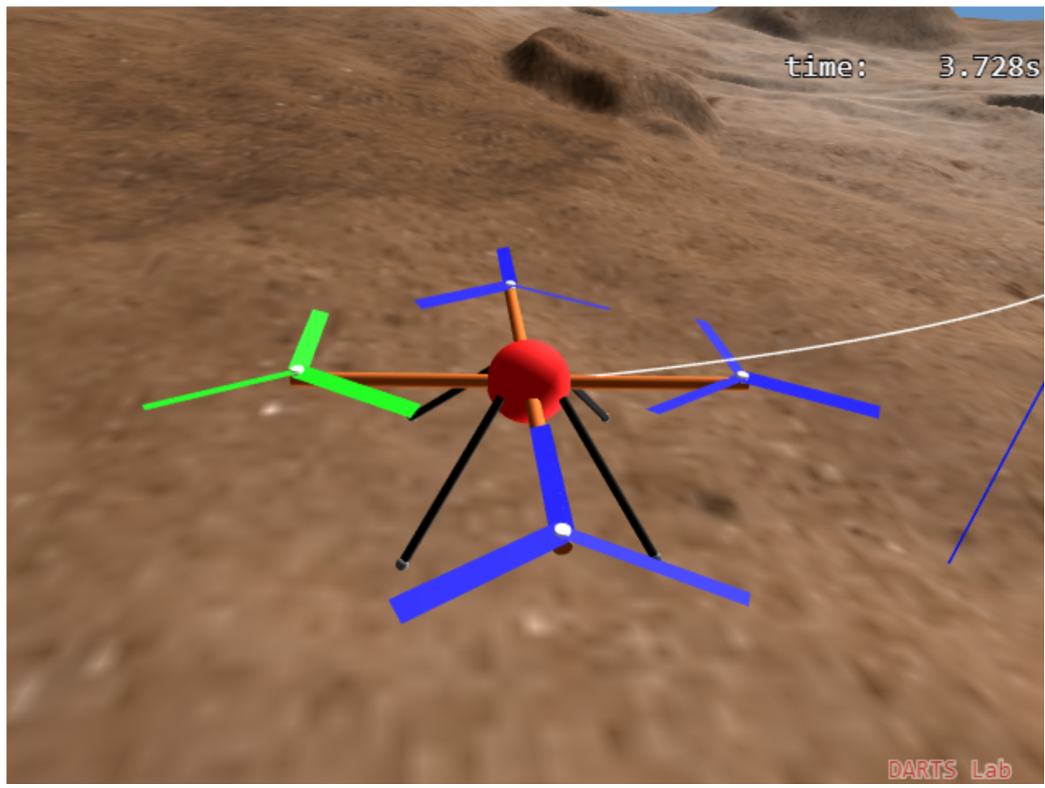
Quadcopter with legs notebook
(Notebook: 1E-Multibody/6-quadrotor-legs)
Extending the rotorcraft to add landing legs and terrain contact models

