Slide 1
Running a Simulation
2023 DARTS Lab Course
Abhinandan Jain, Aaron Gaut, Carl Leake, Vivian Steyert, Tristan Hasseler, Asher Elmland, Juan Garcia Bonilla

Slide 2
Where does this topic fit in the big picture?
Closed-Loop
Flight s/w
Autonomy/Control
Devices
Thrusters, IMU,
Cameras etc
Environment
Terrain, Gravity
Atmosphere,
Ephemerides etc
Analysis
Data logging
Parametric
Monte Carlo
Sim Manager
propagation, fsm,
events
Dynamics
Rigid/flex bodies
Articulation
Attach/detach etc
Geometry
CAD parts
Primitives
Visualization
3D graphics
stripcharts
Usability
Introspection
CLI, GUIs, Scripting
Docs, Training
Knowledge base
Evolution
R&D, new applications
new tools & capabilities
Deployment
Bundling
Porting
Issue tracking
S/W Mgmt
Version control
Build system
Test suite
Reusability
Architecture
Configurability
Refactoring

Slide 3
Build/Run a Simulation
Build simulation
  Create simulation manager
  Add models, assemblies, etc
  Lock (set up full state vector, etc)
  Set initial state
  Set up logging, FSM, pre and post events
  Audits (signal connectivity, etc)
  Setup up geometries and graphics
Run sim
  Advance time
  Live stripcharts, printouts, etc
Post analysis

Slide 4
State Propagation

Slide 5
The Simulation Step
N integration
sub-steps
We propagate the simulation forward in time using the simulation step() command
  The integrator updates the system state during the step
  At the end of each step we can do IO, perform user commands, etc (ie, an “IO Step”)
  Each IO Step can incorporate N integration sub-steps
  Each integration step uses as many derivative calls as the integrator needs
t
T_{i}
T_{i+1}
IO Step
Perform IO,
User CMDs
Perform IO,
User CMDs

Slide 6
Inside a Simulation IO Step
Pre dynamics
Dynamics
Post dynamics
BeginIOStep events
State
Machine
State
Transitions
- State Action
Discrete Dynamics
data-flow
model graph
Continuous Dynamics
- preDeriv
- data-flow models
- multi/flex bodies
- device dynamics
- env dynamics
- terrain models
- postDeriv
Discrete Dynamics
data-flow
model graph
EndIOStep events
Logging
COMMANDS INPUTS
TELEMETRY OUTPUTS
…
Integ. step
N-Integration steps
T1
Sim Time
Note: T1 < T for real-time sim
T
Wall-Clock Time
Notes:
This illustrates the sequence of actions inside Dsends at every step of the simulation. Each step spans the following (in order);
Inputs at start of input/output step including commands and data
Pre dynamics State-Machine execution within which the following occur (in order):
State action procedures associated with each active state
Transition check procedures for each active state
State transitions as triggered by the transition checks
Execution of all of the side-effects specified for each transition made
Dynamics Data flow step within which the following occur (in order):
Discrete dynamics data-flow preceding continuous dynamics with the execution order managed by Dshell based upon the partial-ordering derived from the data-flow graph.
One or more integration steps managed and sequenced by the Dshell integrator, with the Darts engine computing the multi-body dynamics related derivatives, the individual model files providing additional derivative information as needed, and Dshell managing the exection order based upon the partial ordering constraints derived from the data-flow graph.
Discrete dynamics that follow the continuous dynamics with the execution order managed by Dshell based upon the partial ordering derived from the data flow graph
Post io-step Dshell managed watch-handlers that trigger their actions based on:
Monitored variables that change their value since he last simulation step
periodic user-specified events
Simulation outputs at end of simulation input/output step
Note that all these are executed in a single thread. The execution time for the entire step is T1 and the corresponding simulation time interval is T. Note that T1 should be less than T if a real-time simulation is needed.

Slide 7
Integration

Slide 8
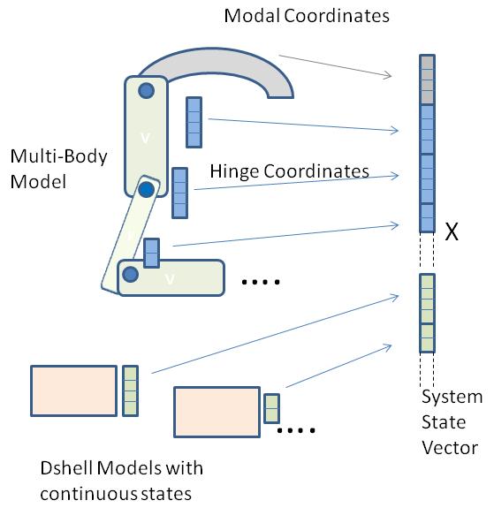
Integrator Basics: The State
Full System State Vector
Combination of multibody state, model continuous states
Each body contributes
to part of the full
system state vector
Models with continuous states also contribute to
the full system state vector
Not covering details of packing/unpacking

Slide 9
Integrator Basics: State & Integrator
The integrator owns the state
  Necessary because multi-step integrators (such as CVode) have additional internal states
  The integrator evolves the state using derivative info from multibody (DARTS) and continuous models
  When the integrator advances the state, it is copied out to multibody and model continuous states
  This means that we cannot just change the simulation state by changing multibody or continuous coordinate values. There are reset methods to do state changes/initialization properly

Slide 10
Integrator and Multibody
The Mbody (multibody) is a scratch board, more intuitive to interact with, but state pokes/modifications must be pushed back to the integrator by requesting a “soft reset” of the integrator. (more later..)
Multibody & model continuous state derivatives
Integrator
DARTS
Actuators
Sensors
Multibody & model continuous state

Slide 11
Numerical Integrators
All Integrators are derived from the DIntegrator base class
  Common basic integrator interface
  Supports more sophisticated integrators
Examples
  DIntegrator_rk4
  DIntegrator_euler
  Dintegrator_cvode
  Many more
In DIntegrator
In CVode (SUNDIALS)
In DArkOde

Slide 12
Integrators and Solvers
To allow combinations of different types of multibody models and algorithms with different types of integrators, we have the DynSolver and DIntegrator families of classes that can be used together
  DIntegrator: Knows nothing about the multibody – only how to propagate the state of the system given the state derivative function and/or residual functions. Specialized versions of this class allow for the support of different time-stepping schemes, explict/implicit methods, partitioned methods, non-smooth methods etc.
  DartsDynSolver: Knows nothing about integration, but knows about DARTS and how to solve the dynamics problem. It provides derivative and residual methods needed for state propagation. Specialized versions of this class encapsulate different multibody techniques, e.g. for tree, closed-chain systems. It is provided with an integrator.

Slide 13
Integrators Taxonomy
Integrators
Integrators family
Smooth
Non-Smooth
Internal
(fixed step)
Third party
DartsContactDynamics
Needs smooth integrator
Explicit
(deriv method)
Implicit
(residual fn uses only x predicts)
CVODE
Var step
Multistep
Stiff option
DArkODE
Var step
Single step
Explict & implicit
IDA
DAE
Residual fn uses x & xdot predicts
Regular
Partitioned
(udot & qfot fns)
Regular
Partitioned
(udot & qfot fns)
Euler
RK4
VelSymplectic
Moreau
Trapezoidal
Mid-point
Backward Euler
Theta
VelVerlet
Newmark beta
HHT theta
Moreau Jean

Slide 14
DynamicsSolver Taxonomy
Dynamics solver options
Dynamics solver
Tree MBD
Closed-Chain
MBD
DartsTree Solver
Smooth ODE integrator
_dshellDeriveCB
DartsAugmented
(TA) Solver
Smooth ODE integrator
_dshellDerivCB
Options
  No error control
  Baumgart
  Projected
GGL Solvers
IDA DAE integrator
_dshellResidualsCB
DirectGGL
IndirectGGL

Slide 15
Other Factors Affecting
State Propagation

Slide 16
Prescribing and Masking Joints
Prescribing and masking are independent concepts within a Simulation and Ndarts
  Prescribing only controls how the dynamics algorithms compute the torques and accelerations for a joint:
    Computes any forces/torques necessary to achieve a desired acceleration
  Masking is used to hide (mask) selected Ndarts joint states from the Dshell integrator (to override their values)
    The idea is that Dshell models (and not the integrator) manage these masked state values.
    Masking controls whether joint position/velocity states come from the integrator (which is the normal case) or are a “deus ex machina” mechanism within a model to directly set the values.

Slide 17
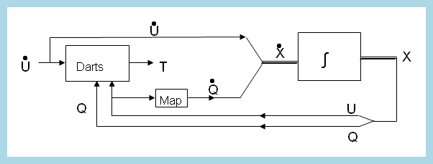
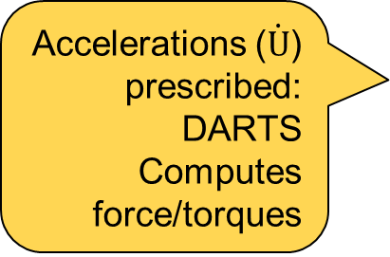
Prescribing Joint Motions
Not prescribed (normal)
  Motion/accelerations computed from the applied forces/torques:
Prescribed joint motions
  Forces/torques computed from prescribed state and accelerations:
In both cases, either forces/torques or motions are computed by Ndarts
forces/torques → DARTS → Motion
Motion →DARTS → forces/torques
Accelerations ($\dot{U}$) prescribed: DARTS Computes force/torques

Slide 18
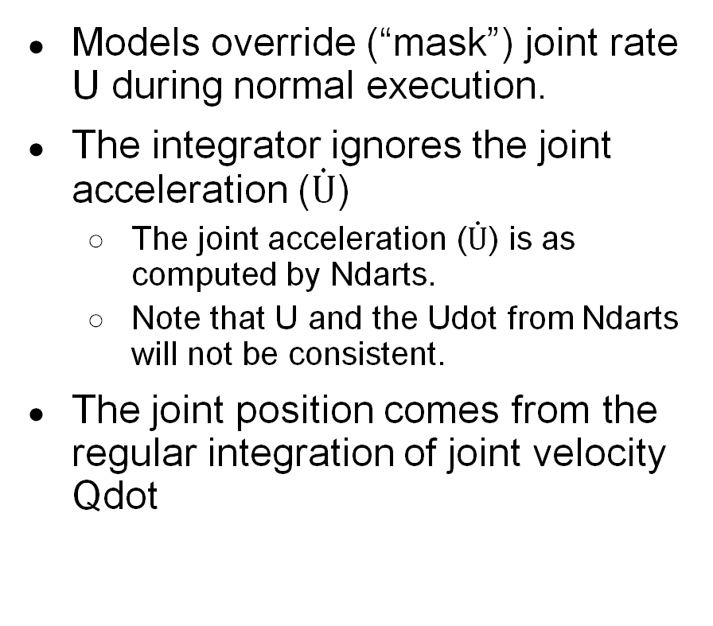
Masking – Joint masking in U (joint rate)
Desired joint rate U_{d}
Models override (“mask”) joint rate U during normal execution.
The integrator ignores the joint acceleration ($\dot{U}$)
  The joint acceleration ($\dot{U}$) is as computed by Ndarts.
  Note that U and the Udot from Ndarts will not be consistent.
The joint position comes from the regular integration of joint velocity Qdot
Model
Joint[i]
U Mask
Ndarts
U_{d}
Joint[i]
Udot
∫
Joint[i]
U
Masked
Joint[i]
Qdot
∫
Joint[i]
Q
Integrated normally

Slide 19
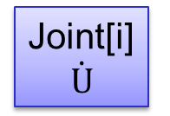
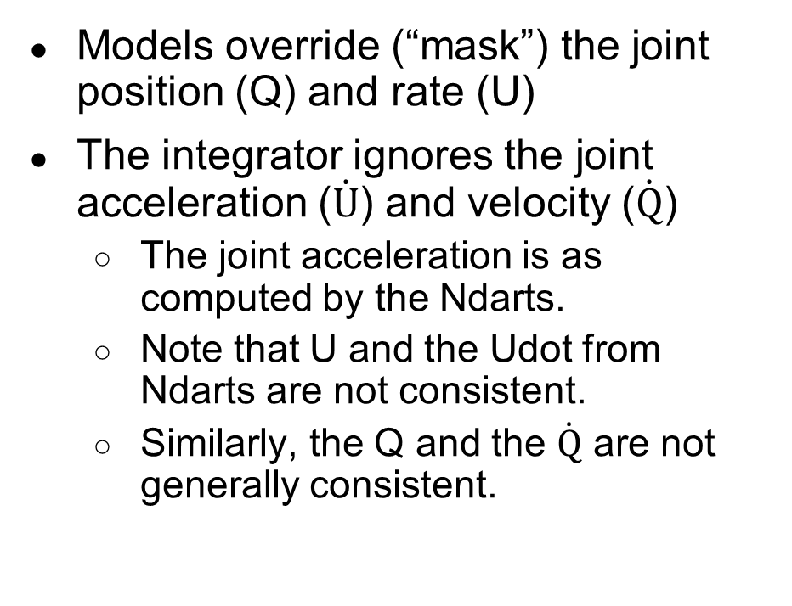
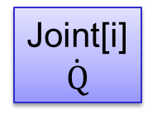
Masking – Joint masking in Q/U
Models override (“mask”) the joint position (Q) and rate (U)
The integrator ignores the joint acceleration ($\dot{U}$) and velocity ($\dot{Q}$)
  The joint acceleration is as computed by the Ndarts.
  Note that U and the Udot from Ndarts are not consistent.
  Similarly, the Q and the $\dot{Q}$ are not generally consistent.
Desired joint Q_{d}, U_{d}
Model
Joint[i]
Q, U Mask
Ndarts
U_{d}
Joint[i]
$$\dot{U}$$
∫
Joint[i]
U
Masked
Q_{d}
Joint[i]
$$\dot{Q}$$
∫
Joint[i]
Q
Masked

Slide 20
Structural Changes

Slide 21
Locking Internals
Objects know about children objects and their lock status
Structural change at one level unlocks the object and all its parents/ancestors
  This ensures that any structural change with side effects is handled properly before the sim can proceed
lockObject() locks all children and descendants

Slide 22
Structural changes
TO make a structural change:
  Simulation must be stopped
    Do these actions between simulation steps
  After structural changes:
  sim.lockObject()
  This will do a hard integrator reset to reallocate integrator state
  State changes (without topology and state structure changes) may just need soft integrator resets

Slide 23
TimeKeeper
TimeKeeper
  Manages the epoch
  Tracks the simulation time
  Supports time queries for a variety of time references
    sim time
    J2000
    UTC
    GPS
    TT – Terrestrial Time
    TAI – International Atomic Time
    more…

Slide 24
Dshell Events

Slide 25
What are Dshell Events?
Callback functions (C++ or Python) that can be called (“fired”) when the simulation reaches some time or condition
Types of Events:
  Timed events
  IO events
    Executed at each simulation time step
  Model events
    Invoked before or after a model’s function such as endIntegrationStep(). Can be created at runtime without recompiling the model.
  Step-validation events (implicit)
  (executed when a condition is met)
x
x
x
x
x
x
x
x
x
t
x
x
x
x
t
x
t

Slide 26
Examples of Dshell events
Events to control data logging frequency
Events to refresh 3D visualization after simulation steps
Events to refresh stripcharts and guis with data after simulation steps
Events to force simulation hop boundaries when specific conditions are met, eg. impact with ground, crossing an altitude threshold, collision between bodies etc.

Slide 27
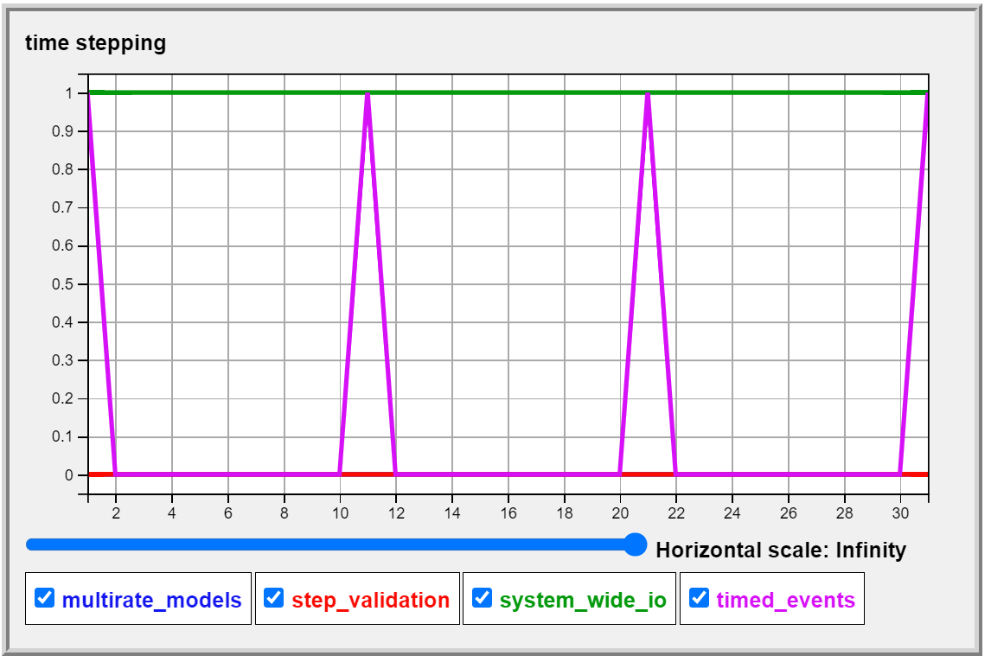
Timed Events Notebook
Demonstrate the use of timed events – adding, deleting, updating, modifying etc.
E-Dshell/Part-4B-Events/01-demo-events

Slide 28
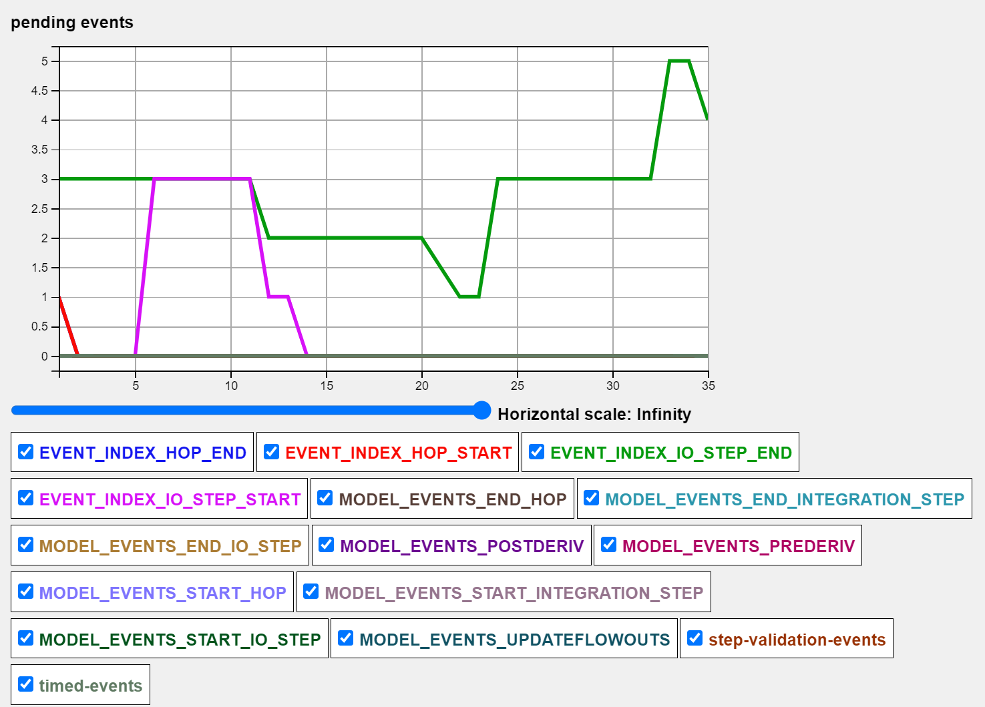
I/O Events Notebook
Demonstrate the use of I/O events – adding, deleting, prioritizing, modifying
E-Dshell/Part-4B-Events/01-demo-events

Slide 29
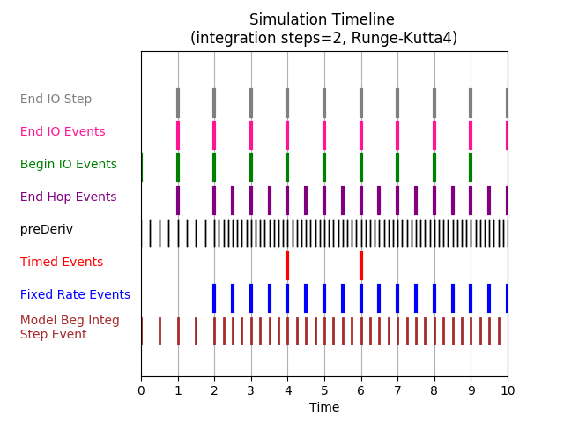
Multiple regular events notebook
Demonstrate simulation with the timed, I/O and model-based events and show a timeline
  E-Dshell/Part-4B-Events/03-Combined-Event-Timeline

Slide 30
Step-Validation Events
x
Synonyms
  zero-crossing
  “regula-falsi”
Motivation
  Need to stop simulation hop at precise time that a condition is met (e.g., leg touching the ground)
  Allow carrying out of actions at time when a condition is met whose timing cannot be predicted explicitly
If you want the sim to stop stepping time as well, you'll need to set sim.e_stop equal to True in your callback
t

Slide 31
Example behavior at zero-crossing
Extra IO step at zero-crossing event
var2
var2
(modified dynamics)
var1
var2 (original dynamics)
target
X
0
1
2
3
4
5
6
7
t
2 integration substeps per IO step
Abbreviated substep to stop at event
2 integration substeps in shortened IO step to get back in sync with regular IO steps

Slide 32
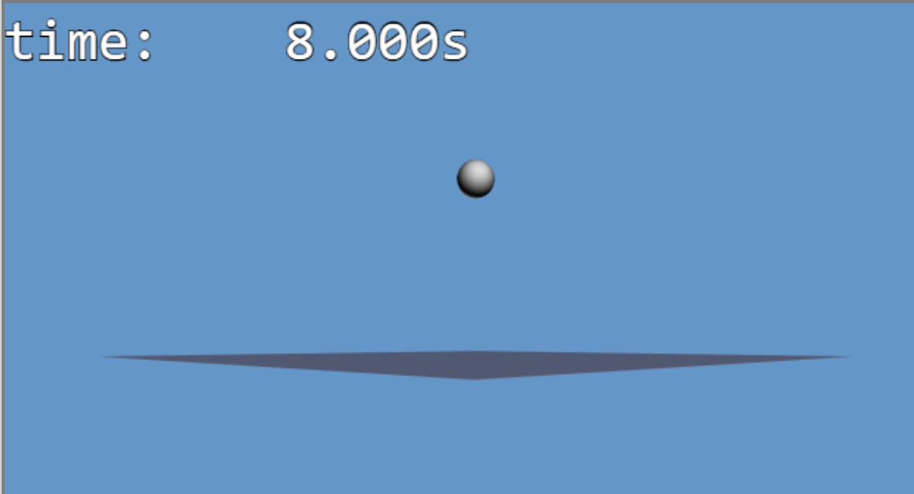
Step-validation event notebook
Demonstrate setting up and using a step validation event to detect a ball making contact with the ground
E-Dshell/Part-4B-Events/02-Step-validation-event

Slide 33
Simulation Time Hops

Slide 34
Simulation Time Barriers
A time barrier is created for a specific time by any activity scheduled to occur at the time
Examples of explicit barriers are
  End of normal simulation step (default IO Step)
  End of a multi-rate model IO step
  End of an integration step (not sub-steps)
  A scheduled Dshell event such as user-defined timed events
Implicit time barriers are associated with of zero-crossing events (eg. touch down)
The system needs to be in a correct, and consistent state at each barrier

Slide 35
Simulation Time Propagation: Hops
The consistent state requirement at each barrier drives the simulation time stepping process
The simulation proceeds by propagating the state in hops from one barrier to the next, carrying out the barrier activities and then on to the next.
  Each barrier to barrier state propagation is referred to as a simulation hop
N integration
sub-steps
t
T_{i}
T_{i+1}
IO Step
Usually a “Hop”

Slide 36
Simulation Timeline

Slide 37
Simulation Hop
Thus simulation state time evolution is simply a succession of simulation hops determined by the collection of barrier conditions
Within each simulation hop, the time integration of the state is carried out by a number of integration sub-steps defined by the nIntegrationSteps value (default 1).

Slide 38
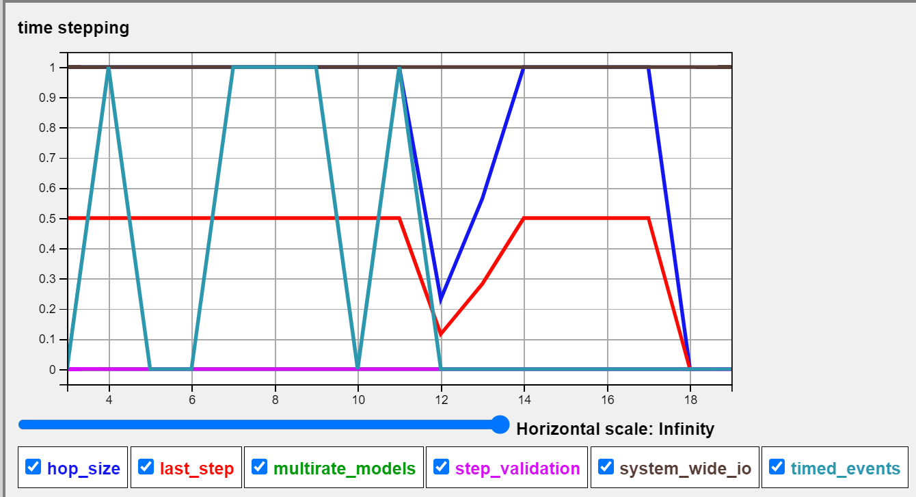
Hops determination by Multi-rate Model & Various Types of Events Notebook
Demonstrate the simulation hop boundaries determined by multi-rate models and different types of events
E-Dshell/Part-4B-Events/01-demo-events

Slide 39
Zero-Crossing Events & Hops
While the simulation attempts to propagate the state from the hop start to hop end times, it also monitors registered zero-crossing conditions
Any zero-crossing condition that gets triggered during a hop, terminates the hop at the zero-crossing time (effectively an implicit barrier is inserted).
Events associated with the zero-crossing condition are handled, and a new hop is used to complete the interrupted hop

Slide 40
Sequencing
Simulation Behavior
(Finite State Machine)

Slide 41
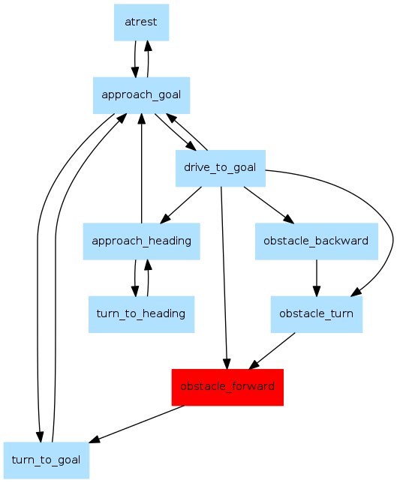
Controlling Simulation Sequencing Logic
Often need to change simulation behavior as system evolves through different modes over time (eg. EDL sequence)
Finite State Machines offer ability to configure a state/sequencing machine with states and transitions to handle a wide range of simulation events
  Deploying parachutes at set dynamic pressure
  Timed separations
  More details later

Slide 42
Finite State Machines (FSM)
An FSM uses states (boxes) with transitions (arrows) to model complex behaviors.
When a transition is “triggered”, the “state” of the FSM switches from one pre-defined state to another.
Actions can be executed upon transitions, entering states, leaving states, and while remaining in a state
FSM actions can make structural changes to the models and dynamics
transition
State1
State2
If condition “A”
State1
State2

Slide 43
When are FSMs processed?
All FSMs are processed in startIoStep() phase
Simulation Input/Output Step
Pre dynamics
Dynamics
Post dynamics
BeginIOStep events
State
Machine
State
Transitions
- State Action
Discrete Dynamics
data-flow
model graph
Continuous Dynamics
- preDeriv
- data-flow models
- multi/flex bodies
- device dynamics
- env dynamics
- terrain models
- postDeriv
Discrete Dynamics
data-flow
model graph
EndIOStep events
Logging
COMMANDS INPUTS
TELEMETRY OUTPUTS
…
Integ. step
N-Integration steps
T1
Sim Time
Note: T1 < T for real-time sim
T
Wall-Clock Time
Notes:
This illustrates the sequence of actions inside Dsends at every step of the simulation. Each step spans the following (in order);
Inputs at start of input/output step including commands and data
Pre dynamics State-Machine execution within which the following occur (in order):
State action procedures associated with each active state
Transition check procedures for each active state
State transitions as triggered by the transition checks
Execution of all of the side-effects specified for each transition made
Dynamics Data flow step within which the following occur (in order):
Discrete dynamics data-flow preceding continuous dynamics with the execution order managed by Dshell based upon the partial-ordering derived from the data-flow graph.
One or more integration steps managed and sequenced by the Dshell integrator, with the Darts engine computing the multi-body dynamics related derivatives, the individual model files providing additional derivative information as needed, and Dshell managing the exection order based upon the partial ordering constraints derived from the data-flow graph.
Discrete dynamics that follow the continuous dynamics with the execution order managed by Dshell based upon the partial ordering derived from the data flow graph
Post io-step Dshell managed watch-handlers that trigger their actions based on:
Monitored variables that change their value since he last simulation step
periodic user-specified events
Simulation outputs at end of simulation input/output step
Note that all these are executed in a single thread. The execution time for the entire step is T1 and the corresponding simulation time interval is T. Note that T1 should be less than T if a real-time simulation is needed.

Slide 44
Example FSM States & Transitions
fsmstates = [
# STATE_NAME ENTRY_ACTION DURING_ACTION EXIT_ACTION
['Initialize', None, None, None],
['Coast', uponEntry(fsm), None, None],
['Separation', uponEntry(fsm), None, None],
['Terminate', uponEntry(fsm), None, None],
]
transitions = [
# FROM_STATE TO_STATE CHECK_FUNCTION ACTION_FUNCTIONS
['Initialize', 'Coast', True, [ ]],
['Coast', 'Separation', atTime(fsm, 5.0), [separate(fsm)]],
['Separation', 'Terminate', atTime(fsm, 10.0), [sim.terminate ]],
]
Note: some function names modified for brevity

Slide 45
FSM Usage
...
# Get handle for default sim FSM object
fsm = sim.fsm()
# Define the states and transitions
fsmstates = …
transitions = …
# Parse the states and transitions
fsm.parseStates(fsmstates)
fsm.parseTransitions(transitions)
# initialize the FSM state
fsm.reset()
# register the FSM with the simulation manager
# Execute the sim (FSMs automatically updated)
sim.step()

Slide 46
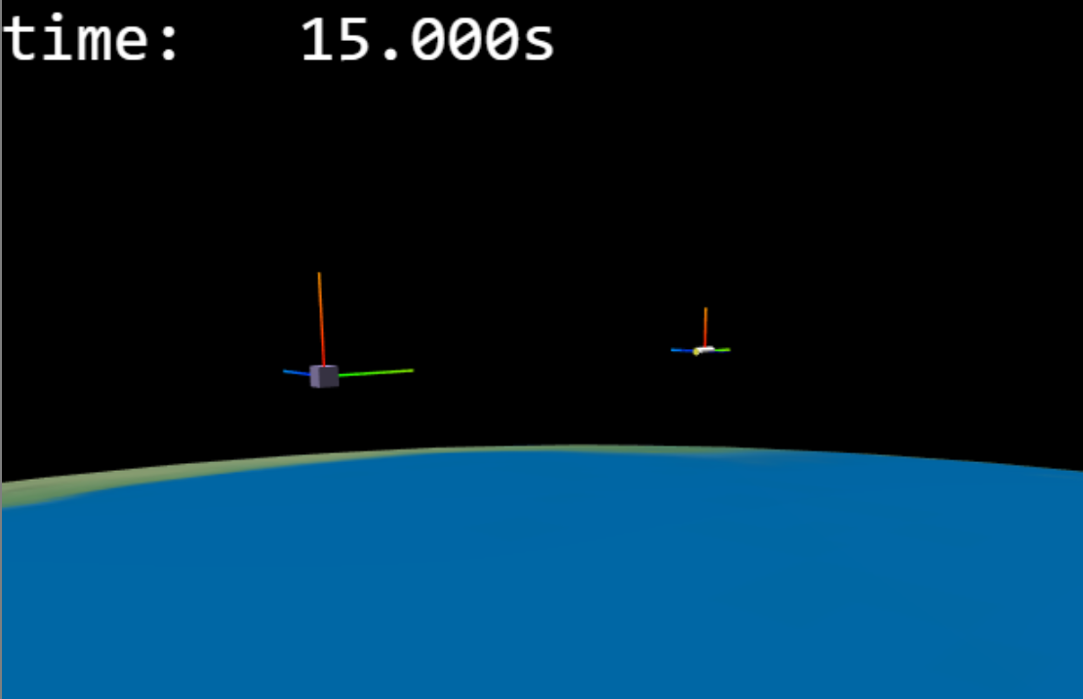
Running a sim with an FSM notebook
Show simulation using an FSM to sequence control actions
  E-Dshell/Part-4A-StatePropagation/01-Separate-Vehicles-with-FSM

Slide 47
BACKUP

Slide 48
Simulation Manager

Slide 49
Using the Simulation manager
Key methods
  Time stepping
  Introspecting and managing its key components
    multibody, frame container, DVar container, …
  Geometry creation
  Visualization creation

Slide 50
Run script (part 1 - Imports)
… imports
sim = SimulationExecutiveNdarts()
junk = sim.integrationSteps(2)
# Load the parameter libraries
sys.path.append('./library')
from library.actuators import Library as actuators
from library.bodies import Library as bodies
from library.targets import Library as targets
from library.states import Library as states
from library.sites import Library as sites
Create simulation manager, set up integrator
Import libraries for simulation parameters
(files/folders by convention)

Slide 51
Run script (part 2a - Configuration)
config = {
'Earth' : {
CLASS : 'TargetAssembly',
PARAMS : {
'Target' : targets['Ellipsoidal Earth'],
'Bodies' : bodies['Target']['Bodies']
}
}, # end 'Earth'
'Cannonball' : {
CLASS : 'VehicleAssembly',
BASENAME : 'CannonballBase',
PARAMS : {
'Bodies' : bodies['Cannonball']['Bodies'],
'Position' : states['Cannonball']['Position'],
'Attitude' : states['Cannonball']['Attitude'],
},
Assembly definition for target planet (Earth)
Assembly definition for space craft

Slide 52
Run script (part 2b - Configuration)
ASSEMBLIES : {
'grav' : {
CLASS : 'AsphericalGravityActuatorAssembly',
CONTEXT : {
BODY : 'CannonballBase'
},
PARAMS : {
'Gravity' : actuators['Gravity']['Standard'],
'Target' : targets['Ellipsoidal Earth']
}
}, # end 'grav'
} # end ASSEMBLIES
} # end 'Cannonball'
} # end config
Sub-assembly definitions for space craft

Slide 53
Run script (part 3 – Init and Run)
top_asm = sim.createAssemblies(config)
sim.bindState()
# Other initializations, as desired
# Set up events, sequencing, logging
# visualization, etc
for i in range(100):
sim.step()
if sim.terminated():
break
sim.close()
Create assemblies, models, etc
Initialize
RUN!
Cleanup

