Slide 1
Dshell Models
Abhinandan Jain, Aaron Gaut, Carl Leake, Vivian Steyert, Tristan Hasseler, Asher Elmland, Juan Garcia Bonilla

Slide 2
Where does this topic fit in …
Closed-Loop
Flight s/w
Autonomy/Control
Devices
Thrusters, IMU,
Cameras etc
Environment
Terrain, Gravity
Atmosphere,
Ephemerides etc
Analysis
Data logging
Parametric
Monte Carlo
Sim Manager
propagation, fsm,
events
Dynamics
Rigid/flex bodies
Articulation
Attach/detach etc
Geometry
CAD parts
Primitives
Visualization
3D graphics
stripcharts
Usability
Introspection
CLI, GUIs, Scripting
Docs, Training
Knowledge base
Evolution
R&D, new applications
new tools & capabilities
Deployment
Bundling
Porting
Issue tracking
S/W Mgmt
Version control
Build system
Test suite
Reusability
Architecture
Configurability
Refactoring

Slide 3
Assemblies create the simulation backbone: multibody, models, and data flow
Assembly hierarchy
The purpose of an Assembly is to construct the multibody, models, and data flow.
Once that is complete, the assembly’s work is done and is not generally needed at runtime
Asm2
Asm4
Python
An Assembly is a Factory creating dataflow and multibody models
Asm1
Asm3
Asm5
Construction
Run-time
mdl2
mdl3
bd1
bd3
mdl1
C++
mdl4
mdl5
bd2
Emergent model dataflow
Emergent multibody model

Slide 4
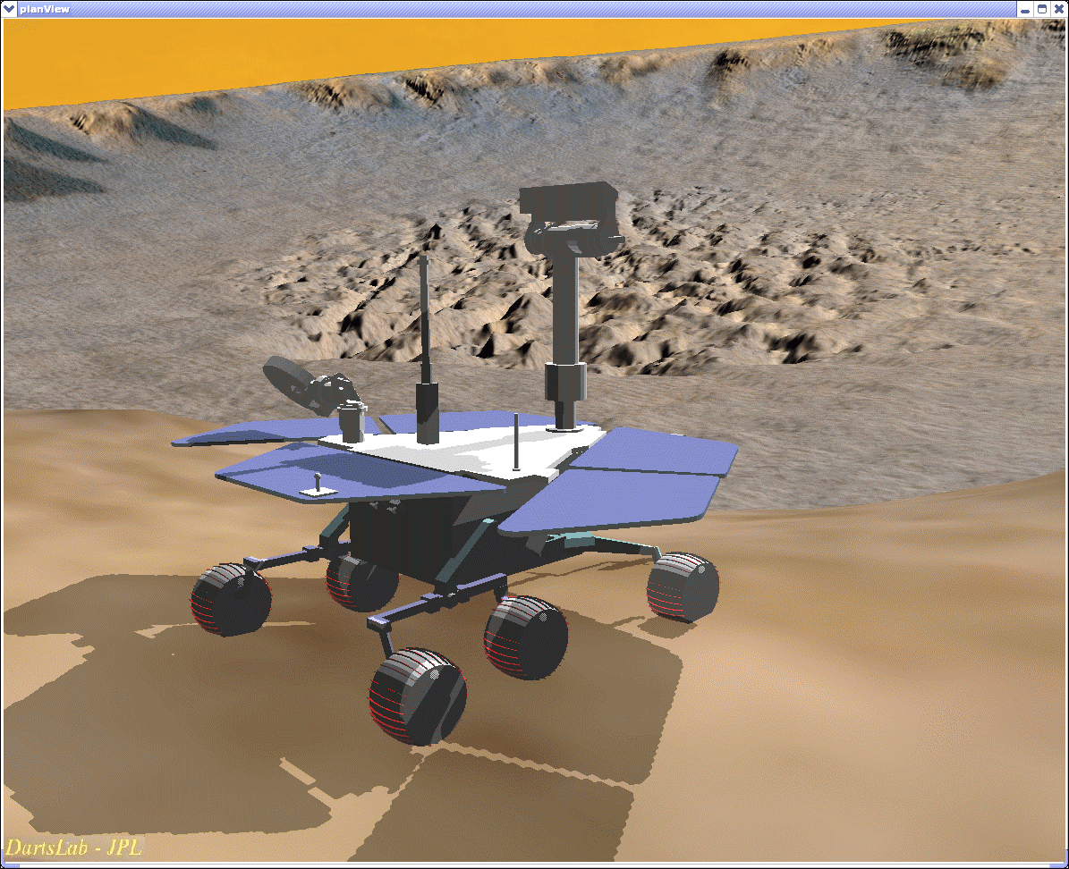
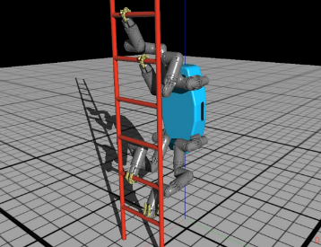
Dshell Models – Background
Our goal is to model physical systems
Spacecraft, ground vehicles, robots
Physical systems are composed of low-level devices or subsystems such as encoders, IMUs, thrusters, etc and interactions with the environment
We will use Dshell Models to simulate or “model” these components
These models are DARTS aware, and can hence get and set data with the vehicle dynamics layer
The component models can be assembled into a data flow and exchange data with other models as well

Slide 5
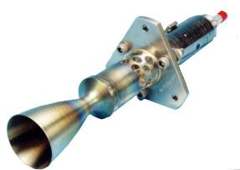
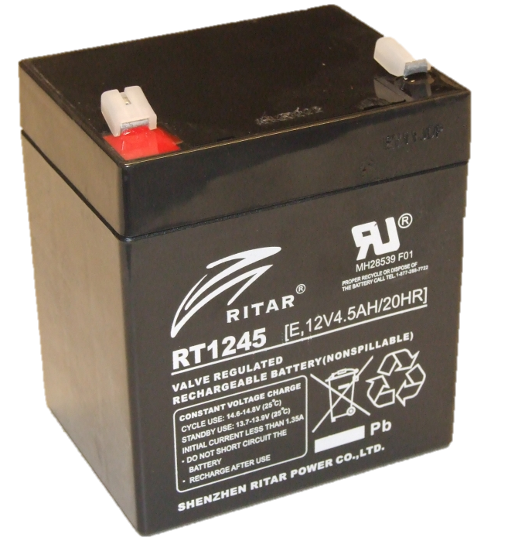
Goals of Dshell Models
Model a wide range of devices and subsystems
Devices that interact with the multibody system
Other devices/subsystems not directly related to the multibody (eg, batteries)
Fast simulations (implemented in C++)
Reusable
Support multiple instances in one simulation (perhaps with varying parameters)
Reusable across different simulations
Scalable in performance & fidelity
Clear limited interface allows drop-in replacements to improve fidelity or reduce fidelity (faster)
Enforce encapsulation (Information hiding to reduce coupling)
Analogous to Simulink S-functions, except that Dshell models have DARTS interfaces for getting and setting dynamics data crucial for vehicle dynamics simulations

Slide 6
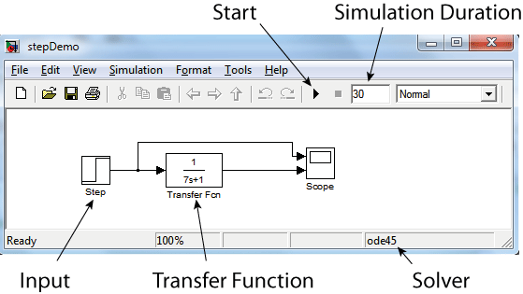
Parallels with Simulink
Image by By Thomas Haslwanter [CC BY-SA 3.0], via Wikimedia Commons
Similar components based approach
Both use component models and dataflows
Key difference is the presence of the DARTS multibody dynamics block in Dshell for our vehicle dynamics focus
Dynamics models are complex and is computationally expensive
Dynamics has interfaces to most of the models (many signal lines in and out)
Interfaces depends on the specific mechanism and other models in the sim
We treat DARTS as a foundational middleware available to all the components
Matlab/Simulink is more general purpose

Slide 7
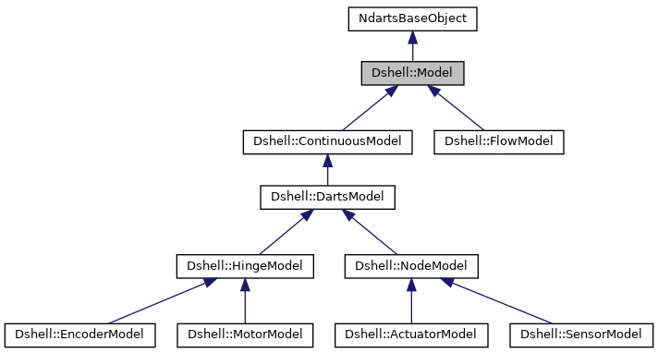
Dshell Model Classes
Models are a C++ classes which models devices, components, or environment entities
Implements governing equations/logic
Self-contained
DartsModel
ContinuousModel: supports continuous states independent of the multibody
NodeModel: Act/Sense body nodes:
Actuator / Sensor
HingeModel: Act/Sense hinges:
Motor / Encoder
FlowModel
Independent of multibody, no continuous states (eg, GNC)

Slide 8
Available Dshell Models?
Module (selected) | Types | Continuous | Actuators | Sensors | Motors | Encoders | Flow
AeroModels | Aerodynamics |  | 1 | 5 |  |  | 1
AeroPythonModels | Aerodynamics |  | 1
CameraImageModels | Camera imaging |  |  | 6 |  |  | 4
GeneralModels | Misc, mostly basic | 2 | 14 | 16 | 28 | 5 | 4
GravityModels | Gravity |  | 15
AdvancedGravityModels | Gravity |  | 4
DshellCommonModels | Misc |  | 3 | 7 | 1 | 2
PowerModels | Power |  |  |  |  |  | 4
RoboSimianModels | Robotics |  |  |  | 6
RoverDynModels | Rovers mechanisms |  | 4 | 7 | 11 | 3 | 3
RoverHdwModels | Rovers sensors |  |  | 3 |  |  | 15
RoverNavModels | Rover navigation |  | 5 | 2 |  |  | 23
RoverppModels | Rover |  |  |  |  |  | 3
SurfaceContactModels | Vehicle-soil interaction |  | 20 | 4
VehicleModels | Spacecraft models |  | 14
 | Total | 2 | 81 | 50 | 46 | 10 | 57
(All 70 modules: > 500 models)
Total in these modules: 246

Slide 9
Dshell Model Basics

Slide 10
Dshell Model example
Example – Rotor Thrust Model
Rotor Thrust Model (“Actuator”)
W = Rotor Speed
Compute Thrust
F = k*W*W
F
Rotor Speed
Apply force F to a body
Parameter k

Slide 11
Dshell Models
Models emulate component behavior
Contain model states and perform computations to model the device or subsystem
Take data in (“flow inputs”) and put data out (“flow outputs”)
Model interconnection into data flow via signals
Customized via parameters
Interact with multibody (optional)
Reusable C++ component models with ability to sub-class
Auto-code generator - with support for template revisions using Python
Parameters
Flow Inputs
State Variables
- discrete
- continuous
- scratch Variables
Flow Outputs
Commands
Fault Injection
Actuator and Sensor Models access Vehicle Data from attachment Node
Model 1
Signal A
Model 2
DARTS Multibody/Flexbody Engine
Dshell Model Sphinx documentation

Slide 12
Dshell Model Internal Data
Parameters (‘params’)
Used in modeling computations
Discrete states (‘states’)
Track model state (changed by model logic)
Continuous states (‘cont_states’)
Models set derivatives, system integrates
Scratch variables (‘scratch’)
Intermediate calculations, data for debugging
flowIns/flowOuts (‘flow_in’ / ‘flow_out’)
Provide/get data to/from other models
The data in these can be scalar or vectors of: floats, int, enums, bool, user-defined structs, pointers, and strings
F = k*W*W
→ mode
$$\int_{0}^{t}{ }$$

Slide 13
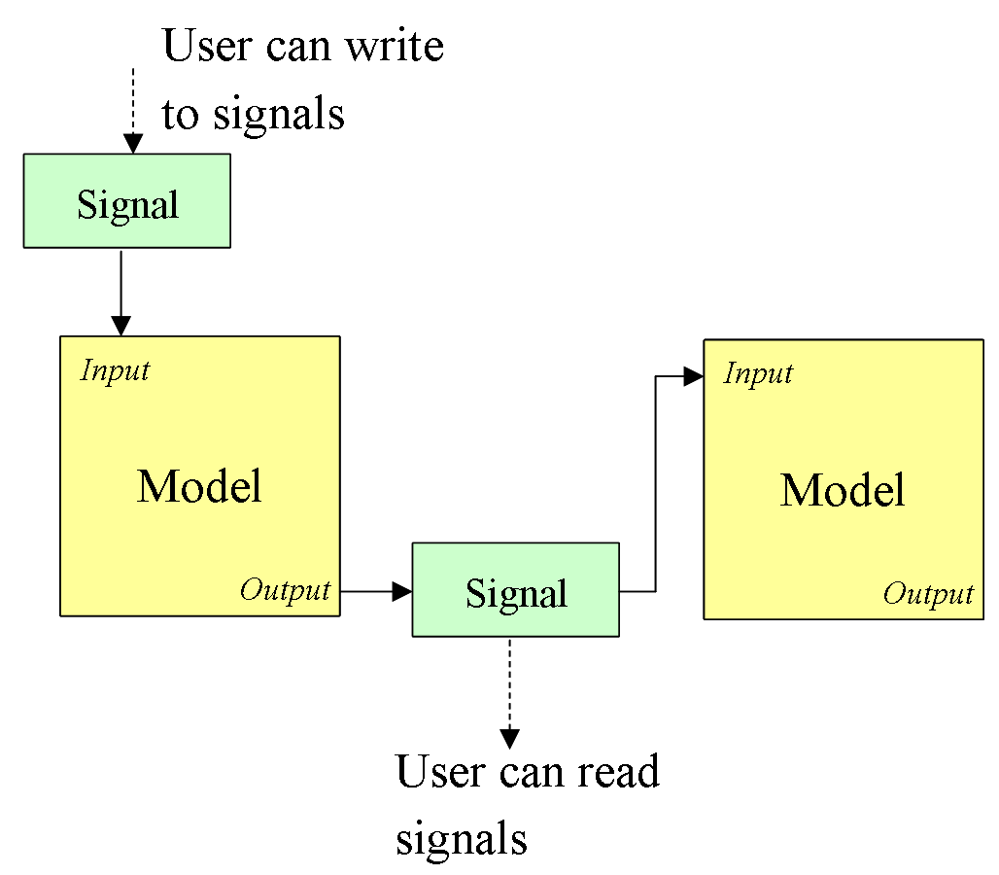
Dshell Signals for Connecting Models
Models are “black boxes” – with limited interaction between them except via connections (information hiding)
Connections between models are through “signals” – shared data buffers
Signals are data buffers for:
Floats, integers, etc
Vectors of floats, integers, etc
Slices of vectors
allow splitting signal vectors to multiple modes
Models have FlowIns & FlowOuts to connect to signals.
Models do not create signals!
Black box!

Slide 14
Dshell Models – Data Flow
Note that upstream models must have their computations done before downstream models!
Model execution order must be determined in advanced (sorted) for the proper execution order
The way that models are connected creates a “data flow”
Model A
Model B
Model C
Model D

Slide 15
Notebook: Creating Signals
Demonstrate creating signals of different data types
Scalar and vector values signals
Creating signal slices, and slices from slices
E-Dshell/Part-2-Models/01-Basic-use-of-signals

Slide 16
Notebook: Signals & Models
Demonstrate using signals with a model
Demos signal freshness and re-tying signals
E-Dshell/Part-2-Models/02-Use-of-signals-in-a-model

Slide 17
Notebook: Using signal ties
Demonstrate using signal ties in a run script to connect signals and models at lower levels of the assembly hierarchy
E-Dshell/Part-2-Models/03-Tying-signals-in-run-scripts

Slide 18
Dshell Models + Multibody
Multibody
System
_{Motor}
Body j
…….
…
M
S
Body i
Body k
F
_{Sensor}
F
S
S
F
..... ...
F
Body m
F
A
E
Flow models
F
_{Encoder}
_{Actuator}
…
Connections / Hinges (Darts) Flow Connections (Dshell)
A Actuators Models M Motor Models
S Sensor Models E Encoder Model F Data Flow Models

Slide 19
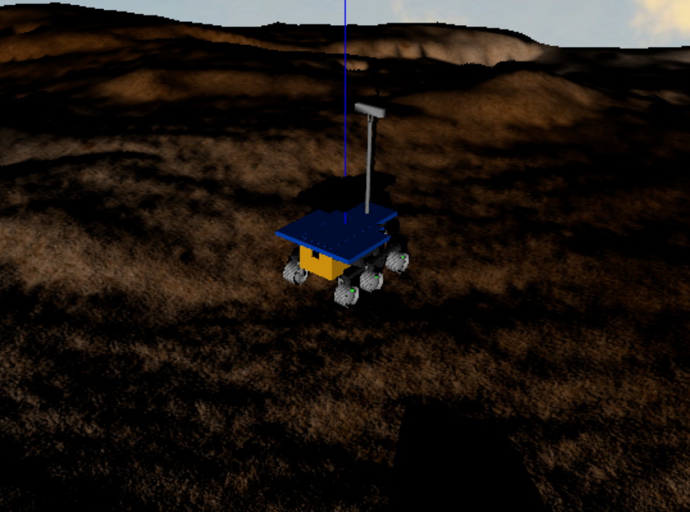
Assemblies + Models + Multibody
Detailed examination of a Rocky 8 rover simulation model including the assemblies, multibody structure, the models and the signals
E-Dshell/Part-2-Models/04-Roams-models

Slide 20
Defining a Model Class

Slide 21
Basic Model Information
Model definition file (*.mdl) used for model interface definition and creation
Defines the parameters, states, inputs and outputs for a model
Available at runtime via model meta data function
Boiler plate C++ code is auto-generated from the mdl files
The parameter, states etc. data is can be accessed at run-time access through Dvar “specNodes”
Data is also used by other sim-related tools
Dshell GUI simulation data browser
model linker

Slide 22
Model “mdl” interface definition
The model .mdl file example
This metadata can be accessed at runtime
[Type]
Name = PinEncoder2
Kind = encoder
Keywords = {Hinge!Pin}
[params]
[[polarity]]
Type = int
Length = -
Brief description =
"""Sign convention"""
[scratch]
[[gearRatio]]
Type = double
Length = -
Brief description = """gear ratio of hinge"""
Long description = """"""
[states]
[[offset]]
Type = double
Length = -
Brief description = """Joint angle offset"""

Slide 23
Model & Signal Introspection
Introspect with DVar specnodes
From command line
model.specNode()
signal.specNode()
From Dshell gui

Slide 24
Model Spec Node
Model data is accessible through its “spec Node” (the DVar interface)
Steps:
Get the model object specnode
>>> sp = model.specNode()
Peek / Poke its data
>>> sp() → get python dictionary of all model data
>>> sp[‘param.R’]() → get value of parameter ‘R’
>>> sp[‘param.R’](1.5) → set the value of R to 1.5

Slide 25
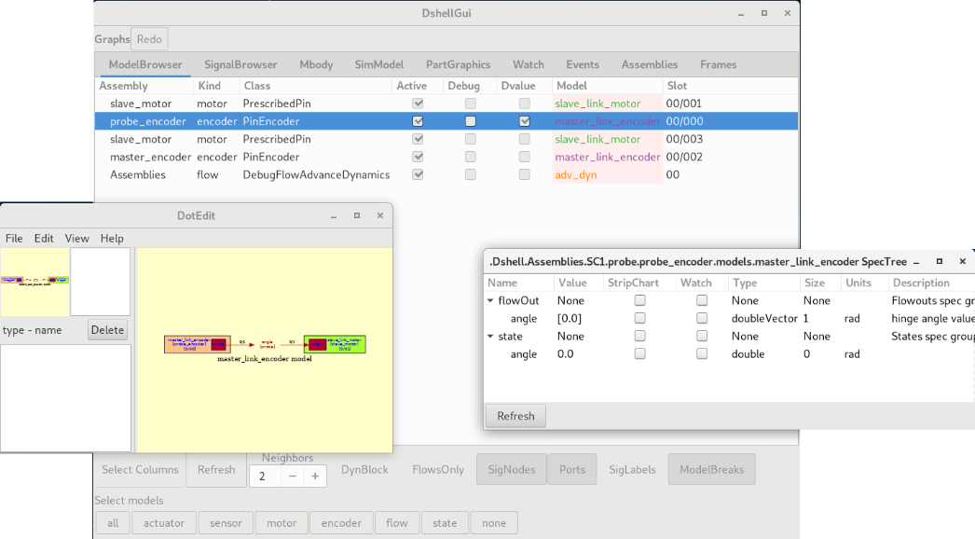
Dshell gui
Much easer to use the Dshell GUI!
sim.gui()

Slide 26
Notebook: Model Instancing & Inspection
Demonstrate creating model in a run script and creating and tying signals to it
E-Dshell/Part-2-Models/08-Create-model-in-script

Slide 27
Notebook: Interacting with Models
Shows details of interacting with a basic dosimeter model
E-Dshell/Part-2-Models/09-Basic-model-interactions

Slide 28
Notebook: Accessing Model Metadata
All a model’s data defined in its ‘*.mdl’ file is available at runtime without a live instance of the model.
This notebook shows details of accessing model meta data at runtime
E-Dshell/Part-2-Models/10-Accessing-model-metadata

Slide 29
Data Flow Model Order

Slide 30
Data Flow Model Execution Order
What order do models get executed in within the models data flow?
Model order must conform to the physics of the modeled system and logic of the simulation
Model (A) whose flowOuts go to some other models (B) flowIns implies that Model A must be executed first since it is "upstream“
Some exceptions here that will be explained later
Most of model order determined from model flows (the rest is arbitrary but lexically ordered for repeatability)
Model sorting is automatic
Model sort loops can occur. To resolve we may need to add:
Model break (ignore connection between two models during sort)
Model constraints (force one model to be "upstream" of another)
Model A
First
Model C
Model B
Second
Model D
Third

Slide 31
Example Model Ordering
Model A
Model B
Precedence:
A → B
A → C → D
Model C
Model D
A, B, C, D
or
A, C, B, D
or
A, C, D, B
After Sorting:
Arbitrary ordering resolved by alphabetical sorting
Equivalent

Slide 32
Simulation Model Data Flows
Flow Models (no continuous states, advance with tick)
Dynamic models (continuous states or interacts with DARTS)
Flow DebugFlowAdvanceDynamics
Flow Model F3
Sensor Dyn Model D4
Encoder Dyn Model D1
Flow Model F1
Continous Model D5
DARTS
Flow Model F2
Actuator Dyn Model D2
Motor Dyn Model D3
Model Order: F1 → F2 → [ D2 → D5 → D1 → D3 → D4 ] -- > F3

Slide 33
Flow Model Loop Notebook
Demonstrate breaking a flow models loop by adding a flow break for the purposes of flow model order sorting
E-Dshell/Part-2-Models/05-Model-add-flow-break

Slide 34
Dynamics Model Loop Notebook
Demonstrate breaking a dynamics models loop by adding a dynamic break for the purpose of dynamics model order sorting
E-Dshell/Part-2-Models/06-Model-add-dynamic-break

Slide 35
Inter-Model Constraint Notebook
Demonstrate forcing a specific order using a model order constraint when there are multiple potential orderings possible (due to partial ordering)
E-Dshell/Part-2-Models/07-Model-add-order-constraint

Slide 36
Standard Model Methods

Slide 37
Dshell Model Methods
All Models
constructor Any model-specific setup
setup()
processParams() Install provided parameters into local data Any necessary auxiliary calculations
updateFlowOuts() Compute new values for flowOuts and update the flowOuts so signals get updated
Etc (eg, user defined)
Darts/Continuous Models
preDeriv() / postDeriv() – Functions that are called to interact with the multibody system
beginIOStep() / endIOStep() – functions that will
beginIntegration() / endIntegration()
Etc (eg, user defined)
Flow Models
hop() – advance the internal logic or governing equations

Slide 38
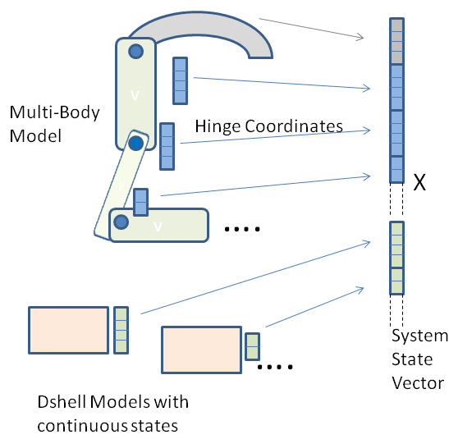
More about Model Design
Models only interact with the DARTS multibody object through bodies, nodes, etc., directly assigned to them
Can access their body/joint
A model cannot “see” the rest multibody system!
Models with continuous states only interact with their own states, not the “big X” state vector
Can see their continuous states
Can only set derivatives for their continuous states
Such information hiding is a key design feature of models to use information hiding to reduce coupling across the models and simulation complexity

Slide 39
Instancing a Dshell model

Slide 40
Creating a model instance
Process:
Chose Dshell model to instantiate
Create/obtain signals to be connected to the model flowIns/flowOuts
Tie signals to flowIns / flowOuts
Set parameter data
Dshell Assemblies are typically used to manage models and signals creation and tying them to create the dataflow
Assemblies usually create the multibody, models, and data flow
Assemblies are not needed for state time propagation
Note: An Assembly keeps track of the models that it creates
Parameters
Flow Inputs
State Variables
- discrete
- continuous
- scratch Variables
Flow Outputs
Actuator and Sensor Models access Multibody Data from attachment Node

Slide 41
Example Model Instancing
After creating the model, it needs to have its model parameters set
asm.addSignal('signame', {'length': 1, 'type': 'double',
'comment': 'signal description)
mdl = asm.addModel('mdlname', 'encoder', {
'MODEL_TIES': encoder_ties,
'class': 'PinEncoder',
'comment': 'encoder model',
'outb': body})

Slide 42
Multirate Models

Slide 43
Multirate Model Events
Allows setting model BeginIOStep or EndIOStep functions to execute at an arbitrary rate (for any models)
The multirate IOStep functions are called at exactly the specified rate, not the normal system IO step rate.
Normally done in C++ code but API supports registering multirate models via Python
All models can be used as multi-rate models
Can choose whether a model should be used in a multi-rate manner or not
By default model’s rate is in sync with simulation steps
The IOStep methods are specifically for IO or multi-rate actions. The Hop and integration methods are for state propagation
x
x
x
x
t

Slide 44
Multirate Model Events
x
x
x
x
t
Python API
For fixed rate:
Provide a callback function that will determine the next time to execute:
Any model can be used as a fixed-rate or as a multi-rate model
sim.registerMultiRateModel(mdl, <fixed_rate>)
sim.registerMultiRateModel(mdl, <multirate_callback_fn>)

Slide 45
Objects as Model Parameters

Slide 46
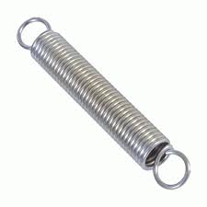
Accessing Objects within Models
C++ models often need access to external objects: Terrains, Frames, Nodes, Bodies
Example:
To set up spring between two bodies, attach the model to node1 one body (Body1)
How do you get the position of the other end of the sprint on the other body?
Model encapsulation prevents direct access to the rest of the multibody!
How can we pass the attach point (node2) on the other body to the model?
There is now a simplified way to get such objects into models as parameters
In the past we passed in addresses or UUIDs as parameters and cast them (awkward, error-prone)
Body1 with model
node1
node2
Body2

Slide 47
Improved Object Access within Models
Goals
Provide a unified, consistent way to pass objects into models
The model autocoder should handle the bulk of the work
Simplify C++ model code dealing with objects
Make adding any new object type to be very simple and not require additional non-auto-generated C++ code to handle retrieval and type conversions.

Slide 48
Model Object Parameters
The model autocoder now supports for ‘object’ parameter types in the model .mdl files to handle objects:
The model autocoder generates code using the ‘Class’ name to cast the objects appropriately. It includes the proper header includes as specified.
Objects are available in model C++ code via params()->xnode (with correct type automatically)
Objects would be passed in when models are created or bound.
[params]
...
[[xframe]]
Type = object
Class = Dframe::Frame*
Header = "DFrame/Frame.h"
Length = -
Description = """Node… """

Slide 49
Notebook: Passing Objects as Parameters
This notebook shows how to pass objects as parameters to models
E-Dshell/Part-2-Models/12-Object-Parameters

Slide 50
Variable Size Model Data

Slide 51
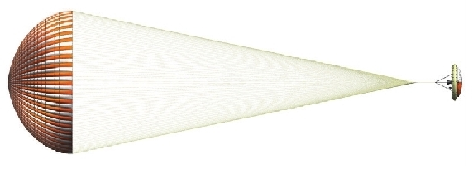
Variable-size Model Data
We sometimes need to model systems that have variable size data
Example: NlinkSpringDamper
Model supports N bridles going from confluence point down to N attach points on the body
Model allows N bridles with separate lengths, spring/damper parameters for each bridle
We need the ability to set independent parameter data for N bridles!
three bridless
confluence point

Slide 52
Variable-size model data
Dshell models support variable sized data
Parameters, scratch, state, flowIns*, flowOuts*, contState
Basics:
The length of variable-length parameters, scratch, states, and continuous state data can be changed at runtime using this API <mdl>.variableArraySize(‘param.var’, 23)
Values can be assigned to variable-length data if the length of the incoming data matches the variable existing length – otherwise the length of the variable must be updated first.
The length of variable-length flowIns/flowOuts is set by the length of the signal they are tied to.
Variable-length arrays of strings and ‘structs’ are now supported

Slide 53
Variable-size model data
API (both C++ and Python)
GENERAL:
<mdl>.variableArraySize(“<type>.<var-name>”, <new-value>)
where: <type> is ‘param’, ‘scratch’, ‘state’, or ‘contState’
SPECIFIC:
<mdl>.isParamVariableArraySize(“<param-name>”) → bool
<mdl>.paramVariableArraySize(“<param-name>”, <new-value>)
<mdl>.stateVariableArraySize(“<param-name>”, <new-value>)

Slide 54
Variable-size model data
Approach
If the data length needs to be changed at runtime, the length must be updated first.
The lengths can be set in the model C++ code if the appropriate length can be determined there
If the model is created and managed by an Assembly (next topic):
In the assembly that creates the model, add code to the assembly bindParams() function that sets the desired length before assigning values.

Slide 55
Notebook: Variable Size Data
This notebook shows handling variable size parameter data
E-Dshell/Part-2-Models/13-Variable-Size-Data

Slide 56
Activating/Deactivating Models

Slide 57
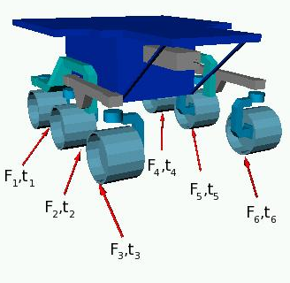
Active/Inactive Models
You may want to use different models for the same device/subsystem during a simulation
Model behavior may change depending on the situation
Eg, in ground vehicle simulations some terrain-tire models handle different situations better (more details in the ROAMS session)
Hard soil → Fiala model
Soft soil → Bekker model
Although it is possible to have a model which is multi-modal, it is better practice to have single-mode models (simpler to test, maintain, develop, etc)
We can have BOTH models in the same simulation hooked up to the same signals, and switch between them by activating one and deactivating the other

Slide 58
Active/Inactive Models
Models can be active or inactive
Models are “active” by default
A model can be deactivated or activated:
<mdl>.active(False)
<mdl>.active(True)
Model code for inactive models is skipped when during simulation execution
Model flowOuts are frozen for inactive models

Slide 59
Notebook: Activating / Deactivating Models
This notebook shows how to activate and deactivate a model at runtime
E-Dshell/Part-2-Models/11-Active-and-inactive-models

Slide 60
Dshell Simulation Architecture Implications

Slide 61
Reuse across Multiple Configurations
Multiple vehicle/simulation configurations
Testbed and analysis needs often require different variants of the vehicle and the simulation model
Often this need can be met via different choices of the ‘config’ values passed to assemblies
In addition, broader variants can be supported by adding/removing assemblies to a baseline configuration
This can all be done within the context of a simulation design, so we seldom need to create and maintain multiple simulators

Slide 62
Model Reuse across Projects
Simulations are created based on parameterized component assemblies and models
User scripts define the specific assemblies to be used for a simulation
While user scripts may not be reusable, most of the code they use is kept separate
Thus it is easy to identify, locate and reuse complex component assemblies and models for use in other projects (eg. sensors, vehicle suspensions, aerodynamics, terramechanics etc)
Indeed, many of these components can even be reused across multiple domains (flight dynamics to ground vehicles to robotics)

Slide 63
Managing Complexity/Brittleness
Vehicle dynamics simulations are notoriously complex and fragile
Physics is complex
Models across multiple domains need to interact with each other and the dynamics
Dshell’s object-oriented, component based approach provides an approach for reducing coupling and complexity
Information hiding and encapsulation is critical to this
Models know nothing about the rest of the simulation other than the node/body/hinge they need
Such direct access to dynamics objects eliminates the needs for complex and brittle bookkeeping needed with black box dynamics
Assemblies know nothing about other assemblies in the simulation – or the specifics of their implementation
The limited coupling allows parts of the simulation to change without impacting the rest
Allows multiple configurations
Allows easier evolution of the different models within a simulation

Slide 64
Key Role of DARTS
We have barely mentioned DARTS in the Dshell description – but it is critical to making Dshell work
Critical DARTS features
Instead of being a typical monolithic dynamics module, DARTS exposes an API and family of objects at all levels – bodies, nodes, hinges, subhinges, subgraphs etc and a rich API
This makes it possible to hand off nodes and hinges to Dshell models to provide the essential but narrow interface between the models and DARTS
The DARTS algorithms are structure dependent, i.e. they only care about the current body topology
This allows us to build up the multibody model incrementally as individual assemblies are added (this can stop at any time)
Moreover, run-time changes to the topology are not a problem
The Dshell component based approach builds upon the DARTS’ API

Slide 65
BACKUP

Slide 66
Recap
What is the purpose of a Dshell model?
To model components of the system and form an inter-connected dataflow for the system level simulation model
What are examples of Dshell models?
Actuators, IMUs, encoders, etc
What is inside a Dshell model?
It has discrete & continuous states, inputs/outputs, parameters
How do the Dshell models interact with the multibody model?
Through handles to nodes and hinges within the multibody model
What types of Dshell models are there?
Continuous, Actuator, Sensor, Motor, Encoder, Flow
How do we inter-connect Dshell models into a dataflow?
Via signals that provide shared data buffers for data space.
How is the calling order of models in the dataflow determined?
Automatically via the inter-connection.
How do we instance a Dshell model?
Use Assemblies to create, configure, and connect models
How can we inspect the contents of a Dshell model?
Dshell Gui, specNodes

Slide 67
What we did not cover …
Variable size parameters
Re-tying model flowIns/flowOuts
Runtime Debugging
Models are active or NOT
“active” by default
A model can be deactivated: m.active(False)
Model code is skipped when models are normally executed
Model flowOuts are frozen

Slide 68
Model Instancing (Notebook: Day2-TuAm-2Models/1-InstanceModel)
Creating signals
Creating models
Setting parameters
Access model specNode
Access signals

Slide 69
Model Instancing & Inspection (Notebook: Day2-TuAm-2Models/1-InstanceModel, continued)
Continue with previous notebook
Access model specNode
Access signals
Dshell Gui

Slide 70
Dshell Model Basics
Aero CM model
Aeroforce actuator model
Simulate functionality of vehicle device, component, environment, etc
Self-contained C++ Dshell model for run-time speed
Inter-coupling interfaces limited to just “signal” connections
Atm Model
Wind Model
aero/sc body
CM Aero Node
Node
B
Type of interaction | Where | Model Type
Body pos / attitude, velocity | Node | Sensor
Hinge coordinates, rates | Hinge | Encoder
Apply force/torque to body | Node | Actuator
Apply force/torque to hinge | Hinge | Motor
None | N/A | Flow

Slide 71
Questions to Address
What is the purpose of Dshell models?
What are examples of Dshell models?
What is inside a Dshell model?
How do the Dshell models interact with the multibody model?
What types of Dshell models are there?
How do we inter-connect Dshell models into a dataflow?
How is the calling order of models in the dataflow determined?
How do we create an instance of a Dshell model?
How can we inspect the contents of a Dshell model?

Slide 72
Model Object Parameters
Passing in objects during model model binding
modelParamSet() functions will be updated to process the object as a NdartsBaseObject pointer and pass it to the model
Can also use model.setModelLinkerParams here to easily set model parameters from an associated parameter class created with model linker.
The model C++ code will need an autogenerated function to cast the NdartsBaseObject pointer to the actual class. The modelParamSet() and related underlying functions, as well as code in addModel(), will use that function to cast values to the correct final types and do error checking.
def bindParams(self):
# Get the object from live # objects or get the object # from param classes, etc.
self.modelParamSet(name, ‘xframe’, frame_object)

Slide 73
Model Object Parameters
Passing in objects during model construction:
The swig layer passes the object to the C++ layer as an NdartsBaseObject pointer
processParams() or related code retrieves and casts the dartsBaseObject pointer back to the appropriate class in the ‘params’ data structure
Requires all objects be derived from NdartsBaseObject (okay for frames, nodes, etc, but will require updating terrain objects)
<asm>.addModel(name, 'actuator',
{ 'class' : <model class>,
'MODEL_TIES' : {},
'params' : {
...
‘xframe' : <frame pointer>
}
})

