Slide 1
Dshell Assemblies
2023 DARTS Lab Course
Abhinandan Jain, Aaron Gaut, Carl Leake, Vivian Steyert, Tristan Hasseler, Asher Elmland, Juan Garcia Bonilla

Slide 2
DARTS Lab Simulation World
Closed-Loop
Flight s/w
Autonomy/Control
Devices
Thrusters, IMU,
Cameras etc
Environment
Terrain, Gravity
Atmosphere,
Ephemerides etc
Analysis
Data logging
Parametric
Monte Carlo
Sim Manager
propagation, fsm,
events
Dynamics
Rigid/flex bodies
Articulation
Attach/detach etc
Geometry
CAD parts
Primitives
Visualization
3D graphics
stripcharts
Usability
Introspection
CLI, GUIs, Scripting
Docs, Training
Knowledge base
Evolution
R&D, new applications
new tools & capabilities
Model and Services
Deployment
Bundling
Porting
Issue tracking
S/W Mgmt
Version control
Build system
Test suite
Reusability
Architecture
Configurability
Refactoring
Architecture

Slide 3
Dynamics Simulation Structure
Control
Software
Multibody has state, expects forces etc. from external sources
Dynamics interfaces with sensors/actuators
Closing the loop with software
Time propagator
Multibody
DARTS
Actuators
Sensors
DSHELL
How we manage the interfaces between the dynamics and device models has a crucial impact on sim brittleness and scalability.

Slide 4
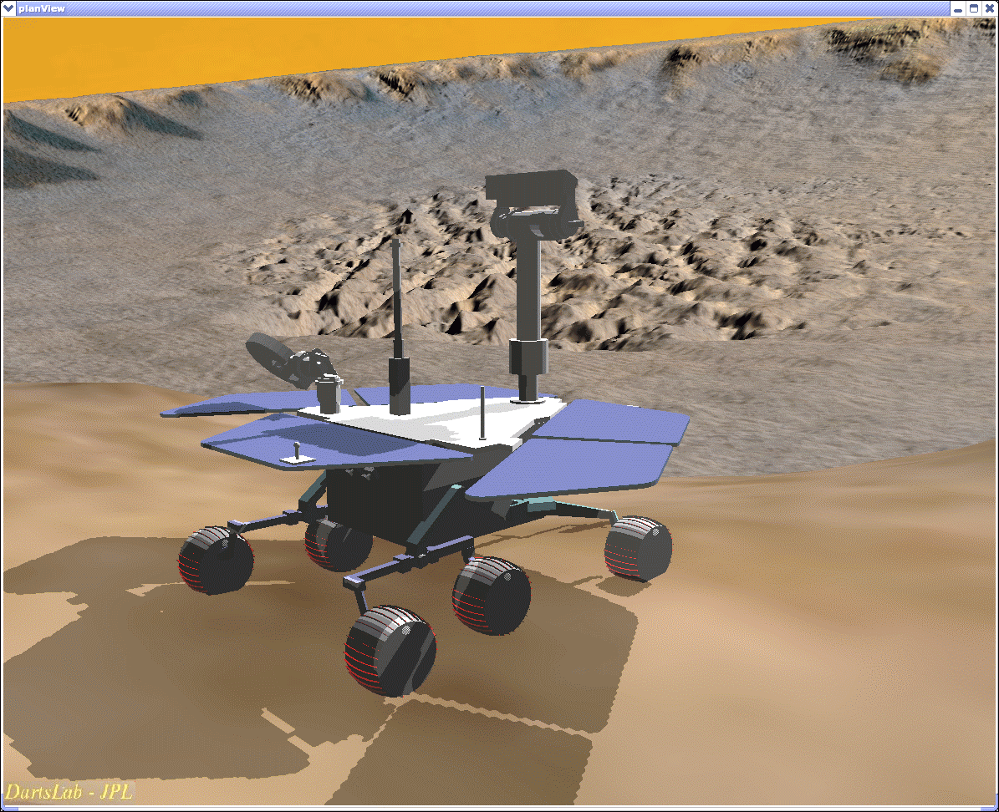
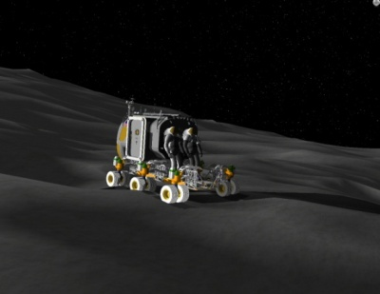
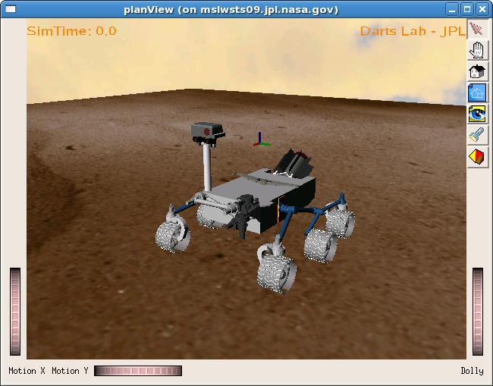
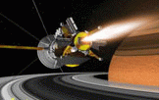

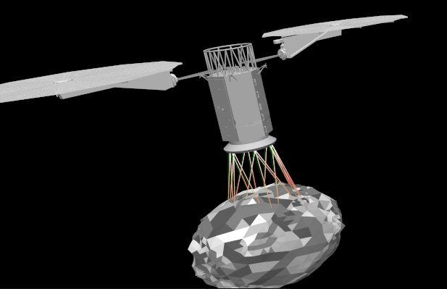
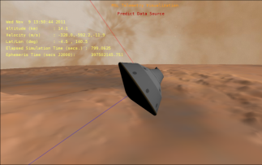
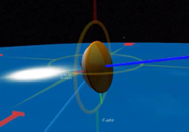
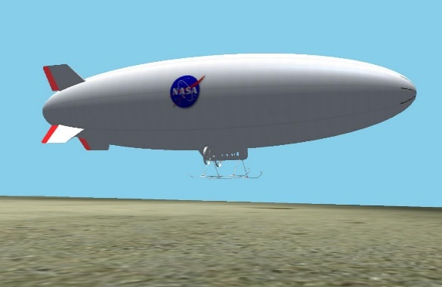
Vehicle Simulation Examples
Rovers
Spacecraft
Aerial

Slide 5
Simulation Complexity
Project | Frames | Dvars | Bodies | Models | Signals | Assemblies
Quadcopter | 33 | 2480 | 5 | 20 | 62 | 21
Mars Heli | 112 | 13000 | 22 | 32 | 76 | 21
Rocky8 | 157 | 21750 | 23 | 96 | 294 | 94
HMMWV | 265 | 24115 | 36 | 34 | 92 | 34
Athlete | 250 | 34649 | 43 | 176 | 586 | 182
RoboSimian | 301 | 71310 | 69 | 167 | 341 | 249
Dual-Arm | 508 | 11858 | 41 | - | - | -
ISS Jettison | 64 | 7147 | 4 | 30 | 123 | 28
SLS | 274 | 23230 | 41 | 110 | 614 | 103
PERA | 114 | 6625 | 7 | 46 | 171 | 52
Orion | 251 | 18724 | 32 | 99 | 564 | 118
Mars 2020 | 190 | 32326 | 23 | 60 | 107 | 55

Slide 6
Context
We have seen some of the key pieces, eg. DARTS needed for the modeling physics of complex vehicle dynamics
Even with these in hand, additional challenges remain for building and using heavy-hitting real-life engineering simulations
  Need non-brittle, evolvable/pliable design
  Support for multiple vehicle/testbed configurations
  Reusable across testbeds, projects and domains
  Auditable/traceable implementation for reviews and V&V
  Usable by non-developers

Slide 7
Dshell Simulations
Simulations CONTAIN:
Vehicle model(s)
  Multibody system, frames, graphics
  Device models, data flows
  Assemblies for sub-systems
  “Black board” for data access (DVar)
Sequencing/state machine (FSM)
Event manager
Integrator
Simulations DO:
Time stepping (integration)
Handles events, FSM, logging
Introspection support (DVars, gui)
Multibody
System
Models &
Data Flows
Sub-system
assemblies
Sequencing
State-Machine
Event
Manager

Slide 8
Dshell Assembly

Slide 9
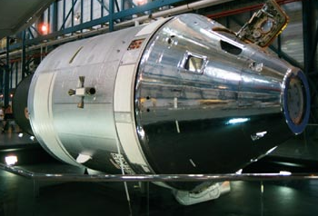
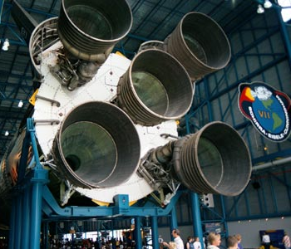
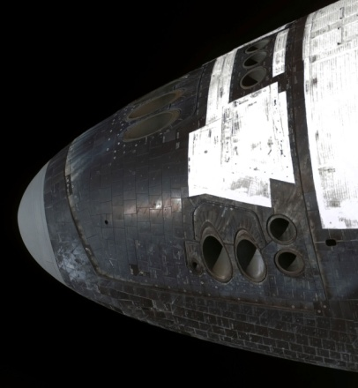
Recurring subsystems in spacecraft
Generic Thruster Subsystem
Similar Thruster Subsystems:
Similar functions/topology
Differing parameters
Spacecraft chassis body
Fuel Tank
Goal:
Create reusable “assemblies” to model generic subsystems
Fuel Lines +
pump + valving
Thruster

Slide 10
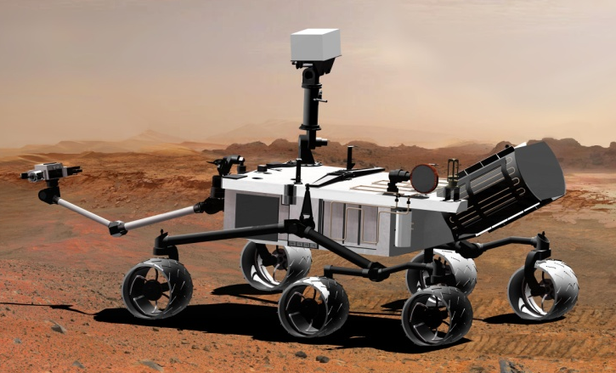
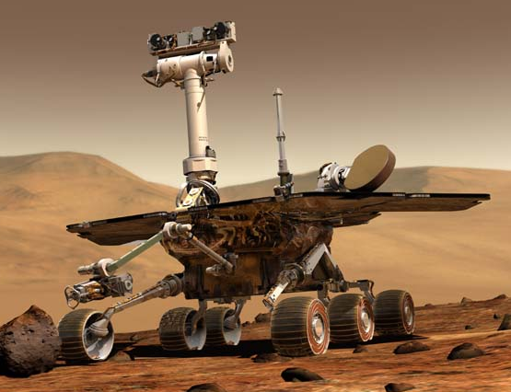
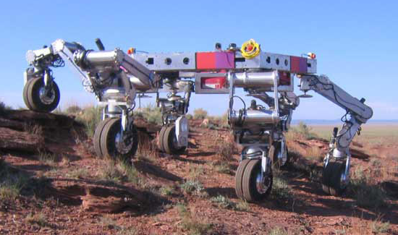
Recurring Assemblies in robotic ground vehicles
Generic Wheel Assembly
Similar Wheel Subsystem Assemblies
Similar function & configuration
  Predictable differences in configuration (eg, number of wheels, steered, etc)
Differing parameters
Parent body
*Steer motor + encoder
“Ankle” Body
*Wheel drive motor + encoder
Wheel

Slide 11
Ground vehicle component assemblies
Scenario
SunPosition
Environment
Gravity
link 1
…
Locomotion
Software
link n
Navigation
Vehicle1
Hardware
Arm
link 1
…
Vehicle2
link n
Chassis
Mast
Left
Wheels
Suspension
Sensors
wheel 1
…
wheel n
Cameras
…
Right
IMU
SunSensor
Contact
Motors
Front
Nav

Slide 12
What are Dshell Assemblies?
Assemblies are hierarchical building blocks for organizing simulation components
Eg. assemblies for thrusters, propulsion systems, vehicles etc
Every Assembly represents a fully functional component/subsystem of the system being modeled
  An assembly should be a self-contained unit for a sub-system
Assemblies are containers for bodies, nodes, frames, signals, Dshell models and other sub-assemblies
  An assembly constructs models and sub-assemblies and connects their signals
  Creates bodies, nodes, frames, models, signals, sub-assemblies
Assemblies are parameterized, include logic for variants, are reusable within a simulation and across various sims
In Python (primarily for construction time, not runtime)
  Based on C++ base class

Slide 13
Assemblies create the simulation backbone: multibody, models, and data flow
Assembly hierarchy
The purpose of an Assembly is to construct the multibody, models, and data flow.
Once that is complete, the assembly’s work is done and is not generally needed at runtime
Emergent multibody model
Asm2
Asm4
Asm1
An Assembly is a Factory creating dataflow and multibody models
Python
Asm3
Asm5
Construction
Run-time
mdl2
mdl3
bd1
bd3
mdl1
C++
mdl4
mdl5
bd2
Emergent model dataflow

Slide 14
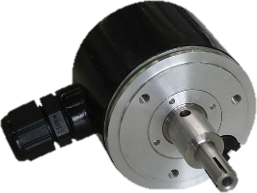
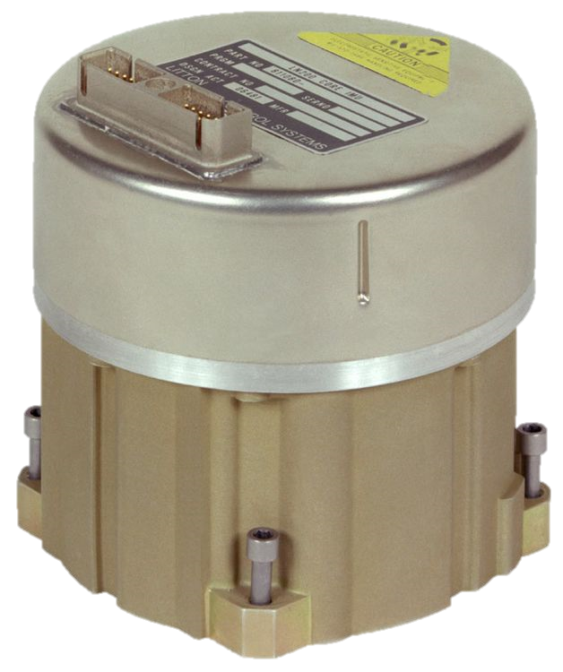
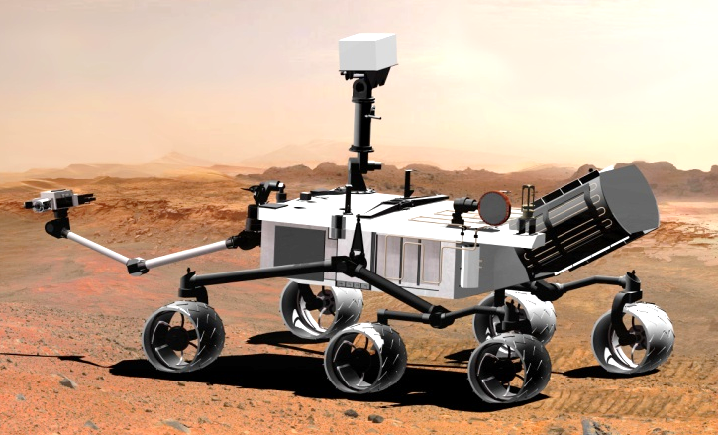
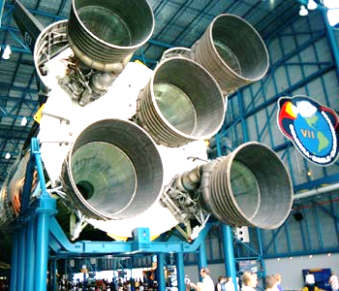
Examples of assemblies
Basic
  Eg, Encoder, IMU
Complex
  VehicleAssembly (for spacecraft, rovers etc)
  PropulsionSystemAssembly
    Constructs Thrusters, Fuel Tanks, and
    manifolds in flexible topologies
Variations
  Gravity: 7 interchangeable assemblies of varying fidelity

Slide 15
Available Assemblies
Dshell++ (2)
DshellCommon (50)
Aero (4)
Gravity (6)
IMU (4)
Propulsion (10)
GravityModels (2)
Other (26)
RoverVehicles (99)
CameraResponse (1)
SurfaceContactAssemblies (10)
Not exhaustive!

Slide 16
The Dshell Assembly Class

Slide 17







Assembly Metaphor
Home
Tall
Person
Apartment
Short
Context
(abode)
Parameters
(height)
Signals
(relationships)
Config
(gender)
Communication
Sub-assemblies
(accessories)
Clothes
Shoes
Phone

Slide 18
An Assembly Constructor
Python Assembly constructor:
__init__(self, name, config, context, params, signalTies,
description, tag)
self – the newassembly object
name – name of the new assembly
config – creation options
context – how to embed in the rest of the sim
params – Parameter data for contained models, etc
signalTies – How to connect (tie) external signals with internal signals for models, sub-assemblies
description – Description of the assembly
tag – A tag for simple retrieval

Slide 19
config – Configuration Options
What is the config attribute?
Used at creation time select supported configuration variants, internal topology, etc
Options to customize assembly internal structure
  Topology, e.g. Number of links in an arm
  Whether wheel assembly is steered (flags)
  Other creation-time variants options
config options allows variants of an assembly, within baked-in limits
Typical config option data types support validation (e.g., numeric ranges, string choices, etc.)

Slide 20
context – Data for embedding
Data to connect the assembly (or its internal parts) into the external parts of the simulation / multibody system
  e.g., parent body and location of a thruster model
'vforce' : {
'class' : 'ExternalDisturbanceActuatorAssembly',
...
'context':{'body':'CapsuleBase'},
},
Apply the force to this body
(model is “attached” to this body)

Slide 21
Assembly ‘params’
Parameters (typically numerical) for it and all its children assemblies
  Class-level list of parameter class objects
  Parameter class objects enforce parameter data validation
Assemblies use the parameter data to set the parameters in its models, and pass parameter data down into the children assemblies it creates…
_param_types = { ‘paramName’ : <ParamBaseClass> }

Slide 22
Creating an Assembly Instance
Assembly “Part” Class (template)
‘config’uration: options for assembly creation (eg. topology, number of links, optional sub-assemblies, steered wheels)
Assembly Creation
Assembly “Part” instance
context: data needed to embed the assembly in the simulation (e.g. parent body)
Attached Part (unparameterized)
‘param’eters: data for specifying assembly, model properties (e.g. mass, noise level)
Bind Params
Part (ready for simulation)

Slide 23
Key Assembly Methods
Construction methods (called in order)
  addSignals() – Make signals for models/asms
  addModels() – also add bodies, nodes
  addAssemblies() – Create sub-assemblies
  More tomorrow!
Post-construction methods
  bindParams() – Install the parameter data into contained bodies, models, etc
  bindState() – Set the initial state of the assembly (contained bodies, models)

Slide 24
Key Assembly Methods
Data retrieval in Assembly code
  config() – Retrieve configuration options
  context() – Retrieve context data
  params() – Retrieve parameter data
  specNode() – Get the DVar data access
  dump()
Others
  description()
  simulation()

Slide 25
Notebook: Instancing an assembly
Add the instance of an existing assembly class in a script, and introspect
  E-Dshell/Part-3-Assemblies/01-Instance-assembly

Slide 26
Notebook: Define an assembly
Define an assembly class from scratch and instance it in a script
  E-Dshell/Part-3-Assemblies/02-Define-and-use-assembly

Slide 27
Assembly builder notebook
Demonstrate using the assembly builder to create a simulation and its assemblies via a configuration definition dictionary
  E-Dshell/Part-3-Assemblies/
  04-Spacecraft-assembly-builder

Slide 28
“Pref-fab” Assemblies
Dshell assemblies can be used to create arbitrary simulations and variants based on the configuration specified.
However, for specific projects (eg. Mars Heli) or vehicles (eg. RoboSimian), the overall configuration is well defined – with much narrower variants
For such systems, we can define assembly classes (eg. AthleteVehicleAssembly) that contain the details of the vehicle configuration.
  Users simply have to instantiate this class to get the full vehicle
  User scripts are much more compact – and less error prone since the lot of the code is tucked away in the assembly class
  Such assemblies will typically support configuration variants (eg. no arm, with cameras, terramechanics options) to support different needs
  Projects can lock down model definitions via such assembly
In general simulations will use some combination of such pre-fab assemblies and script based simulation configuration definitions

Slide 29
Inspecting an assembly

Slide 30
Basic Assembly Information
Sources of Assembly internal information
  Run script “config” dictionary
    Assembly Code
  Direct access through “specNodes”
  Assembly functions
  Dshell GUI simulation data browser

Slide 31
Assembly Spec Node
Assembly data is accessible through its “spec Node” (the DVar interface)
  Get the model object specnode
  Peek / Poke its data
  Most useful to get data for contained models, etc
aspn = asm.specNode()
    aspn() → get python dictionary of all assembly data
    aspn.keys() → list of child branches
    { ‘config’, ‘context’, ‘models’, ‘param’, ‘signals’, …}
    aspn[‘models.model1’] → specnode for ‘model1’

Slide 32
Assembly functions
Get contained model:
Get contained assembly
Get names of contained models:
  mdl = asm.model(‘act’)
  mdl.specNode()()
  casm = asm.assembly(‘child’)
  casm.specNode()[‘models’]()
  [m.name() for m in asm.modeList()]

Slide 33
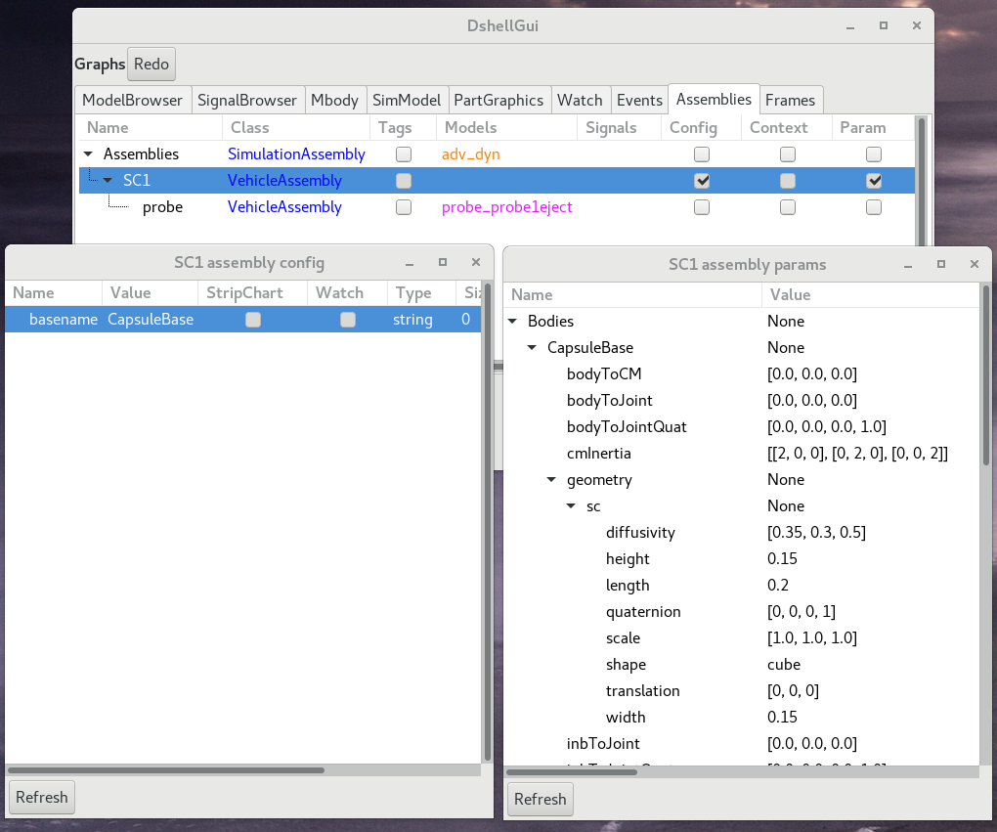
Dshell gui page for assemblies
Hierarchy of assemblies
Contained models
Contained signals
Easy access to config, context, and param data

Slide 34
Connecting Assemblies

Slide 35
Hierarchical Assembly Structure
Assemblies form a hierarchical tree
    Spacecraft1 (VehicleAssembly)
      Gravity Assembly
      IMU
      Probe (VehicleAssembly)
        Gravity Assembly
    Spacecraft2 (VehicleAssembly)
  NOTE: ‘Probe’ could have been done at the top level, but VehicleAssembly has some utilities for dealing “sub”-vehicles
Each assembly is responsible for properly connecting its children assemblies!
Full system model consists of all the sub-systems in the assembly tree
Spacecraft1
Spacecraft2
Gravity
IMU
Probe
Gravity

Slide 36
Passing information between Assemblies
Assemblies define the models and signals they contain
Signals serve as the interface objects to inter-connect models within and across assemblies
So who creates/owns the interface signals?
Assembly “Signal ties” provide a connectivity solution that allows us to design assemblies and their constituent signals, while still allowing sharing of signal with other assemblies
Assembly 1
Signal
Assembly 2

Slide 37
Connecting Sub-System Assemblies
The parent assembly provides signals used to connect models in peer assemblies
Assembly B does not know about Assembly C, therefore the parent assembly A must create
Signal ‘a’ and use it to connect the models in its children assemblies
But at the same time ensuring that B&C do not create duplicate signals
Assembly “Signal Ties”
Assembly B
Parent
Assembly A
Model B
b_out
Assembly C
Signal ‘a’
Model C
c_in

Slide 38
Assembly Signals and Signal Ties
 | Tied to local model |  | NOT tied to local model
Signal created locally in the asm | Not passed down | Passed down | Not passed down INVALID | Passed down
Signal created by parent asm | Not passed down | Passed down | Not passed down ERROR | Passed down
asm
asm
asm
mdl
mdl
mdl
asm
asm
asm
mdl
mdl
mdl
NOTES:
“Passed down” (to child assemblies) is either directly by signalTies into child assemblies or by “Pending Ties”
The O symbol means the assembly creates signal with “addSignal()” but actually uses signal from parent (via the “signal ties” used which creating the child assembly). In case of “pending ties” there may be no “addSignal()” call.

Slide 39
Notebooks: Assembly signals
Show how to connect signals from one peer assembly into another
  E-Dshell/Part-3-Assemblies/03-Tie-models-in-peer-assemblies

Slide 40
Customizing a Simulation Assembly

Slide 41
Customizing Simulations
Assembly ‘config’ options allows choosing variants of an assembly, within baked-in limits, eg. number of thrusters in propulsion system
Can make changes beyond this (update quad-copter by adding another rotor!)
  Calling assembly ‘addAssembly()’ method
  Using assembly builder to add additional sub-assemblies via config dictionaries
Can even alter pre-fab assemblies via such surgery if desired

Slide 42
Evolve & configure simulations
Evolve simulations by adding and/or changing sub-system assemblies
  Eg. can add or remove a wheel, rotor blade, thruster by simply adding or removing the corresponding assembly
    Does not require updating global interfaces
Can change the fidelity of specific sub-systems, eg. alternative fidelity gravity models

Slide 43
Add/Remove Assemblies at Runtime
It is possible to add or remove assemblies on the fly
  Assemblies must delete any data they created
    E.g., Bodies, nodes, frames, etc.
    Tagged items get removed automatically
Notebook:
  E-Dshell/Part-3-Assemblies/05-Add-delete-rover-assemblies

Slide 44
Architectural Issues

Slide 45
Encapsulation
Assemblies share data only through signals connecting their models in the data flow
Information hiding to reduce coupling
Hiding internal detail allows replacing assemblies with alternative ones for different fidelity and granularity
  Assemblies have an “API”
    Signals
    Parameters
  Any assembly matching the signals and parameters can be substituted
Parameters
Asm
Signals

Slide 46
Assembly Python Implementation
The Dshell base assembly class is a C++ class
Assembly classes are all derived from this C++ base class, however most are implemented in Python
Python implementations are convenient since no compilation is required
Moreover there is no impact on performance since all of the work that assemblies do is done upfront during initialization, and they are not involved during the time domain simulation part

Slide 47
BACKUP

Slide 48
Recap
What is a Dshell assembly?
  A sub-system model that can be used to hierarchically create parts of a simulation.
What are examples of an assembly?
  Vehicle, Gravity, IMU, Wheel, Encoder, Thruster, PropulsionSystem
What does an assembly create?
  Bodies, nodes, frames, Dshell models, signals, sub-assemblies
What do we need to instance an assembly?
  config defines the internal structure, context the external interface, etc
How do we instance an assembly?
  Use the AssemblyBuilder
How can one expand an assembly’s functionality at run-time?
  By using the addAssemblyFromDict() method
How do we inter-connect dataflows across assemblies?
  By using signal ties for sharing signals across assemblies.
How do we inspect an assembly?
  GUI, specNodes

Slide 49
What we did not cover …
Details of Parameter classes
Assemblies can also be deleted on the fly (must call its .close() method first)

Slide 50
Instancing an assembly notebook
(Notebook: Day2-TuAm-3Assemblies/1-InstanceAssembly)
Add an assembly two ways
  AssemblyBuilder
  Add another assembly directly

Slide 51
Assembly builder notebook
(Notebook: Day2-TuAm-3Assemblies/1-InstanceAssembly)
Run script with asm config dict
Add another assembly via assembly builder

Slide 52
Introspection notebook
(Notebook: Day2-TuAm-3Assemblies/1-InstanceAssembly)
Illustrate some previous commands for getting at info via specNodes

Slide 53
Where does this topic fit in the big picture …
Closed-Loop
Flight s/w
Autonomy/Control
Devices
Thrusters, IMU,
Cameras etc
Environment
Terrain, Gravity
Atmosphere,
Ephemerides etc
Analysis
Data logging
Parametric
Monte Carlo
Sim Manager
propagation, fsm,
events
Dynamics
Rigid/flex bodies
Articulation
Attach/detach etc
Geometry
CAD parts
Primitives
Visualization
3D graphics
stripcharts
Usability
Introspection
CLI, GUIs, Scripting
Docs, Training
Knowledge base
Evolution
R&D, new applications
new tools & capabilities
Deployment
Bundling
Porting
Issue tracking
S/W Mgmt
Version control
Build system
Test suite
Reusability
Architecture
Configurability
Refactoring

Slide 54
Quadcopter Case Study

Slide 55
Quadcopter sim components
Vehicle dynamics, devices, environment and controller in closed loop
Gravity
model
desired rotor speed
Thrust, Encoder
Controller
cmd
Rotor 1
Multibody
model
Flight
Controller
Thrust, Encoder
Controller
Rotor 2
Fuselage
Rotor 3
Thrust, Encoder
Controller
Rotor 4
Thrust, Encoder
Controller
fuselage
state
rotor speed and torque
State
sensor

Slide 56
“Multibody-Centric” Design Pattern
Control
Software
Multibody dynamics is complex and involves specialized skills
The dynamics model and solver are traditionally a black box for the simulator
The multibody-centric approach thus builds the central dynamics as a monolithic black box
Device etc models are built separately and integrated with the multibody dynamics
Close the loop with the flight/control software
Multibody
Actuators
Sensors
Artificial divide, in spite of tight coupling, makes the interfaces between the dynamics and device physics complex!

Slide 57
Problems with this Approach
Adding a rotor, landing leg, camera requires simultaneous changes to the monolithic multibody model, and its complex interfaces to accommodate the new device models
  Easy to get this wrong
  The simulator design is brittle and accommodating changes and extensions is difficult
Design brittleness arises from the monolithic multibody model from the multibody-centric design pattern

Slide 58
Multibody-Centric Design Pattern
Issues with the multibody-centric design pattern
  Artificial separation between dynamics and device physics models is at odds with the tight coupling between them!
  Treats data and methods as separate entities
  Requires lots of cross coupling and use of global data structures to manage interfaces
  Structural changes in one place have ripple effect of multiple changes in other places
  Difficult to scale up the design
  Complexity growth can box you in!
  Very difficult for anybody but original developers to reuse component models
Dshell uses a different design pattern – that does away with the monolithic multibody model

Slide 59
“Subsystem-Centric” Design Pattern
Ndarts allows multibody model to be built up incrementally and in a distributed way
The multibody model is an emergent model from building sub-systems
Does away with complex booking and interfaces with device models
Control
Software
DARTS
Actuators
Sensors
At creation, each device model is provided the node/hinge object it needs – so no explicit global interface is needed.

Slide 60
Use assemblies to create all components of a sub-system
Gravity
model
Build up simulations via a hierarchy of assemblies.
desired rotor speed
Thrust, Encoder
Controller
Rotor assembly
cmd
Rotor 1
Multibody
model
Flight
Controller
Thrust, Encoder
Controlle
Rotor 2
Fuselage
Thrust, Encoder
Controlle
Rotor 3
Rotor 4
Thrust, Encoder
Controlle
fuselage
state
State
sensor
rotor speed and torque

Slide 61
Single rotor assembly details
A rotor assembly includes a rotor body with a node, coupled to encoder, controller, motor models and thrust model
Rotor body
thrust
thrust
torque
speed
encoder
speed
controller
volt
motor
desired speed
(from flight controller)

Slide 62
Quadcopter assembly hierarchy
Flight
controller
Gravity
Motor
Rotorcraft
Rotor 1
Thrust
Motor
Fuselage
Rotor 2
Assembly containment hierarchy
Thrust
Motor
Rotor 3
Thrust
Rotor 4
Motor
Each rotor assembly creates its body, nodes etc
Assemblies are objects, so can have multiple instances
Thrust

Slide 63
Why sub-system centric design pattern?
The multibody model is not a monolithic module that we explicitly build!
  Built incrementally by the yard
Device models that interact with dynamics have narrow access to the node or hinge they need
  Minimizes coupling and interaces
  Device models do not know or care about other aspects of the multibody model
Modular and decoupled design
Much easier to modify and scale up

Slide 64
Emergent mechanism & dataflow
Assembly hierarchy
Asm2
Asm4
Factory creating dataflow and multibody models
Asm1
Asm3
Asm5
Construction
Run-time
mdl2
mdl3
bd1
bd3
mdl1
mdl4
mdl5
bd2
Emergent model dataflow
Emergent multibody model

Slide 65
Questions to Address
What is a Dshell assembly?
What are examples of an assembly?
What does an assembly create?
What do we need to instance an assembly?
How do we instance an assembly?
How can one expand an assembly’s functionality at run-time?
How do we inter-connect dataflows across assemblies?
How do we inspect an assembly?

Slide 66
Assemblies Enable …
Creating different configurations of a system
  Rover mechanical model (no sensors)
  Rover for locomotion (no cameras or navigation s/w)
  Rover for navigation (different navigation s/w options)
Creating variants of a system
  4 wheeled rover
  Different steered wheel combinations
  Legged rovers
Sharing assemblies across different types of systems

Slide 67
What is in an Assembly Class?
The Assembly class (template / recipe)
  Functions to create or manipulate the assembly
  Functions to retrieve its internal parts (eg, models, signals, sub-assemblies it creates / owns)
  Other common utility functions
  Optional functions to perform custom functions specifically for this assembly

Slide 68
What is in an Assembly Instance?
Internal data/objects it creates:
  Signals, bodies, models, and sub-Assemblies
Data used in its creation:
  “config” options (eg, number of links in arm)
  “context” data used to embed the assembly in its parent / simulation
  “params” data for properties for its models/sub-asms

Slide 69
DARTS/Dshell Software Highlights
The DARTS/Dshell software is a toolkit for high-performance engineering simulations for aerospace, robotics etc. applications featuring:
  Comprehensive for aerospace/robotics applications
  Mature, industrial strength
  Multi-mission architecture
  State-of-the-art dynamics
  Tailorable and scalable API
  Fast and real-time
  Batteries included
  Modern software design
  Evolving capabilities

