Slide 1
NdartsFlex
Flexible Multibody Dynamics
2023 DARTS Lab Course
Abhinandan Jain, Aaron Gaut, Carl Leake, Vivian Steyert, Tristan Hasseler, Asher Elmland, Juan Garcia Bonilla
Notes:
1

Slide 2
Where does this topic fit in the big picture?
Closed-Loop
Flight s/w
Autonomy/Control
Devices
Thrusters, IMU,
Cameras etc
Environment
Terrain, Gravity
Atmosphere,
Ephemerides etc
Analysis
Data logging
Parametric
Monte Carlo
Sim Manager
propagation, fsm,
events
Dynamics
Rigid/flex bodies
Articulation
Attach/detach etc
Geometry
CAD parts
Primitives
Visualization
3D graphics
stripcharts
Usability
Introspection
CLI, GUIs, Scripting
Docs, Training
Knowledge base
Evolution
R&D, new applications
new tools & capabilities
Deployment
Bundling
Porting
Issue tracking
S/W Mgmt
Version control
Build system
Test suite
Reusability
Architecture
Configurability
Refactoring

Slide 3
References
NdartsFlex Sphinx docs
NdartsFlex Doxygen docs
See NdartsFlex, FModal, and NESCFlex tests
3

Slide 4
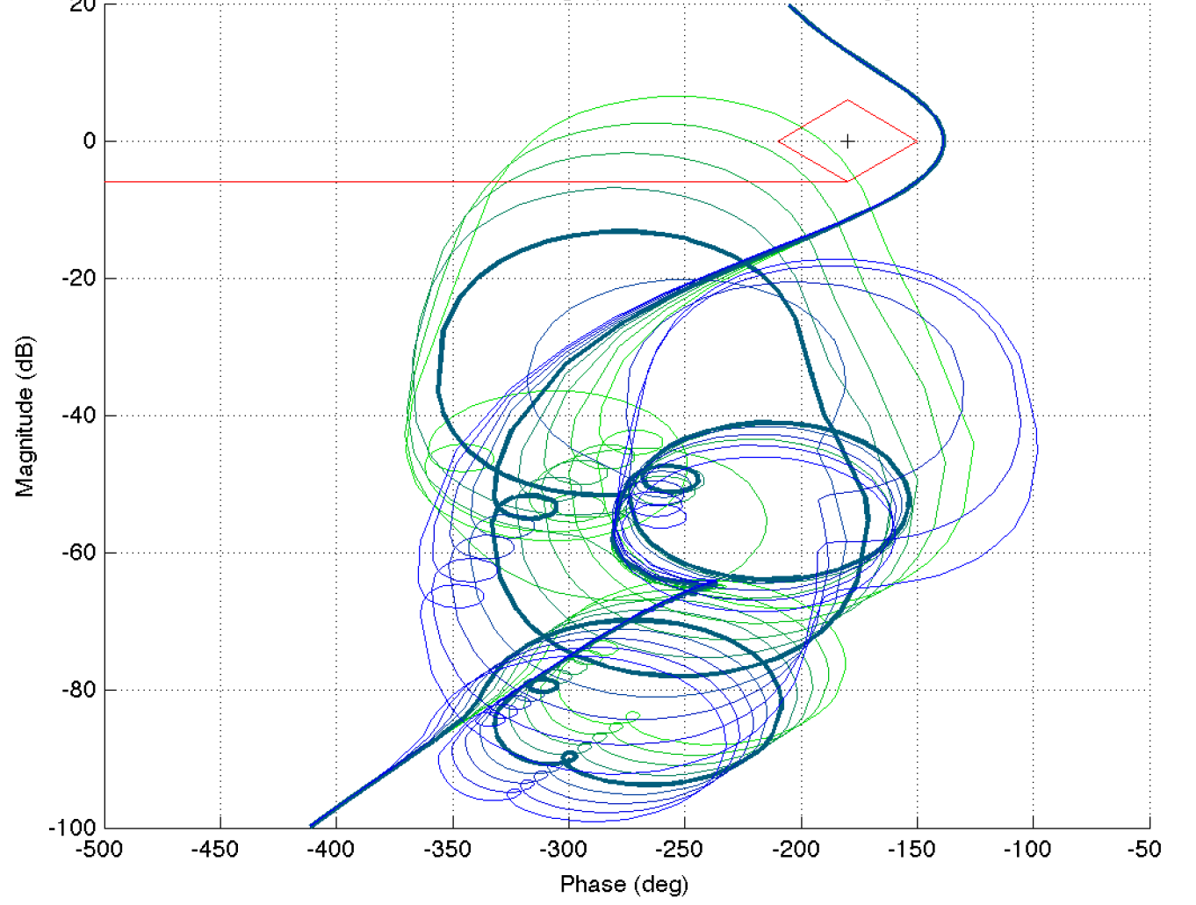
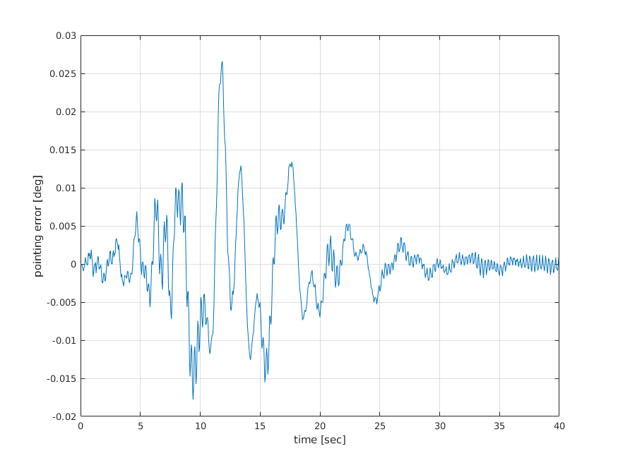
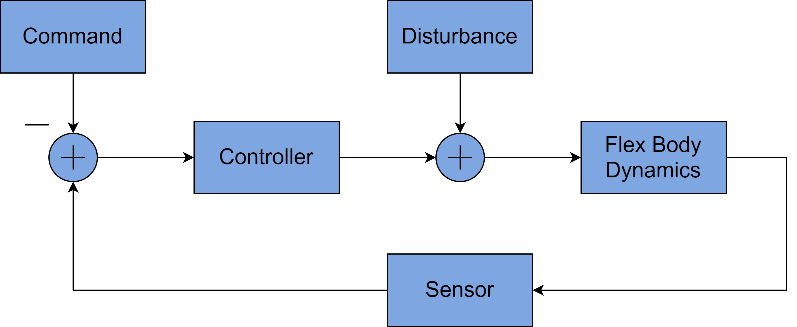
Flexible Body Dynamics Significance
Flexible body effects can negatively impact control system stability and performance
  Underlying dynamics can be time-varying, multibody, and contain nonlinearities, rigid-flex coupling, and large mode sets
  This analysis is typically carried out for multiple channels, time segments and modal data sets, therefore requiring many models
Nichols plots (linear analysis) illustrates the potential for controls-structures interaction
flex body effects
Sample Block Diagram
Time-domain nonlinear model results illustrate undesirable pointing error due to control system interaction with structural modes

Slide 5
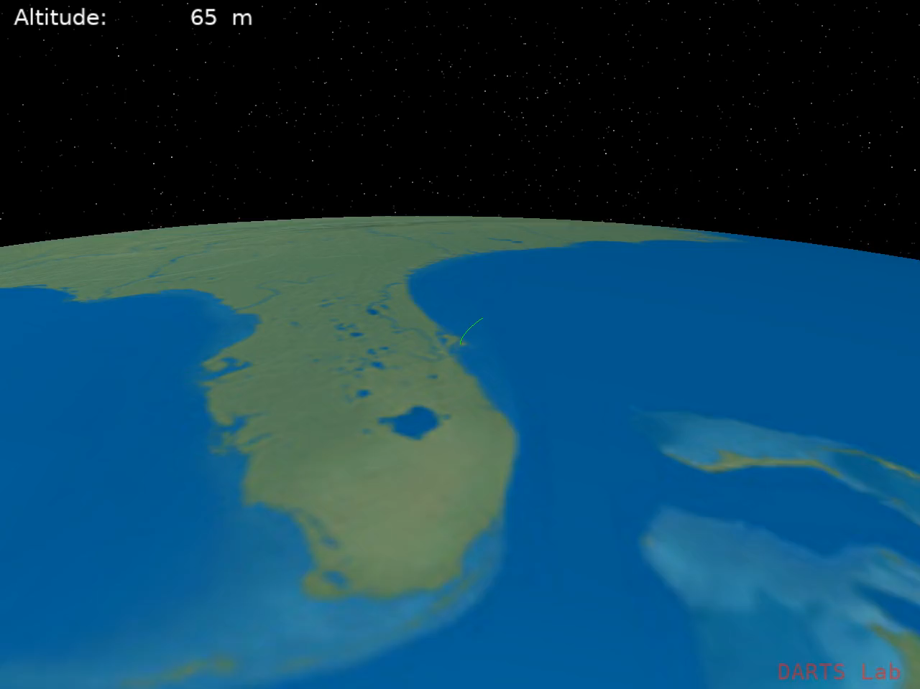
Flexible Launch Vehicle Closed-Loop Simulation

Slide 6
DARTS Toolkit
Spatial Operator Algebra (SOA) methodology
analytical minimal coordinates multibody dynamics
Applications
Mechanism Modeling
robotics, aerospace,
spacecraft, landers, launch vehicles,
ground vehicles,
molecular dynamics
biomechanics
rigid/flex bodies, tree/graph topologies, serial/parallel mechanisms; smooth & non-smooth dynamics, fast O(N) recursive algorithms, structure-based algorithms, variable topology, constraint embedding, hybrid dynamics, C++/Python, model importers/exporters
Simulation
Analysis
Embedded
Research
solve equations of motion, O(N) forward dynamics,
real-time closed-loop simulations, ODE solver,
closed-chain dynamics, contact & collision dynamics
kinematics, workspace analysis, Jacobians, inverse dynamics, mass matrix, manipulability, constraints, grasp analysis, operational space inertia, under-actuated systems
embedded real-time models, Jacobians, collision free path planning, real-time control, gravity/load compensation, load balancing, feed-forward control, estimation, whole body motion control
multibody dynamics algorithms & formulations,
diagonalized dynamics, sensitivity analysis, constraint embedding, Fixman potential

Slide 7
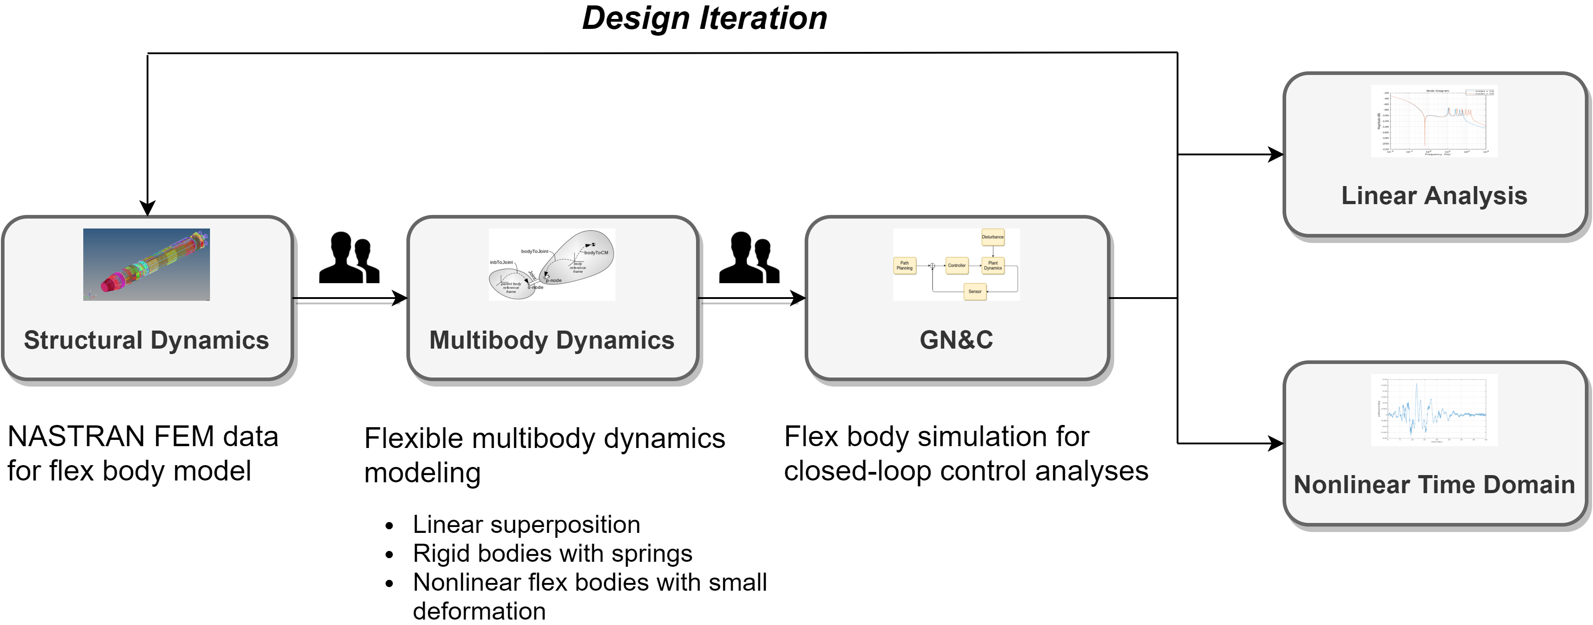
GN&C Flex Modeling Challenges
Multiple specialties and domains are involved, which require hand-offs, leading to disconnects and delays. This adversely impacts ability to develop and refine G&C models.
Commonly faced challenges:
  Time-consuming design iterations
  Lack of GN&C-focused sanity checks prior to model delivery
  Reliance on custom tool sets that can be difficult to modify and often incorporate complex dynamics in an ad-hoc manner
  Costly code development to interface structures datasets with GN&C tools
7

Slide 8
FEM-to-GN&C Pipeline
Captures all non-linear rigid-flex coupling effects
No iteration needed to include missing effects
Applies to arbitrary vehicle configuration
GN&C Time-Domain Simulations & Testbeds
General Nonlinear Multibody Dynamics Model
(e.g., DARTS)
Automated
Linearization
FModal
Vehicle Structure
(e.g., NASTRAN)
GN&C Linearized Model
(Control Design & Analysis)
Design iteration
Modify modal requirements and structural testing
Iterate control system design

Slide 9
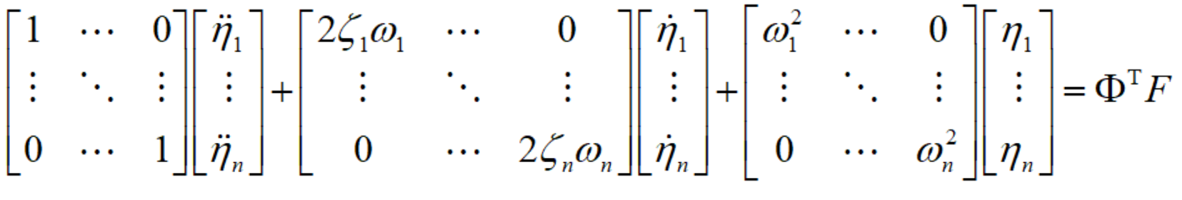
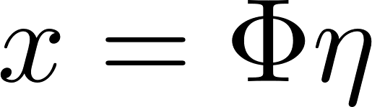
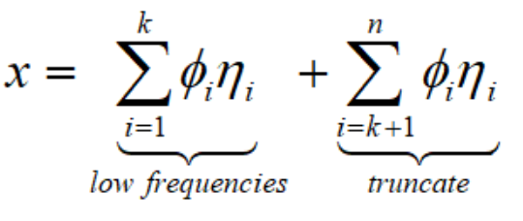
Linear Structural Dynamics Modeling
Finite Element Modeling
Modal Analysis
Model Reduction
large number of degrees of freedom
small deformation
nodal (physical) coordinates
coupled linear equations of motion
modal (generalized) coordinates
uncoupled linear equations of motion
remove modes that don’t contribute to points of interest (sensors, actuators, etc.)
mode displacement
balanced truncation
residual modes
9

Slide 10
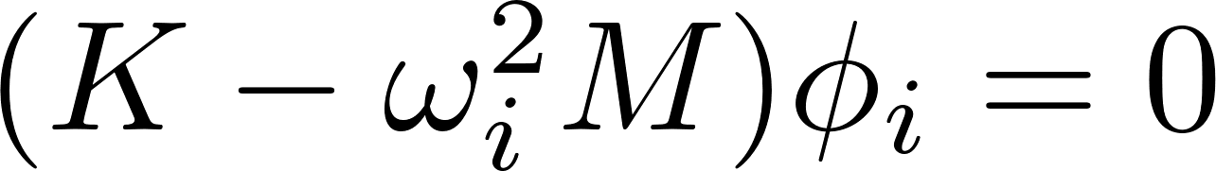
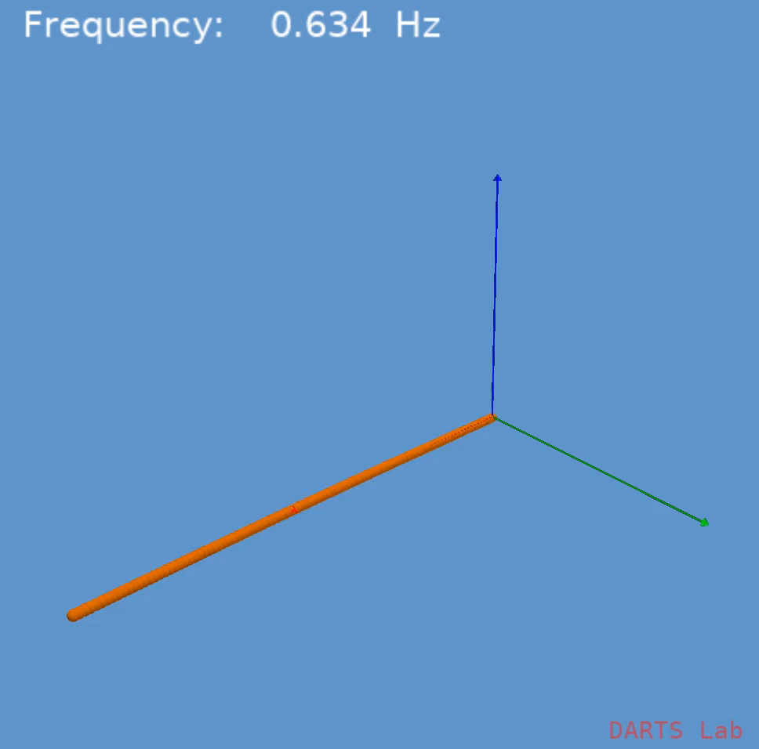
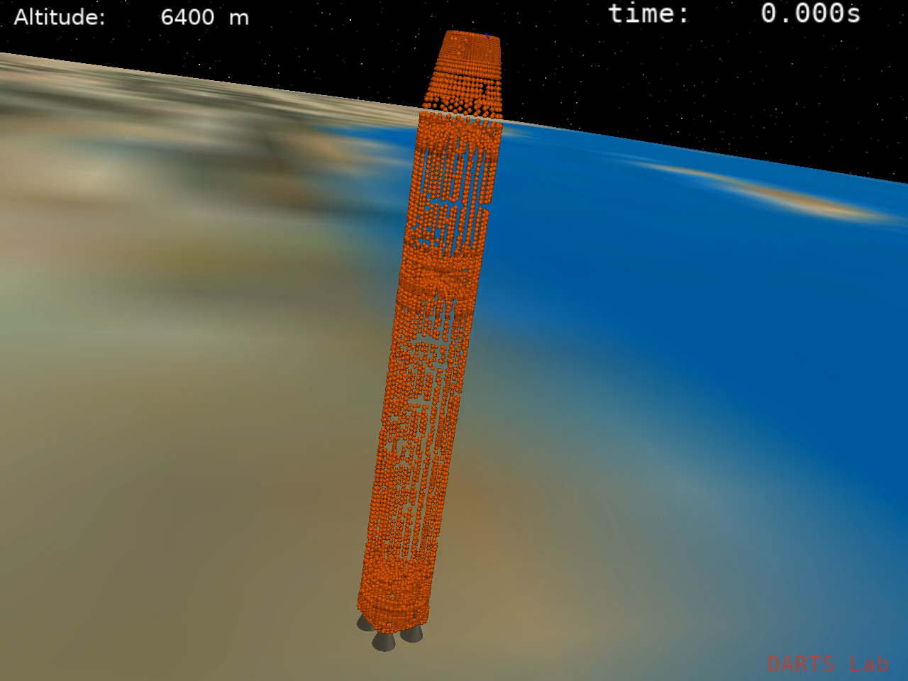
Mode Shape Visualization
For each fundamental mode shape, there exists a corresponding frequency of vibration obtained from the generalized eigenvalue problem
1st − 5th bending modes
of a simple beam
1st bending mode (3.3 Hz) of a complex launch vehicle
10

Slide 11
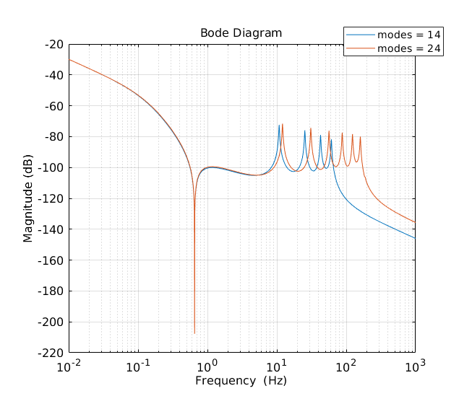
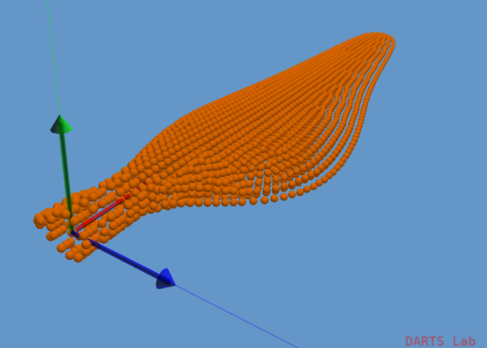
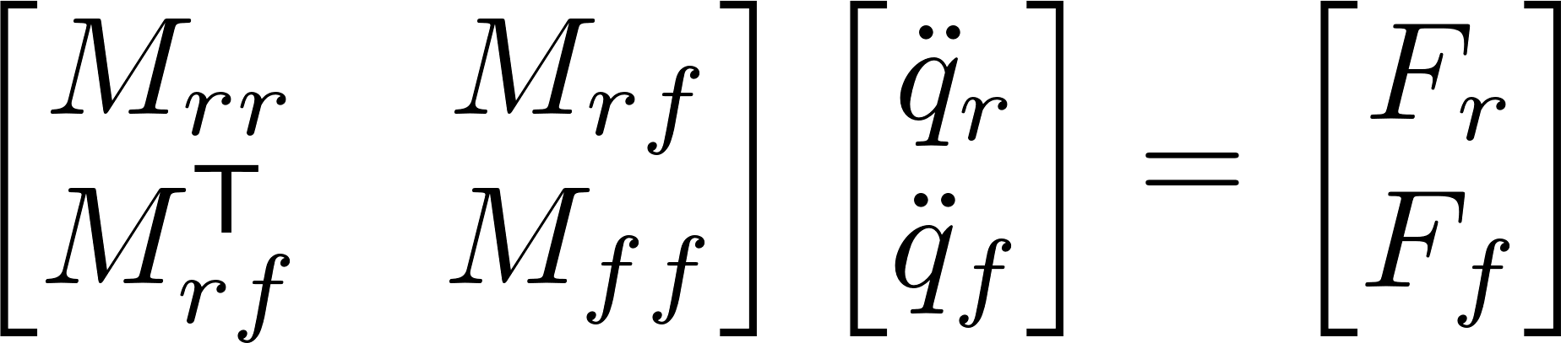
Model Reduction
Model reduction is a necessary step for GN&C simulation purposes
The rotorcraft blade pictured below has 16842 degrees of freedom (too large to directly implement!)
Modal truncation (a form of model reduction) approximates the full FEM
  Reduces degrees of freedom but retains desired frequency content
Modal Truncation
10³ – 10⁶ DOF!
10¹ – 10³ DOF
11

Slide 12
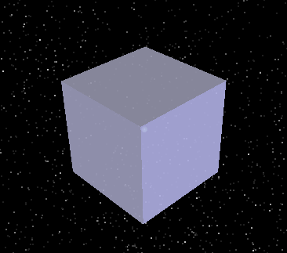
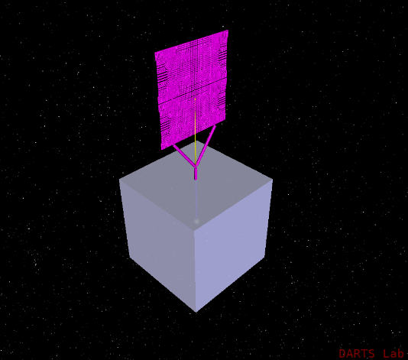
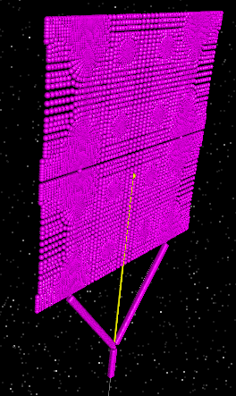
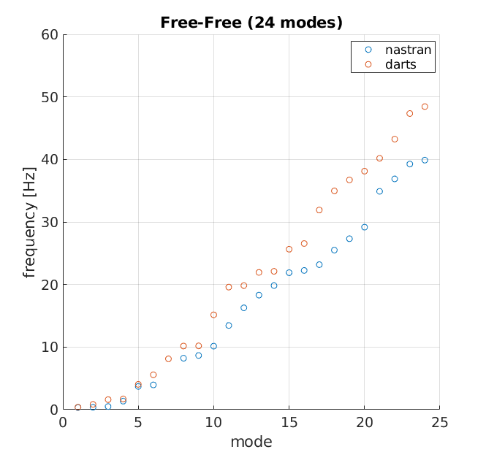
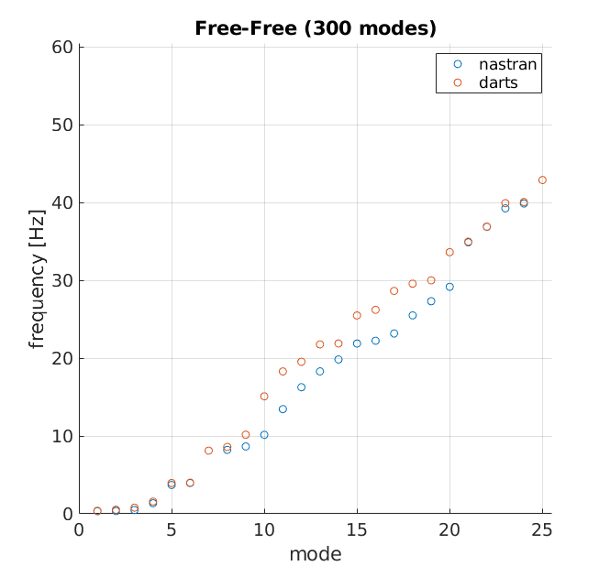
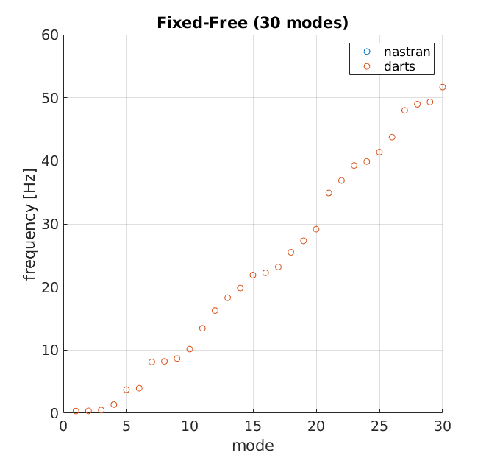
Mode Choice Effects Model Fidelity
Component Models
System Models
  22824 grid points
  136944 dof
Craig Bampton (fixed-free) modes are better suited for combining component models with fixed boundary conditions
24 free-free
300 free-free
30 fixed-free

Slide 13
Building Flexible Multibody Models in DARTS/Dshell
13

Slide 14
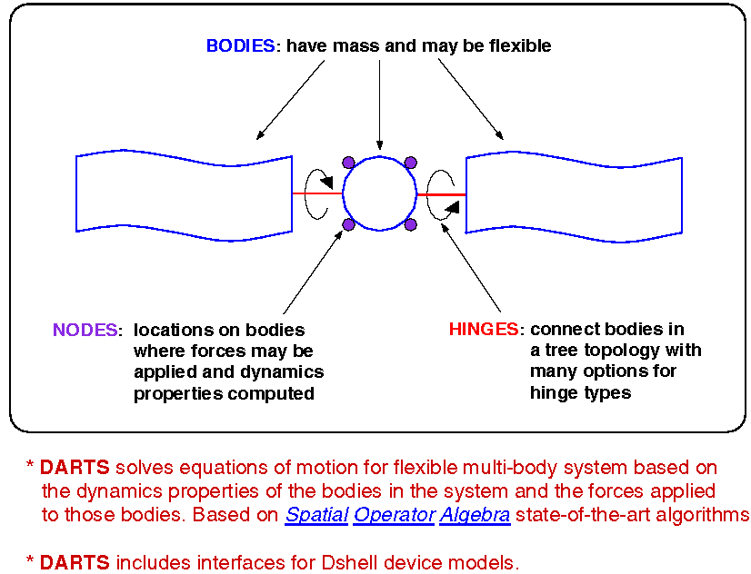
DARTS
Rigid/Flexible Real-Time Multibody Dynamics Engine
Minimal coordinates
Optimal O(N) algorithm
Serial & tree
Closed-chain
Contact & collision
Variable topologies
Abhinandan Jain, "Robot and Multibody Dynamics: Analysis and Algorithms", Springer, 2010.

Slide 15
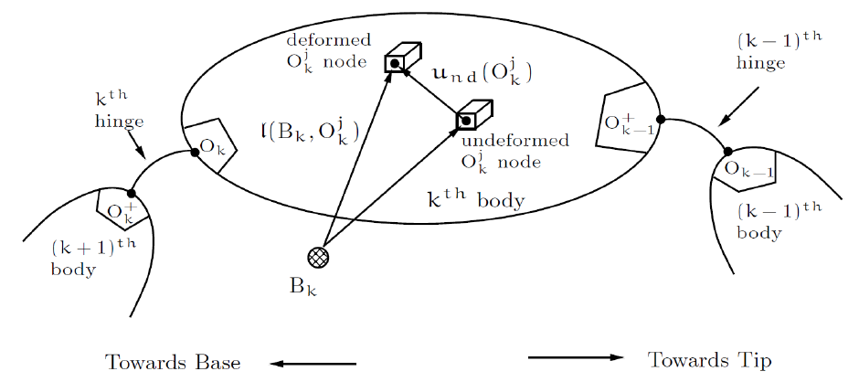
Coupled Flexible Bodies in DARTS
Flexible bodies have small deformable dofs in addition to large articulation dofs
The SOA operator approach and mass matrix inversion methods continue to apply
Dynamics algorithm is O(N) in articulation dofs (quadratic in deformable dofs)

Slide 16
The DARTS Flex Multibody Solution
Based on structure based recursive algorithms from Spatial Operator Algebra (SOA)
Minimal coordinates formulation; arbitrary topology
ODE (not DAE) formulation – simpler & larger time steps
Lowest cost O(N) recursive algorithm; no code generation
Configuration changes (add/remove/reattach) bodies at run-time: algorithms automatically adapt to new topological structure
Support for flexible bodies with closed-chain and contact dynamics
Can directly use modal data – no model tuning required
Can create multibody configurations via data files or procedurally
Can enable/disable prescribed motion at hinges
Supports mass property changes (e.g. fuel consumption)
Hinge types – 0 to 6 dof, 12 hinge types
Bilateral constraints – frame pair, hinge based, shapes based
Can create and articulate stick graphics for verifying model

Slide 17
NdartsFlex
The DartsFlexBody class is for deformable bodies
Has additional deformation stiffness and damping properties
Requires additional modal matrices for each node on the body
  Each node on a deformable body is of type DartsFlexNode (which has the modal matrices specific to the node)
SOA recursive methods continue to apply for flex bodies

Slide 18
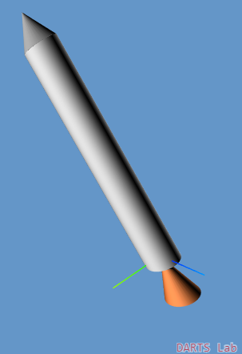
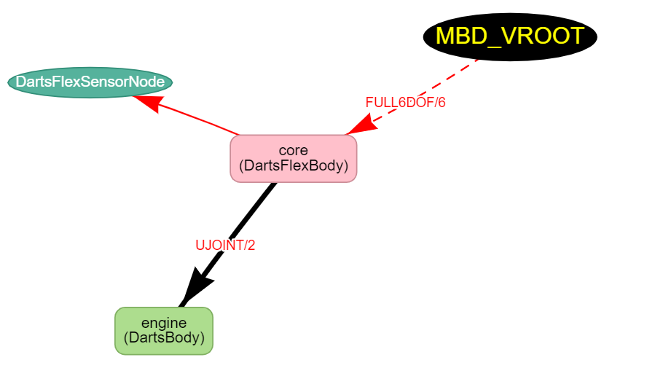
Ndarts Flex Body
(Notebook: F-FlexDynamics/01-CreateFlexLV)
Create a flexible multibody system using an example launch vehicle system.
18

Slide 19
Interfacing with NASTRAN using FModal
19

Slide 20
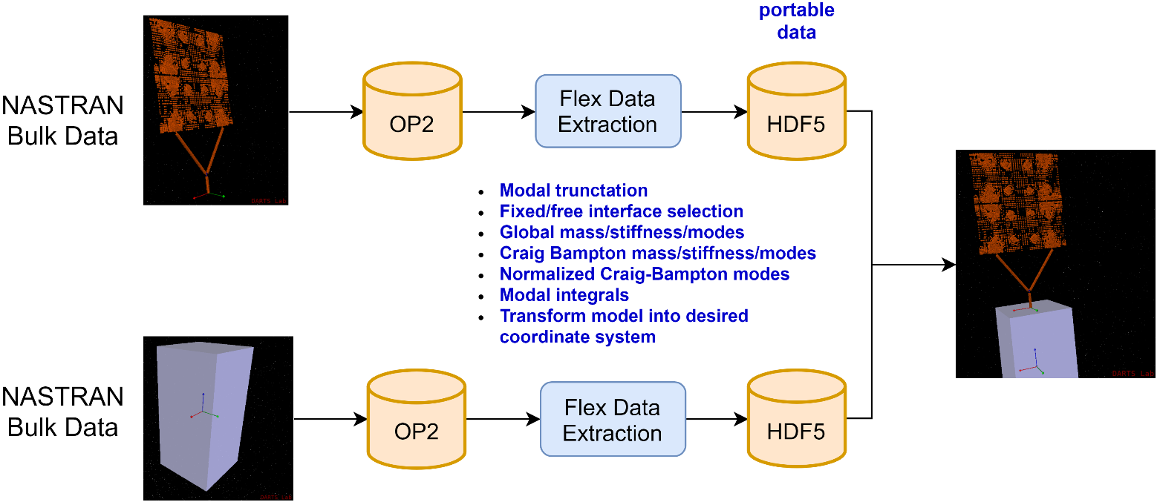
FModal – NASTRAN to Multibody Dynamics Pipeline
FModal: a toolset written in C++ and Python that simplifies NASTRAN execution and data extraction for multibody dynamics tools
Imports complex NASTRAN bulk datasets
Creates custom OP2 output stored in “portable” HDF5 data files
Simplifies complex and time consuming model iteration process by tying together general purpose structural and multibody dynamics tools critical for GN&C design and analysis
20

Slide 21
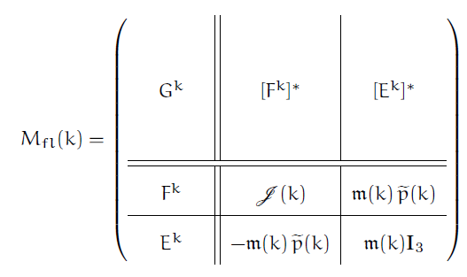
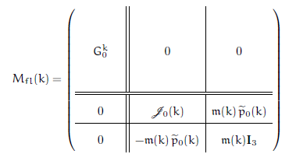
Improving Flexible Body Dynamics Model Fidelity
Deformation dependency of flex body mass properties is commonly ignored because FEM data products are difficult to obtain
Modal integrals are needed to support models where there are
  large deformations or angular rates
  mode shapes that are non-orthogonal to rigid body motion (for example, with fixed-free models such as Craig-Bampton)
Flexible Body Mass Matrix with Modal Integrals
Modal Generalized
Mass Matrix
Rigid/Flex
Coupling
Flexible Body Mass Matrix without Modal Integrals
Rigid Body
Mass Matrix
21

Slide 22
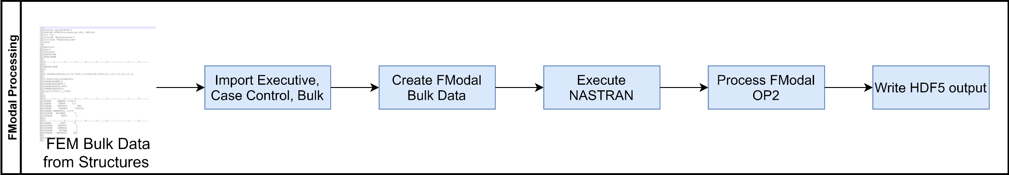
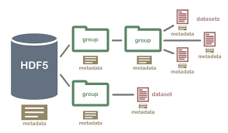
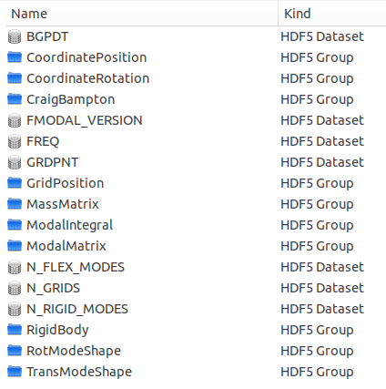
FModal Processing
Sample FModal HDF5 File
FModal interface allows easy modification of GN&C relevant NASTRAN output
  Modal truncation
  Fixed/free interfaces
  Output coordinate transformations
Standard HDF5 output includes
  Grid point and coordinate system definitions
  Mode shapes for both free and fixed interfaces
  Physical (G-set) mass and stiffness matrices stored in sparse format
  Rigid body mass properties about desired reference point
  Mode shapes at all, or desired, grid points
  Modal integrals
22

Slide 23
Importing NASTRAN Data
(Notebook: F-FlexDynamics/02-NASTRAN_tbeam)
Run a NASTRAN model and import NASTRAN modal data.
23

Slide 24
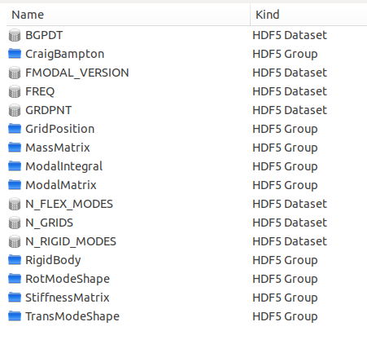
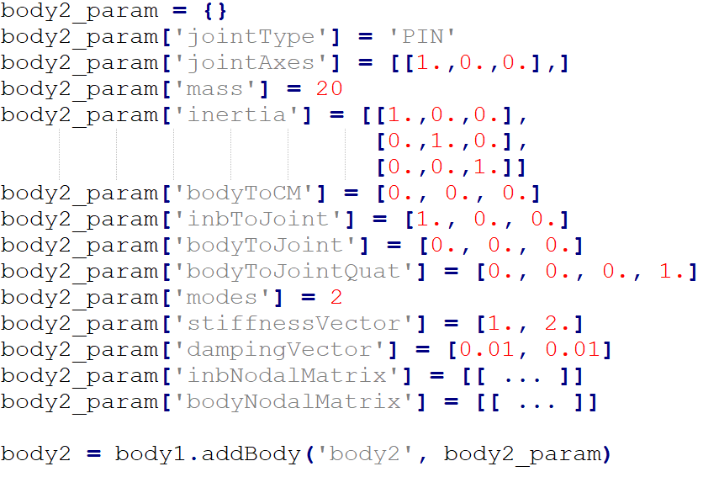
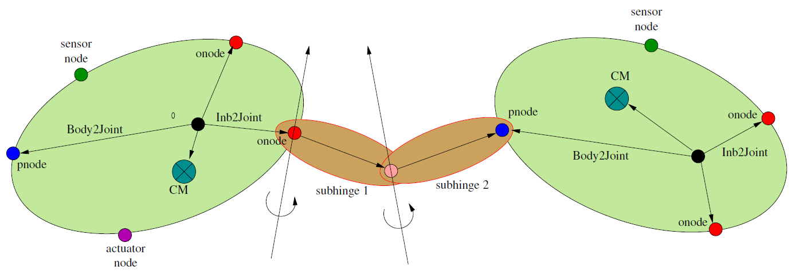
ReadHDF5Flex − FModal to DARTS
Multibody Dynamics
DARTS Multibody Dynamics
FModal HDF5 File
Flex Nodes
Flex Bodies
24

Slide 25
ReadHDF5Flex Utility
(Notebook: F-FlexDynamics/03-ReadHDF5Flex)
Evaluate rigid body properties, grid point locations, mode shapes at specific grid points, modal integrals, etc.
Build a DARTS model from an HDF5 flex file.
25

Slide 26
Building Flexible Multibody Simulations with Dshell
26

Slide 27
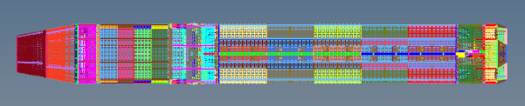
Building Up a Dshell Simulation with
Component FEM Bodies
Component FEM models based on GN&C needs
Select hinge types for multibody articulation and add actuator / sensor models in Dshell
Dshell
FModal
Time domain simulation
DARTS
Multibody
Engine
Rigid Body
Booster FEM
FModal
Linear model
Engine
Actuators
IMU
Sensor
27

Slide 28
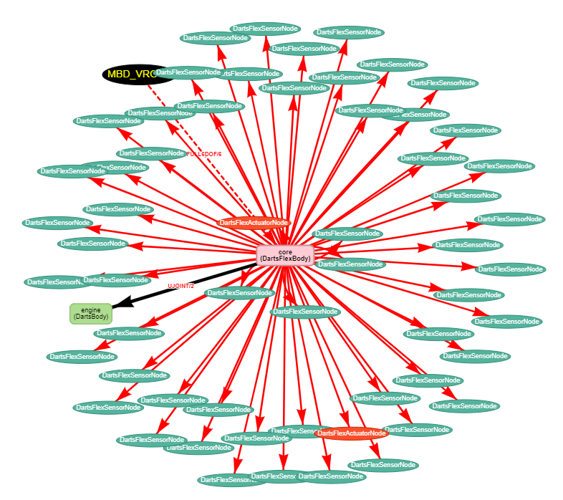
Dshell Flexible Body Simulations
(Notebook: F-FlexDynamics/04-FlexLVSensAct)
Create a Dshell simulation for flexible multibody systems with sensors and actuators.
28

Slide 29
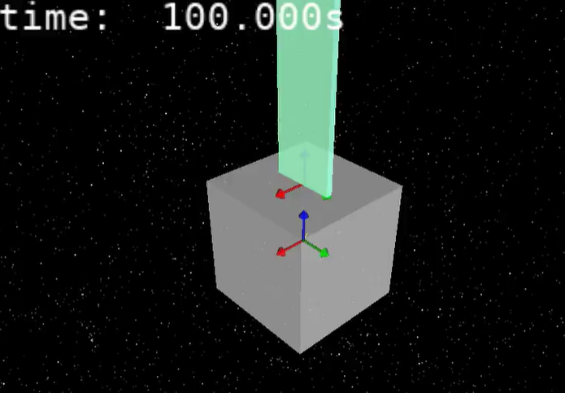
Rigid Multibody Spacecraft Simulation
(Notebook: F-FlexDynamics/05-RigidSolarArray)
Build a rigid multibody dynamics time-domain simulation using HDF5 flex data.
29

Slide 30
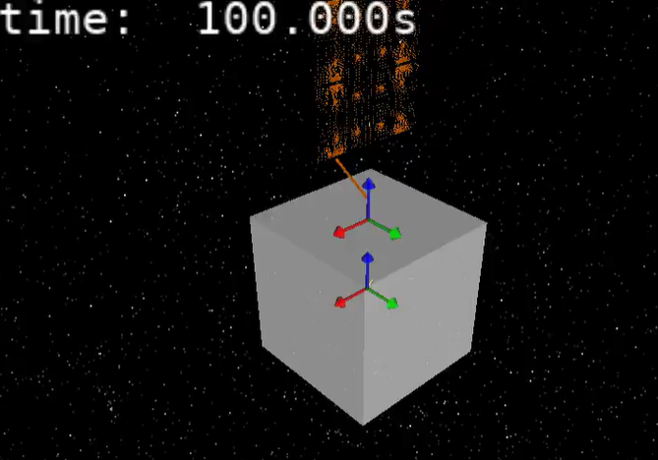
Flexible Multibody Spacecraft Simulation
(Notebook: F-FlexDynamics/06-FlexSolarArray)
Build a flexible multibody dynamics time-domain simulation using HDF5 flex data.
30

Slide 31
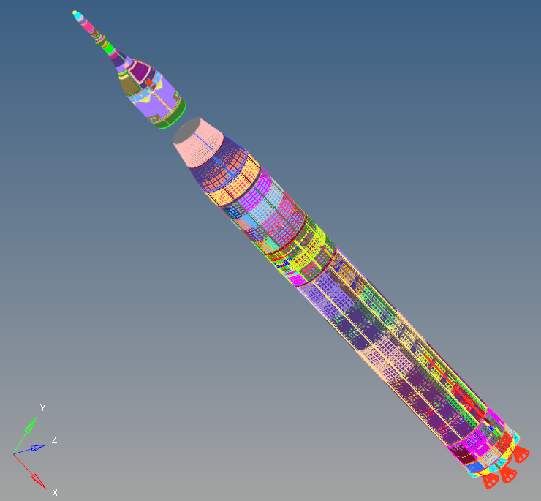
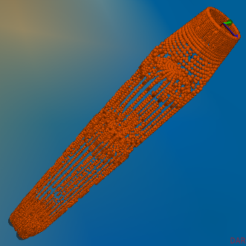
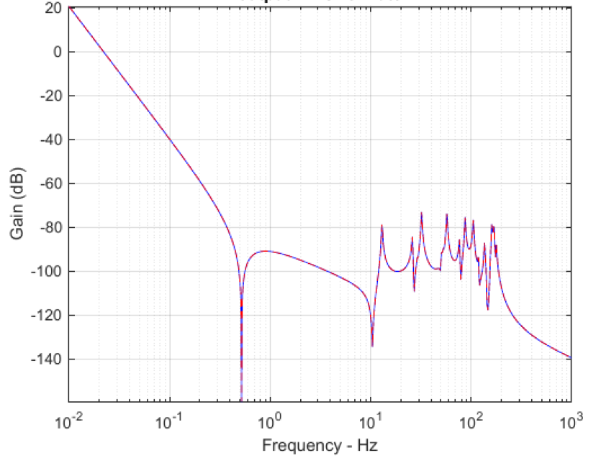
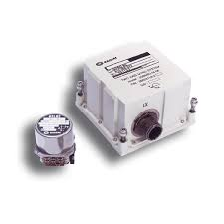
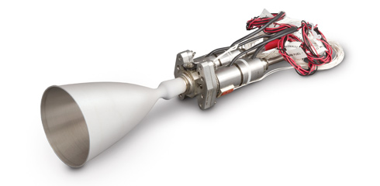
Dshell System Linearization
Dshell linearization allows arbitrary specification of system inputs and outputs for linear state space modeling.
Linearization includes all effects modeled in DARTS/Dshell
(e.g., multibody dynamics, actuator dynamics, aeroelastic coupling, etc.)
Linear System
NASTRAN FEM
Dshell
Controller
Plant Dynamics
FModal
DARTS Flexible Multibody Model
Sensor
Linearization and
Linear Analysis
Sensors
Actuators
GN&C Algorithms
31

Slide 32
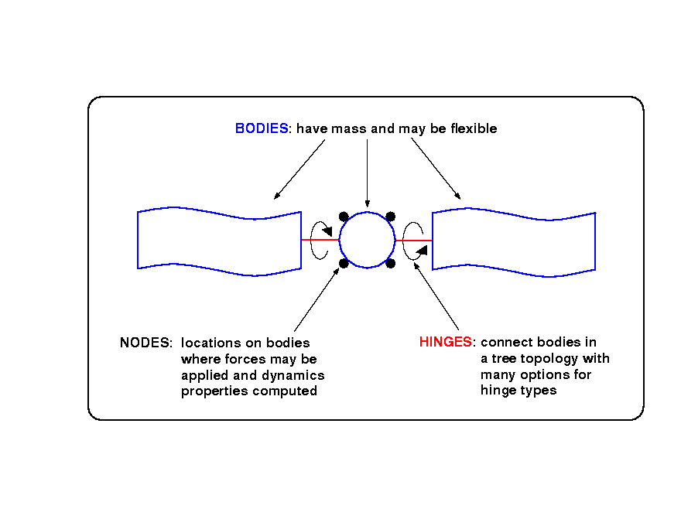
Flexible Multibody System Linearization
(Notebook: F-FlexDynamics/07-SystemLinearization)
Build a linear state space model with inputs and outputs, and compute system frequencies.
Control
Software
Flexible
Multibody
Actuators
Sensors
DVar spec nodes
32

Slide 33
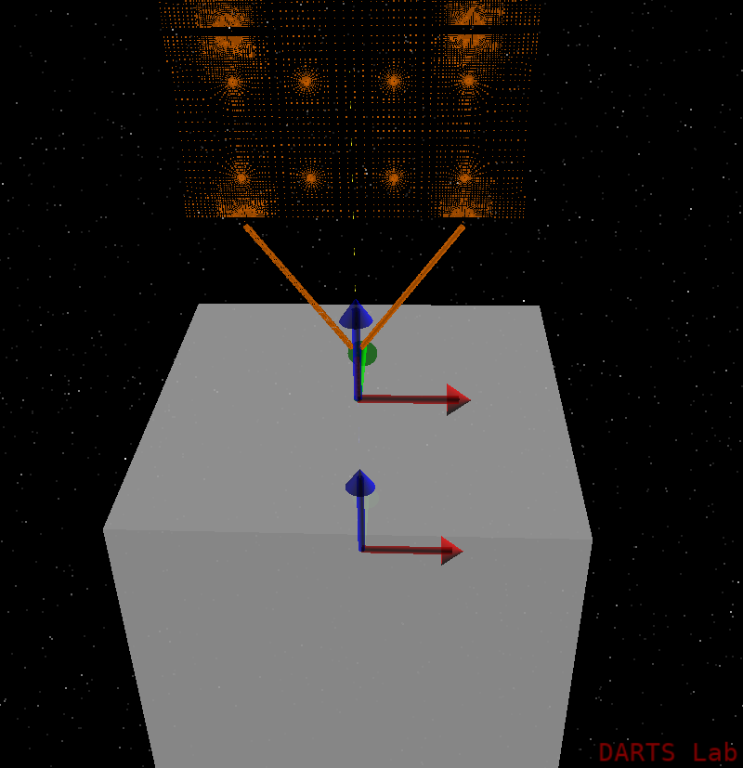
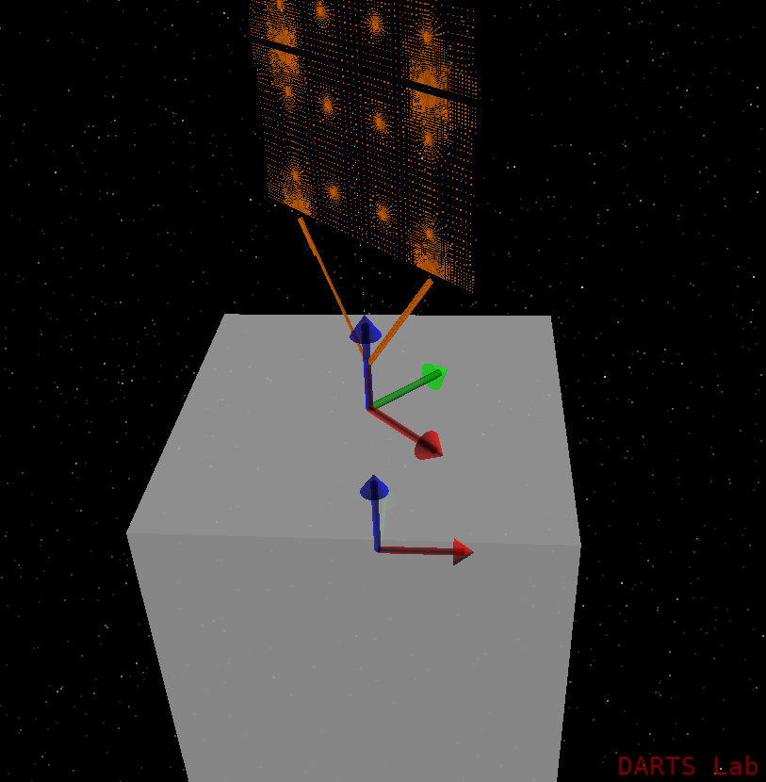


Generating Linearized Models for Multiple Configurations
(Notebook: F-FlexDynamics/08-LinearizeMultipleConfig)
Generate multiple linear models for flexible body systems with varying configurations.
$$θ=0^{°}$$
$$θ={−45}^{°}$$
33

