Slide 1
Quadcopter Reference Problem
Part 1
2023 DARTS Lab Course
August 14, 2023
Abhinandan Jain, Aaron Gaut, Carl Leake, Vivian Steyert, Tristan Hasseler, Asher Elmland, Juan Garcia Bonilla

Slide 2
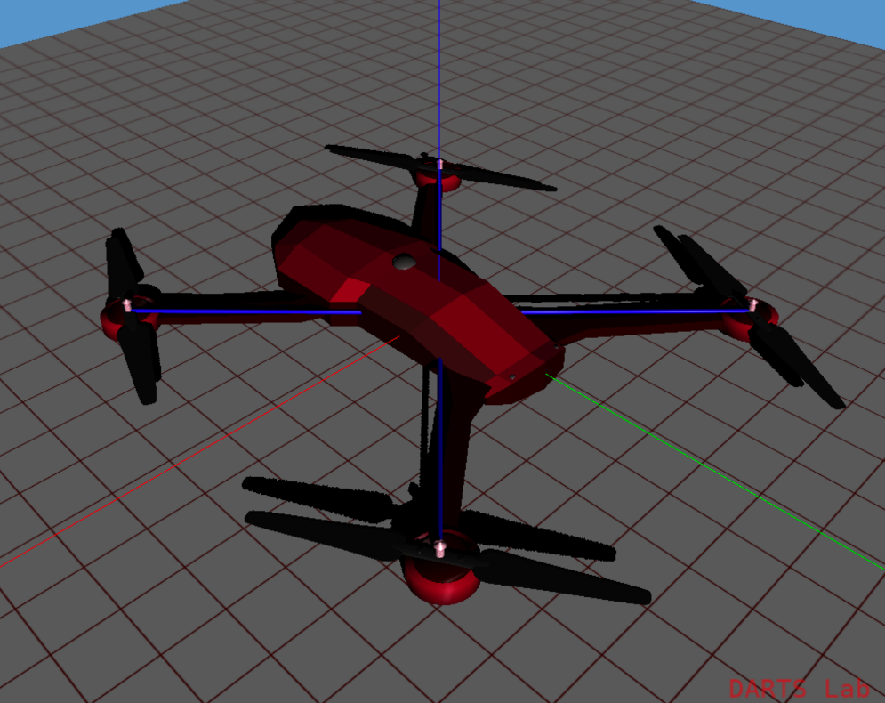
Quadrotor reference problem
We will use the reference problem of a quadrotor simulation as a concrete example of each component of the DARTS/Dshell framework
Topics we will cover:
Inspecting an existing simulation
Using DARTS for multibody dynamics and component models
Refactoring for speed and reusability with Dshell
Adding terrain with SimScape
And more…

Slide 3
Inspecting the quadrotor sim
For practically any simulation, there are foundational capabilities we will want:
A math library to handle rotations, transforms, and so on.
A kinematics layer to determine relative frame transforms.
A way of accessing and creating simulation variables in a uniform manner.
The ability to log simulation data for post-analysis.

Slide 4
Inspecting the quadrotor sim
For practically any simulation, there are foundational capabilities we will want:
A math library to handle rotations, transforms, and so on.
A kinematics layer to determine relative frame transforms.
A way of accessing and creating simulation variables in a uniform manner.
The ability to log simulation data for post-analysis.
SOA Math
DFrame
DVar
DataRecorder

Slide 5
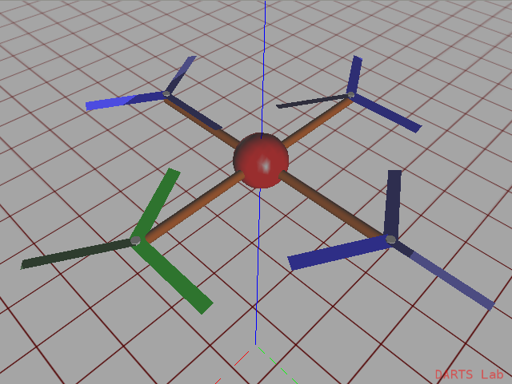
Inspection notebook (notebook: Quadrotor/01-Inspection)
Inspect a complete quadcopter simulation and use foundational libraries to model a tilt sensor

