Slide 1
Data Logging 2023 DARTS Lab Course
Abhinandan Jain, Aaron Gaut, Carl Leake, Vivian Steyert, Tristan Hasseler, Asher Elmland, Juan Garcia Bonilla
Notes:
1

Slide 2
Where does this topic fit in the big picture?
Closed-Loop
Flight s/w
Autonomy/Control
Devices
Thrusters, IMU,
Cameras etc
Environment
Terrain, Gravity
Atmosphere,
Ephemerides etc
Analysis
Data logging
Parametric
Monte Carlo
Sim Manager
propagation, fsm,
events
Dynamics
Rigid/flex bodies
Articulation
Attach/detach etc
Geometry
CAD parts
Primitives
Visualization
3D graphics
stripcharts
Usability
Introspection
CLI, GUIs, Scripting
Docs, Training
Knowledge base
Evolution
R&D, new applications
new tools & capabilities
Deployment
Bundling
Porting
Issue tracking
S/W Mgmt
Version control
Build system
Test suite
Reusability
Architecture
Configurability
Refactoring

Slide 3
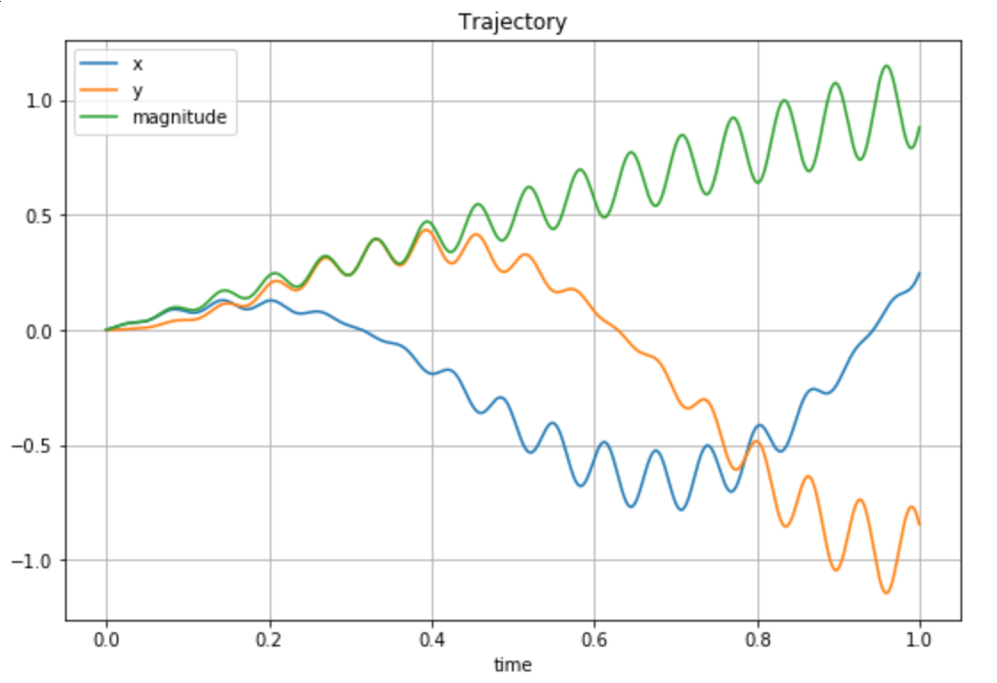
Why do logging?
Logging decouples simulation runs and post-analysis
Analysis is often exploratory; with logging, analysis requirements can change without needing to rerun the simulation
Use case: run multiple simulations in parallel and perform aggregate analysis on the logged data

Slide 4
Logging requirements
Requirements
Low I/O overhead
Memory efficient
Uses a widely supported binary format that is scalable and portable

Slide 5
HDF5 Logging

Slide 6
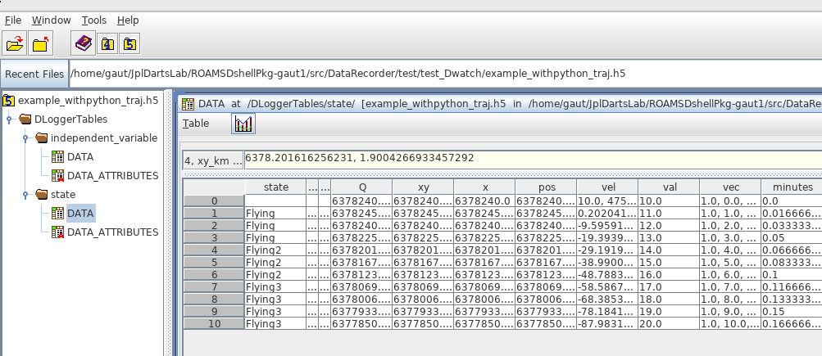
HDF5 data format
HDF5 is a hierarchical binary data format
Standard: open source, usable from Matlab, Mathematica, etc…
Scalable: can handle very large datasets; designed for efficient I/O; don’t need to load the whole thing
Portable
Lossless

Slide 7
DLogger
DLogger: low level data-logging solution
Logs data to HDF5 data files
C++ solution for speed
Saves DVar spec nodes
Save-as-you-go to avoid memory limitations
Writes are batched for efficient I/O

Slide 8
Logging requirements
More advanced logging requirements
Allow logging of multiple “tables” of grouped data
Allow control of logging by simulation events
Be able to log virtually any variable in the simulation
Log units

Slide 9
DataRecorder
Our main solution for procedural data logging
Can log to different backends
DLogger (hdf5)
CSVLogger (csv)
Stripchart (live plots)
Dump (prints to standard output)
Easily extended with new backends
Procedural interface for setting up logging in the simulation script

Slide 10
Specifying variables to record
Recorder – the main container class used in DataRecorder
Group – a group of DVars within a Recorder instance
All simulation variables logged by DataRecorder must be DVars
DVars are added to a group
Convenience functions for setting up DVars

Slide 11
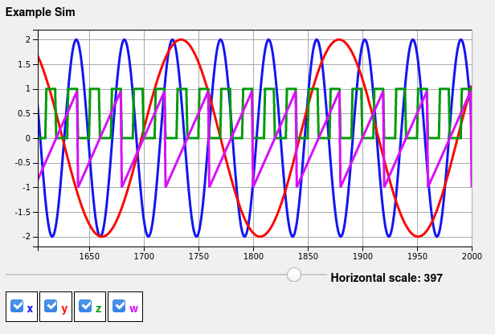
DataRecorder notebook (notebook: B-Preliminaries/14-DataRecorder)
Standalone example of DataRecorder usage

Slide 12
Dwatch
Dwatch is built on top of DataRecorder
Saves DVar specs (most simulation variables) and Python functions
Event and/or state based logging
Config file setup
Located in the DataRecorder module

Slide 13
Specifying variables to record
Dwatch uses ONLY DVar spec strings
Set up in Python using a configuration file
The actual logging is done in C++
Full DVar spec strings, eg:
Strings that can be evaluated to produce DVar spec strings (ending in ‘.specString()’:
Spec strings are used to look up spec nodes that are passed down to Dlogger.
‘.mbody.darts.bodies.Base.hinge.Q’
‘body.parentHinge().subhinge(0).[‘relVel’].specString()’

Slide 14
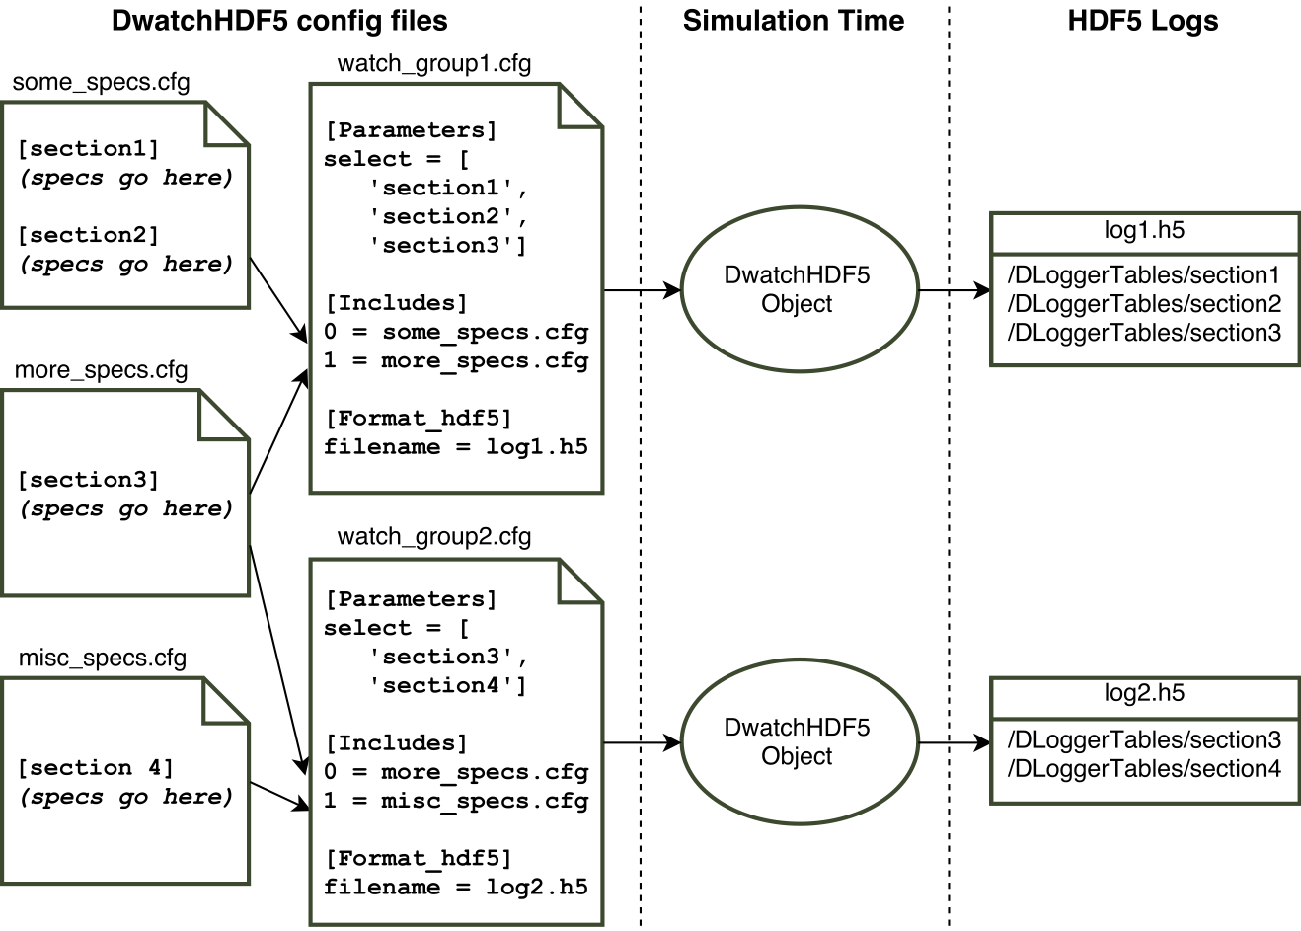
Dwatch structure

Slide 15
Dwatch HDF5 stack
Dwatch-style configobj file(s), with “includes”
Each file may have a ‘select’ to indicate variables to log
Textual descriptions of DVar specstrings for each log variable
Dwatch
(config file)
paramsFromDwatch
(python)
Inputs: one top-level .cfg file
Creates one Dwatch “group” per ‘select’ in any included file
Builds DVar strings for each log variable
Various Recorder subclasses for different backends
HDF5Recorder uses Dlogger for HDF5 logging
Consists of “Group”s containing Dvars
Recommended API for setting up logging procedurally
DataRecorder
Dlogger
(C++)
Handles low-level HDF5 file creation (Single HDF5 file for multiple Dwatch groups/tables)
Provides “DLoggerTable” class and APIs
Writes DVar objects to HDF5 packet tables
Notes:
15

Slide 16
Specifying variables to record
Most useful data is already available via specNodes, which are attached to most objects
But what if we want to log something that isn’t already available?

Slide 17
Specifying variables to record
Solution: can also log Python functions
May return strings, doubles, vector of doubles, etc...
Dwatch will convert the function to a DVar (eg: PyDoubleLeaf) internally.
Takeaway: most useful variables are already DVars, but if not, they can be converted to DVars, so all cases are covered.

Slide 18
Support for Python Functions
Converting Python functions to DVar specs:
Identify the type of result DVar Py*Leaf object
state = """{ 'type' : 'string',
'maxLength': 20,
'function' : 'getCurrentState',
'description' : 'current fsm state',
'units': '', }"""
Python function

Slide 19
Support for Unit Conversion
Logging a DVar in different units:
Type indicates a change of units
minutes = """{ 'type' : 'doubleNewUnits',
'specString': '.Dshell.time',
'old_units': 'sec',
'new_units': 'minutes',
'scaleFactor': 1.0/60.0, }"""

Slide 20
Logging Interface
Time-based logging
Parse Dwatch .cfg files (spec string data, timing, and frequency)
Create DataRecorder logging object
Create Dshell event with logging object as client data
Event controls start/stop time
Event controls periodicity
FSM Controlled Logging
Parse Dwatch .cfg files
Create DataRecorder logging object
FSM takes control of logging object
FSM controls logging with this logging object
Register Dshell Event and delete event when complete (may include some timing info)
FSM invokes logging object update() function as desired

Slide 21
Additional resources
DataRecorder sphinx documentation
QA 339: features of DwatchHDF5
QA 67: logging from simulations
QA 695: getting DVars in different units
QA 559: viewing logged data

Slide 22
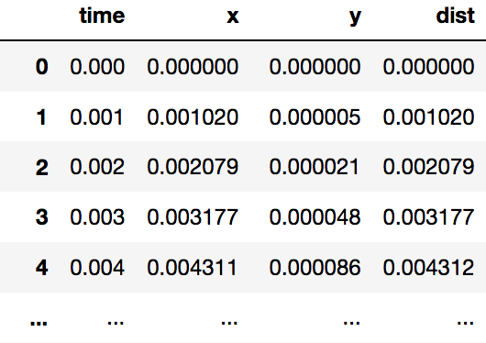
Logging notebook (notebook: B-Preliminaries/15-Dwatch)
Using Dwatch to log spec nodes

Slide 23
Viewing Logged Data

Slide 24
hdfview
HDF5 is a binary format. This is preferable for speed, but it cannot simply be viewed in a text editor.
The HDF group provides the hdfview tool
Used to explore the contents of an HDF5 file
GUI-based
Available for Windows, OSX, Linux

Slide 25
Command-line tools
Other command-line tools on Linux
h5ls: Gets the content of a group within an HDF5 file. Like the Unix ls command, but for HDF5 groups instead of filesystem directories.
h5dump: Dumps the content of a HDF5 file.
Both can be configured with command line options.

Slide 26
Plotme
Plotme is a python script used to plot the variables stored in an h5 file
Uses h5 files from DataRecorder
It has been used for two years to generate plots of the Venus and Earth simulations for the Venus Aerobot project
Usage:
$ python plotme -h
usage: plotme [-h] [-fh5 [H5_FILE ...]] [-dxy [DIFFXY ...]] [-pxy [PLOTXY ...]]
[-pxys [PLOTXYS ...]] [-rbt RBTHRESH] [-pf PLOTFREQ] [-pp PLOTPICKLE] [-l]
[--compare-data [COMPARE_DATA ...]] [--component [COMPONENT ...]] [-i INFO]
[-cmp] [--label] [-s] [--eps-ext] [--same-scale] [--save-dir SAVE_DIR]
[--save-csv [SAVE_CSV ...]]

Slide 27
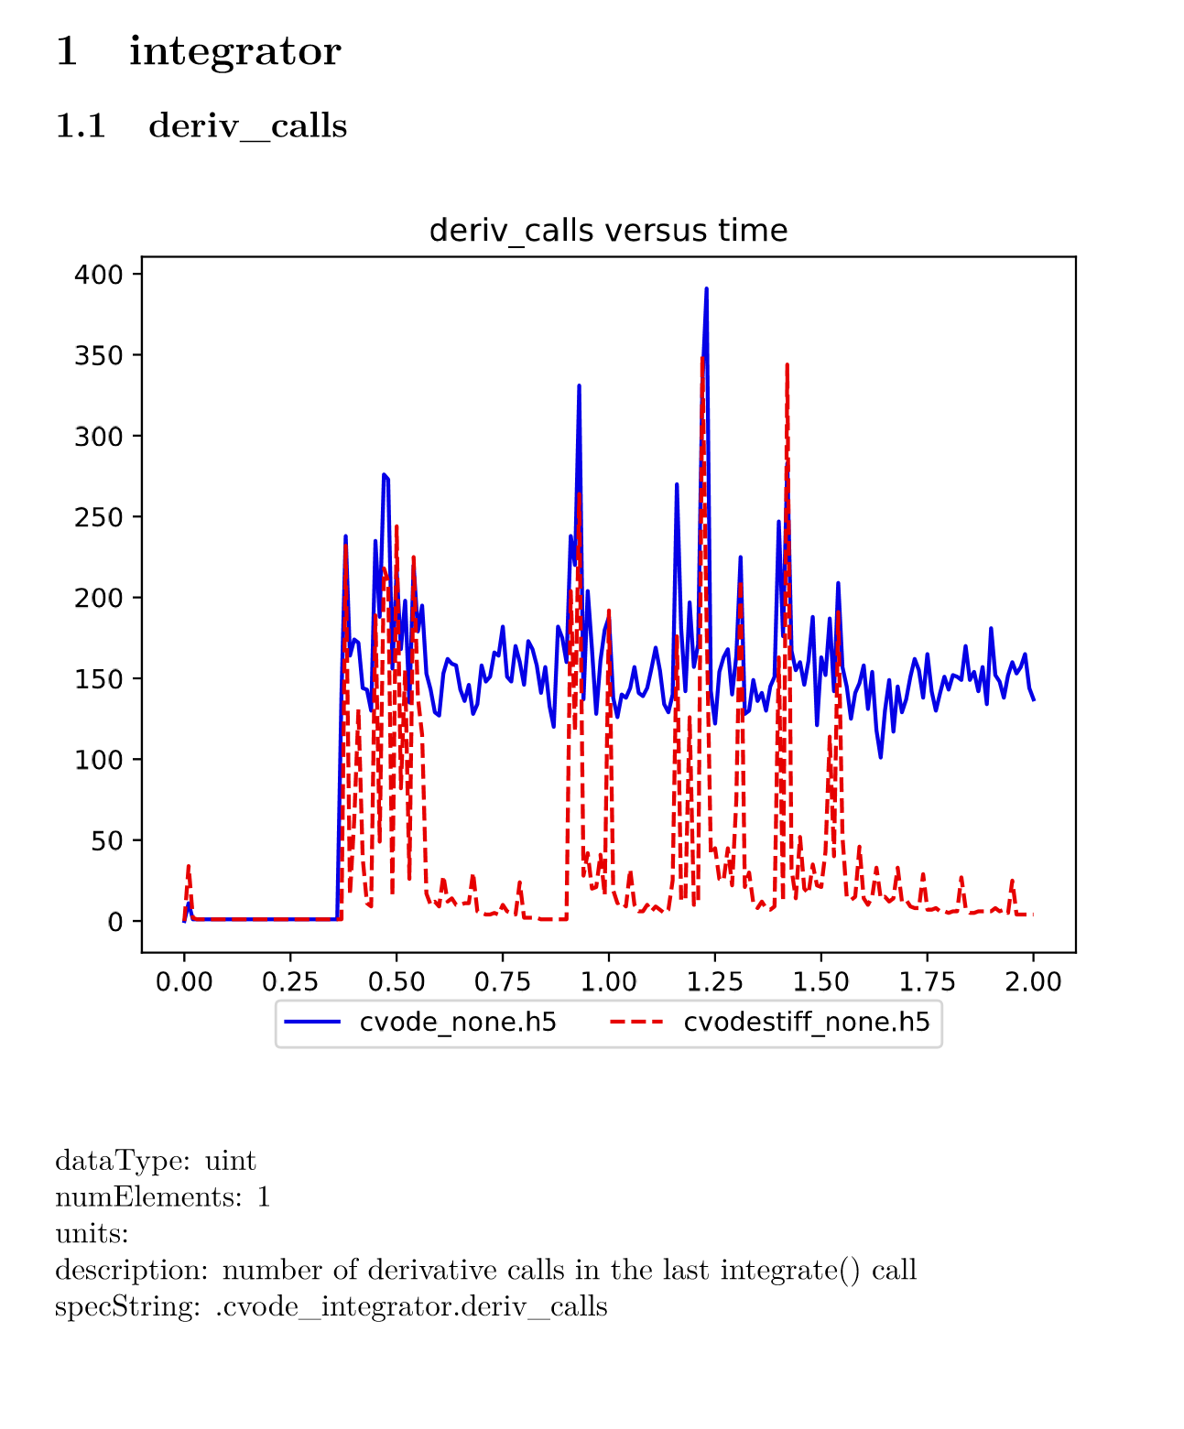
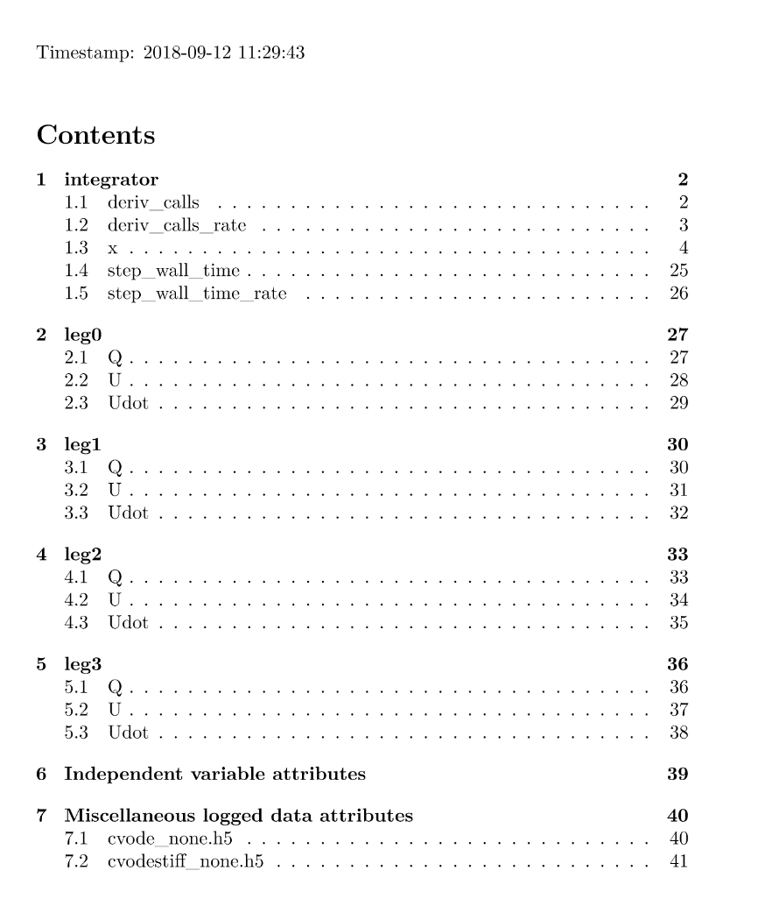
DataRecorder make-booklet
make-booklet: create a PDF document from log files

Slide 28
DataRecorder make-booklet
make-booklet: create a PDF document from log files
Creates a time-series plot for each logged variable
Lists any additional metadata
Requires DLogger HDF5 logs
Command line interface
Optional parameters to tweak behavior
If given multiple log files, plots shared variables together for comparison.
Supports logged vector and string states
Lives in the DataRecorder module

Slide 29
Monte Carlo & Parametric Simulations

Slide 30
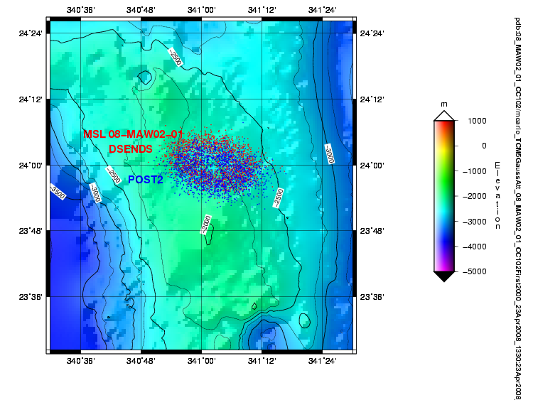
Multi-run example
Entry Guidance Performance
Chute deployment Mach-Q Box dispersions
Landing dispersions

Slide 31
Multi-run requirements
Parameter sweeps, reproducible randomness, and anything in between
No coupling between distinct runs
Job dispatch is flexible with respect to available computing resources and available batch processing capabilities
The Knob and MultiRun classes satisfy these needs

Slide 32
Additional resources
MultiRun sphinx documentation
Knobs sphinx documentation
Config file sphinx documentation

Slide 33
Backup

Slide 34
Post-analysis using pandas

Slide 35
Post-analysis requirements
Analysis library requirements:
Fast and capable of handling large datasets
Can import from HDF5
Fast to set up scripts: analysts shouldn’t need to write C++ code.
Has a library of common data operations
There are many solutions: Matlab, Mathematica, Python.
pandas is an open source Python solution that meets these requirements.

Slide 36
pandas DataFrame
pandas implements the DataFrame data structure for tabular data with heterogenous columns.
The function, read_hdf, creates a DataFrame object from an HDF5 table.

Slide 37
Some DataFrame operations
pandas has a rich set of operations that may be performed on DataFrame objects.
pandas has built-in plotting capabilities such as line plots, histograms, bar plots, scatter plots, and box plots.
DataFrames are built on NumPy arrays, so the NumPy, SciPy, and Matplotlib libraries are compatible.

Slide 38
Additional resources
pandas documentation
QA 559: viewing logged data
QA 68: how to carry out analysis

Slide 39
Knobs
Requirement: Parameter sweeps, reproducible randomness, and anything in between
A Knob object produces possible values for a simulation input.
Subclasses of Knob produce different kinds of value sets. For example:
ListKnob: a list of values for a parameter, to be exercised over a series of runs.
UniformKnob: picks a random value from a given uniform distribution for each run. May be seeded for reproducibility.

Slide 40
Output area
Requirements: No interference between distinct runs
Each run needs distinct names for its output files.
The MultiRun class facilitates this by providing a unique directory name to each run.
More on the MultiRun class later

Slide 41
Multirun with batch processing
Requirement: Flexible job dispatch
Each system has it’s own computing resources.
Some systems come with batch processing capabilities (eg: on HPC clusters we use Portable Batch System (PBS) to create batch jobs).
The base MultiRun class is a framework for executing multiple runs, but is not capable of launching new processes.
Usage: Launch multiple processes. In each process, create a MultiRun object with a unique sequential run number.
Suitable for systems that already have batch processing capabilities.

Slide 42
IPythonMultiRun
Requirement: Flexible job dispatch
On the other hand, many systems don’t come with batch processing software.
The IPythonMultiRun class is derived from MultiRun and adds functionality necessary to execute multiple runs in parallel.
Creates an IPython cluster consisting of engines on a local machine or distributed over a series of remote machines via SSH.
Runs are automatically dispatched to available engines across the cluster.

Slide 43
Recap
Why do logging?
Decouples simulation runs from analysis.
How to do high performance logging with large datasets?
Use HDF5
How to configure logging for a simulation?
Use a DwatchHDF5 style config file
How to enable logging in a simulation?
Use setupDwatchHDF5 on the config file, then do one of the following:
Pass the logging object to an FSM
Create a Dshell event
Manually call the update method

Slide 44
Recap
Why are multi-run capabilities needed?
Parametric sweeps
Monte Carlo experiments
Dealing with uncertainty
How to vary parameters in a multi-run context?
Use Knobs
How to do a multi-run simulation?
Use a config file together with Knobs and a MultiRun instance.
If the system already has batch job capabilities, use those with MultiRun.
Otherwise, use IPythonMultiRun to set up a cluster.

Slide 45
Recap
What are the requirements for analysis?
Good performance, HDF5 compatible, minimal developer overhead, and a strong library of functions.
How to do analysis on logged data?
Use pandas and fine-tune with NumPy, SciPy, and Matplotlib where necessary.

Slide 46
Questions to Address
Why do logging?
How to do high performance logging with large datasets?
How to configure logging for a simulation?
How to enable logging in a simulation?
Why are multirun capabilities needed?
How to vary parameters in a multirun context?
How to do a multirun simulation?
What are the requirements for analysis?
How to do analysis on logged data?

