Slide 1
Run-Time Data Access
2023 DARTS Lab Course
Abhinandan Jain, Aaron Gaut, Carl Leake, Vivian Steyert, Tristan Hasseler, Asher Elmland, Juan Garcia Bonilla

Slide 2
Where does this topic fit in the bigger picture?
Closed-Loop
Flight s/w
Autonomy/Control
Devices
Thrusters, IMU,
Cameras etc
Environment
Terrain, Gravity
Atmosphere,
Ephemerides etc
Analysis
Data logging
Parametric
Monte Carlo
Sim Manager
propagation, fsm,
events
Dynamics
Rigid/flex bodies
Articulation
Attach/detach etc
Geometry
CAD parts
Primitives
Visualization
3D graphics
stripcharts
Usability
Introspection
CLI, GUIs, Scripting
Docs, Training
Knowledge base
Evolution
R&D, new applications
new tools & capabilities
Deployment
Bundling
Porting
Issue tracking
S/W Mgmt
Version control
Build system
Test suite
Reusability
Architecture
Configurability
Refactoring

Slide 3
Run-Time Data Access (DVar)

Slide 4
DVar documentation
DVar Sphinx docs
DVar doctest
DVar Doxygen docs
Course 2020 slides and videos

Slide 5
Simulation objects & their data
fuel, …
coord Q, …
Propulsion model
hinge
Body 1
position
Simulation
Body 2
sensor node 1
orientation
velocity
position
inertia
orientation
mass
scalars/vectors of int, double, bool, string, etc

Slide 6
DVar data blackboard
DVar
fuel, …
coord Q, …
Propulsion model
hinge
Body 1
position
Simulation
Body 2
sensor node 1
orientation
velocity
position
inertia
mass
orientation
The DVar data blackboard provides a neutral layer for all objects to provide access to their data.
data blackboard

Slide 7
Why the DVar layer?
Simulation objects
Frames, bodies, nodes, models, integrator …
Rich data buried in large family of sim objects
Blackboard layer that provides standardized access to data independent of owner object
DVar
data access & modification
ROS i/f
stripcharts
track data units
monitors
logging
DVar decouples services from sim object details
gui

Slide 8
DVar hierarchical structure
DVar Branch
Leaf
Leaf
DVar Container
DVar Branch
DVar Branch
Leaf
Leaf
Leaf
scalars/vectors of int, double, bool, string, etc

Slide 9
Attributes of a DVar “smart” data object
Has a unique “spec string” address within blackboard
Knows its data type
Knows its data size
Knows its quantity/units type
Dynamic value is computed on demand
Can be tied to Python variables and methods
Has Python get/set interface
Branch trees can be mapped into Python dictionaries
Most sim objects have DVar spec nodes
Can register triggers associated with spec value
Can derive
  Slices from array types
  Specs with data in different units
  Pre get/set callbacks for transforming data

Slide 10
The simulation DVar container
Every simulation has a DVar container which contains all the DVar objects for the simulation in a tree hierarchy
Access the DVar container:
Useful DVar container functions:
  getDVar() → get a DVar object by URI
  create/delete DVar branches and leaves
  getTopLevelDVars()
  etc
dvc = sim.dvarContainer()

Slide 11
specNode() method
DVar manages a tree structure for all data in the simulation, along with a URI (uniform resource identifier) to peek/poke the data
Virtually all simulation objects have the specNode() method to get their DVar data interface instance
DVar objects allow you to peek and poke the corresponding simulation object
Example:
x_spec_node = obj_x.specNode() // get spec node for obj_x
x_spec_node() → x // returns value of x
X_spec_node(new_x) // set new value of obj_x

Slide 12
What objects have specNodes?
Bodies
Frames
Hinges
Models
Signals
Assembly
body = sim.mbody().body(‘Probe’, 0, True)
bspn = body.specNode()
bspn() →
{
...
'cmInertia': [1.5, 0.0, 0.0,
0.0, 1.5, 0.0,
0.0, 0.0, 1.5],
'compositeMass': 15.0,
...
}

Slide 13
specNode() examples
Body DVar data
Model DVar data
left_rocker =
roams.mbody().body('RockerLeft’, 0 , False).specNode()
encoder =
roams.model('WheelRockerSideRight_encoder’, 0, False).specNode()

Slide 14
Can also look up via “spec string”
Every DVar object has a unique “spec string” URI
  Dot-separated name based on the tree hierarchy of the DVar object
  Unique
  Ex: .Dshell.Assemblies.SC1.vforce
Less robust than access via object specNode() method
...
# Get the Simulation’s DVar container
vf = sim.dvarContainer().getDVar(‘.Dshell.Assemblies.SC1.vforce’)
vf.dump()
<dump output>

Slide 15
Drilling Down into a SpecNode
Select a subcomponent of the specNode:
Or take a slice:
pos = body.parentHinge().specNode()['Q']
pos() →
[-1447.764, 0.00403361, -8.74771e-10,
-8.88424e-19, 4.346851e-10, 0.0020043, 0.999998]
pos = probe.parentHinge().specNode()['Q(0-2)']
pos() →
[-1447.764, 0.00403361, -8.74771e-10]

Slide 16
DVar
(Notebook: B-Preliminaries/13-DVar)
Basic DVar usage
Creation
Inspection
DVar Branch
Leaf
Leaf
DVar Container
DVar Branch
DVar Branch
Leaf
Leaf
Leaf

Slide 17
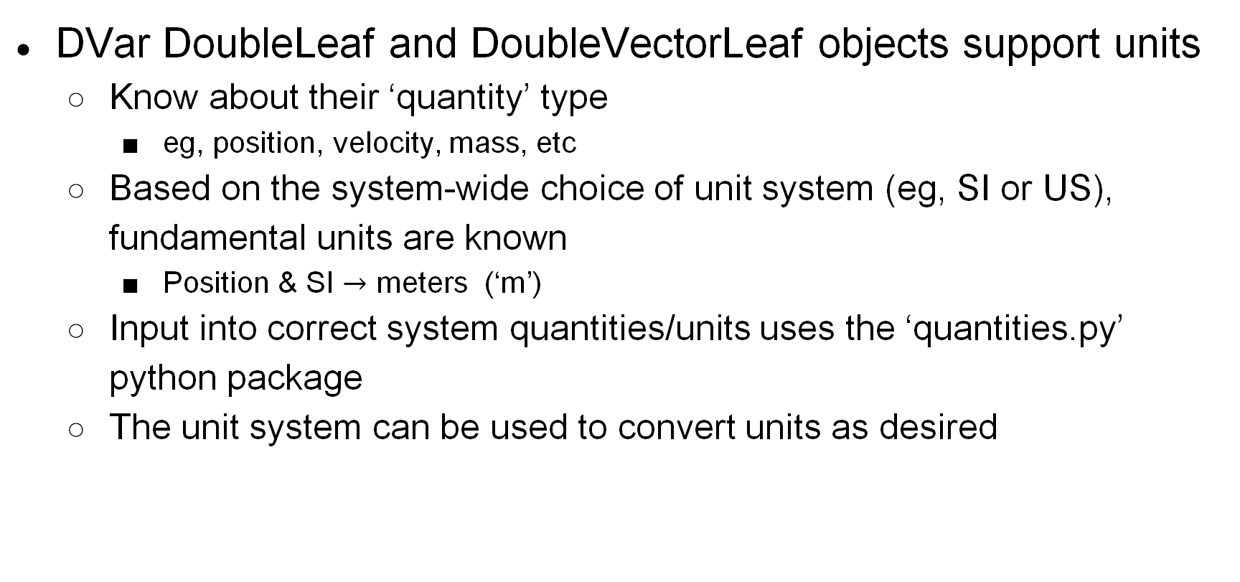
Units aware
DVar DoubleLeaf and DoubleVectorLeaf objects support units
  Know about their ‘quantity’ type
    eg, position, velocity, mass, etc
  Based on the system-wide choice of unit system (eg, SI or US), fundamental units are known
    Position & SI $→$ meters (‘m’)
  Input into correct system quantities/units uses the ‘quantities.py’ python package
  The unit system can be used to convert units as desired

Slide 18
Stripcharts & logging
Once we have list of spec nodes, can use them to generate real time stripcharts and log data to files for later analysis
Stripchart (displays during sim run)
Logging to file
  Can log DVars to file using DataRecorder (covered later)
sim.stripchart(specs_list, title)

Slide 19
ROS interface
ROS is a popular inter-process communication (IPC) capability used in the robotics community
Can be used to close the loop with simulations
DVar includes a ROS interface for leaf specs
  publishing: spec.rosPublish()
    Will publish a ROS message with spec id and values
  Subscribing: spec.rosListen()
    By default will update spec value from incoming message
    Can change callback handler to be something else
See DVar/test/test_ros test case

Slide 20
Recap
What are some of the reasons we might want to get access to simulation data?
  Inspection, modification, logging, stripcharts
How can we access data in a simulation?
  DVar provides a layer to access simulation data
  Most simulation objects provide a ‘specNode()’ function that returns the DVar item for that object
How are the DVar objects organized?
  Using a hierarchy identical to the topology of the created simulation objects, with a path/URI using a “dotted” syntax
What types of data are available through DVar?
  Simulation variables, computed results
What are some other, useful things can spec nodes can do?
  Callback functions that can modify how peek/pokes are done

Slide 21
What we glossed over/skipped …
Importing from Python dictionaries
Creating DVars in different units
Creating extra DVars
preGet/postSet callback methods
Watching a DVar for monitors
Populating GUI panels
DVar specs for Python functions
DVar slices

