Slide 1
Frames Layer 2023 DARTS Lab Course
Abhinandan Jain, Aaron Gaut, Carl Leake, Vivian Steyert, Tristan Hasseler, Asher Elmland, Juan Garcia Bonilla

Slide 2
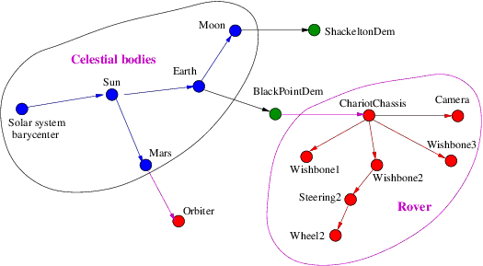
Simulation tree of frames
DFrame Sphinx docs
DFrame Doxygen docs
Course 2020 slides & video
Examples of frames:
location of a thruster on the s/c bus
the motion of a pair of frames due to hinge articulation
the motion of the moon wrt to the earth; the earth wrt the sun etc.
Frames form a tree with edges defining transform between adjacent ones

Slide 3
Motivation
Simulations can have many moving frames, e.g.
Bodies, nodes, planetary bodies, CM frame …
Often, ask what is the pose (position/velocity etc.) of a frame?
These are INCOMPLETE questions! There is an unspecified but implied “from” frame (often inertial frame)
Steps involve sequences of Phi/PhiStar etc transformations across path in the tree
Error prone, time consuming and tedious
The DFrame frames layer provides a simple way to make such queries for arbitrary pair of frames

Slide 4
Frame & Frame2Frame software classes

Slide 5
Working with DFrame frames
DFrame module provides the Frame and Frame2Frame classes
The FrameContainer class is a container class for all frames
Some frames come for free
Bodies, nodes, planetary bodies are automatically Frame instances
Frames for CM locations are automatically created
However, users can create, add, or reattach arbitrary frames
Users/simulation is only responsible for updating the transform etc. properties of each parent/child frame pair edge
For rigid attachments, this is a one time step

Slide 6
Frames (Notebook: B-Preliminaries/10-Frames)
Creating
Attaching
Showing in 3D graphics

Slide 7
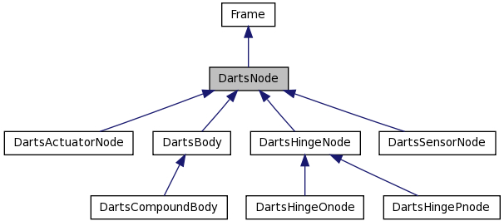
Frame’s are base classes for Bodies & Nodes
Location of interest
Has extent and mass properties
Location on a body
Can apply forces
For an inter-body hinge
Articulated body related classes

Slide 8
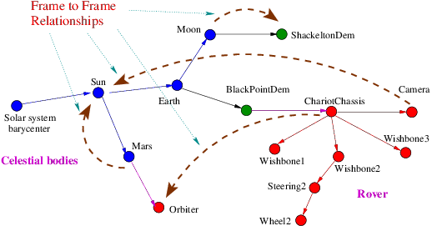
Frame to Frame relationships
Frame2Frame objects define relationships between oframe/pframe pairs.
They can be used to obtain relative transforms, velocities accelerations
Joint angles and rates modify edge properties

Slide 9
Frame2Frame Class
Consists of a frame pair – <oframe, pframe>
Used for quantities relating one frame to the other
Homogeneous transformation
Relative velocity
Relative acceleration
Can compute relative velocity and acceleration with derivatives taken wrt another frame
Requires <derivFrame, oframe> Frame2Frame
Default derivatives are wrt oframe
Same for acceleration

Slide 10
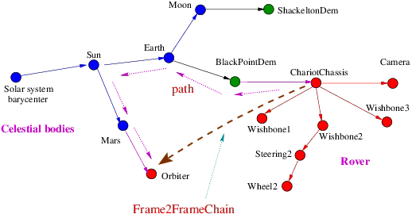
Arbitrary pair of frames
ChainedFrame2Frame class manages arbitrary oframe/pframe pairs in the tree.

Slide 11
ChainedFrame2Frame
ChainedFrame2Frame instance are objects that have a beginning (oframe) and an end (pframe)
have all the smarts to chain together all the computations needed to compute the relative properties
know the connecting path
can do reversals across branches as needed
can handle changes to paths
only compute on demand
cache results, and recompute only if any of the edges has changed!

Slide 12
Recipe for frame to frame use
Create a frame container instance and populate it with frames, and form edges to connect them
Identify the oframe/pframe frame pair you are interested in
Use oframe.frame2Frame(pframe) method to get the Frame2Frame instance (edge or chained)
Use the frame to frame instance methods to get information
relTransform(): returns the relative pose
oframeDerivRelSpVel(): returns the relative spatial velocity as observed from the oframe
oframeDerivRelSpAccel(): returns the relative spatial acceleration as observed from the oframe

Slide 13
Frame2Frame (Notebook: B-Preliminaries/11-Frame2Frame)
Creating a Frame2Frame
Making relTransform, vels, accels queries
Dumping

Slide 14
Computational Aspects
For N frames, have potentially N(N-1) frame to frame pairs
Too expensive to keep all combinations up to date
On demand computation
Do not compute and update properties of all existing frame 2 frame pairs with every motion – only on demand
Cache frame to frame property values until a component edge value changes to make path value stale
Only recompute stale values

Slide 15
Frame2Frame’s are base classes for body hinges
Family of frame to frame classes
Abstract base class
Frame2Frame
Sequence of connected Frame2Frames
Parent/child frame pair
EdgeFrame2Frame
ChainedFrame2Frame
Frame pair with user specified relative transforms
PrescribedFrame2Frame
DartsHinge
DartsSubHinge
Darts body subhinge
Darts body hinge
Bodies specialization

Slide 16
Spice Frames

Slide 17
Spice Frames
The SpiceFrame class is a Frame class with a NAIF id
The SpiceFrame2Frame class is a EdgeFrame2Frame class where the oframe & pframe pair are both SpiceFrame instances
Can use the Spice library to query the location of celestial bodies (and spacecraft)

Slide 18
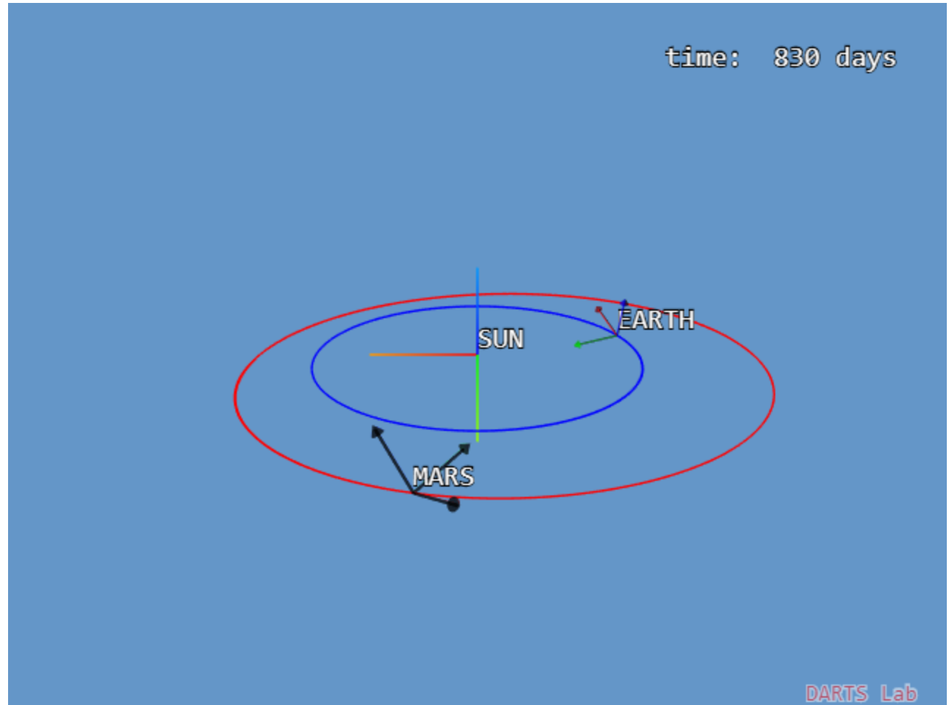
SpiceFrame (Notebook: B-Preliminaries/12-SpiceFrames)
Creating SpiceFrames
Querying planetary transforms
Changing times to change values

Slide 19
Frames Layer
Frames Layer
Multibody
world
Visualization
frames
Celestial
bodies
Control
frames
The frames layer provides a unifying foundation for most of the simulation related objects, allowing pose etc queries to be easily made across diverse domains.

Slide 20
Recap
What are frames?
Any point of interest, eg. bodies, attachment points, terrains, celestial bodies, center of mass location and instances of the Frame class.
What are frame to frames?
These are Frame2Frame instances for a oframe/pframe pair that can provide relative pose, velocity etc. information
How can we get position/attitude, velocities of arbitrary frames?
By using the from.frame2Frame(to) chained frame to frame
What does the frame layer buy you?
Does away with custom user code for querying relative pose information.
How are the computational costs low despite the flexibility?
By use of lazy evaluation and data caching.
What are key classes derived from the frame classes?
Bodies, nodes, subhinges and hinges are derived from these classes.
What are SpiceFrames?
Frames with NAIF ids whose pose is obtained via the Spice library.
What is the a way to visualize frames?
By using the viz show() and showFrame2Frame() methods.

Slide 21
What we glossed over/skipped …
More exotic methods
other derivatives
Coriolis terms
Can attach/detach frames
Fixed, prescribed, and unrotated frames
looking up frames
dumping frames tree
Defining custom update callbacks for transforms, velocities, etc.

