Slide 1
Math Library Overview 2023 DARTS Lab Course
Abhinandan Jain, Aaron Gaut, Carl Leake, Vivian Steyert, Tristan Hasseler, Asher Elmland, Juan Garcia Bonilla

Slide 2
Outline
Linear algebra
Vectors (SOAVector, SOAVector3)
Matrices (SOAMatrix, SOAMatrix33, …)
Attitude representations
SOAQuaternion, SOARodriguezVector, SOAEuler, …
Homogeneous transforms
SOAHomTran
Spatial notation and rigid body quantities
Spatial vectors (SOASpatialVector)
Spatial inertias (SOASpatialInertia)

Slide 3
Documentation & Resources
The key math classes live in the SOA module, and the class names have the ‘SOA’ prefix
SOAVector
SOAMatrix
SOAQuaternion
…
SOA Doxygen docs
SOA Sphinx documentation
SOA doctests
Course 2020 slides and videos

Slide 4
Vector Classes

Slide 5
SOAVector (Notebook: B-Preliminaries/01-SOAVector)
The SOAVector class for vectors
variable length, fixed length
creating from Python lists
the dump, pydump and call method

Slide 6
SOAVector3 (Notebook: B-Preliminaries/02-SOAVector3)
The SOAVector3 class for 3-vectors
includes methods such as tilde, cross, etc.

Slide 7
Matrix Classes

Slide 8
Matrix classes
Similar to SOAVector/SOAVector3 we have the SOAMatrix, SOAMatrix33, SOAMatrix66 classes for matrices
Overloaded operators
Getting/setting values, the call() method
The dump and pydump methods
Various matrix methods

Slide 9
SOAMatrix (Notebook: B-Preliminaries/03-SOAMatrix)
variable size
creating from Python lists
the dump, pydump and call methods
various operations

Slide 10
Attitude Representations

Slide 11
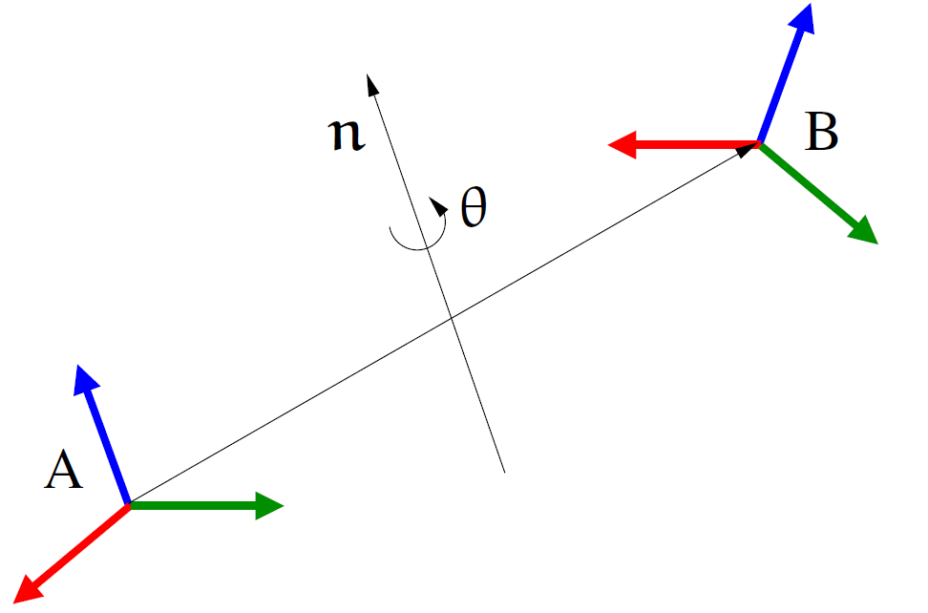
Attitude Representations
The attitude of frame B with respect to frame A can be defined as a rotation about a fixed axis
(unit quaternion)
(exponential formula)
(angle/axis)

Slide 12
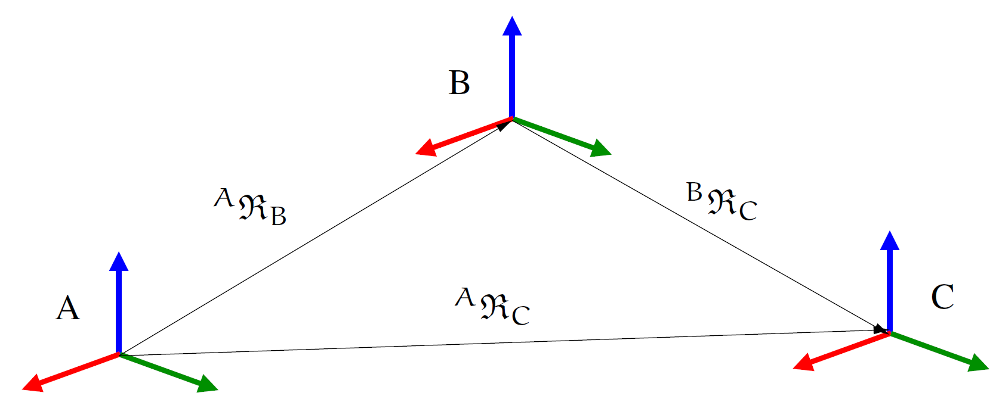
Accumulation of Rotations
indices must match when composing
Can compute rotations by composing successive ones.

Slide 13
Available attitude representations
Representations & classes
Rotation matrices (SOARotationMatrix) [9 scalars]
Unit quaternions (SOAQuaternion) [4 scalars]
Euler angles (SOAEuler) [3 scalars]
Rodrigues parameters (SOARodrigues) [3 scalars]
Angle/axis parameters [4 scalars]
General result: minimal (3 scalar) attitude representations cannot both be global and non-singular.
See QA entry 597 for more details
Euler angle & Rodrigues params are global, but singular
Cayley representations are non-singular, but not global
minimal

Slide 14
SOAQuaternion (Notebook: B-Preliminaries/04-SOAQuaternion)
An overview of the SOAQuaternion class

Slide 15
Attitude Representations notebook (Notebook: B-Preliminaries/05-attitude_representations)
Euler angles
Rodrigues parameters
Rotation matrices

Slide 16
Homogeneous Transforms

Slide 17
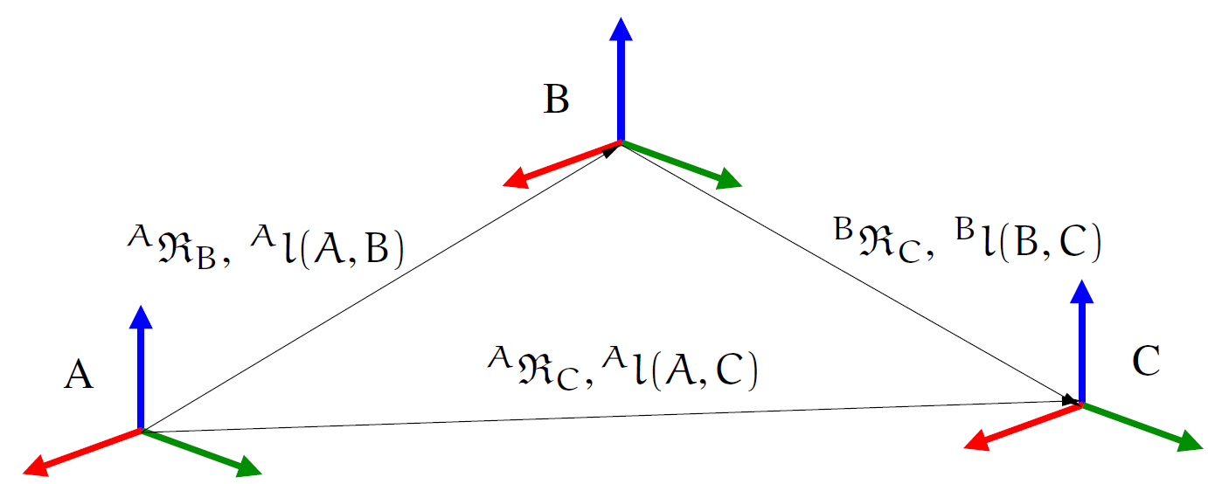
Working with both position/rotations
Typically have to deal with both rotations and displacements simultaneously.

Slide 18
Homogeneous Transform
Combined attitude and position information is also referred to as “pose”.
A pose can be represented as a 4x4 homogeneous transform matrix.
SOAHomTran
class
Inverse:

Slide 19
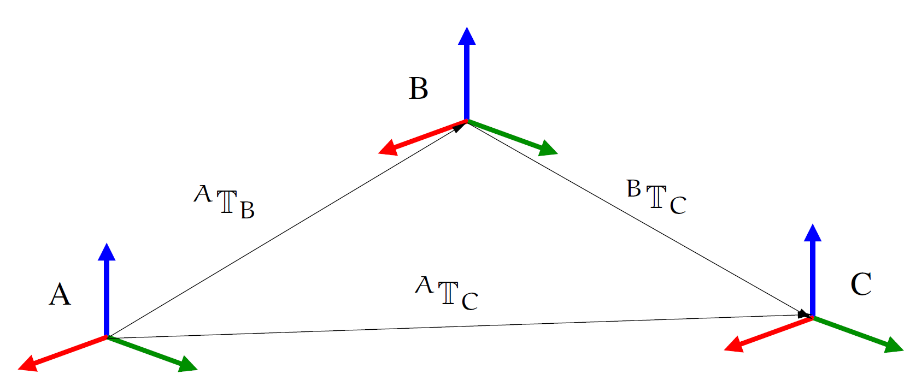
Propagating pose across frames
Computing overall relative pose by composing component poses (like rotations)
Propagates positions and rotations simultaneously
composing homog. transforms
relative position

Slide 20
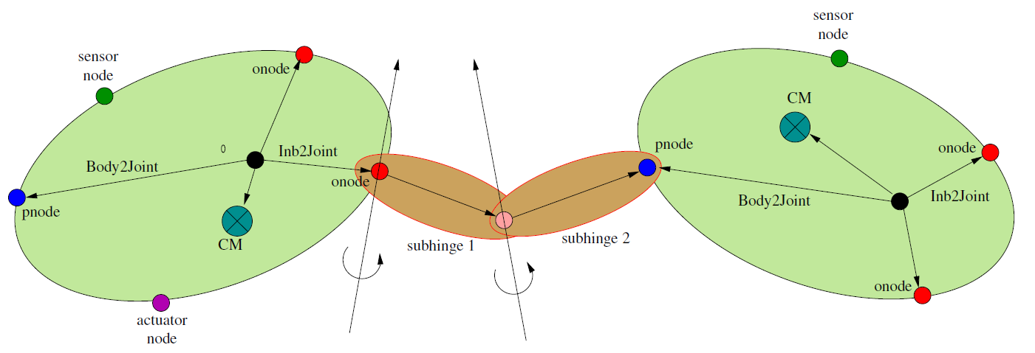
Propagating Poses
Frequent need to compute poses of bodies and frames with respect to each other and the inertial frame.
constant
constant
variable

Slide 21
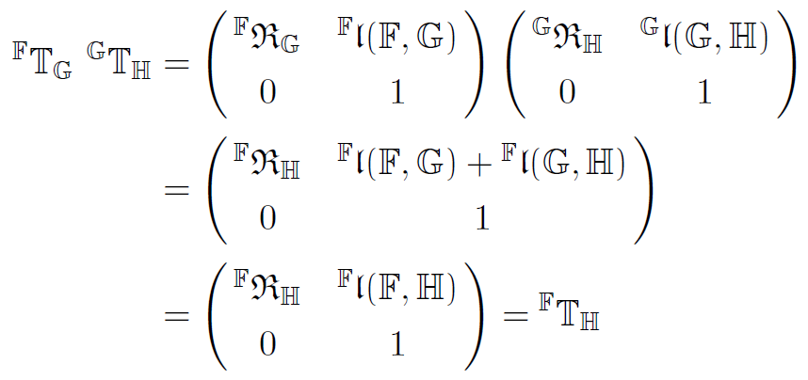
Composing Homog. Transforms
Claim:
Verification:

Slide 22
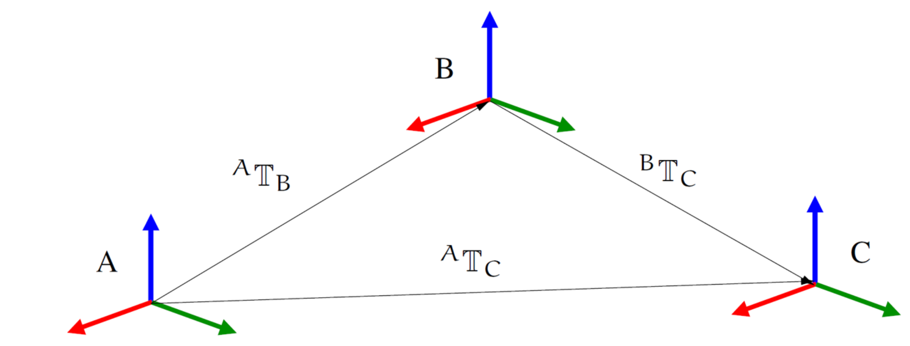
SOAHomTran (Notebook: B-Preliminaries/06-SOAHomTran)
Products
Getting translation/quaternion elements
Transforming a position

Slide 23
Rigid Bodies & Spatial Notation

Slide 24
Linear/Angular properties
When working with kinematics and dynamics, we often have to work with a combination of linear and angular properties
position/attitude
linear/angular velocities
force/moments
linear/angular momentum
mass/inertia
Only at the body CM are the position & angular properties mostly decoupled
However, general, non-CM reference frames are often used – leads to messy coupling
ref
frame
CM

Slide 25
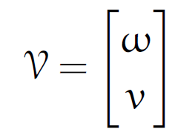
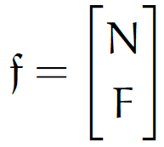
Spatial Notation
"spatial" notation – combines linear & angular terms together to help work with general (and not just CM) frames
position/attitude: homogeneous transform
velocities: spatial velocity [w, v] 6-dimensional
accelerations: like-wise
forces: spatial force [N, F] 6-dimensional
moment
SOASpatialVector
class
force
spatial velocity
spatial force
See Spatial Operator Algebra book reference for details

Slide 26
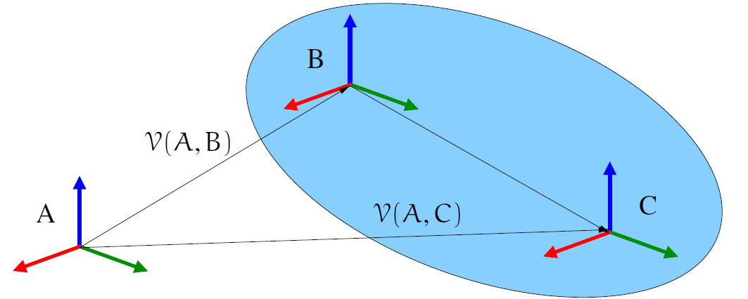
Transforming spatial velocities across a rigid body
Consistent way to transform spatial velocities across any pair of points on a rigid body
QA entry 31
Uses components of the T(A,B) homogeneous transform
SOAHomTran.PHIStar method

Slide 27
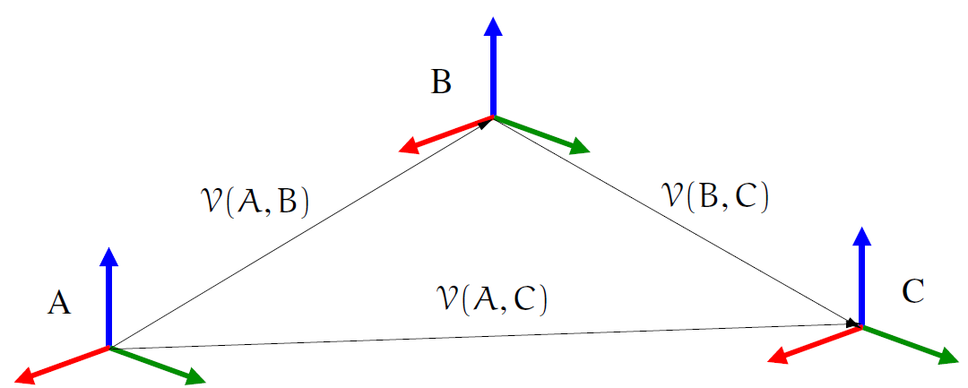
General spatial velocity transformations
Can accumulate spatial velocities across multiple frames
Example: A is inertial frame, and want inertial spatial velocity of C given inertial velocity of B, and C wrt B (eg. hinged bodies)
QA entry 31
Inertial frame
hinge

Slide 28
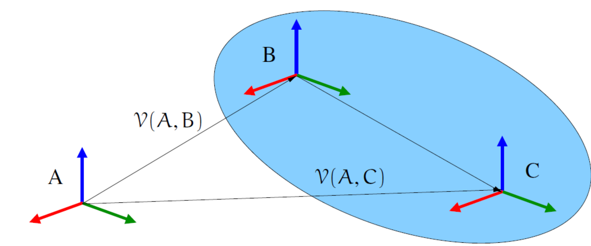
SOASpatialVector (Notebook: B-Preliminaries/07-SOASpatialVector)
Overview of the spatial vectors class

Slide 29
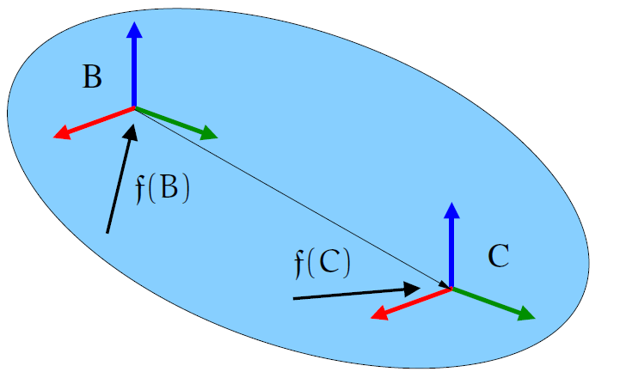
Transforming spatial forces
Can transform forces and moments across points on a rigid body
moments
forces
SOAHomTran.PHI
method
QA entry 31

Slide 30
Accumulating Spatial Forces
There is often a need to compute the overall spatial force on a rigid body, eg. from attached actuators
The process is to transform each of the forces to a common point, and then sum them up as follows
overall spatial
force at B
transform spatial
force to B

Slide 31
SOAHomTran Phi/PhiStar (Notebook: B-Preliminaries/08-RigidBodyTransformations)
Transforming spatial velocities
Transforming spatial forces
The PHI and PHI_star methods

Slide 32
Spatial Inertias

Slide 33
Rigid body inertias
Mass properties of a rigid body are characterized by
Scalar mass, m
First moment of inertia 3-vector p (vector from the body frame to the CM)
Second moment of inertial, 3x3 inertia matrix J
Traditionally these terms are kept apart in the linear and angular equations of motion
This works well only at CM
Otherwise get nasty cross-coupling terms

Slide 34
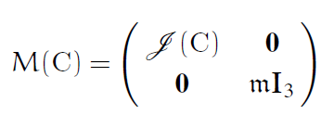
Rigid body spatial inertia
Spatial inertia of a rigid body about CM
Spatial inertia of a rigid body about any point
SOASpatialInertia class for spatial inertias

Slide 35
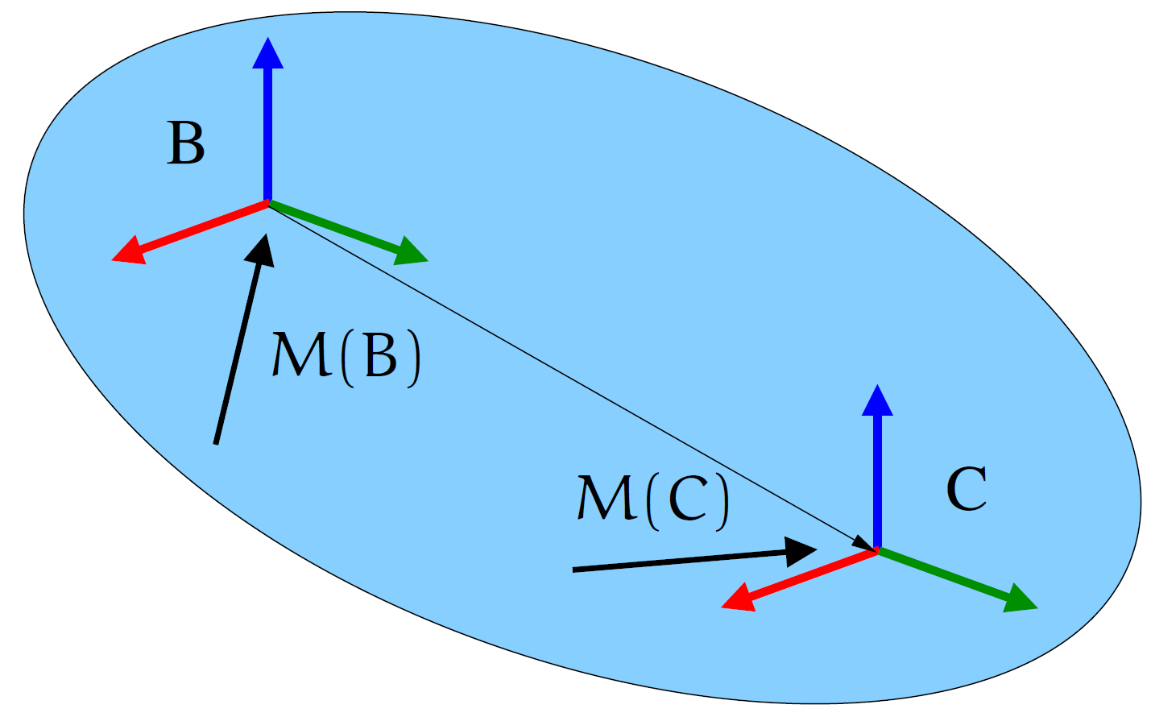
Transforming Spatial Inertias
General way to transform spatial inertias across any pair of points on a rigid body
Parallel axis theorem
SOASpatialInertia.parallelAxis() method
Simpler, and more compact than conventional parallel axis theorem for 3x3 rigid body inertias.

Slide 36
Combining spatial inertias
Often need total effective mass properties of a collection of bodies
Requires transforming all mass properties to a common point (parallel axis theorem) and then adding them together

Slide 37
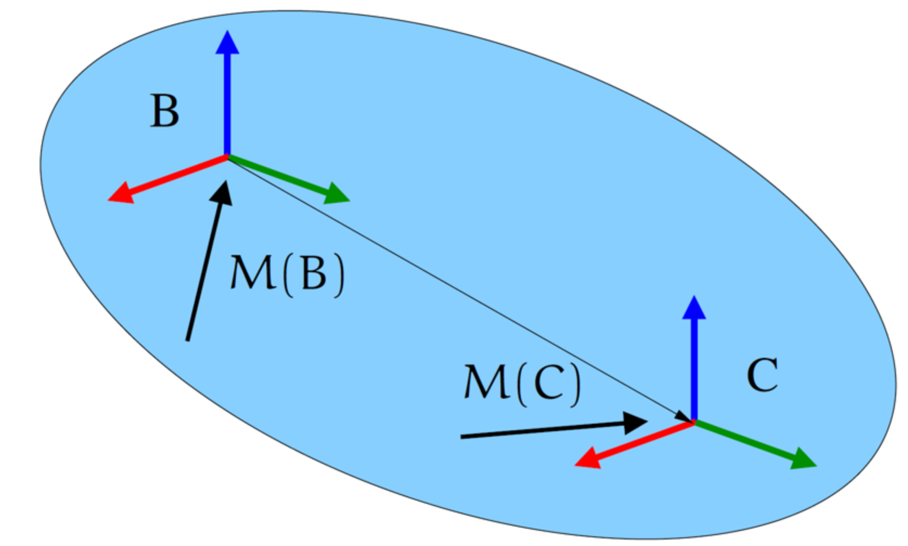
SOASpatialInertia (Notebook: B-Preliminaries/09-SOASpatialInertia)
Constructing them
Getting the matrix form
Parallel axis theorem

Slide 38
Rigid Body Kinetic Energy
Body kinetic energy can be defined by the spatial inertia and spatial velocities
Kinetic energy is invariant to reference point when working with spatial quantities. Indeed
This is a generalization of the well know quadratic expression for positional and angular energies at the CM

Slide 39
Spatial Transformations Recap
Spatial notation offers concise & consistent transformation expressions for arbitrary non-CM points
Spatial velocities
Spatial forces
Spatial inertia
Kinetic energy
Spatial momentum

Slide 40
Recap
What are the matrix/vector library classes?
SOAVector, SOAMatrix classes
How are the C++/Python software languages being used?
C++ for all heavy lifting with SWIG generated Python bindings for usability
What are the supported attitude representations?
Mainly unit quaternions, but also rotation matrices, Euler angles, Rodrigues parameters, angle/axis representations
What are the aerospace & robotics conventions for rotations?
Geared to transform ‘from’ vectors to ‘to’ vectors – or the other way around
How do we use unit quaternions?
Via the SOAQuaternion class for all attitude representations
How do we use homogeneous transforms?
Via the SOAHomTran class for all pose representations
What are spatial velocities, forces, inertias and momentum?
Combined linear and rotational 6-d quantities
Why use spatial notation in kinematics and dynamics?
Makes rigid body transformations much simpler & concise via Phi and PhiStar methods

Slide 41
What we did not cover …
Attitude representations – rotation matrix, Rodrigues parameters
Various matrix methods
Interpolation classes
Lie group connections
Different types of spatial velocity definitions
PhiStar/ad connection
More phi/phistar properties
Quadrature integration
Coriolis terms for acceleration accumulation (methods exist) - see QA site

