Slide 1
2023 DARTS Lab Course
Welcome!
Abhinandan Jain, Aaron Gaut, Carl Leake, Vivian Steyert, Tristan Hasseler, Asher Elmland, Juan Garcia Bonilla

Slide 2
Welcome to the 2023 DARTS Lab course!
Course info at https://dartslab.jpl.nasa.gov/course2023
Hopefully, you have logged into https://dlabnotebooks.jpl.nasa.gov and tried out the notebooks & graphics. You can run/edit them any time.
Slides can be downloaded from https://dartslab.jpl.nasa.gov/course2023_material/
No ITAR/CUI discussion please – the course has non-US attendees
Please sign into Webex with your name & stay on mute, except when you would like to ask question.
  Please use the chat for any logistics/non-technical questions or help requests
  Feel free to enable video when asking questions
  The sessions are being recorded
Remote attendees should "raise their hand" in Webex to ask questions. In person attendees should use the mic so remote attendees can hear them.
We would appreciate your feedback on the course on the course feedback form (link is on the course page). Multiple ongoing submissions are welcome.
We will take a break mid-way through each session.
Course dinner on Monday 6:30pm at Pinnochio's restaurant ($40 cash to Asher).

Slide 3
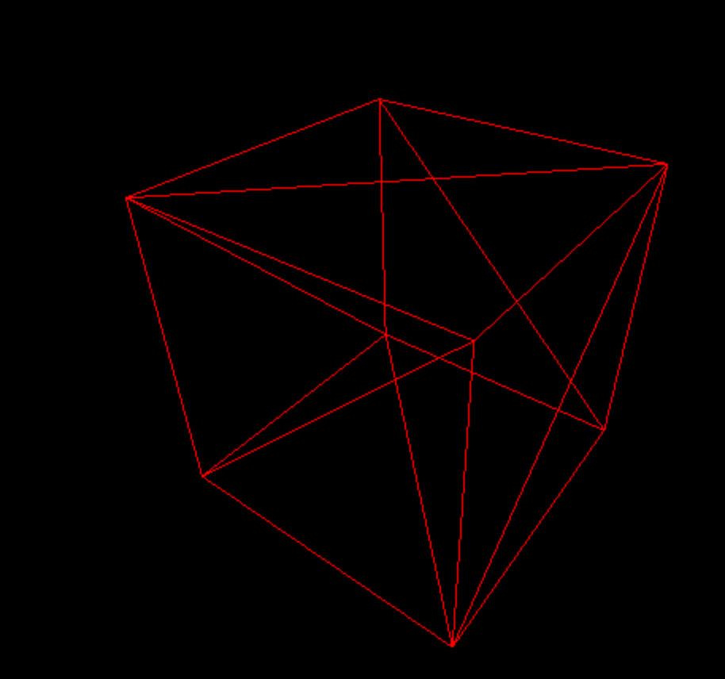
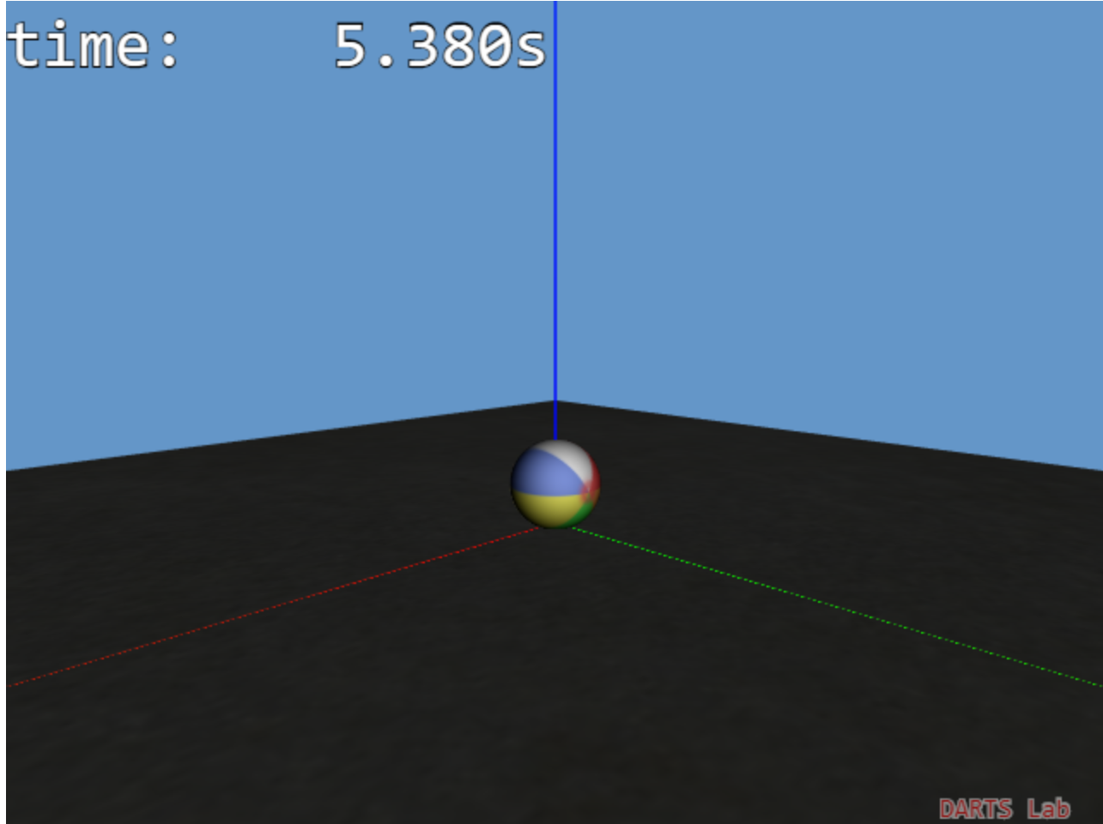
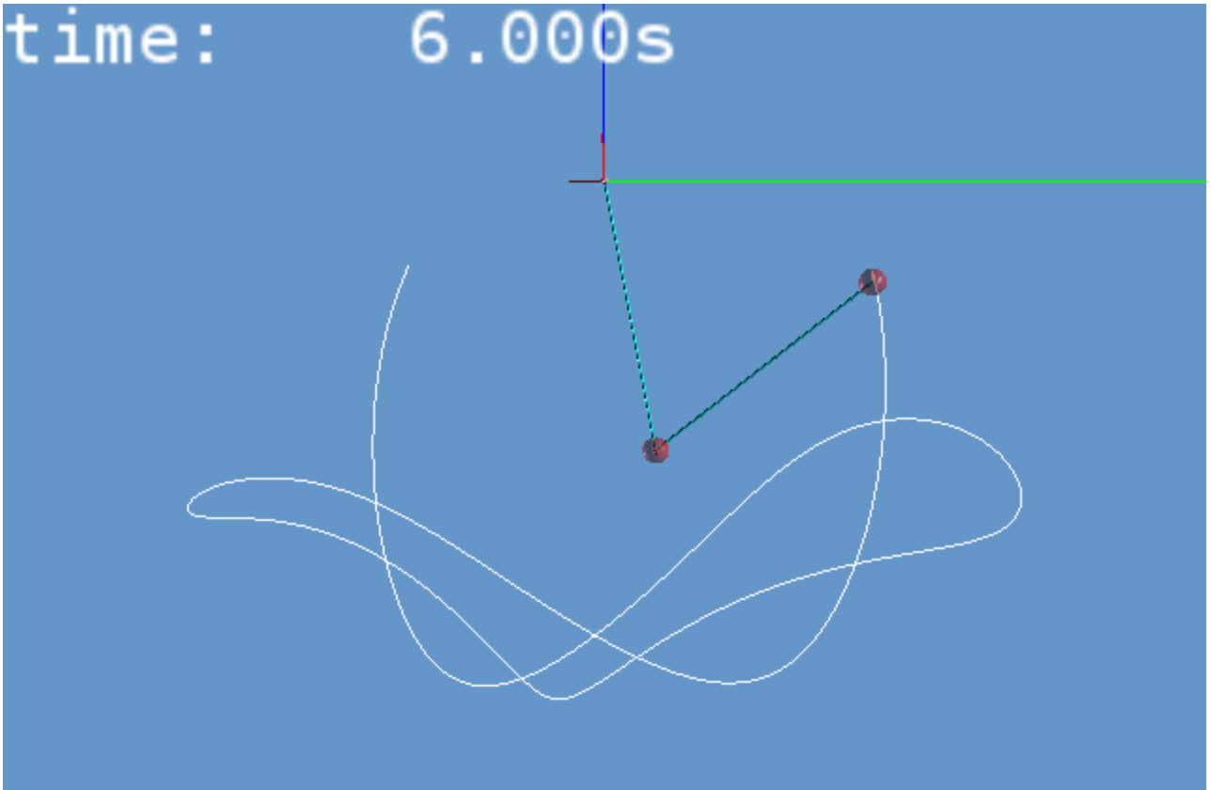
Notebook demos
(Notebook: A-Welcome/01-hello_world)
(Notebook: A-Welcome/02-bounce)
(Notebook: A-Welcome/03-double_pendulum)

